Slide 1

Empowering Enterprise AI on Kubernetes
dkube.io

Slide 2

Empowering Enterprise AI on Kubernetes
Backed by 7+ years of Kubernetes expertise, DKube has delivered multiple customer solutions and built robust platforms for MLOps, LLMOps, and AI.
Our Platforms
DKube
An end-to-end k8s-based MLOps platform that enables data scientists to build, train, and deploy complex ML models.
DKubeX
A k8s-based enterprise-grade private AI platform to build, deploy, and scale Generative AI and ML securely within your infrastructure.
LLM-Stack
A k8s-based rapid AI solution development platform with prebuilt tools for AI workflow automation, secure user access, observability and model serving.
dkube.io
Empowering Enterprise AI on Kubernetes
Notes:
Openweb ui for llm stack as a frontend tool, and various observability tools + langflow

Slide 3
DKube
An enterprise-ready, Kubernetes-native MLOps platform that enables data engineers, data scientists, ML engineers and production engineers to build, train, deploy, and monitor models — on-premises or in the cloud.
Unified MLOps Stack: Combines data preparation, training, deployment, and monitoring in one platform.
Open & Flexible: Built on open-source frameworks like Kubeflow and MLflow for portability and seamless integration.
Hybrid Deployment: Runs seamlessly across on-prem and cloud environments (EKS, AKS, GKE).
Enterprise-Grade Security: Ensures compliance, governance, and secure access across all ML workflows.
dkube.io
Empowering Enterprise AI on Kubernetes

Slide 4

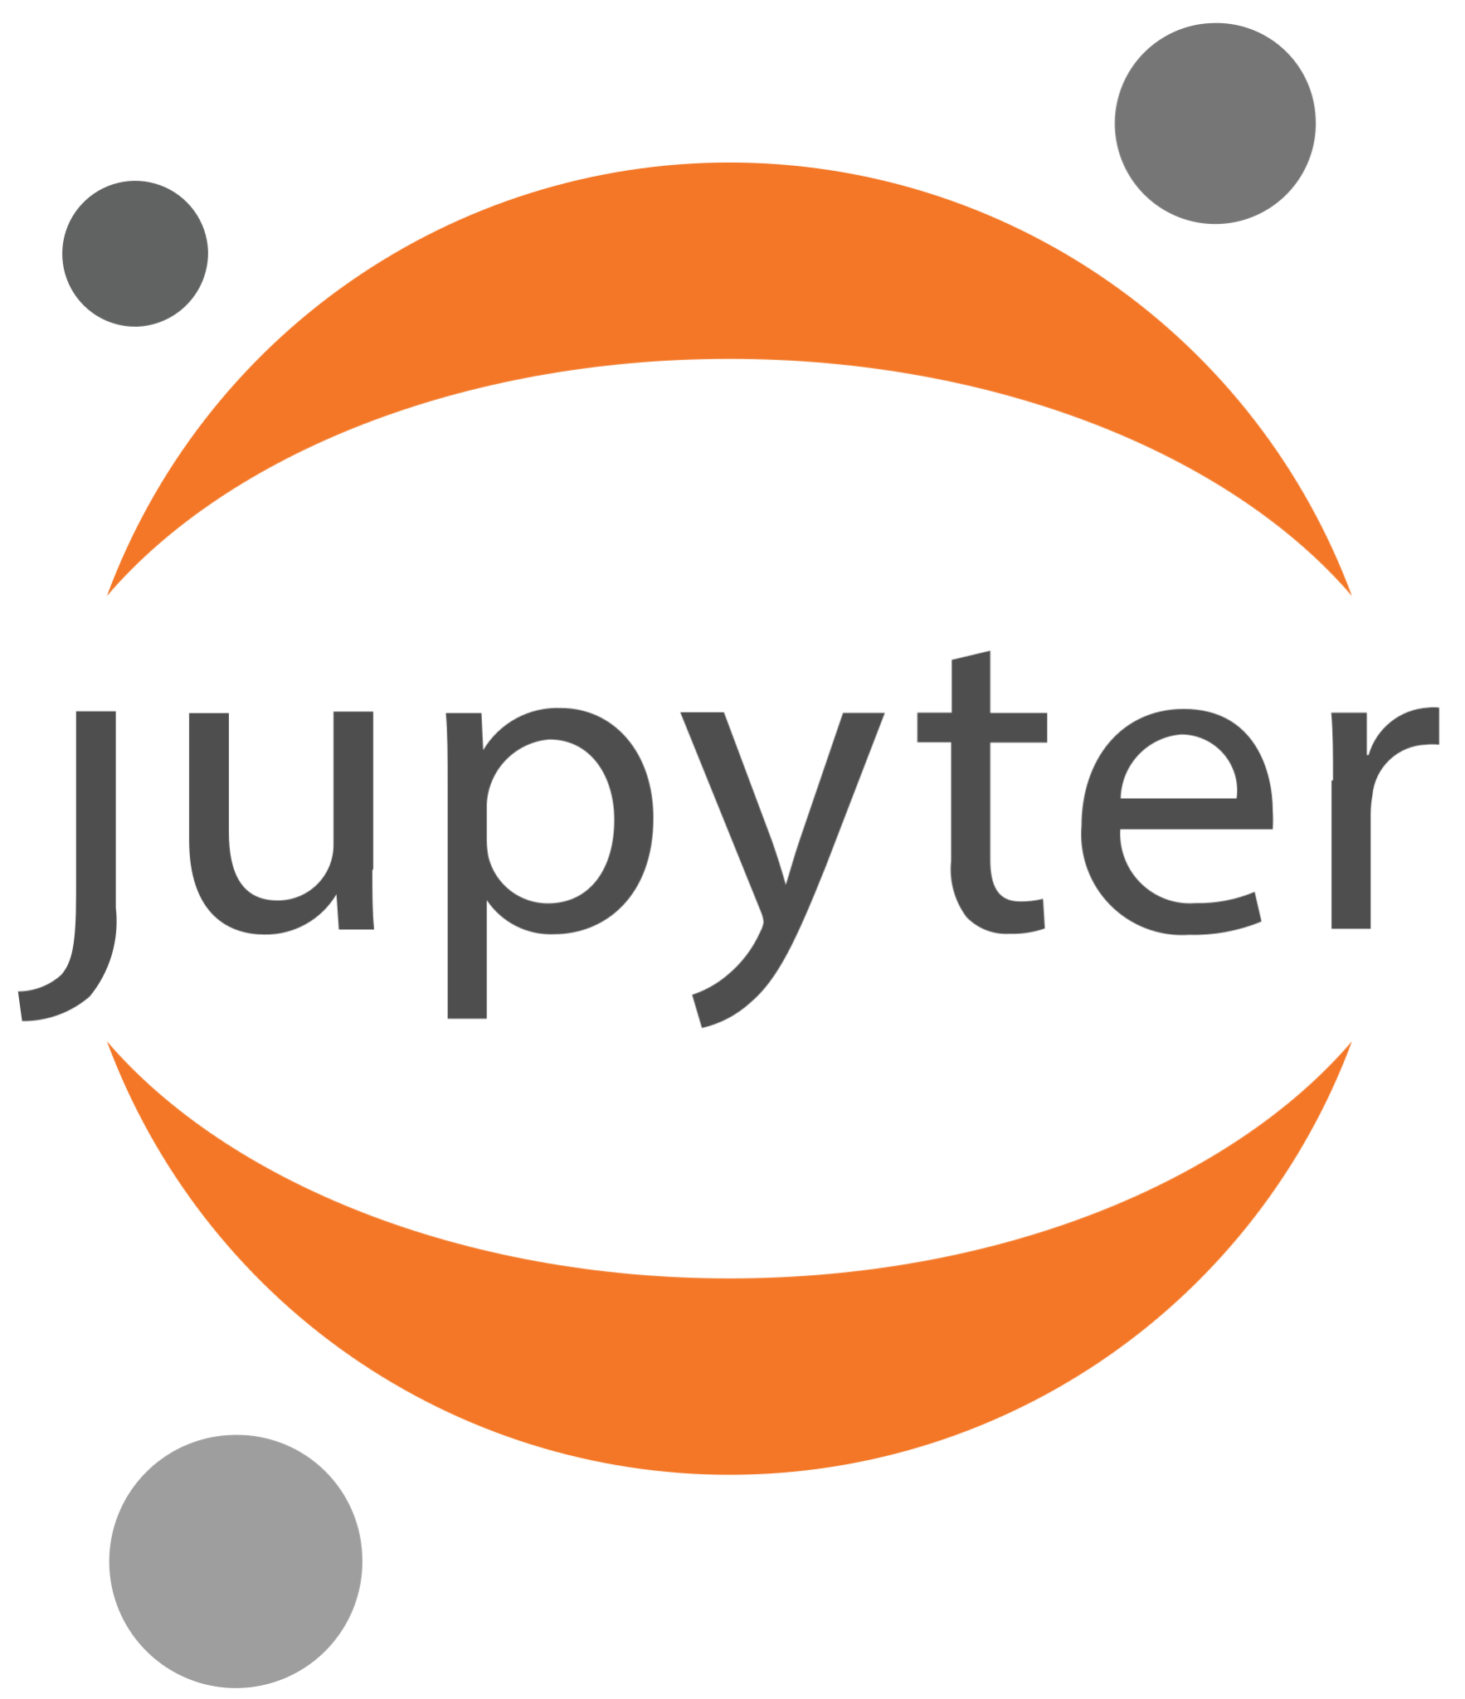

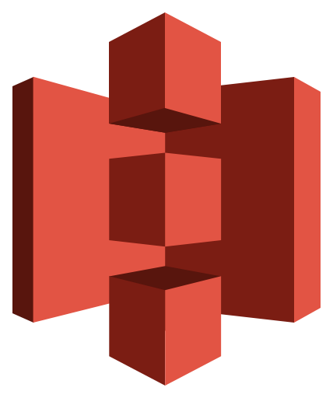
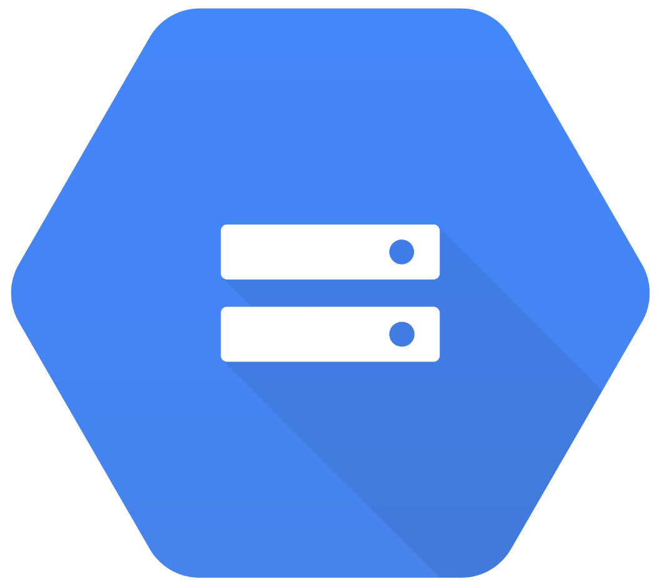
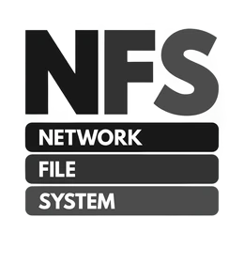







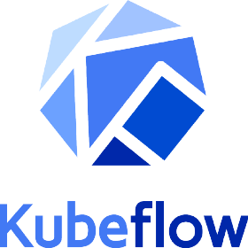

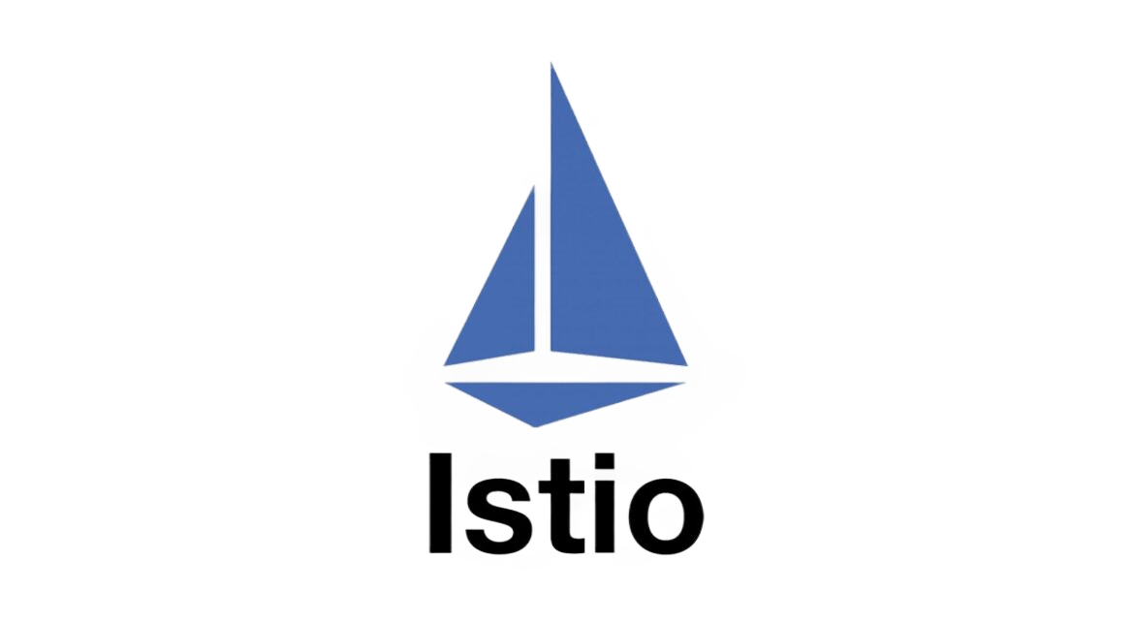




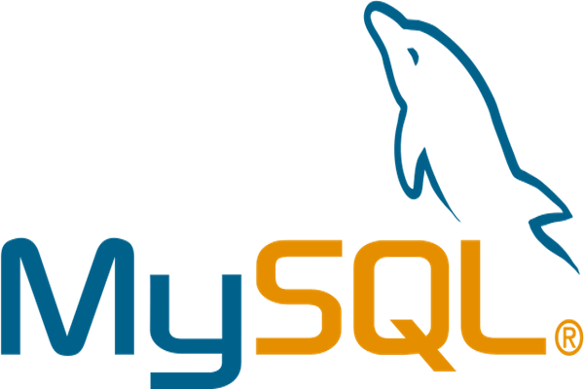
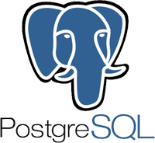

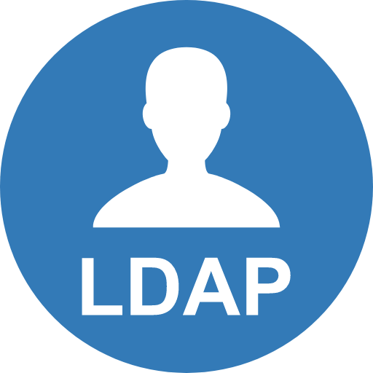

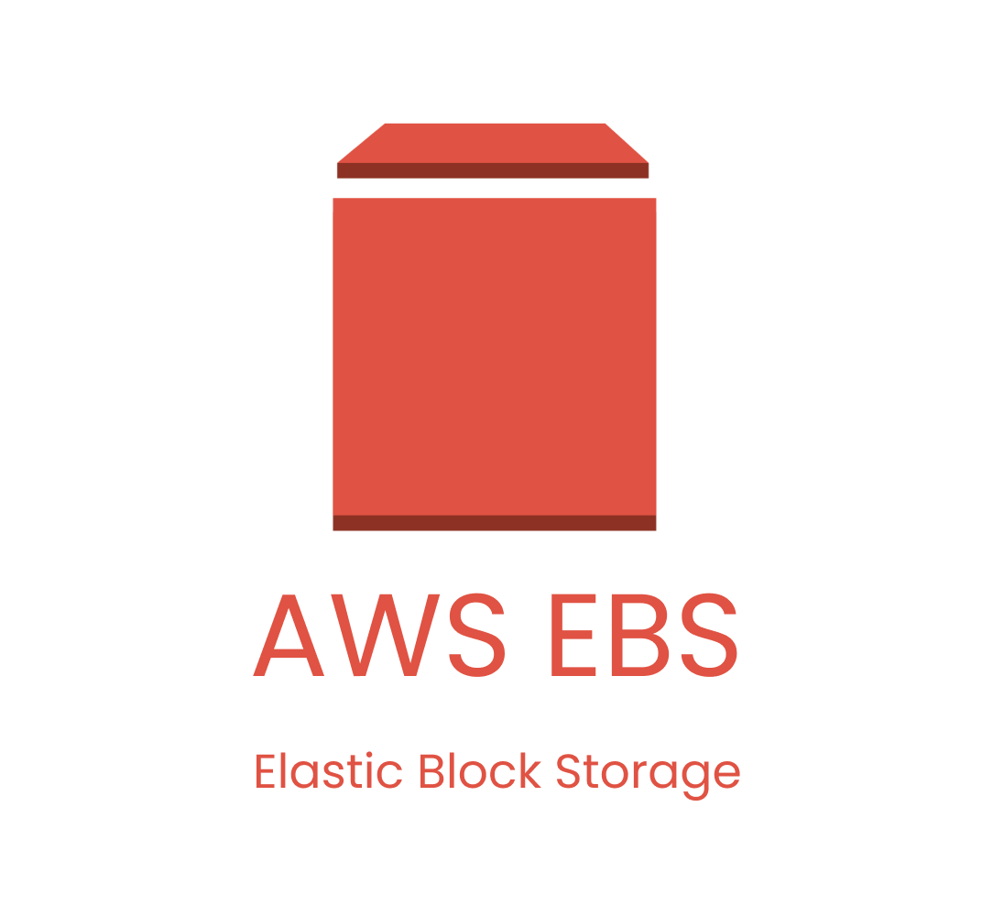



DKube Architecture
Project (Code)
Dataset / Model
Load-
balancer
MLaaS Objects
MLaaS Apps
S3 Buckets
GCS Bucket
Kubernetes Volumes
Web URL
Ingress
Metrics Controller
Job/Workflow Controller
Version Controller
DKube Controller
Kubeflow Pipelines
Local
MLaaS Components
Log Controller
Storage Controller
DB Server
AuthN Controller
Object Store
File System
Local
GCP PD
Kubernetes Volumes
Storage
Google Kubernetes Engine
Community Kubernetes
Infrastructure
dkube.io
Empowering Enterprise AI on Kubernetes

Slide 5
DKubeX - A Kubernetes Based Platform
Our enterprise-grade private AI platform to build, deploy, and scale MLOps, LLMOps and generative AI workflows securely on your infrastructure — built on Kubernetes for simplified AI operations with strong security, governance, and cost efficiency.
DKubeX runs seamlessly on any Kubernetes environment, offering flexibility and portability.
Supported Environments:
On-Prem / Private Clouds: RKE2, and other Kubernetes distributions for organizations running within their own datacenters or private infrastructure.
Public Clouds: AWS EKS, Azure AKS - offering multi-cloud support and cloud-agnostic deployment across major providers.
dkube.io
Empowering Enterprise AI on Kubernetes

Slide 6
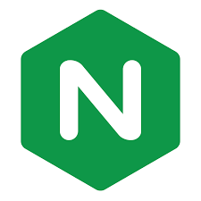



DKubeX Architecture
NGINX
Auth
Application Interface
SecureChat
API Endpoints
CLI/UI
Security Group
D3X K8S Service
User Interface
FM Controller
D3X Controller
Workspace
LLM Controller
SKY Controller
Feedback
Vector Store
Deployments
MLFlow
KubeFlow
SecureLLM
Databases
Datasets
KServe/vLLM
Model Store
Jobs
Monitoring
Postgres
Cache
LLM/EMB Models
Lineage
Pipelines
Reports
Prometheus/Grafana
Loki
Storage
CPU Nodes
GPU Nodes
EFS/NFS
dkube.io
Empowering Enterprise AI on Kubernetes

Slide 7
DKubeX – Features
Fully Kubernetes-based Infrastructure
Simplified Installation
Robust Security and User Management
Comprehensive User Workspaces
ML Training
ML Serving and Management
MLOps Integration
LLMOps: Powering Generative AI
LLM Fine-Tuning
Generative AI and Agentic Solutions
dkube.io
Empowering Enterprise AI on Kubernetes

Slide 8
LLM-Stack
A Kubernetes-based unified AI development platform with pre-built tools for model serving, observability, workflow automation, and secure user access.
Open & Extensible: Built on open-source frameworks like LiteLLM, Langflow, and Arize Phoenix for flexible integrations and model interoperability.
Hybrid Deployment: Runs seamlessly across on-prem and cloud environments (EKS, AKS, GKE) using Helmfile-based deployment automation.
End-to-End Observability: Monitors model performance, costs, latency, and user interactions through integrated observability tools like HyperDX and Phoenix.
Enterprise-Grade Security: Features OAuth2 authentication, role-based access, and governance through Dex + OAuth2 Proxy for secure access to all services.
dkube.io
Empowering Enterprise AI on Kubernetes
Notes:
It streamlines the deployment, monitoring, and management of end-to-end AI workflows using tools like OpenWebUI, LiteLLM, Langflow, Arize Phoenix, and HyperDX.

Slide 9
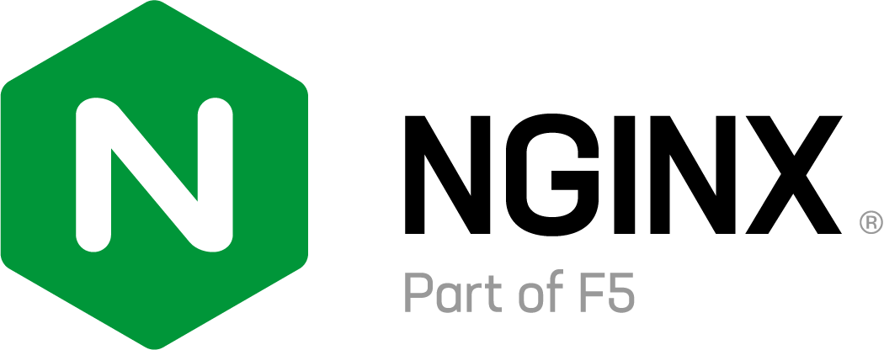





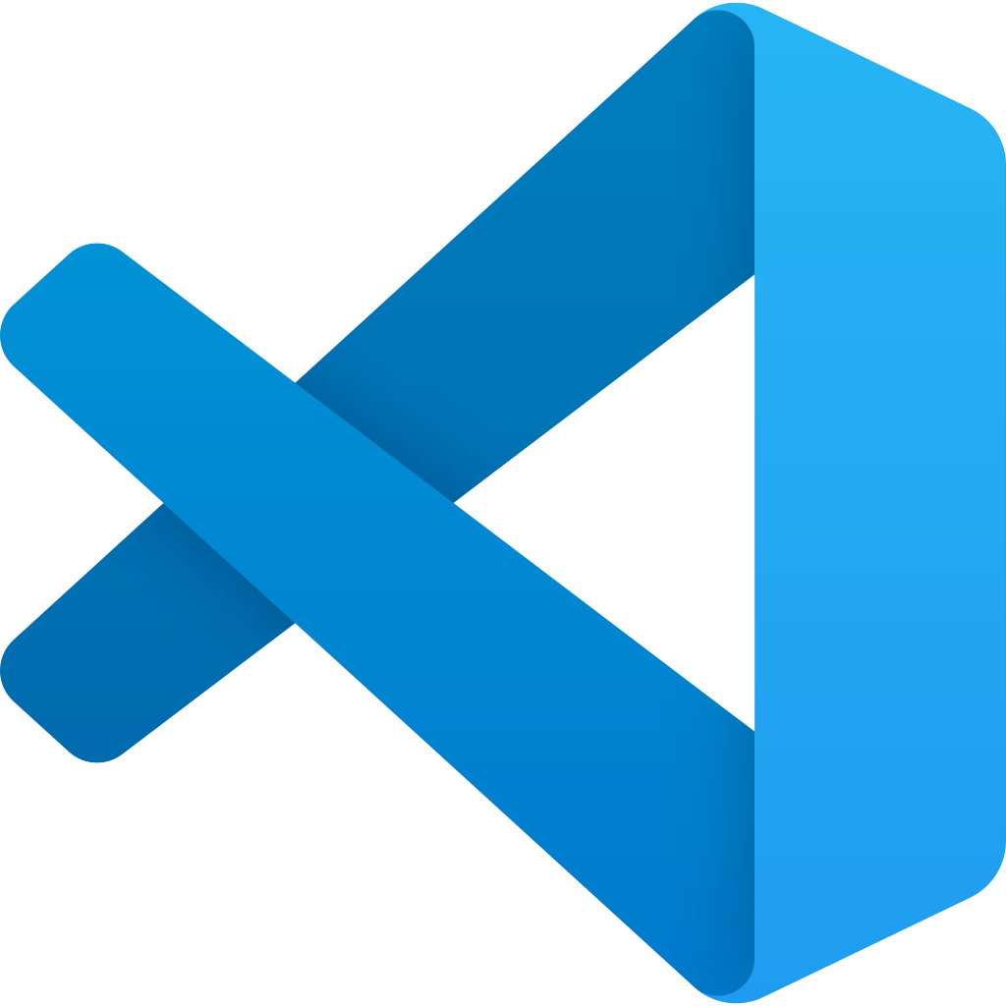




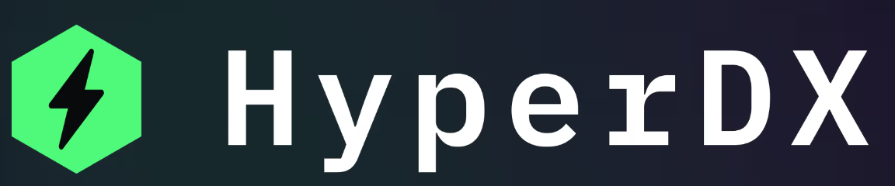
LLM-Stack Architecture
Load Balancer
Authentication
Homepage
Dashboard
Frontend
AI Workflows
Workspace
Gateway
LLM Models
External
Observability
Supporting Services
Database
Observability
dkube.io
Empowering Enterprise AI on Kubernetes

Slide 10
Customer Use Cases
Customer Support AI (Insurance)
IT Support Agent
MLOps Platform Enablement
Agentic AI Solution
Accelerating Research with Compute Platform
CNI Plugin for Kubernetes
Cloud Native Platform (K8S) Services
Virtual PCIe Fabric management using Kubernetes
dkube.io
Empowering Enterprise AI on Kubernetes
Notes:
Ipv4,ipv6 and dual-stack networking for workloads PCIe, we developed microservices to handle orchestration (who gets which device), network tunneling, monitoring

Slide 11

Our Solutions
Multi agent workflow that lets users to generate hypothesis over a certain topic while refining it, using the elo scores and re-ranking agents.
A multi-agent assistant that streamlines workplace processes with intelligent automation, powered by RAG for document retrieval and knowledge querying.
Unified, multi-agent platform that lets users explore data from various sources using no code.
QueriLynx
AI Research Lab
AskX
RAG-native AI copilot that streamlines teaching tasks, personalizes learning, and enhances student engagement in higher education.
An AI-driven document assistant that streamlines workflows through intelligent sorting, key field extraction, and deep document analysis.
A smart, personalized health AI agent that continuously monitors your health data, analyzes trends, and delivers tailored recommendations and action plans.
Virtual Teaching Assistant
DocMind
PulseIQ

Slide 12








Customers
dkube.io
Empowering Enterprise AI on Kubernetes
Notes:
altos
thermofischer
roche
cisco
nutanix
stackpath
fungible

Slide 13
Build. Scale. Innovate.

Slide 15

Robust Security and User Management
Enterprise-grade access control and identity management are built in.
Supported OAuth Providers:
Git · Okta · Keycloak · Google · Microsoft ADFS
Value to AWS Enterprises:
Seamless integration with corporate identity systems
Role-based access and audit trails for every user action
Meets security and compliance standards expected in regulated industries
dkube.io
Empowering Enterprise AI on Kubernetes

Slide 16
Comprehensive User Workspaces
Pre-configured environments for data scientists and MLOps teams
IDEs: RStudio, JupyterLab, VS Code
Integrated File Browser and Terminal access
Consistent, ready-to-use setup across teams and projects
Accelerates experimentation and collaboration
dkube.io
Empowering Enterprise AI on Kubernetes

Slide 17
ML Training
Provides environments like Jupyter, Vscode, R
Integrates with tools like Ray, Kubeflow and flyte
Tools for training and serving traditional machine learning models.
Run distributed ML jobs on Kubernetes using Ray and submit ML training jobs on cloud (AWS, GCP)
Supports GPU/CPU resource allocation
Ensures reproducible and efficient training workflows
Uses Mlflow for tracking experiments and training runs including the parameters. metrics, artifacts of the training runs.
dkube.io
Empowering Enterprise AI on Kubernetes

Slide 18
ML Model Serving and Management
DKubeX provides flexible model-serving options designed for scalability and performance across environments.
Serving Options:
On Kubernetes: via Ray for containerized inference
In Cloud: via Skypilot for managed GPU/compute utilization
Business Advantage:
Choose deployment method based on workload size and cost profile
Unified management for training, serving, and monitoring ML models
dkube.io
Empowering Enterprise AI on Kubernetes

Slide 19
MLOps Integration
Record parameters, metrics, and artifacts
Reproduce and compare runs
Manage model versioning and lifecycle stages
MLFlow - Experiment Tracking
Design and execute complex ML pipelines on Kubernetes
Ensure consistency and scalability across teams
KubeFlow - Orchestration
Automate tuning to improve accuracy and reduce iteration time
Optuna - Hyperparameter Optimization
Real-time insights into model performance and training behavior
Tensorboard - Visualization
dkube.io
Empowering Enterprise AI on Kubernetes

Slide 20
LLMOps: Powering Generative AI
Purpose-built for modern Generative AI workloads on Kubernetes– providing seamless management of LLMs and embedding models across training, deployment, and inference pipelines - both on-prem and across cloud environments.
Core Components:
LLM/Embedding Model Catalog: Ready-to-deploy open-source and NVIDIA NIM models (LLMs and embeddings)
Deployment: KServe (local) or Skypilot (AWS, GCP)
Inference: Run on local GPUs or cloud GPU nodes
Scaling: Auto-optimization for cost and performance
API Access: Standardized endpoints for application integration
dkube.io
Empowering Enterprise AI on Kubernetes

Slide 21
LLM Fine-Tuning
Key Features:
DKubeX simplifies the complex process of fine-tuning LLMs and embedding models
Axolotl Framework: human-readable configuration for fine-tuning jobs
Simplify fine-tuning with intuitive, YAML-based workflows.
Methods Supported: LoRA and QLoRA for efficient tuning
Embeddings: Flag Embedding for performance gains
Synthetic Data Generation: automatic positive/negative example creation
Value:
Accelerated LLM customization for domain-specific applications without infrastructure overhead.
dkube.io
Empowering Enterprise AI on Kubernetes

Slide 22
Generative AI and Agentic Solutions
Enables enterprise-grade Generative AI and multi-agent systems on Kubernetes, accelerating innovation and simplifying rapid GenAI deployment
Retrieval-Augmented Generation (RAG): Build chatbots that understand and respond using enterprise data
Agentic AI: Develop secure, scalable, and cost-efficient end-to-end AI workflows
Framework Proficiency: LangChain · LlamaIndex · LangFlow · MCP Server · LangGraph
dkube.io
Empowering Enterprise AI on Kubernetes

Slide 23
Simplified Installation
DKubeX’s installation process, powered by Terraform and Helm, enables rapid deployment across both AWS, other clouds or on-prem environments.
Terraform-based installation provisions and configures all necessary AWS infrastructure — including EKS clusters, networking, storage, and IAM roles — ensuring a fully integrated and production-ready environment within minutes.
RKE2 installation using Helm charts for simplified on-prem deployments
Consistent configuration across environments ensures repeatability and compliance
dkube.io
Empowering Enterprise AI on Kubernetes

Slide 24
Use Case : Customer Support AI (Insurance)
Implemented a secure, AI-powered Knowledge Engine for a leading health-insurance marketplace to deliver state-specific answers and cut escalations.
Retrieval & Knowledge: Advanced RAG combining state-specific private data with public policy docs for accurate, contextual responses.
LLM Excellence: Fine-tuned Mistral to understand insurance terminology, state policies, and complex queries.
Private Deployment: Fully within the client’s VPC with strict role-based access to state-scoped knowledge.
Guardrails & Governance: Hallucination controls prompting the model to admit uncertainty; comprehensive observability and RBAC.
Performance at Scale: Optimized multi-GPU setup delivering <5-second responses and high throughput.
dkube.io
Empowering Enterprise AI on Kubernetes

Slide 25
Use Case: IT Support Agent
Built an AI-powered Slack assistant to automate IT support, resolve queries instantly, and streamline ticket management.
Conversational AI: Understands issues and provides contextual responses using LLM + RAG.
Knowledge Integration: Retrieves solutions from GitHub, Slack, and Freshservice knowledge bases.
Smart Ticketing: Creates or updates tickets when human intervention is needed.
Observability: Langfuse-based tracing, analytics, and workflow monitoring.
Deployment: Kubernetes-ready architecture with vector databases for scalability.
dkube.io
Empowering Enterprise AI on Kubernetes

Slide 26
Use Case: MLOps Platform Enablement
Enabled full MLOps lifecycle on DKube for seamless model development, training, and deployment on Kubernetes.
Unified Platform: DKube powered end-to-end MLOps — from data prep to serving.
Isolated IDEs: GPU-enabled JupyterLab and VS Code for secure experimentation.
Training & Serving: Used Kubeflow TF Operator and KServe for scalable workflows.
Pipeline Orchestration: Automated ML pipelines through DKube’s Kubeflow integration.
dkube.io
Empowering Enterprise AI on Kubernetes

Slide 27

Self-Evaluating Multi-Agent System
Traceability and Observability
Agents collaborate and self-correct to ensure accurate, high-quality responses.
Track agent actions and inspect generated SQL for full transparency.
Unified, multi-agent powered platform that lets users explore data from various sources using no code.
Connects & Queries multiple databases
Secure and Scalable
Seamlessly connect to and query multiple SQL databases.
Deploy anywhere with built-in access controls and enterprise-grade security.
Empowering Enterprise AI on Kubernetes
Notes:
2. The Data Challenge
Data is scattered, technical, and hard to access.
Most users can’t write SQL or build visualizations.
Slow, inconsistent insights = missed opportunities.

Slide 28

Empowering Enterprise AI on Kubernetes

Slide 29
AI Research Lab
WHAT IS IT?
WHY IT MATTERS?
FEATURES
A secure, private GenAI-powered platform where researchers can build, simulate, and visualize agentic workflows — just like experiments in a physical lab.
Transforms the research process into an agile, intelligent, and repeatable system — reducing manual effort and improving scientific rigor.
Agentic research simulations
Secure multi-source data analysis
Scientist-in-the-loop
Workflow sharing and reusability
Traceability, reproducibility, and scalability
High volume data handling.
Empowering Enterprise AI on Kubernetes

Slide 30

AI Research Lab
Empowering Enterprise AI on Kubernetes

Slide 31
AskX
WHAT IS IT?
WHY IT MATTERS?
FEATURES
A multi-agent assistant that streamlines workplace processes with intelligent automation, powered by RAG for document retrieval and knowledge querying.
Saves time and reduces context switching
Improves employee productivity and experience
Provides a single, extensible assistant for diverse workplace needs
Policy & document fetch
Email summarization
Leave & WFH requests
HR queries & ticket raising
Codebase Q&A & colleague finder
Extensible to custom workflows
Empowering Enterprise AI on Kubernetes

Slide 32

AskX
Empowering Enterprise AI on Kubernetes

Slide 33
Virtual Teaching Assistant
WHAT IS IT?
WHY IT MATTERS?
FEATURES
RAG-native AI copilot that streamlines teaching tasks, personalizes learning, and enhances student engagement in higher education.
Saves faculty time by automating content Q&A and objective grading.
Improves student experience with instant, course-scoped answers.
Ensures trustworthy outputs with source citations and RBAC.
Scales reliably with Docker/K8s and modular architecture.
Multi-format ingestion (PDF, PPTX, DOCX, images with OCR)
Course-scoped RAG with citations
Quiz gen & auto-grading + analytics
RBAC: admin, professor, student
Custom LLM configs, flexible models, K8s deploy
Empowering Enterprise AI on Kubernetes

Slide 34

Virtual Teaching Assistant
Empowering Enterprise AI on Kubernetes

Slide 35
DocMind
WHAT IS IT?
WHY IT MATTERS?
FEATURES
An AI-driven document assistant that streamlines workflows through intelligent sorting, key field extraction, and deep document analysis.
Automates repetitive document handling, freeing employees to focus on higher-value work.
Reduces human errors and ensures sensitive data is processed securely.
Enables faster decisions in critical processes like claims, loans, and onboarding.
Integrates seamlessly with existing systems while supporting cloud-agnostic, secure deployment.
Faster processing – automates document handling.
Higher accuracy – minimizes errors, ensures compliance.
Quicker decisions – speeds up claims, loans, onboarding.
Enterprise ready – scalable, secure, and easy to integrate.
Empowering Enterprise AI on Kubernetes

Slide 36

DocMind
Empowering Enterprise AI on Kubernetes

Slide 37
PulseIQ
WHAT IS IT?
WHY IT MATTERS?
FEATURES
A smart, personalized health AI agent that continuously monitors your health data, analyzes trends, and delivers tailored recommendations and action plans.
Real-time personalized health guidance
Unified view of fragmented health data
Automated monitoring and trend detection
Timely, expert-like insights
Better engagement with reminders and reports
Personalized recommendations — tailored to each user’s health metrics.
Action plans — customized improvement steps with progress tracking.
Health reports — periodic summaries with clear insights.
Multi-metric support — integrates diverse health data sources
Compliance ready — HIPAA and PII compliant.
Empowering Enterprise AI on Kubernetes

Slide 38

PulseIQ
Empowering Enterprise AI on Kubernetes

Slide 39
Use case: Accelerating Research with Compute Platform
High-speed compute platform enabling on-demand infrastructure provisioning and reduced time-to-experiment.
Diverse Resources: Quick access to EKS Containers (K8s), EC2 VMs, AWS Parallel Clusters (HPC), and Ray Clusters (AI/ML)
Bridges local development with cloud compute for maximum productivity. Dedicated Desktop App and CLI Commands connect local tools directly to cloud resources
Integrated Workflows: Pre-bundled software for day to day development by users, easy access to dataset using S3 bucket mounting, and simplified Authentication and Authorization
Observability & monitoring of all user & system resources
Cost Optimization: Auto-shutdown of idle nodes, workspaces to reduce spend.Integrated with slack alerts to intimate users.
dkube.io
Empowering Enterprise AI on Kubernetesc

Slide 40
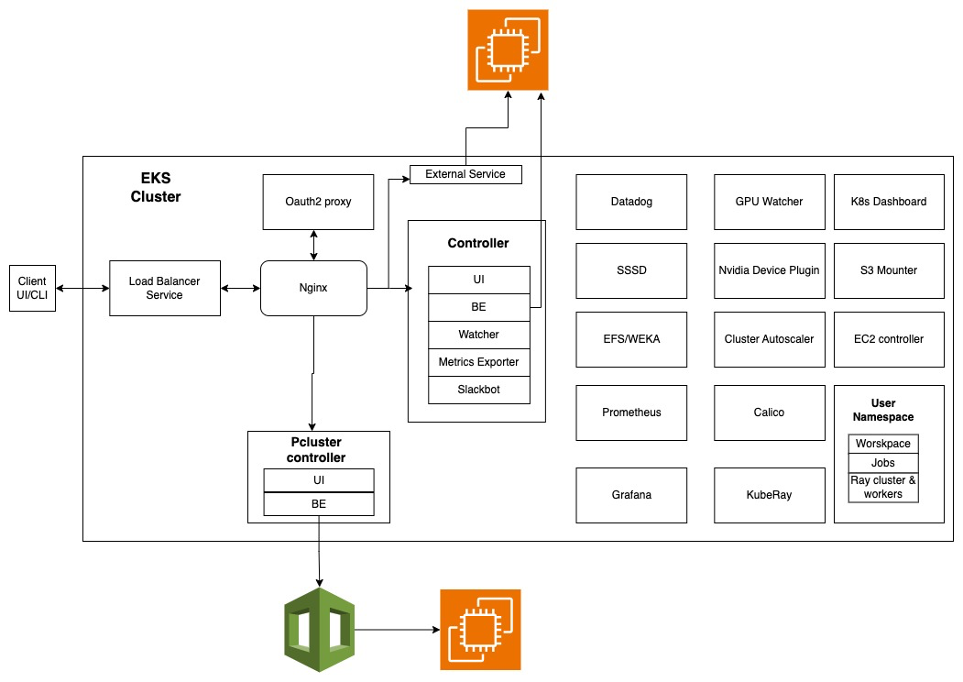
Use Case : Accelerating Research with Compute Platform
dkube.io
Empowering Enterprise AI on Kubernetesc

Slide 41
Use Case : Agentic AI Solution
Developed an intelligent research agent platform leveraging AWS and Bedrock to enhance scientific discovery.
Reasoning & Generation: Integrated Bedrock (Claude) as the core LLM for advanced research insights.
Agent Framework: Built using the Strands Agent SDK to enable autonomous, agentic workflows.
Infrastructure: Deployed on AWS ECS (Fargate) for scalable, containerized services.
Security & Access: Secured via AWS CloudFront + ALB stack and AWS Cognito for identity management.
dkube.io
Empowering Enterprise AI on Kubernetes

Slide 42
Use Case : CNI Plugin for Kubernetes
Built Container Network interface(CNI) for Kubernetes for ACI fabric.
CNI enables containers and pods running in Kubernetes to directly leverage ACI’s policy, segmentation and visibility capabilities.
The plugin provides all networking and security requirements for OpenShift cluster.
Involved in end-to-end automation and verification of CNI plugin in different releases and eco systems (RKE, K8s, OpenShift)
Verification on bare metal, OpenStack VMs, ESX VMs
Optimized some of the features of ACI CNI like SNAT, Network Policies
dkube.io
Empowering Enterprise AI on Kubernetes

Slide 43
Use Case : Cloud-Native Platform (K8s) Services
Worked for Edge Computing Platform provider and implemented cloud native platform(K8s) services to manage
Compute resources(VM and container workloads)
GPU enablement and monitoring for both VM and container workloads
IPv4, IPv6 and dual-network stack support for workload networking using CNI plugins and OVS + SmartNIC on compute hosts.
SmartNIC Open vSwitch integration.
Telemetry
dkube.io
Empowering Enterprise AI on Kubernetes

Slide 44
Use Case : Virtual PCIe Fabric management using Kubernetes
Core objective was to virtualize PCIe connections, enabling remote devices to appear as locally attached to the host system via the PCIe protocol.
Multiple microservices were developed to manage the orchestration, network tunneling and monitoring the virtual PCIe fabric.
Microservices are run as Kubernetes workloads
dkube.io
Empowering Enterprise AI on Kubernetes

