Slide 1

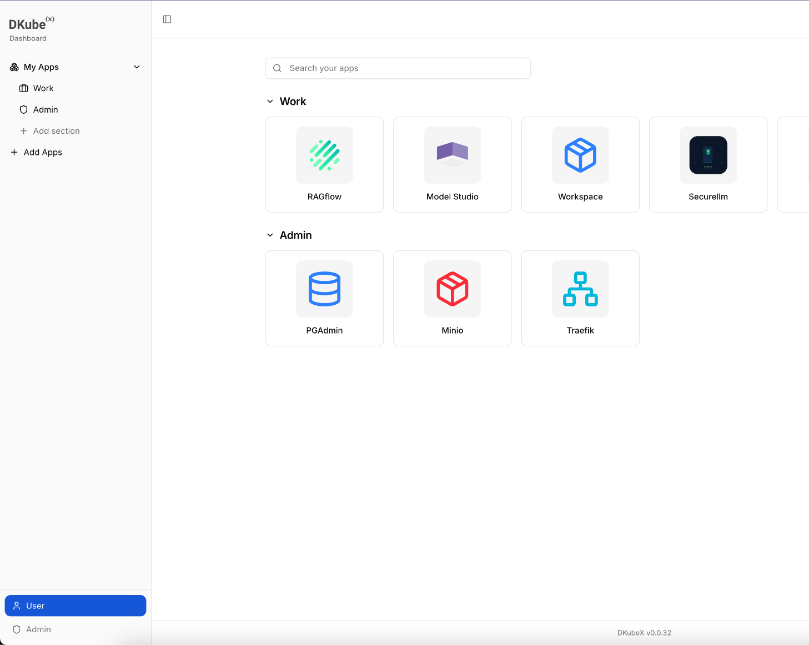
DKubeX 2.0
One platform for enterprise AI applications across hybrid (private and public) environments
dkube.io

Slide 2
Introducing DKubeX 2.0
A Modular Platform for Enterprise AI Applications
DKubeX 2.0 brings together the tools needed to deploy and use enterprise AI applications in a flexible and controlled environment.
Built for private AI deployments
Supports MLOps, ModelOps, GenAI, and agentic workflows
Works across on-prem and public AI models
Delivers capabilities through installable applications
Designed for enterprise control, flexibility, and simplicity
dkube.io

Slide 3
Platform Overview
One Platform for Enterprise AI Operations
DKubeX 2.0 provides a unified experience for users and administrators to access and manage AI applications from one platform.
Unified platform for AI applications and workflows
Separate user and admin experiences
Private (on-prem) model deployments with public models available to use as per need
Flexible platform for different enterprise needs
dkube.io

Slide 4
Application-Based Experience
Everything is Delivered as an Application
DKubeX 2.0 is built around a simple application-based model, allowing teams to use only what they need for each use case.
Browse available applications from a central catalog
Install applications based on business or technical need
Keep the platform modular and easy to use
Expand capabilities without unnecessary complexity
dkube.io

Slide 5
User Experience
Simple Access to AI Tools and Applications
The user console is designed to make application discovery and usage straightforward for day-to-day AI work.
Applications tab: browse and install available apps
My Apps tab: to access installed applications
Launch and manage tools from one place
Default applications include PGAdmin, MinIO, and Traefik
dkube.io

Slide 6
Core Applications in DKubeX 2.0
Built for Real Enterprise AI Use Cases
DKubeX 2.0 includes a growing set of applications that support ML, modelOps, GenAI and agentic workflows.
Workspace for development and experimentation
MLflow for tracking ML workflows, runs, and registering models in MLFlow Model Registry
Model Studio for model search and deployment
RAGFlow for retrieval-augmented AI applications
SecureLLM – a secure gateway for AI models
Langflow for building and orchestrating agentic AI workflows
AgentX for creating and running interactive agent workflows with different agents
Prefect for orchestrating scheduled, event-driven, and automated workflows
dkube.io

Slide 7
Hybrid (Private/Public) AI
Keep Sensitive Workloads Private. Use Cloud when Required.
DKubeX 2.0 helps enterprises align AI deployment choices with the sensitivity of their workloads and data.
Run private AI workloads on-prem
Send selected workloads to public models when appropriate
Support different privacy needs across use cases
Balance control, flexibility, and access to advanced model
dkube.io

Slide 8
MLFlow
Track Experiments, Manage Models, & Streamline ML Workflows
MLflow in DKubeX 2.0 helps teams organize ML development with better visibility across experiments, runs, and model versions.
Track experiments, runs, metrics, and artifacts
Compare model performance across different runs
Register and manage models in the MLflow Model Registry
Support more organized and reproducible ML workflows
dkube.io

Slide 9
Model Studio
Search, Discover, & Deploy Models Faster
Model Studio simplifies how enterprise teams find and deploy models for AI applications.
Search models directly from Hugging Face and NIM catalogs
Discover models from within the platform
Deploy models through a simpler workflow
Playground to interact with deployed models through a chat-based testing experience
dkube.io

Slide 10
SecureLLM AI Gateway
Secure Access to Private Models & Third-Party Model Providers
SecureLLM AI Gateway helps enterprises connect to AI models with better control, visibility, and governance.
Support private models and third-party model providers
Configure external AI providers such as OpenAI, Anthropic, and Ollama
Centralize API key management across model access
Apply guardrails for safer AI usage
Monitor token usage and cost across interactions
dkube.io

Slide 11
RAGFlow
Build Retrieval-Driven AI Applications Grounded in Enterprise Knowledge
RAGFlow in DKubeX 2.0 helps teams create retrieval-based AI applications that connect models to enterprise data and internal knowledge sources for more relevant, context-aware responses.
Build RAG-driven applications and assistants
Connect AI workflows to enterprise knowledge and data sources
Support a wide range of data sources for retrieval-driven AI applications
Ground responses in business context and internal knowledge
Support internal search, Q&A, and knowledge-based AI use cases
dkube.io

Slide 12
Langflow
Design And Orchestrate Agentic Ai Workflows Visually
Langflow in DKubeX 2.0 helps teams build and manage agent-based AI flows through a more intuitive visual interface.
Build agentic AI workflows with a visual builder
Connect models, prompts, tools, and logic in one flow
Experiment with multi-step AI interactions more easily
Support faster development of agent-based applications
dkube.io

Slide 13
AgentX
Create & Run Interactive Agentic Workflows
AgentX in DKubeX 2.0 enables teams to create and run interactive agentic workflows by creating assistants using different agents available with AgentX.
Support agents such as OpenClaw, Claude Code, and Gemini CLI, with the flexibility to extend to additional agents as needed
Support multi-step execution with reasoning, actions, and user interaction
Enable task-oriented AI flows for enterprise use cases
dkube.io

Slide 14
Prefect
Orchestrate Automated Workflows Across Data, ML, & AI
Prefect in DKubeX 2.0 helps teams build, schedule, and manage automated workflows with better control and visibility.
Build and run automated workflows across data, ML, and AI tasks
Support scheduled and event-driven workflow execution
Manage deployments and workflow runs with greater visibility
Extend orchestration across Kubernetes and other execution environments
dkube.io

Slide 15
Law-Lite
Reduce Weeks of Legal Review to Hours
Law-Lite is an AI-powered legal document analysis platform for lawyers and legal teams. It helps automate document review, information extraction, compliance checking, issue identification, and report generation across legal matters.
Automate up to 80% of manual legal review work using AI agents
Extract key information from contracts and other legal documents
Identify missing clauses, conflicting terms, and compliance failures
Generate structured reports for review, delivery, and audit trail purposes
dkube.io

Slide 16
Mortgage-Lite
Automate Mortgage Review with Privacy-First AI
Mortgage-Lite is an AI-powered mortgage underwriting assistant that automates document processing, validation, and compliance checking for mortgage applications using a privacy-first multi-agent architecture.
Automate document processing, validation, and compliance checking for mortgage applications
Process applications in ~4 minutes instead of the industry standard of 4 days
Support underwriting, servicing transfer, and post-close quality control workflows
Protect sensitive data with local processing and anonymized cloud compliance checks
dkube.io

Slide 17
Admin Experience
Centralized Control for Enterprise Environments
The admin experience is designed to provide visibility, control, and operational simplicity across the platform.
Platform-wide dashboard and observability
Manage users and superuser access
Control platform settings from a central console
dkube.io

Slide 18
Configurable Platform Services
Enable What Your Environment Needs
DKubeX 2.0 allows platform capabilities to be turned on or off based on business, security, or infrastructure requirements.
Configure auth, certs, storage, and telemetry
Enable services only when needed
Support optional components such as object storage, file browser, and telemetry tools
Adapt the platform to enterprise deployment preferences
dkube.io

Slide 19
Enterprise-Ready Platform
Built for Practical Enterprise AI Adoption
DKubeX 2.0 is designed to support real-world enterprise AI programs with flexibility and control.
Private AI foundation for enterprise environments
Flexible deployment choices across on-prem and hybrid setups
Controlled access to models, services, and applications
Suitable for secure and scalable AI operations
dkube.io

Slide 20
DKubeX 2.0
One Platform for Enterprise AI Applications Across Hybrid (Private & Public) Environments
Private where it matters
Flexible where it helps
Ready for on-prem and hybrid AI
Contact Us:
info@dkube.io
Know More About Us:
https://www.dkube.io

