Slide 1
Parkinson’s Data Update
Daniel Castaneda Mogollon, PhD
06/01/2026
Sycuro Lab

Slide 2
Sequencing Data Workflow
Raw sequencing data
Illumina adapter removal
PolyG tract removal
Illumina NovaSeq PE 150 cycles
BBDuk
BBDuk
Low-quality read removal
Read merging
Prinseq
BBMap
Metagenomics analysis
Metaphlan 4
Human reads removal
Bmtagger
SGB
GTDB r220

Slide 3
QC Results
Only high-quality read data was used for downstream analysis. Any samples with less than 900,000 reads was filtered out:
158/184 (~86%)

Slide 4
186 *_1.fastq.gz files in the original Data folder
186 *_2.fastq.gz files in the original Data folder
Raw fastqc matches raw data folder number of samples
Same for bbduk adapt and polyg
Same for bbmerge and bmtagger
176 metaphlan samples, 10 for ctrls

Slide 5
Metagenomics Processing
Diversity differences:
ß-diversity (NMDS) – filtered by species-level taxa, CLR normalized
a-diversity (Shannon, Simpson, Observed) – unfiltered, not normalized
Taxonomic enrichment:
Linear mixed model testing (univariate, multivariate) – filtered by species-level taxa
Taxa-to-taxa correlation network:
LASSO and Neighborgh taxa correlation (spieceasi) – filtered by species-level taxa

Slide 6
n = 184 (2024)
67.9% PD
n = 276 (2024)
63.8% PD

Slide 7
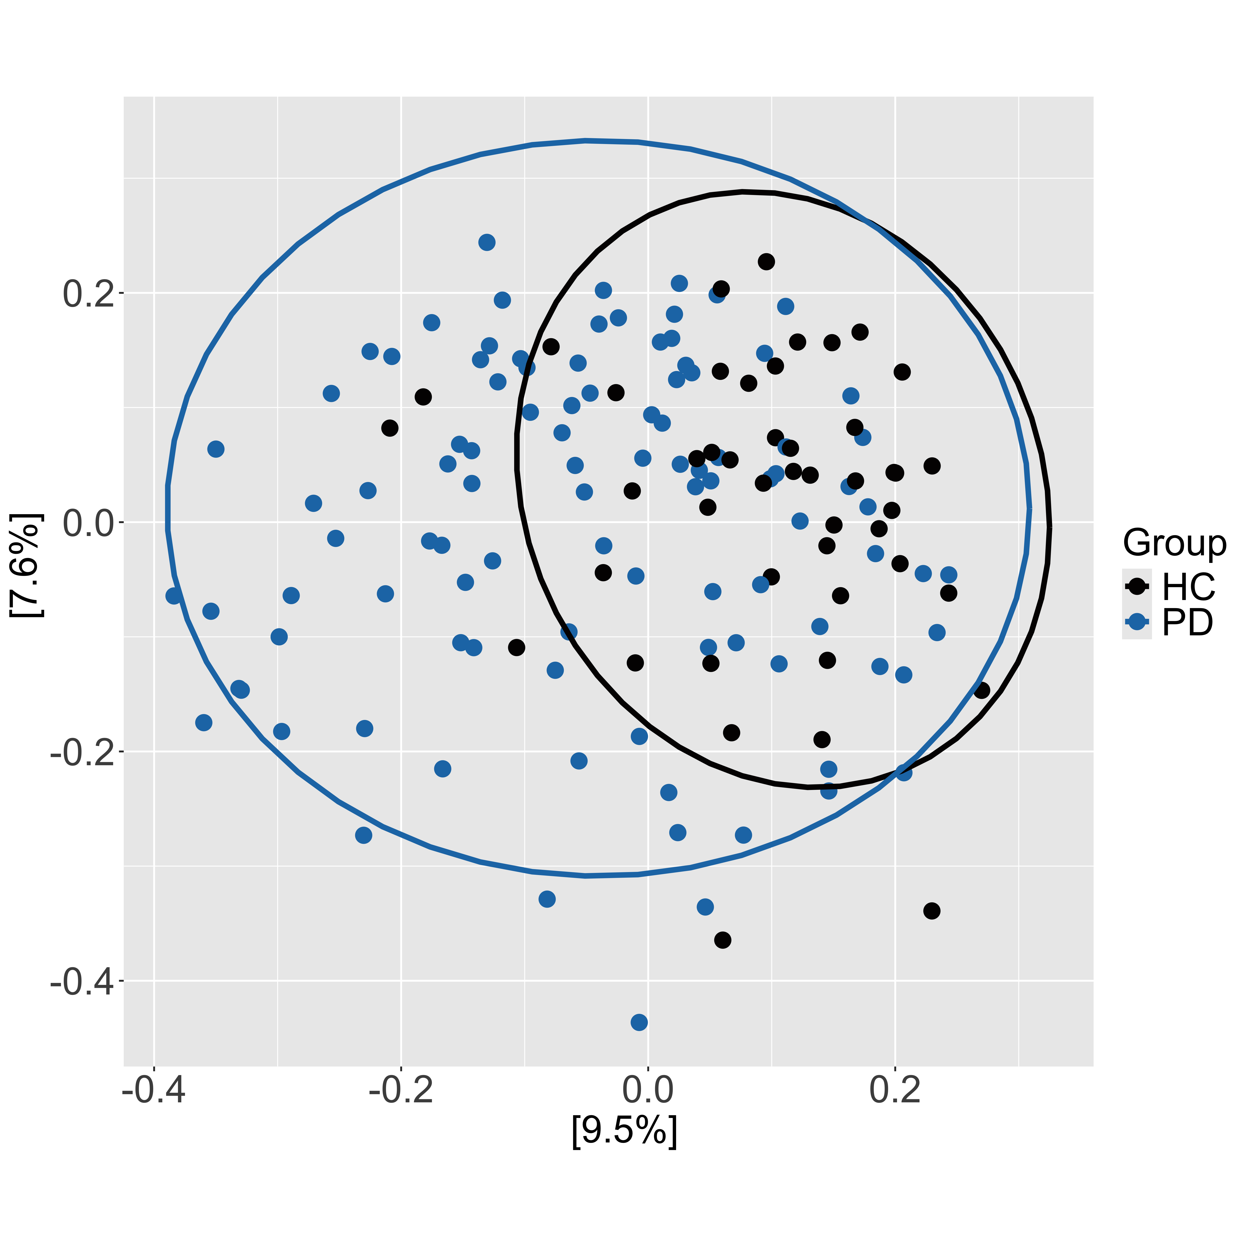
Gut Microbiome Diversity Differs by PD Status
- The overall gut microbiome between PD and HC is significantly different
- HC harbors more bacterial species, but those contribute little to the overall abundance and community evenness
*
p < 0.001

Slide 8
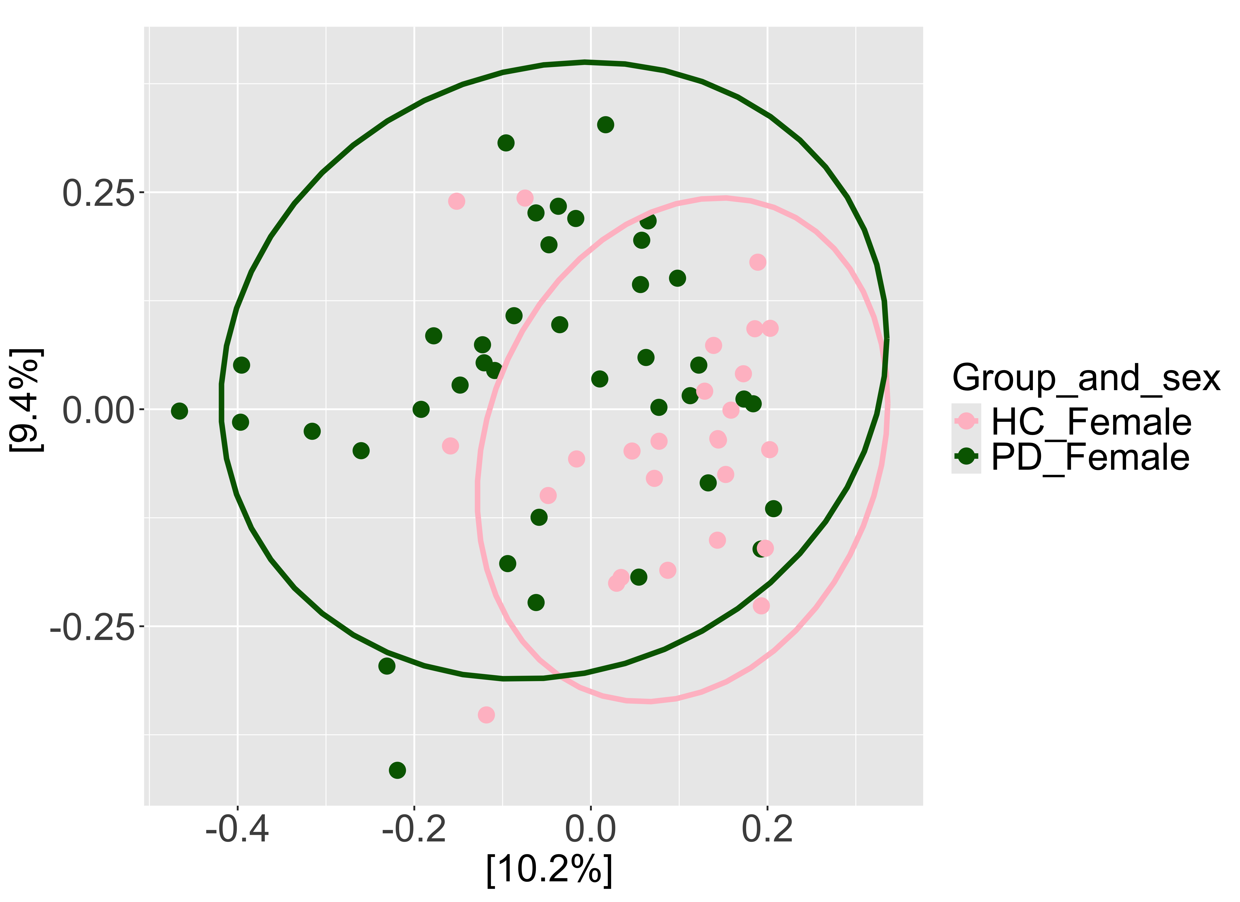
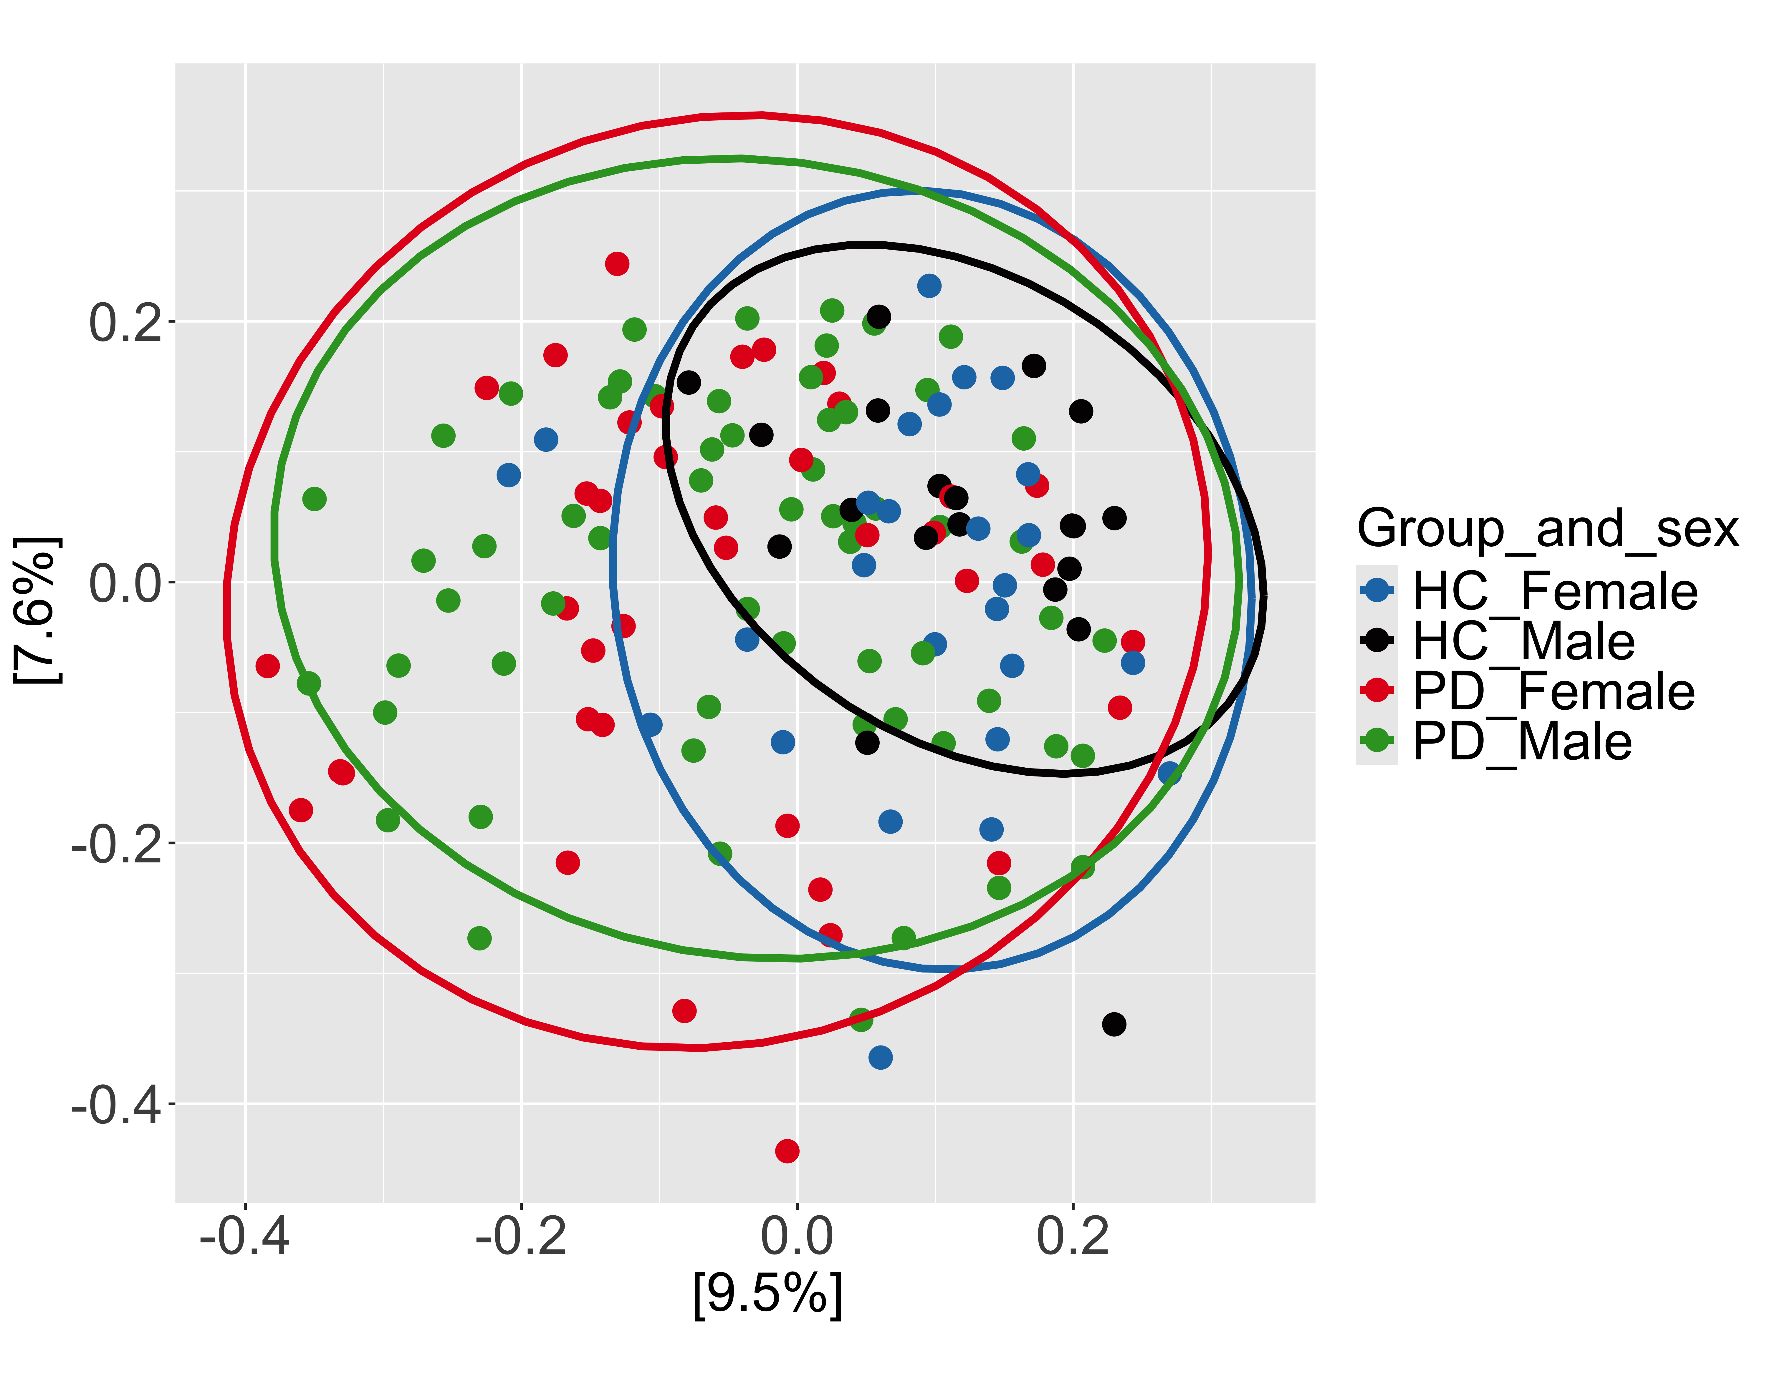
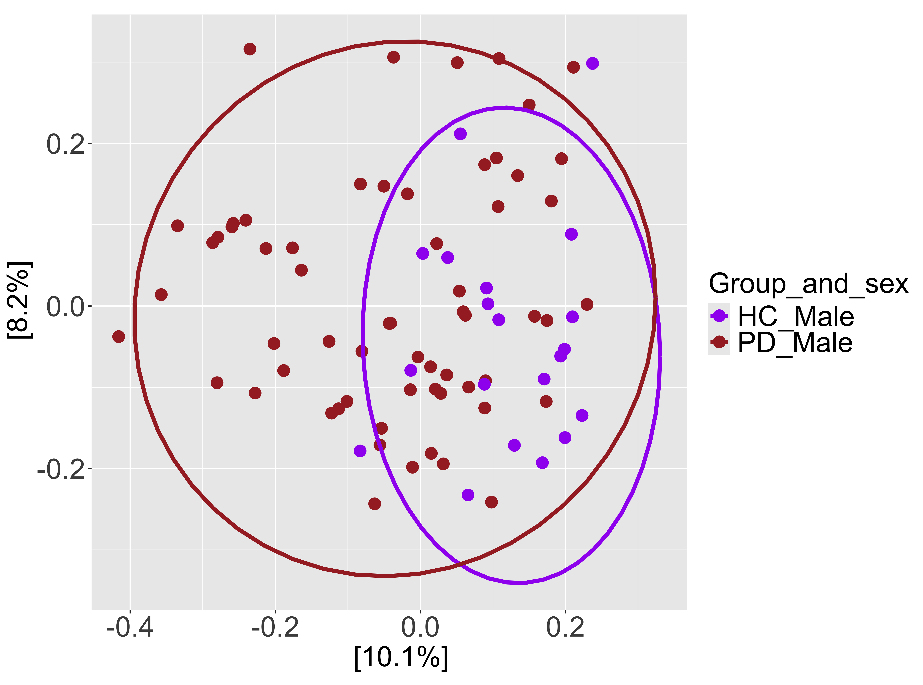
Gut Microbiome Diversity Differs by PD and Sex
p = 0.002
p < 0.001
Pairwise comparison | P-val adj
PD-male vs PD-female | 0.91
PD-male vs HC-male | <0.001
PD-female vs HC-female | 0.002
HC-male vs HC-female | 0.41
p < 0.001

Slide 9
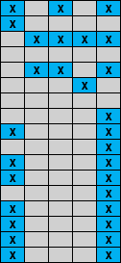
Taxonomic Enrichment by PD Status and Sex
Y ~ ß₀diagnosis + ß₁Sex + e
Barrier integrity
SCFA generation
Barrier disruption
Imidazole production
Levodopa degradation

Slide 10
Functional Enrichment
Cofactor biosynthesis
Cofactor biosynthesis
Metabolite conversion
Protein biosynthesis
Metabolite biosynthesis
Generation of energy and metabolites
Generation of energy and metabolites
Nucleotide biosynthesis
Generation of energy
Biosynthesis of other products
Nucleotide degradation
Vitamin biosynthesis
Vitamin biosynthesis
Vitamin biosynthesis
Sugar degradation
Sugar degradation
Sugar degradation
Protein biosynthesis
Cofactor biosynthesis
Antibiotic resistance
Parkinson’s
Healthy ctrls
Sycuro Lab | University of Calgary | Gut microbiome & Parkinson's disease

Slide 11
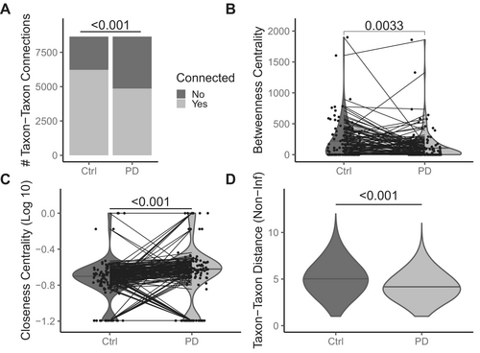
PD Microbiome Networks in BC Study
Connections show a significant association of co-occurring taxa
Betweenness centrality (average number of taxa acting as a bridge between one another) is higher in HC
Closeness centrality indicates how close a taxon is to the rest of the taxa
Avril Metcalfe et al showed evidence of
decreased connectivity in PD gut networks
Tighter clusters
https://journals.plos.org/ploscompbiol/article?id=10.1371/journal.pcbi.1004226#sec001

Slide 12
Microbiome Networks Differ by Connectivity
Node = Bacterial species
Edge = Direct association between two bacterial species after accounting for the rest of the dataset
An edge means that the abundance in two taxa cannot be explained by the rest of the community
Distance = Number of nodes a species needs to traverse in order to reach another taxon
PD network shows a more densely connected microbial network, with more species linked by direct associations and shorter paths.
HC network shows dependency on a small number of connector species
Notes:
Betweenness centrality: Measures how often a bacterial species acts as a bridge connecting other species in the network, the higher the number, the more the species act as bridge.
Harmonic closeness: Harmonic centrality measures how close a bacterial species is to all other species in the network. The higher the value the more it can reach the rest of them through less connections.

Slide 13
ANCOM-BC2 corrects systematic sampling-fraction bias
1
The assumption
Most taxa have equal absolute abundance in both groups. That null majority is what makes the bias identifiable
Why δ ≠ 0 in Parkinson’s
PD → constipation → drier stool → more cells per gram
 | Control | PD
Microbial load | 1×10¹¹ /g | 2×10¹¹ /g
Reads mapped | 2M | 2M
Sampling fraction c | 2×10⁻⁵ | 1×10⁻⁵
2
What it estimates
One log-fold change per taxon, in absolute — not relative — abundance. It starts from compositional data, fits one coefficient per taxon, locates δ per covariate using a maximum likelihood estimate.
δ_group = ln(0.5) = −0.693
3
What makes bias “systematic”
δ is the part of the sampling fraction that correlates with a covariate. There is a systematic sampling-fraction bias that is corrected for.
Same sequencing, half the sampling fraction. Every taxon looks ~50% depleted in PD — before any biology happened.
Filter results on diff_ AND passed_ss_.
Notes:
Corrections from the draft: (1) the assumption is equal ABSOLUTE abundance, not 'equally shared' — that reads like prevalence. (2) The symbol is delta, not the partial-derivative sign. (3) The bias comes from the measurement process, not from the community 'naturally' — and it only counts as systematic when it correlates with a covariate in the formula. (4) Added the subtraction step, which the draft skipped: subtracting delta-hat from every taxon is what produces the lfc. Direction: taxa above the null clump are enriched, below are depleted — both are findings. Significance is W = lfc/se, not distance from the clump.

Slide 14
METHOD 1
MaAsLin 2 models relative abundance
1
What it is
A general linear model fit per taxon, with fixed and random effects, BH-corrected across taxa. Flexible: continuous and categorical covariates
TSS
→
log₂
→
LM
→
BH
Reading a coefficient
coef = 0.85 for group, with TSS + LOG
2
It does not escape compositionality
2^0.85 = 1.8×
TSS produces proportions — that is compositional data. Normalization is a scale model carrying an implicit assumption: constant microbial load, no systematic sampling bias correction
P. vulgatus takes up ~80% more of the community in PD after adjusting for covariates. i.e. For every BMI unit of 1, there is an increase of 0.80 of P. vulgatus
3
Question answered
Don’t interpret the covariate coefficients
After adjusting for age, sex and site, what is the linear effect of group on the log₂ relative abundance of taxon i? The estimand is share of the community — not how much is there.
In a model built to estimate the group effect, the coefficient for BMI or age is not the causal effect of BMI or age.
Notes:
Corrections from the draft: (1) 'Works with non-compositional data after normalizing' is backwards — TSS produces proportions, which IS compositional data. Normalizations are scale models with implicit assumptions; TSS assumes constant microbial load. MaAsLin 2 doesn't escape the scale problem, it declines to model it. (2) MaAsLin2's LOG transform is base 2, so coef = 0.85 means 2^0.85 = 1.8x, an ~80% increase — not 'an increase of 0.85'. (3) It's an increase in the taxon's SHARE of the community, not the amount present. (4) The original example used BMI — Table 2 fallacy, since the model is adjusted to estimate the group effect. Switched to group. Pair with the ANCOM-BC2 slide: same data, different estimand. Disagreement between the two is informative — it signals that total load moved.

Slide 15
Maaslin2
ANCOM-BC2

Slide 16
PD Enrichment after Age Covariate Adjustment Yields Similar Enrichment Profiles

Slide 17
YYC vs YVR
Vancouver
Calgary

Slide 18
Which taxa are different amongst the differences
Previous models are linear:
Model with interaction:
$$ß^{GL}=\left(µ_{PD, Van }− µ_{PD, Cal}\right)−(µ_{HC, Van}−µ_{HC, Cal})$$
The disease effect is larger in Calgary for
E. coli
B = Sex + Group * Location

Slide 19
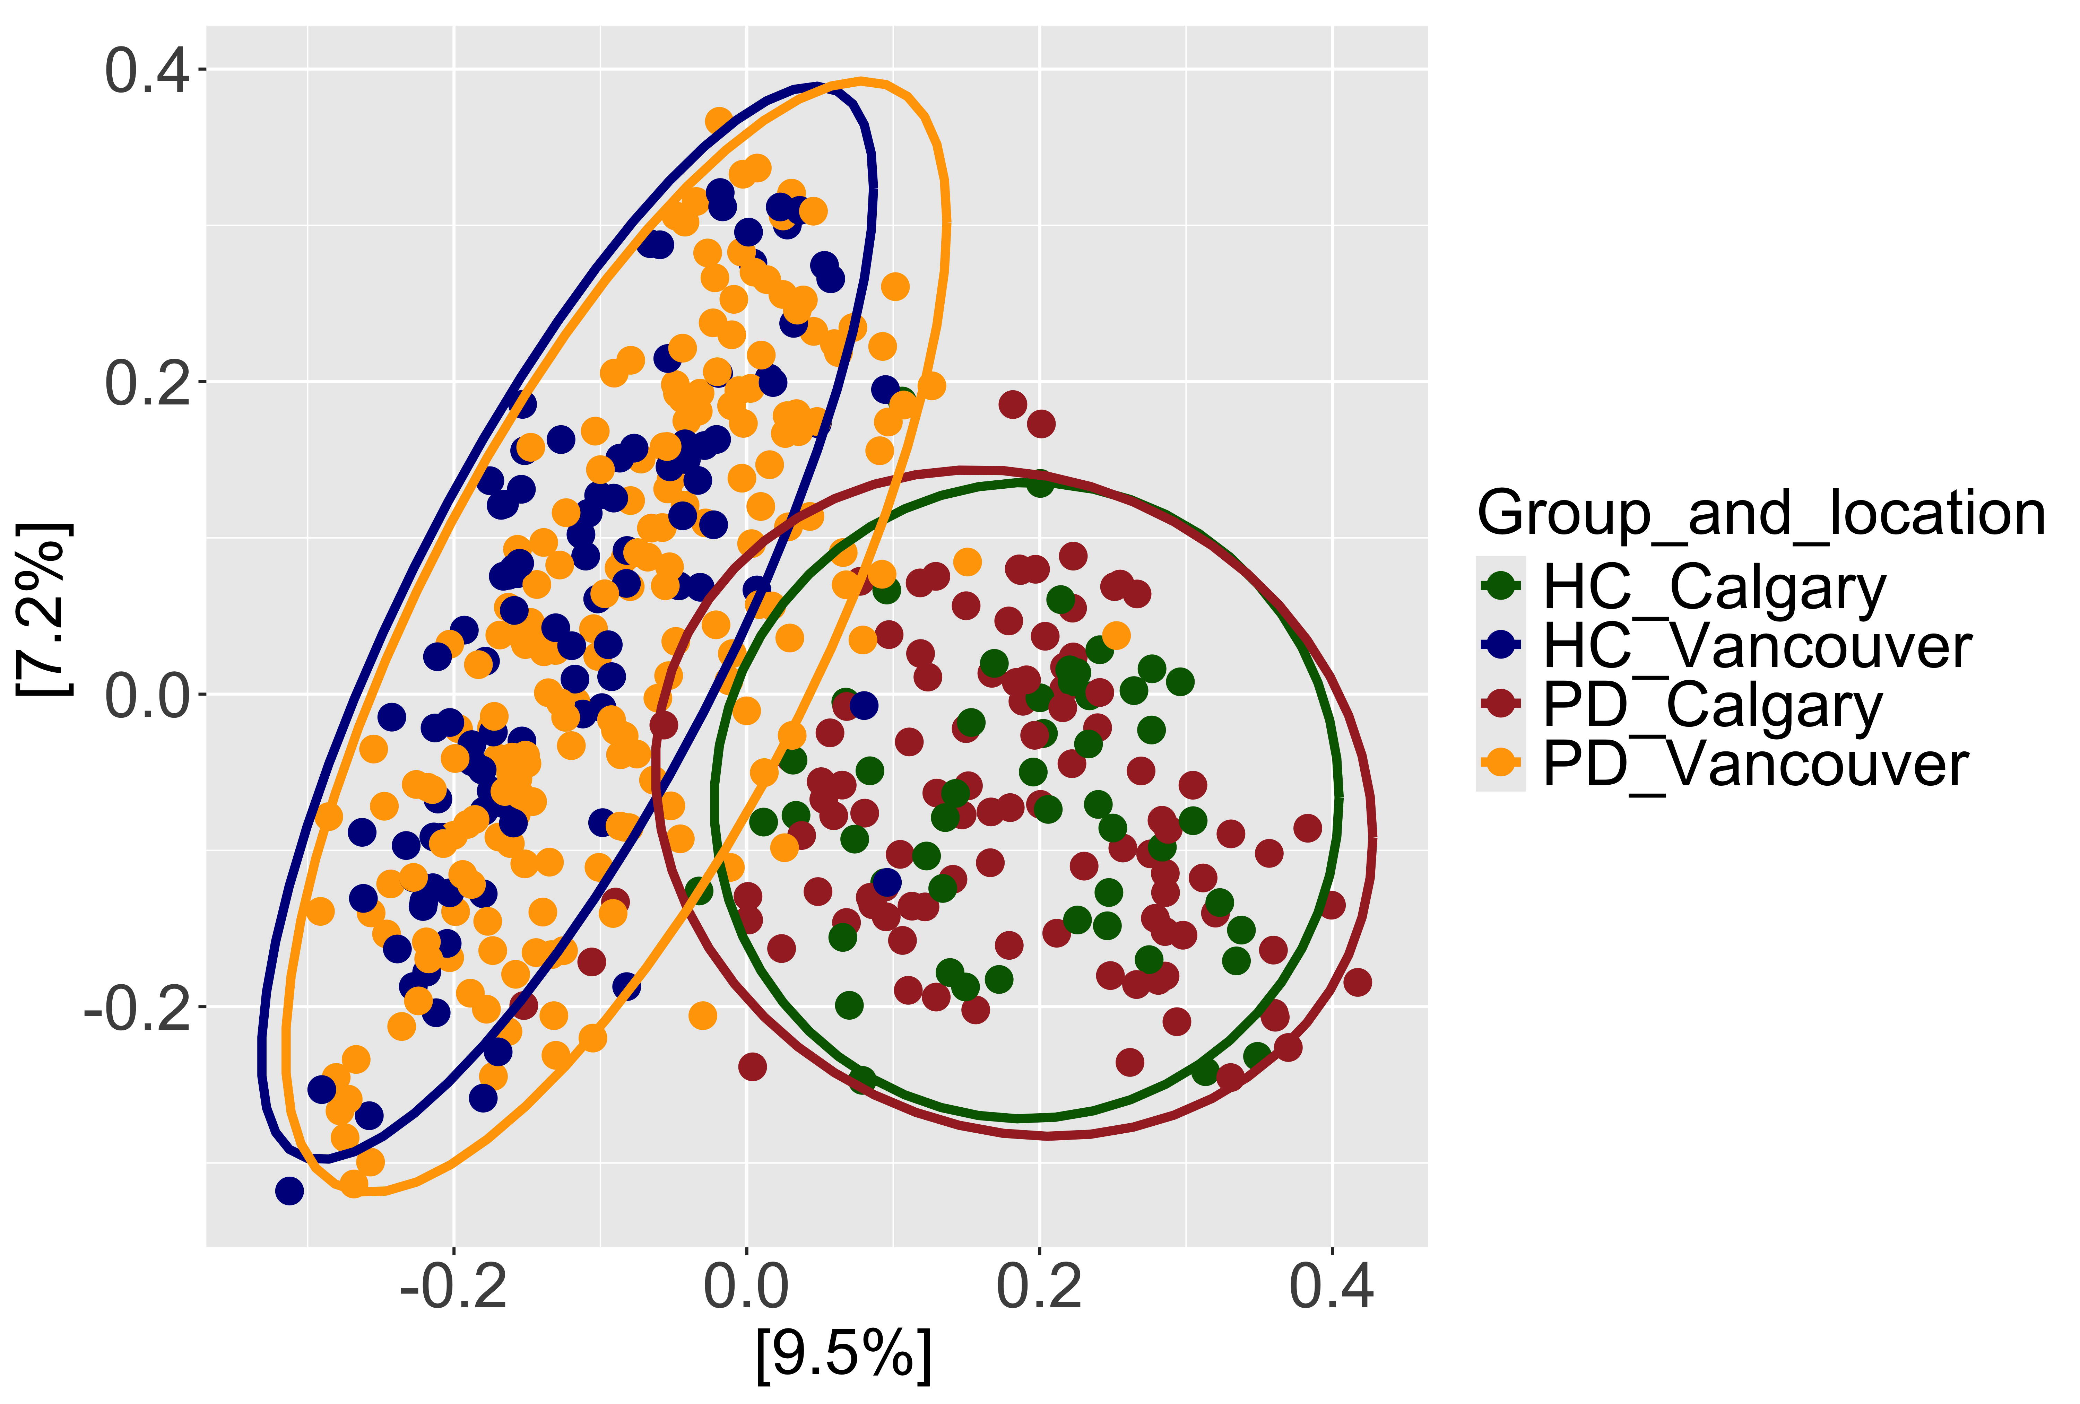

Slide 20
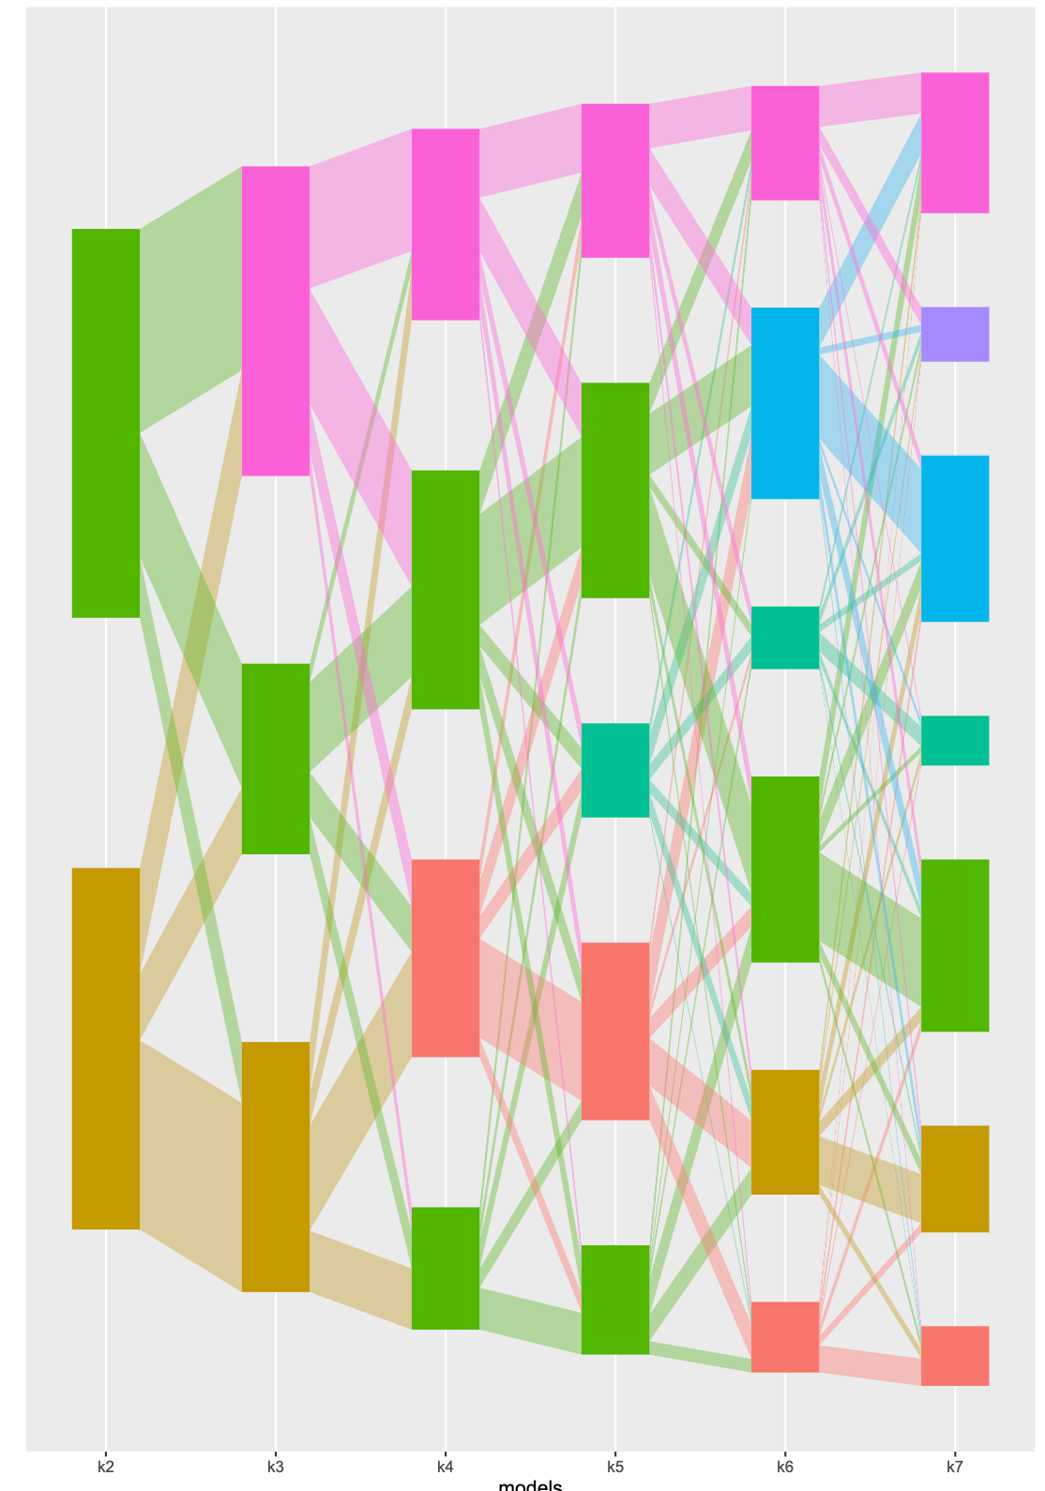
Topic 6
Bifidobacterium 2+ species 0.24
Akkermansia muciniphila_F 0.10
Phocaeicola dorei (0.05)
Topic 1
Akkermansia muciniphila 0.04
UBA11524 sp 000437595 0.03
Bacteroides uniformis 0.02
Topic 3
Alistipes onderdonkii 0.05
Akkermansia biwaensis 0.04
Methanobrevibacter_A smithii 0.04
Topic2
Escherichia coli_F 0.20
Blautia_A wexlerae_B 0.08
Phocaeicola vulgatus 0.07
Topic 4
Bacteroides 2+ species 0.13
Phocaeicola 2+ species 0.09
Agathobacter rectalis 0.03
Topic 7
Phocaeicola vulgatus 0.11
Bacteroides 3+ species 0.24 *
CAG-103 sp000432375 0.07
Topic 5
Blautia 3+ species 0.21
Agathobacter rectalis 0.09
Fusicatenibacter saccharivorans 0.08
2 3 4 5 6 7
Model (k, number of topic)

Slide 21
Baseline Differences
 | PD Patients (n = 125) | Healthy ctrls (n = 59) | p-val
Demographics
Age | 68 ± 8 | 67.5 ± 10 | 0.78
Sex (%M, n) | 61.6% (77) | 39 % (23) | 0.004
BMI (kg/m2) | 26.3 ± 5.5 | 27.2 ± 5 | 0.27
Lifestyle factors
PASE Score | 120 ± 68 | 138.1 ± 57.1 | 0.008
Diagnosis
Diagnosis AND sex
Physical activity score
Sycuro Lab | University of Calgary | Gut microbiome & Parkinson's disease

Slide 22
Baseline Differences (cont’d)
 | PD Patients (n = 125) | Healthy ctrls (n = 59) | p-val
Medical history
PD age at onset | 63 ± 9 | - | -
Functional constipation (%, n) | 25.6% (32) | 3.5% (2) | 0.0002
IBS (%, n) | 90.8% (109) | 72.9% (43) | 0.003
IBS Symptom severity score | 88.3 ± 62 | 65.4 ± 59.6 | 0.01
Treatment and supplements
Benzodiazepines and sleeping-inducing medication (%, n) | 12% (15) | 1.7% (1) | 0.02
Laxatives (%, n) | 12.4% (14) | 1.7% (1) | 0.02
Sycuro Lab | University of Calgary | Gut microbiome & Parkinson's disease

Slide 23
PD Baseline Characteristics
 | PD Patients (n = 125) | Healthy ctrls (n = 59) | p-val
Disease-associated features
MDS-UPDRS part 1 | 9 ± 6 | - | -
MDS-UPDRS part 2 | 14.8 ± 10.3 | - | -
MDS-UPDRS part 3 | 27.4 ± 16 | - | -
Tremor score | 4.5 ± 4.9 | - | -
Akinesia score | 16.5 ± 10.5 | - | -
H & Y stage (PD progression) | 2.2 ± 0.6 | - | -
MDS-UPDRS part 4 | 5.1 ± 3.8 | - | -
Dyskinesia | 0.8 ± 1.3 | - | -
Motor fluctuation score | 3.7 ± 2.8 | - | -
Painful dystonia | 0.5 ± 0.8 | - | -
Non-motor daily living
Motor daily living
Motor exam
Motor complications
MDS-UPDRS: Movement Disorder Society-Sponsored Revision of the
Unified Parkinson’s Disease Rating Scale
Notes:
Tremors and dyskinesia are involuntary movements.
Akinesia loss of voluntary movement
Tremors are rhythmic, shaking, and happen at rest
Dyskinesia is irregular, jerky movements often caused by long-term medication use
Motor fluctuations are the changes in symptoms related to medication timing
Painful dystonia are involuntary contractions that come with sever pain

