Slide 1
Castor HSP ‘edge cost’ iteration
14 ASVs do not have identical EC count to their
Mapped genome
52 ASVs
E. Tayi (2)
Finegoldii
S. Wadsworthensis (3)
P. distasonis (2)

Slide 2
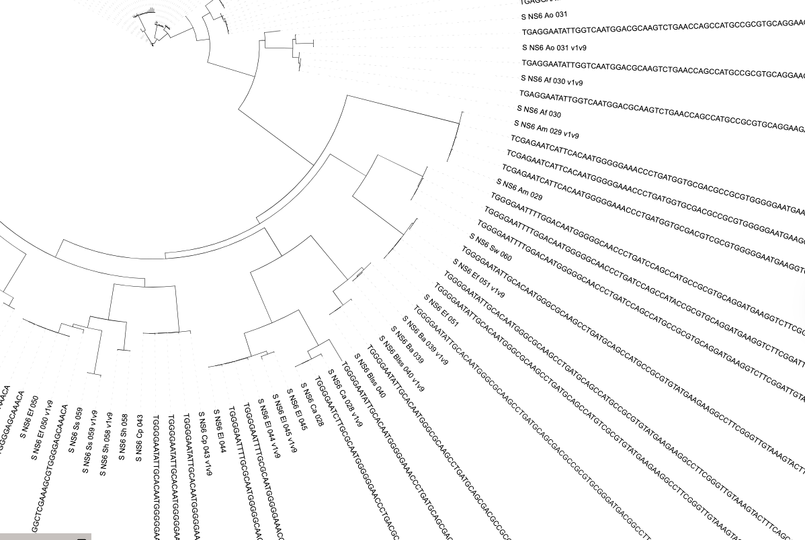
221/1886 ECs have different
counts to the Sw genome

