Slide 1
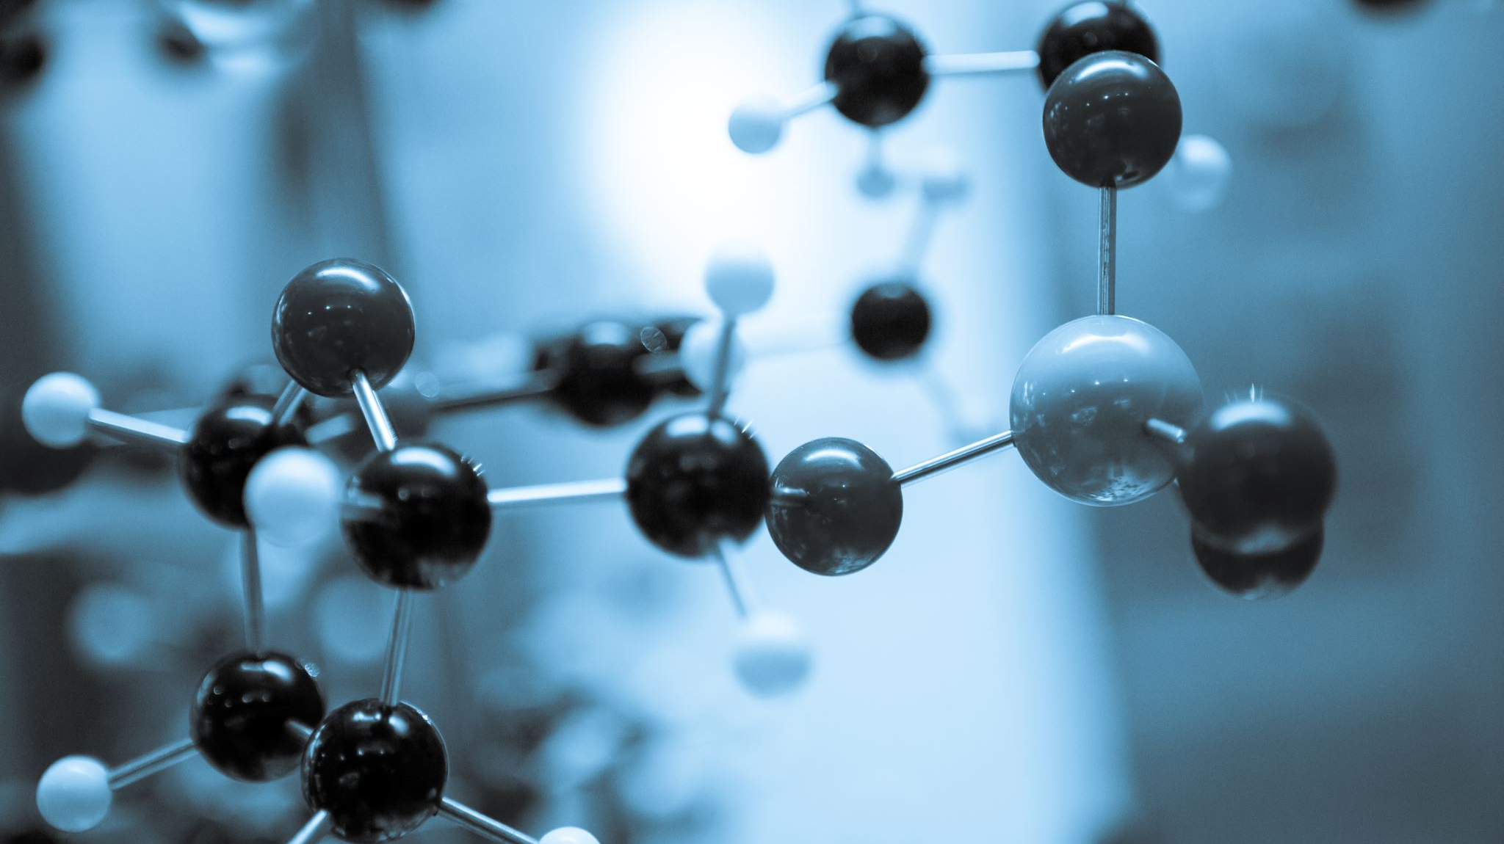
T1D Data Update
Daniel Castaneda Mogollon, PhD
Sycuro Lab
01/21/2026

Slide 2
Action items from our previous meeting
Modify the heatmap figures to indicate which pathways are not encoded by bacteria
Correlation figures of taxa-taxa and pathway-pathway
Improve pathway annotation and network visualization
Determine the core, accessory, and strain-specific gene clusters across different strains of the same species
Notes:
Check with MetaCyc if a bacteria encodes for a pathway that seems suspicious.
PICRUSt2 inocula as a yes or no.
1. Use Laura's Excel file to finish the category naming.
2. PICRUSt2 inocula
3. Tree generation at the end, share with Laura.
4. Pangenomics of strains.
5. Compare the PCoA vs PCA.
Maybe generate a PCA for shared pathways.

Slide 3
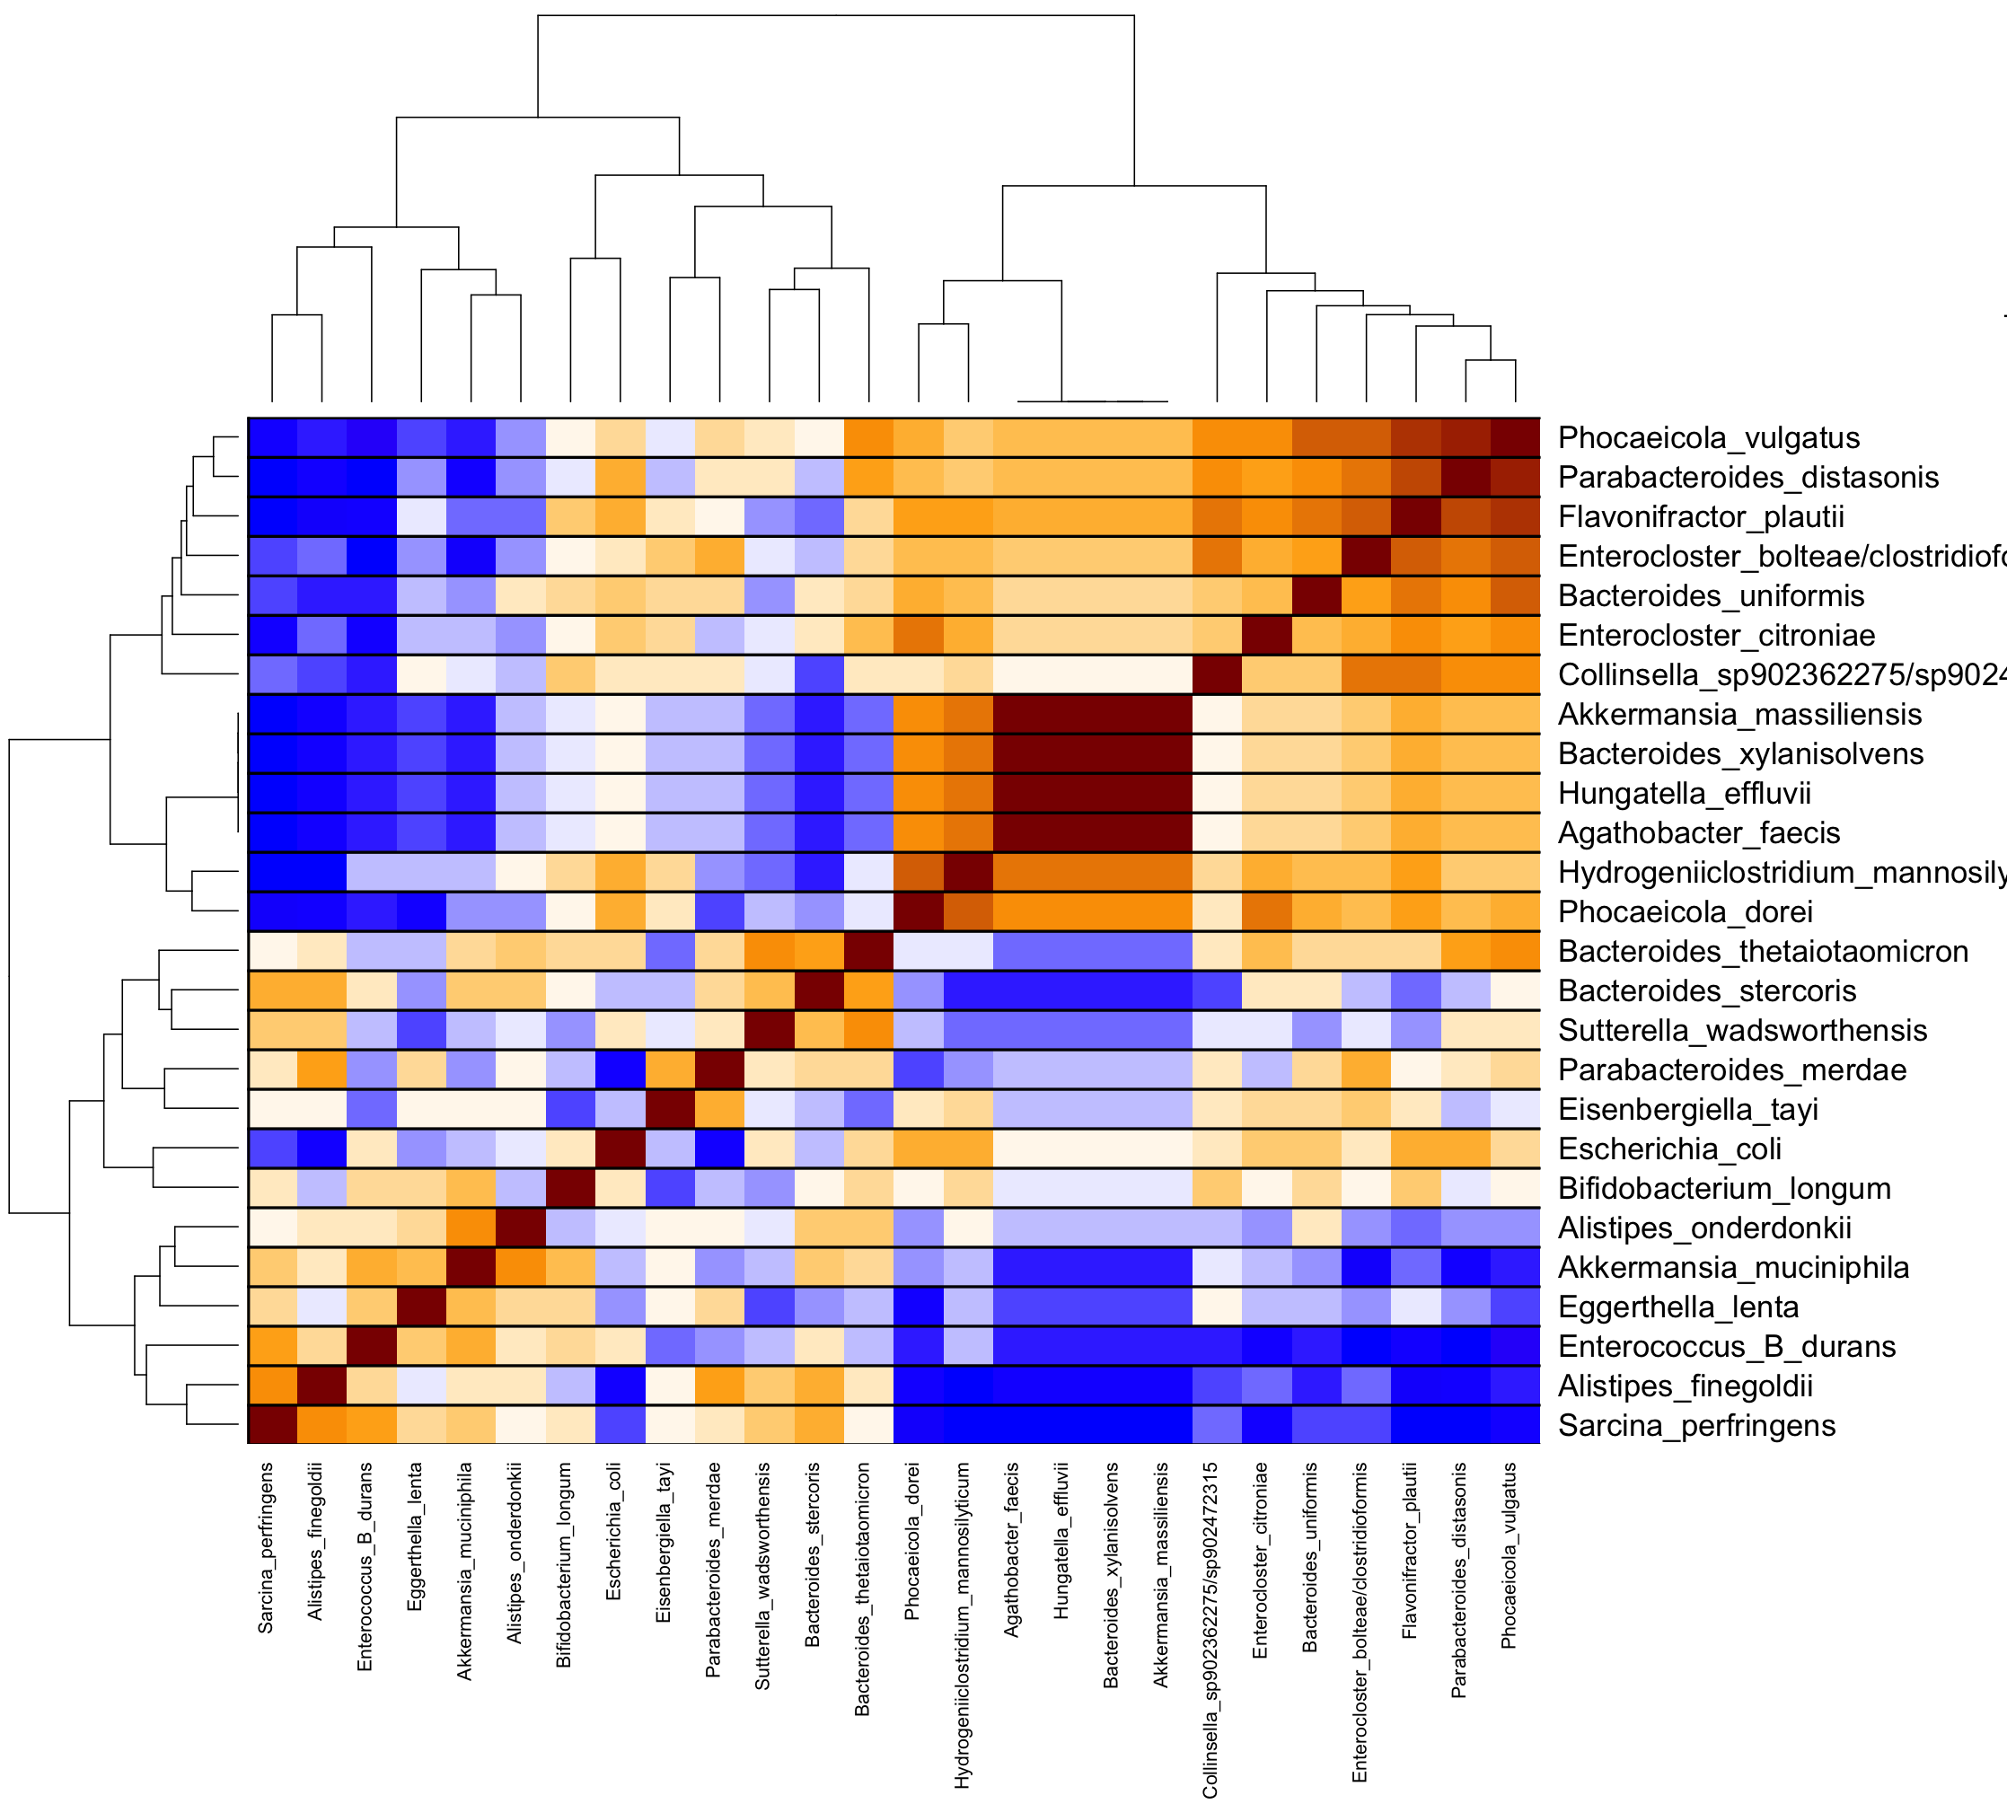
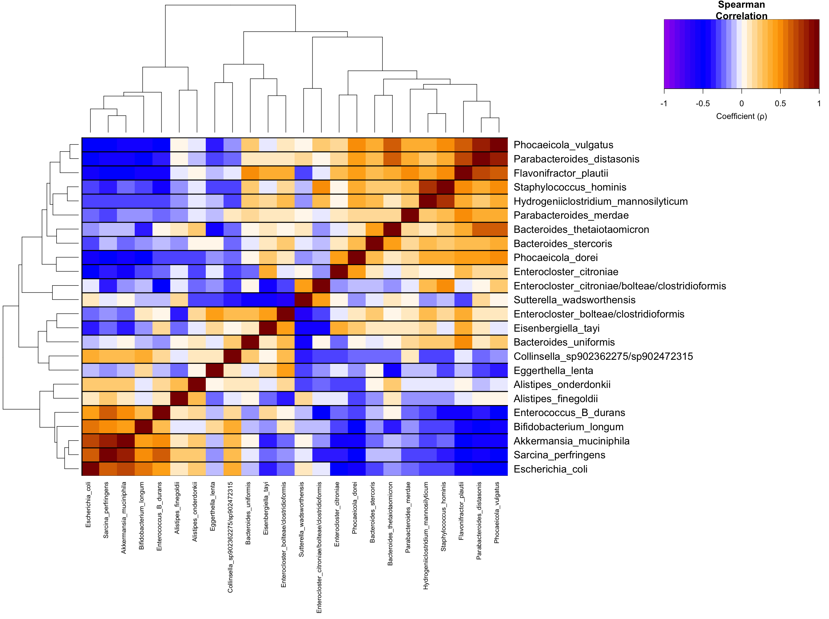
NS1 (taxa-taxa self-correlation)
NS1 w9w10
NS1 w5
Notes:
These heatmaps answer a functional association and correlation and easy to interpret, but does not tell us if there is a conditional dependence between taxa, or if there is an ecological interaction.

Slide 4
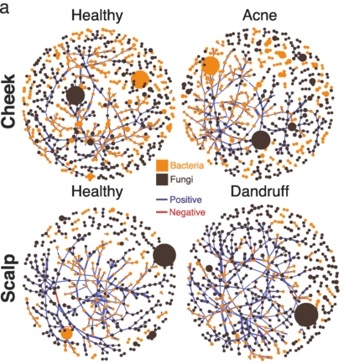
Complement interpretability and visualization for taxa-taxa analysis
SpiecEasi (Sparse InversE Covariance estimation for Ecological Association and Statistical Inference)
- Which taxa are conditionally dependent on each other?
- Explicitly handles compositional data
- Ecological interaction
Birt HWG, Dennis PG. Inference and Analysis of SPIEC-EASI Microbiome Networks. Methods Mol Biol. 2021;2232:155-171. doi: 10.1007/978-1-0716-1040-4_14. PMID: 33161547.

Slide 5
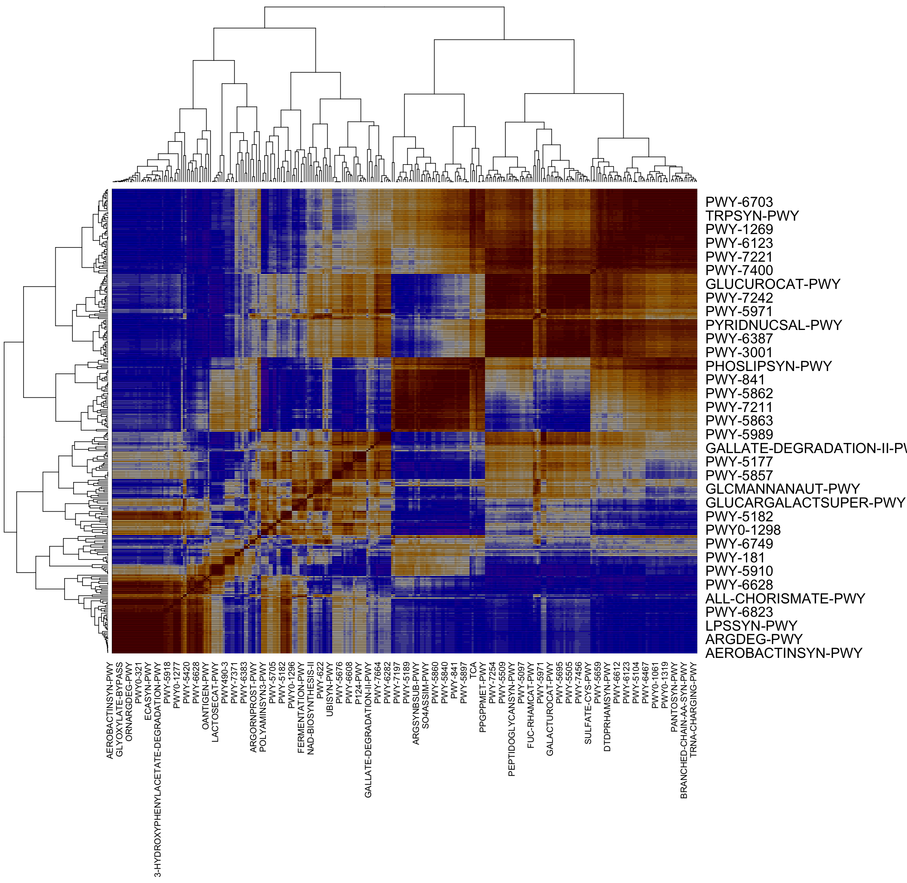
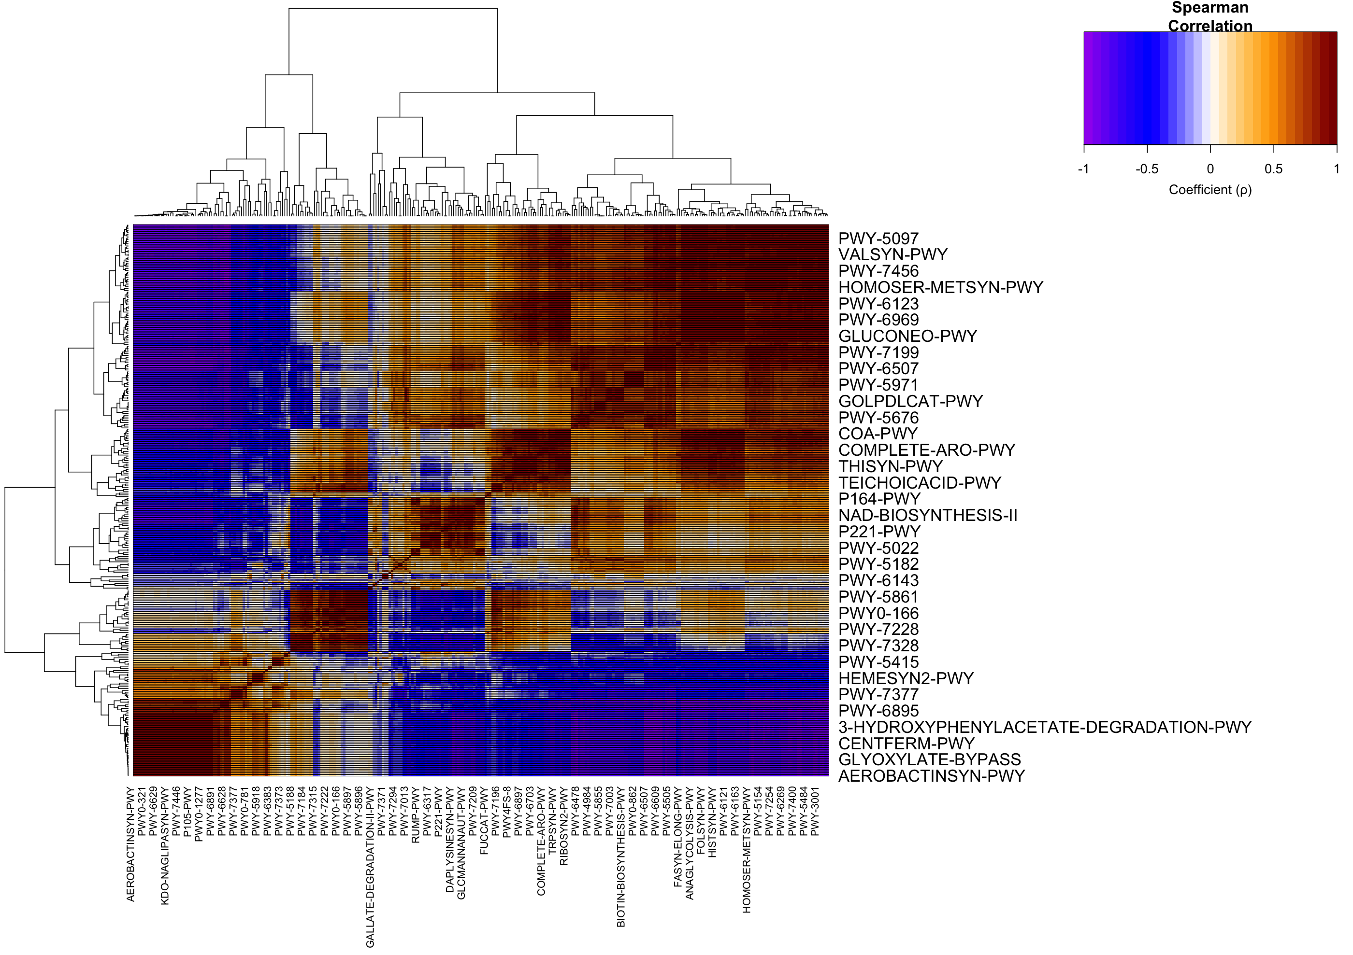
NS1 (pathway-pathway self-correlation)
NS1w5
NS1w9w10
Notes:
It tells us the same inofrmation from the taxa-taxa correlation and taxa-pathway.

Slide 6
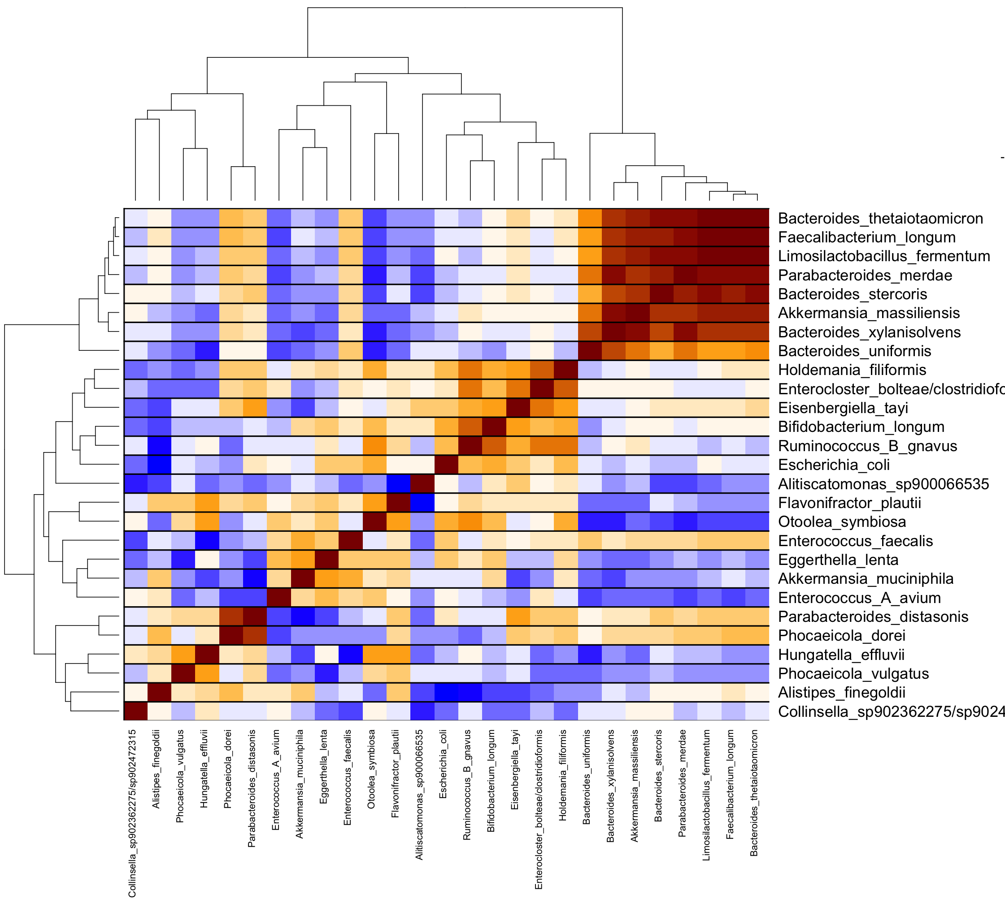
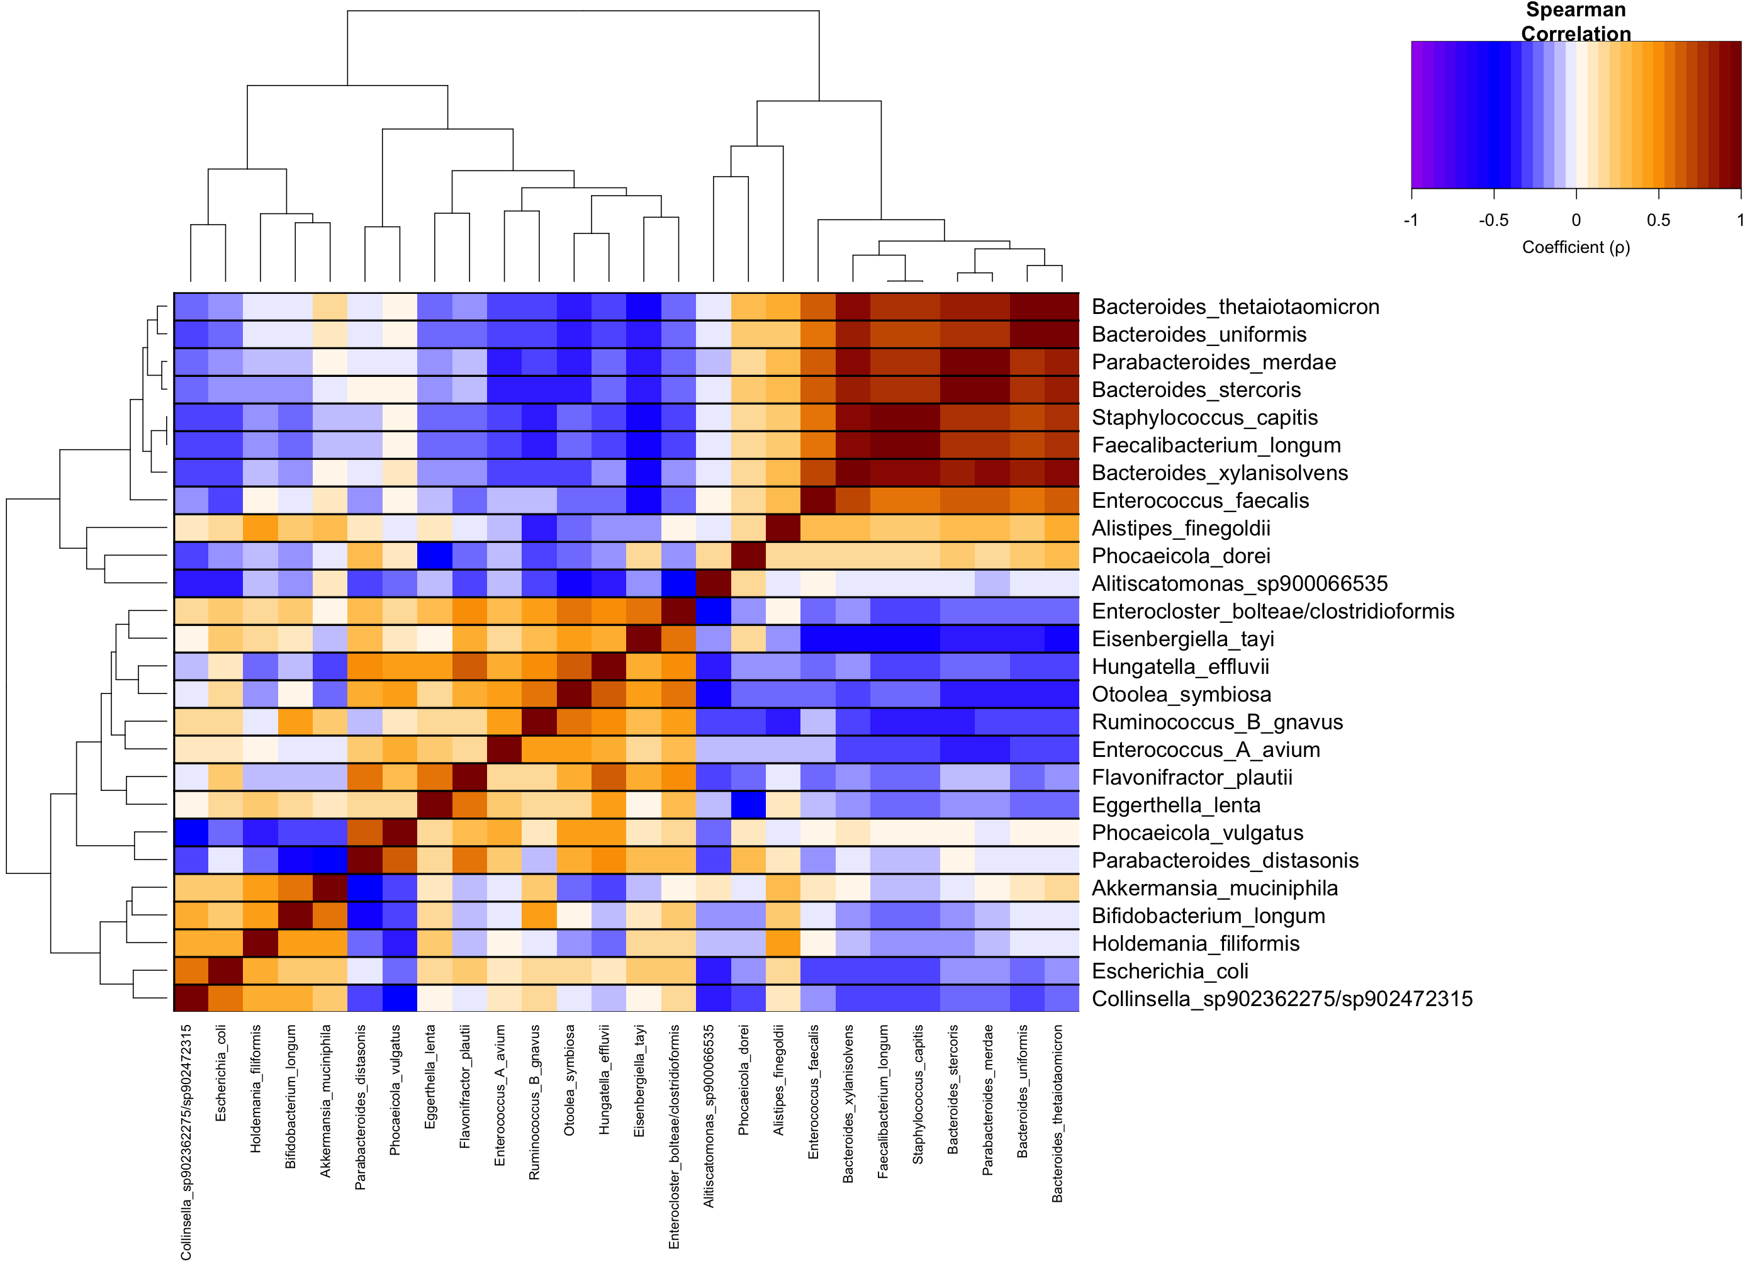
S2 (taxa-taxa self-correlation)
Week 5
Week 9 and 10

Slide 7
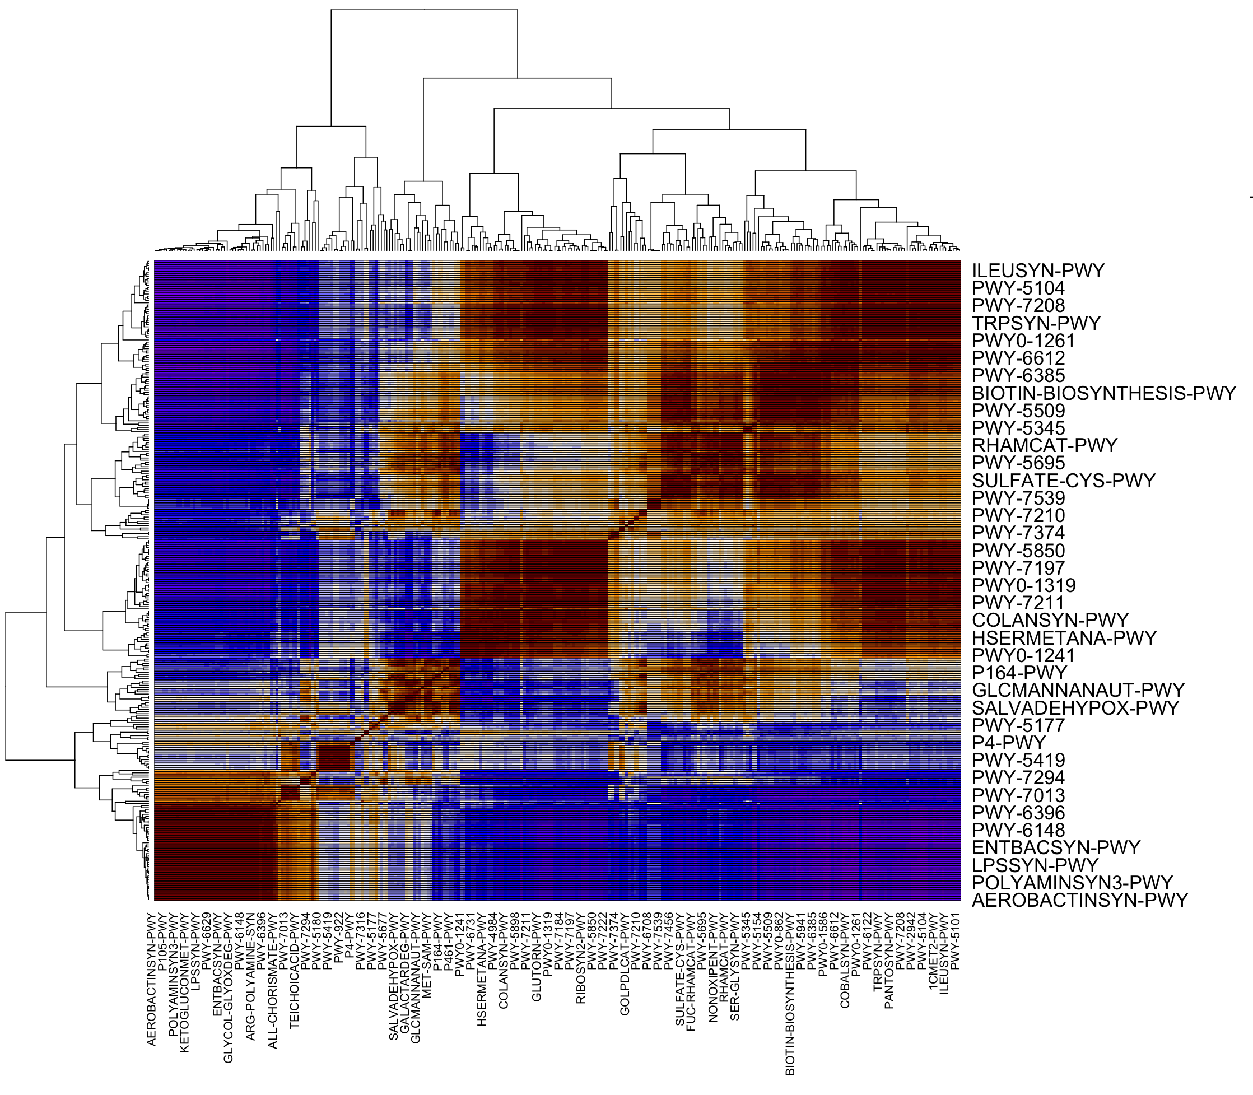
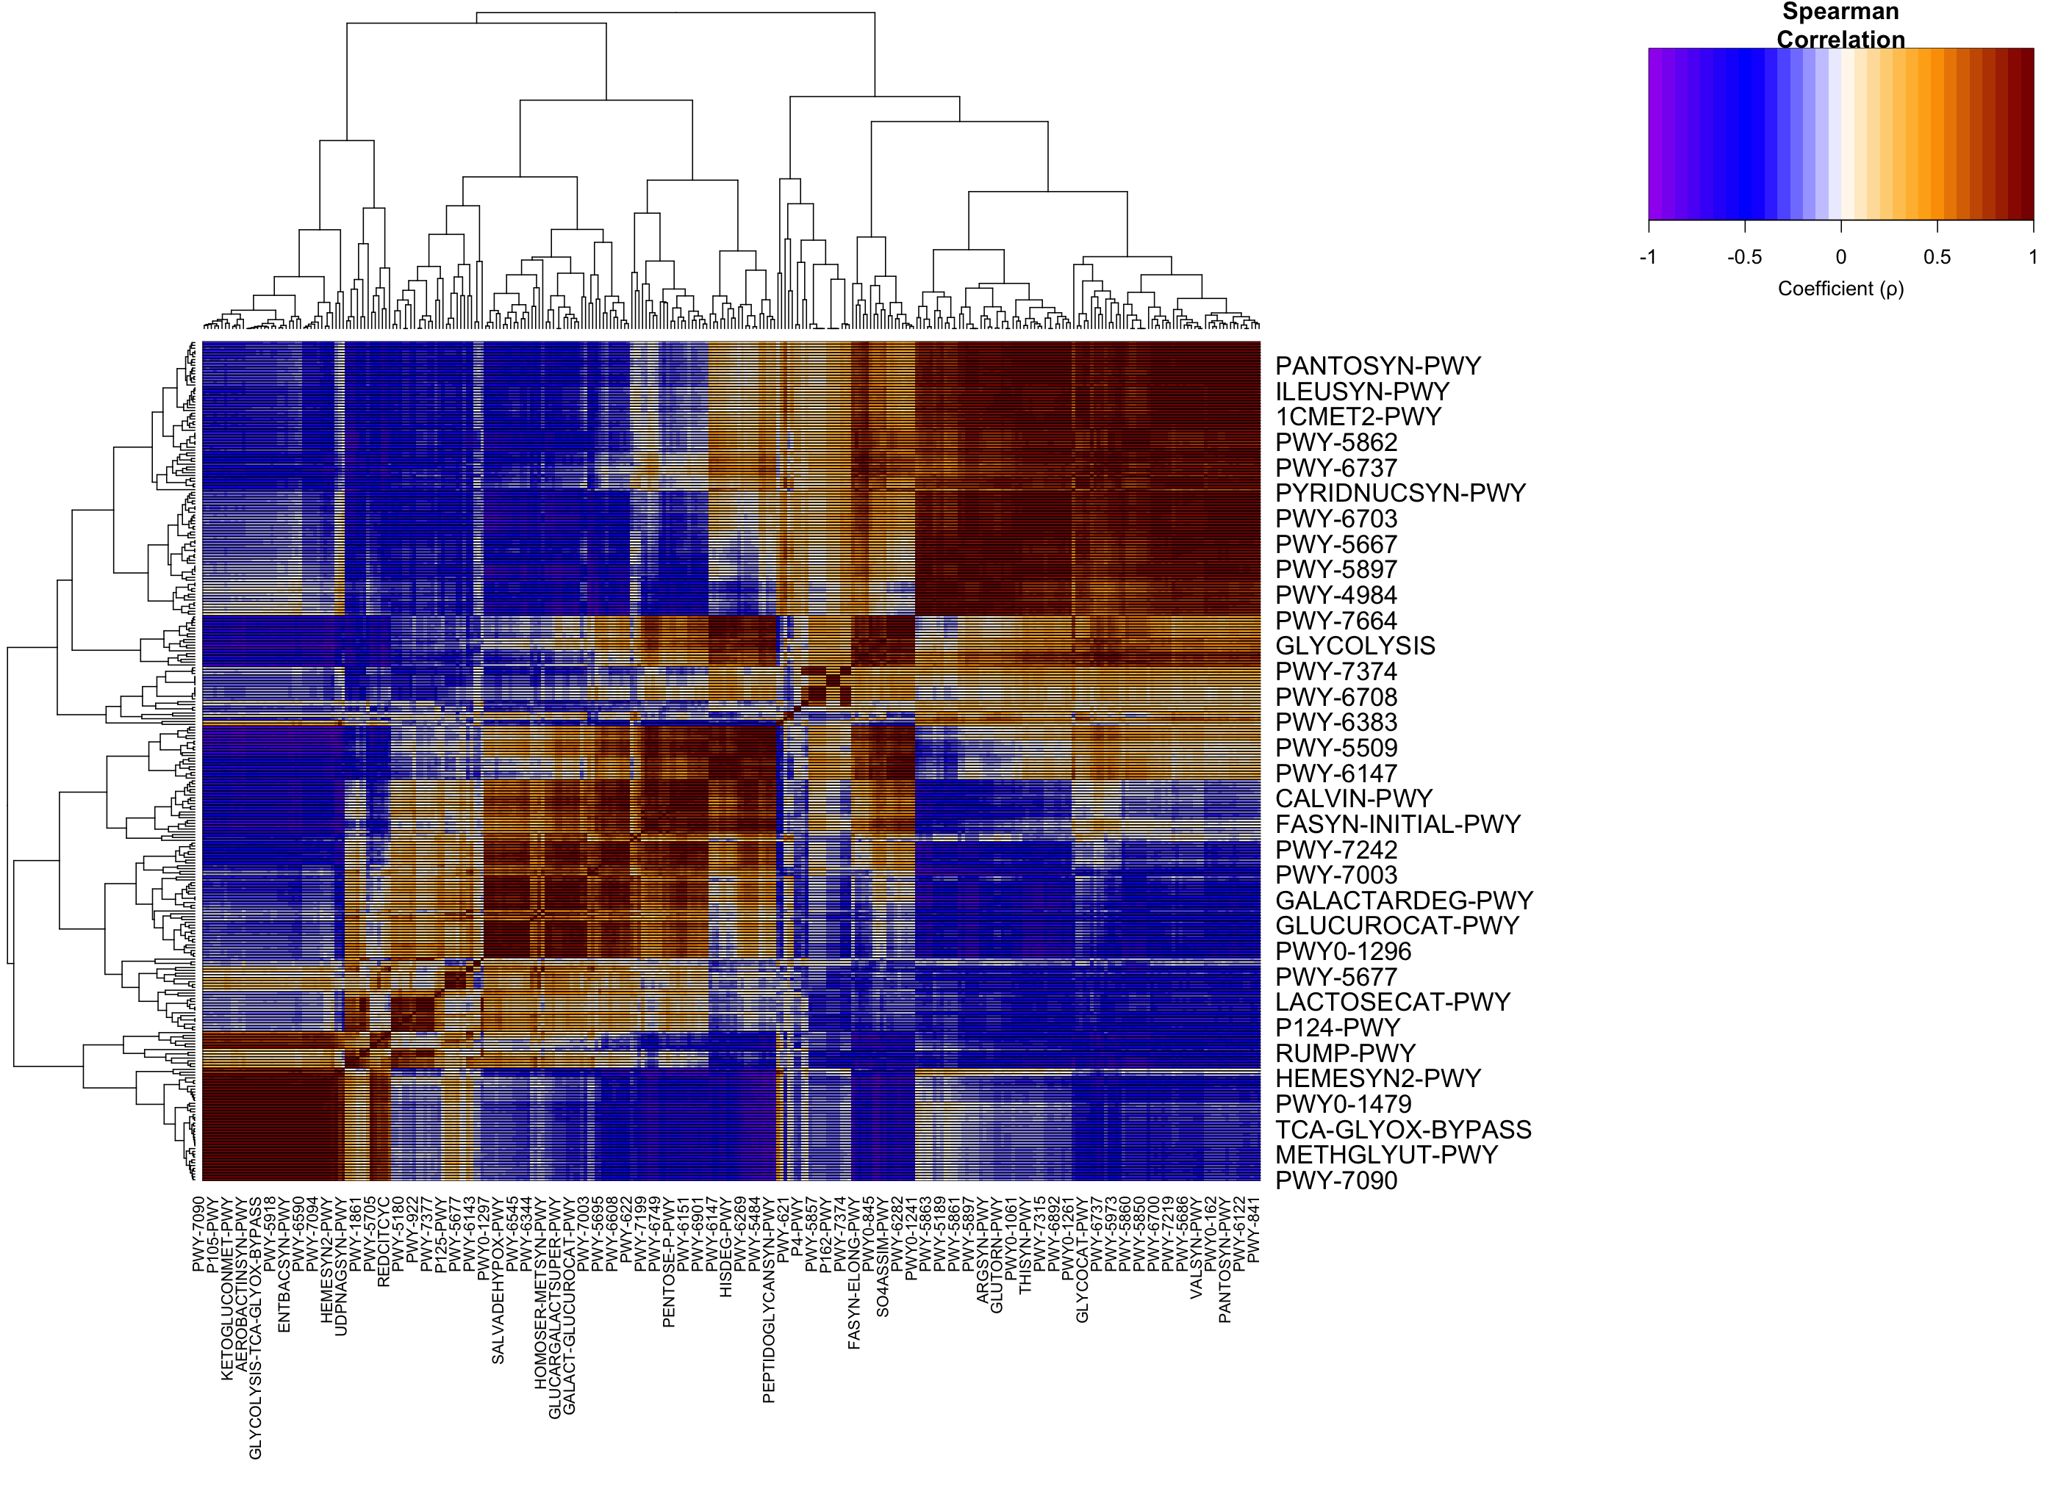
S2 (pathway-pathway self-correlation)
Week 5
Week 9 and 10

Slide 8
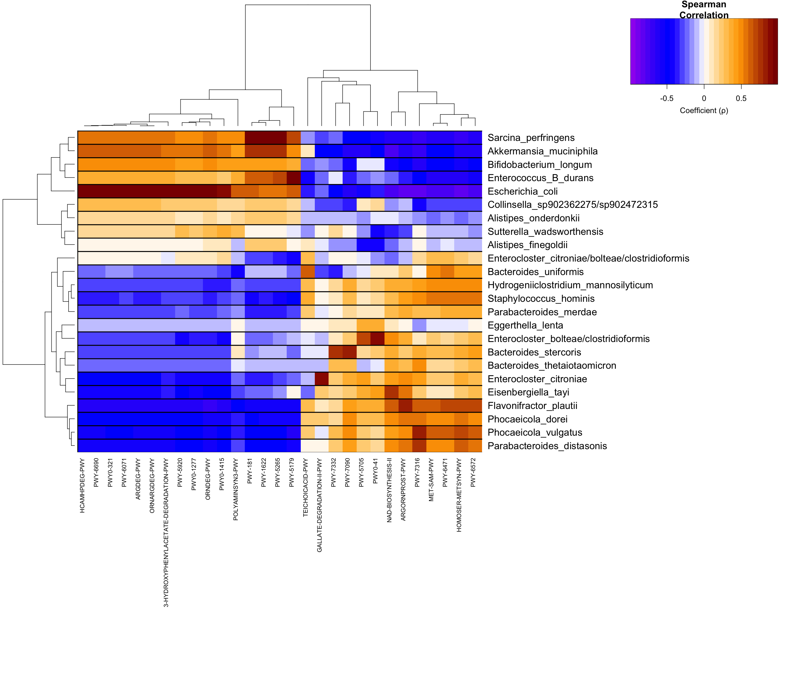
NS1-w9w10 Taxa-Pathway Correlation Network (previous figure)
Enriched in NS1-w9w10 compared to
S2-w9w10

Slide 9
Taxa-Pathway Correlation Adjustment
Inocula ASV count table
PICRUSt2
Per ASV per sample per pathway contribution
ASV-taxon aggregation and mapping
Identify the bacteria encoding for each pathway
Heatmap figure adjustment

Slide 10

NS1-w9w10 Taxa-Pathway Correlation Network (current figure)
Enriched in NS1-w9w10 compared to
S2-w9w10
*Each black dot in each cell represents a
pathway predicted to be encoded
by that taxon*
ASVs mapped only to genus were filtered out
PICRUSt2 predicts functional potential
Metabolic pathways were verified
from the output of 3 inoculum samples
Genome annotation with MetaCyc PGDB inference
or DRAM (MetaCyc support)

Slide 11
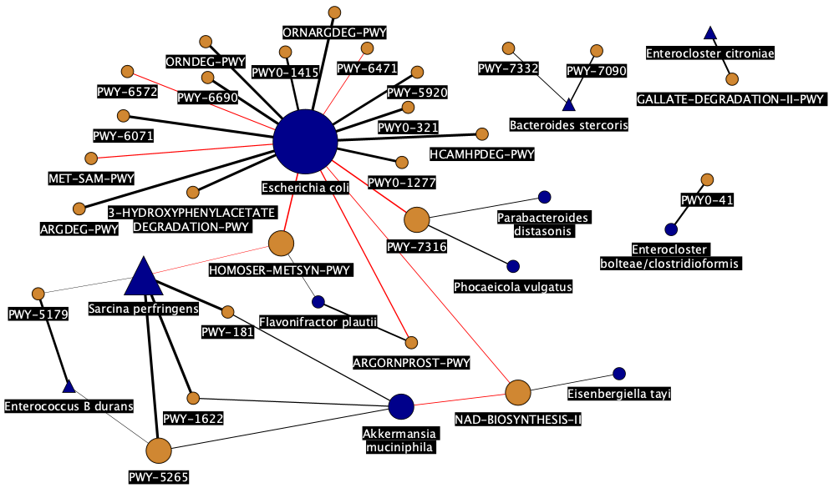
NS1-w9w10 Taxa-Pathway Correlation Network (previous figure)
Node Category
Taxon
Pathway
Spearman coefficient
Enriched in NS1-w9w10 compared to
S2-w9w10
0.7
0.8
0.9
1.0
Directionality
Positive
Negative
Centrality degree
1-2 3-4 5-6
7-8 8+
Sample size contribution (%)
0-20 20-40 40-60
60-80 80-100
Unique Shared

Slide 12
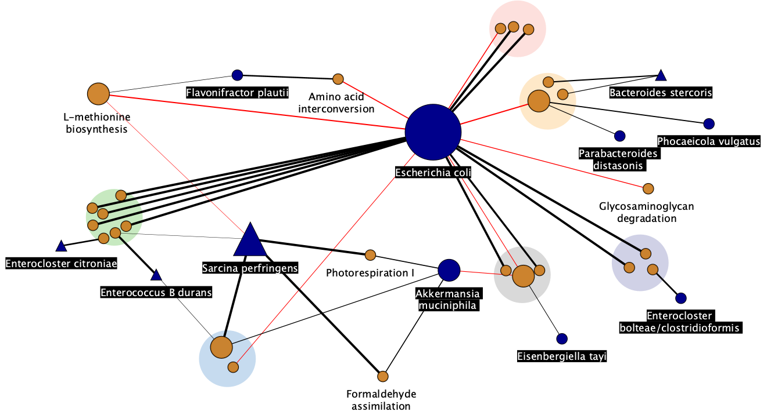
NS1 Enriched and correlated taxa-pathways (current figure)
Node Category
Taxon
Pathway
Pathway grouping
Amines and polyamines
degradation
Aromatic compound
Degradation
L-arginine degradation
Sugar nucleotide
Biosynthesis
Cell wall biosynthesis
Electron carrier
biosynthesis
Spearman coefficient
0.7
0.8
0.9
1.0
Directionality
Positive
Negative
Sample size (%)
0-20 20-40 40-60
60-80 80-100

Slide 13
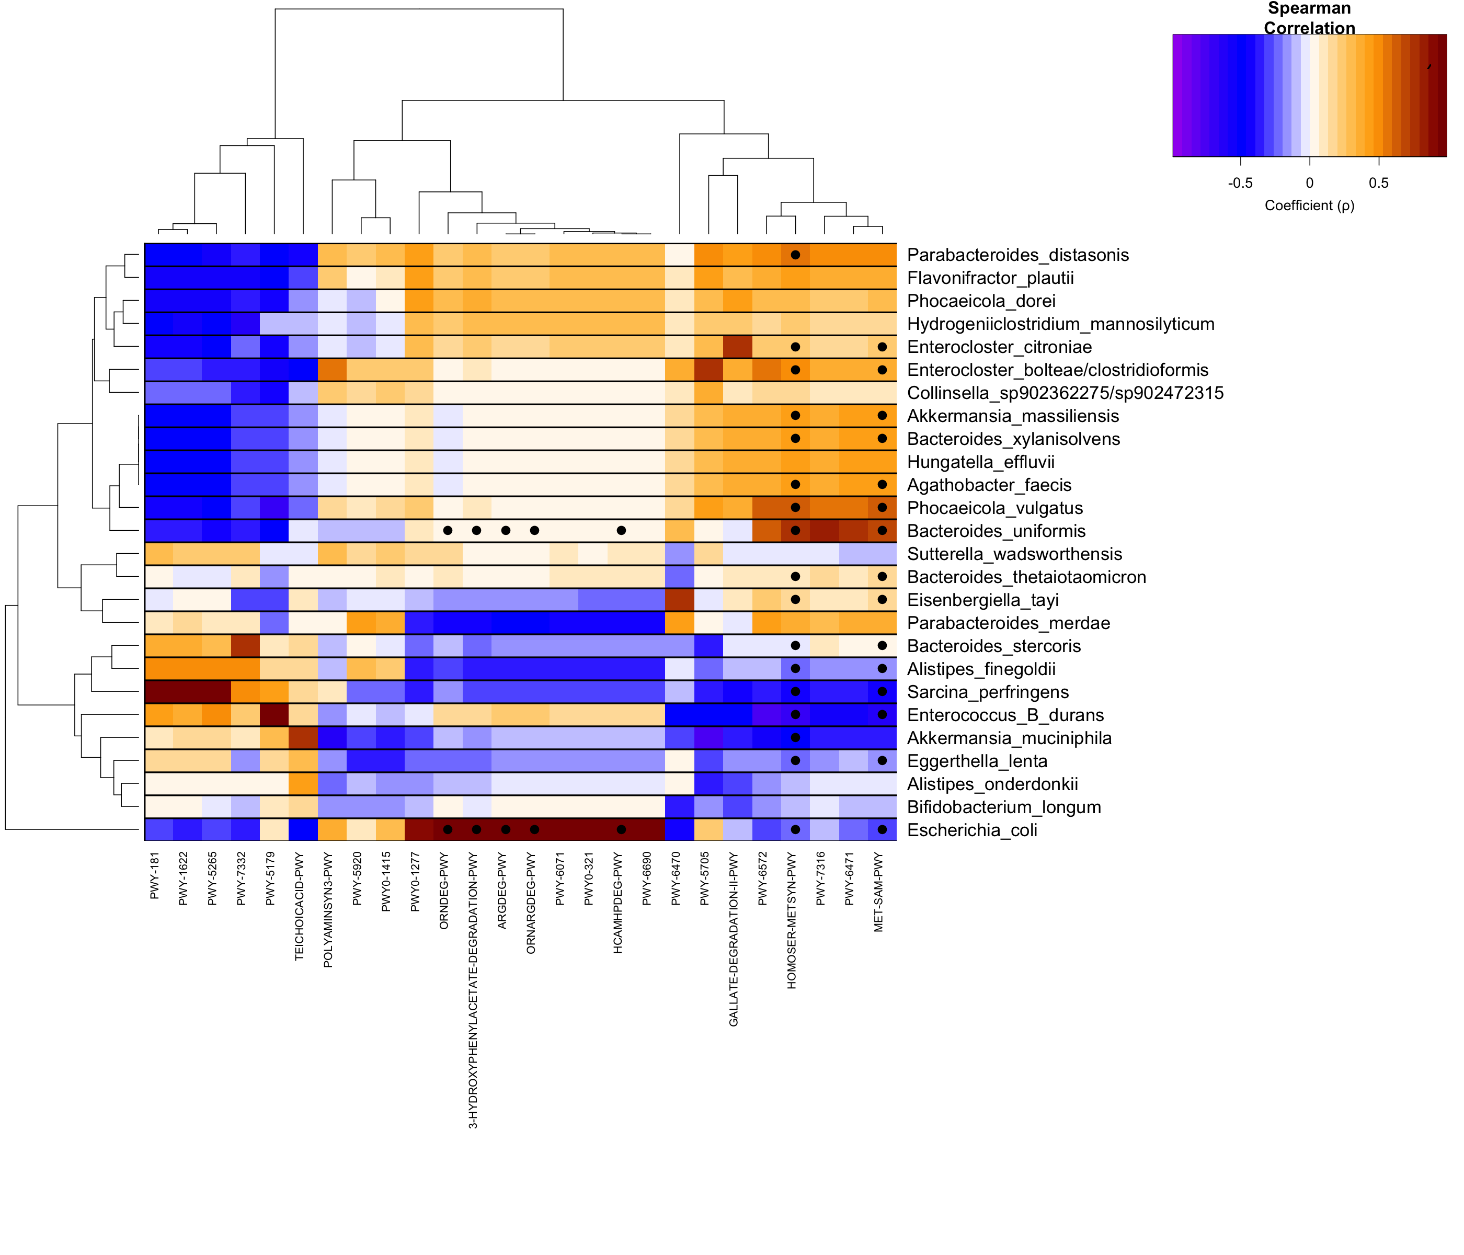
S2-w9w10 Taxa-Pathway Correlation Network
Enriched in NS1-w9w10 compared to
S2-w9w10
*Each black dot in each cell represents a
pathway predicted to be encoded
by that taxon*

