Slide 1
Parameter tunning for FP reduction
Goal: To minimize FPs (avoid FNs if possible)
NS1, NS6, S2, and S5 inoculum and mice (all weeks) were used as data input
ASV sum: 0, 100, 150, 200, 250, 300, 350, 400, 450, 500, 550, 600
ASV length: 0, 200, 250, 300, 350, 400
ASV prevalence: 0, 0.001, 0.005, 0.01, 0.05, 0.10, 0.15, 0.20
Consortium | ASV sum | ASV length | ASV prev | Total FP
NS1 | 600 | 200-400 | 0.10% - 1% | 0
S2 | 100 – 600 | 200-400 | 15%-20% | 0
NS6 | 200-300 | 200-400 | 5% | 0
S5 | 300-600 | 200-400 | 20% | 2

Slide 2
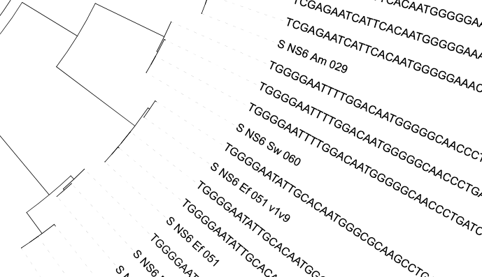
Revising ancestral reconstruction (castor)
Closest taxon is Sw 060
2nd closest is Ef 051

Slide 3
Annotation profile for Sw ASV does not fully match Sw
Number of annotated ECs: 1,886
1,665 ECs (88.3%) show no differences in EC count
1,230 ECs (65.2%) show no differences in EC count

