Slide 1
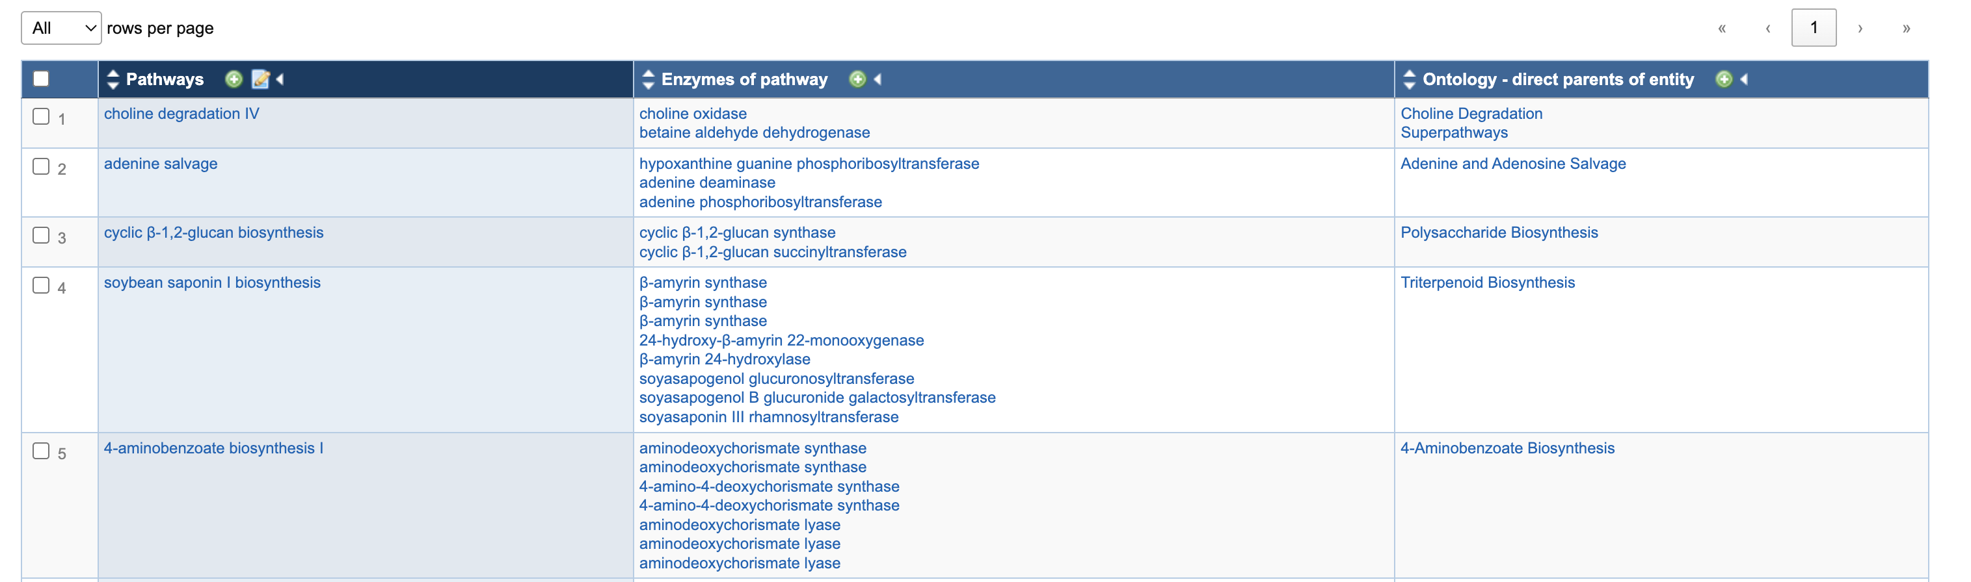
MetaCyc 2026
Database | Reactions | ECs | Pathways | Pathways bacteria
Minpath (2020) |  | 2,170 | 1,054
PICRUSt2 (2023) | 6,771 | 4,607 | 1,018 | 575
MetaCyc (2026) | 19,126 | 14,507 | 3,653 | 2,251
*An enzyme can catalyze multiple reactions* → EC-2.3.1.297 (ceramide synthase) catalyzes RXN-20399 // RXN-20398 // RXN3O-328
*A reaction can be catalyzed by multiple enzymes too. We have more reactions than enzymes*

Slide 2
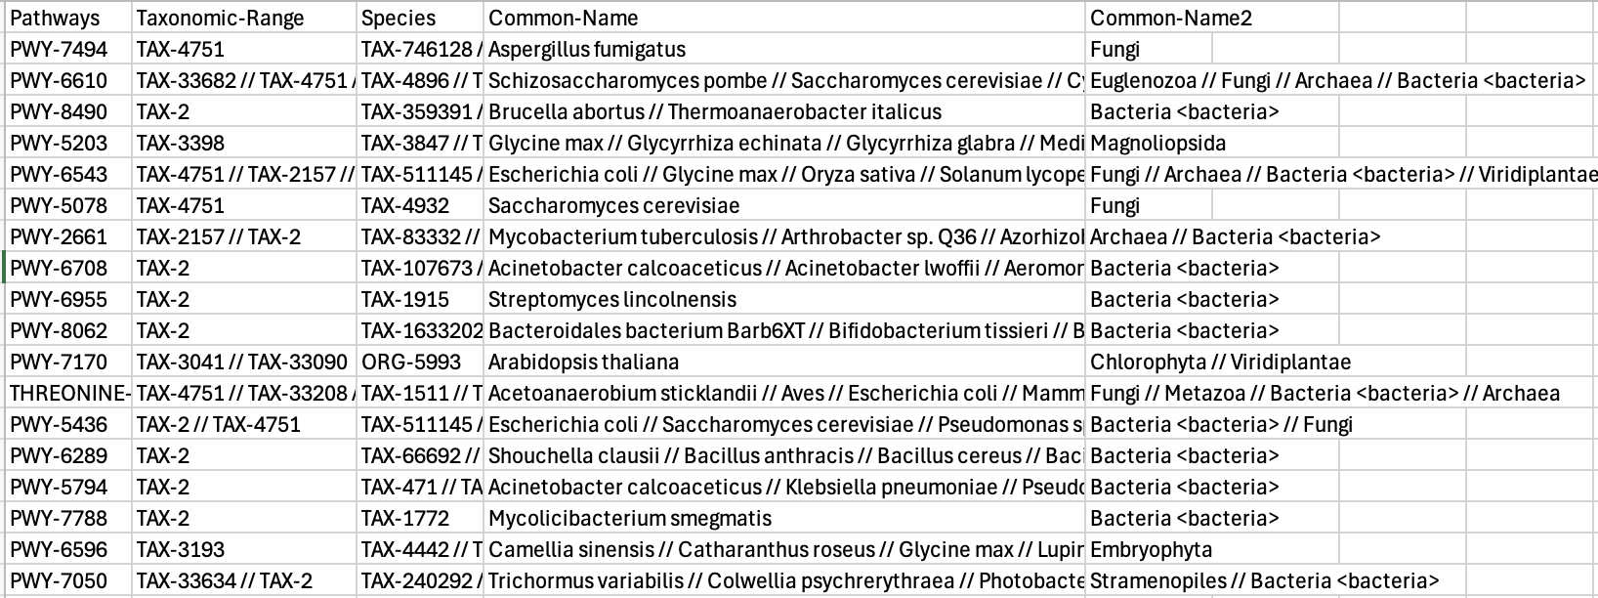
MetaCyc tables:

Slide 3
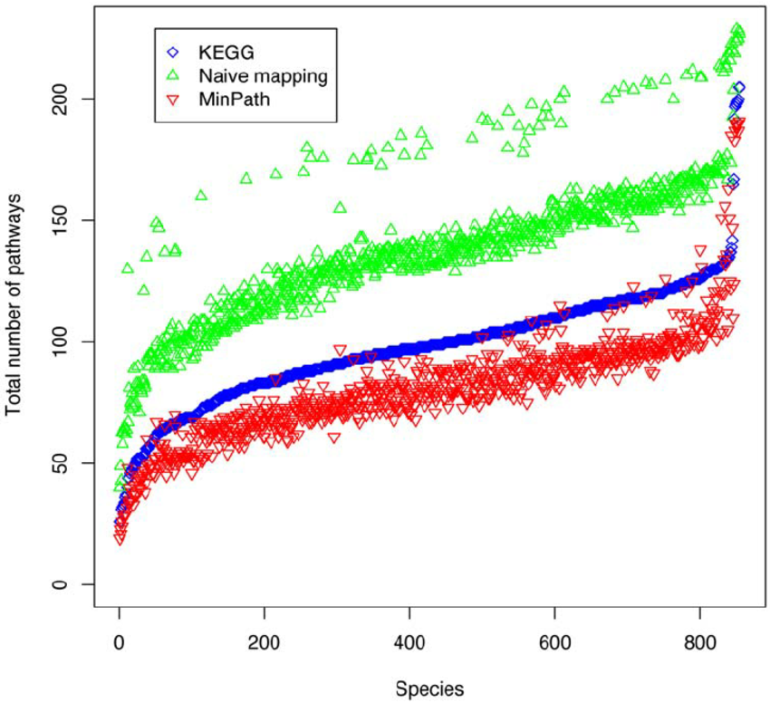
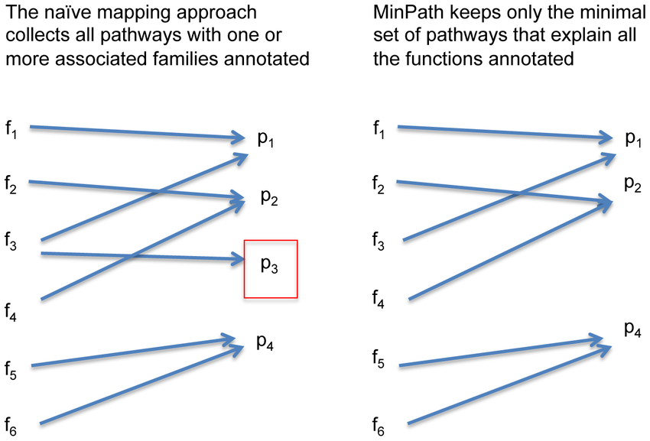
MinPath (PICRUSt2 package)
Naïve approach relies on a min. number of enzymes annotated to call a metabolic pathway
Minimal parsimony looks for the lowest number of pathways using all enzymes present in the annotated genome

Slide 4
MetaCyc 2026 & Have-some-pie
metacyc_genome_annotator.py
Parsed the EC genome annotations for each sample and reformatted for Minpath input
pathway_metacyc_merger.py
Merges the multiple smart tables from MetaCyc with the elements we need (pathway ID, enzymes, reactions, category, summary)
prepping_minpath_files.py
Takes the master table from the previous script and reformats it for MinPath

Slide 5
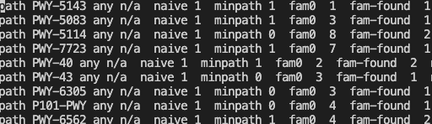
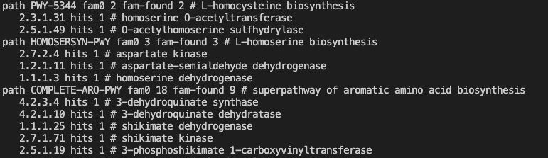
MinPath output
Report:
Detailed report:

Slide 6
Updating the MetaCyc database increased the total number of available pathway definitions but resulted in only modest changes in MinPath pathway predictions

Slide 7
MetaCyc database curation
Polymer-Degradation // Carbohydrates-Degradation // Glycan-Pathways
Noncarbon-Nutrients
Inorganic nutrients
Noncarb nutrients
Noncarbon-Nutrients
Energy-Metabolism SECONDARY METABOLITE DEG Superpathways // Degra/assimil/

Slide 8
MinPath Metabolic Pathways
MetaCyc Metabolic pathways are divided by
6 hierarchical levels:
Level 1:
Glycan pathways
Metabolite activation/inactivation/interconversion
Macromolecule modification
Detoxification
Transport
Bioluminescence/fluorescence/chromoprotein biosynthesis
Degradation/utilization/assimilation
Superpathways
Generation of precursor metabolites and energy
Metabolic clusters
Biosynthesis

Slide 9
PICRUSt2 Predicted Pathways (level 1)
Visually similar to Anvio’s classification
Fishers exact test (or chi square) for binary classification (presence/absence)
Mann-Whitney for number of pathways per category per consortia

