Slide 1
PITCHES 101: QST MEANS BUSINESS
Lab 05 – CS 411 @ Boston University

Slide 2
What’s Going to Go Down
Each team will have a member stand up and state their first idea
I’ll give it a thumbs-up or thumbs-down
In the case of a thumbs-down it’s time for your Pl
Generally, projects should be green-lighted
Only concerns would be scope issues (i.e., not enough or too much work given the time constraints)
Mobile apps are allowed… HOWEVER, we may not be able to support you very much on those
A few teams will have been either newly formed, or have new members
If this applies, you may defer your pitch until next week

Slide 3
BUT FIRST

Slide 4
FRAMEWORKS
LIBRARIES
DATABASES

Slide 5
Library vs. Framework
Both are essentially chunks of code written by someone else to help you perform tasks in a less verbose way.
Library
Collection of reusable, compiled, and tested code that can facilitate the augmentation of application functionalities.
A library implements many functions, variables, and parameters.
Framework
Enables a coding environment that contains low-level libraries to address conventional coding issues.
The objective of a framework is to deliver faster development of an application.

Slide 6

Express.js
A powerful JavaScript framework that allows you to develop a server-side component using JavaScript.
Advantages
Easy to learn
End-to-end development with ONLY JavaScript
Faster than Python
Large selection of libraries of packages
Disadvantages
Async/await can be tricky to learn

Slide 7

React.js
A powerful AND popular JavaScript library.
Advantages
Easy to learn
Reusable components
Large and active community
One-way data flow (also called unidirectional)
Disadvantages
Lack of proper documentation

Slide 8
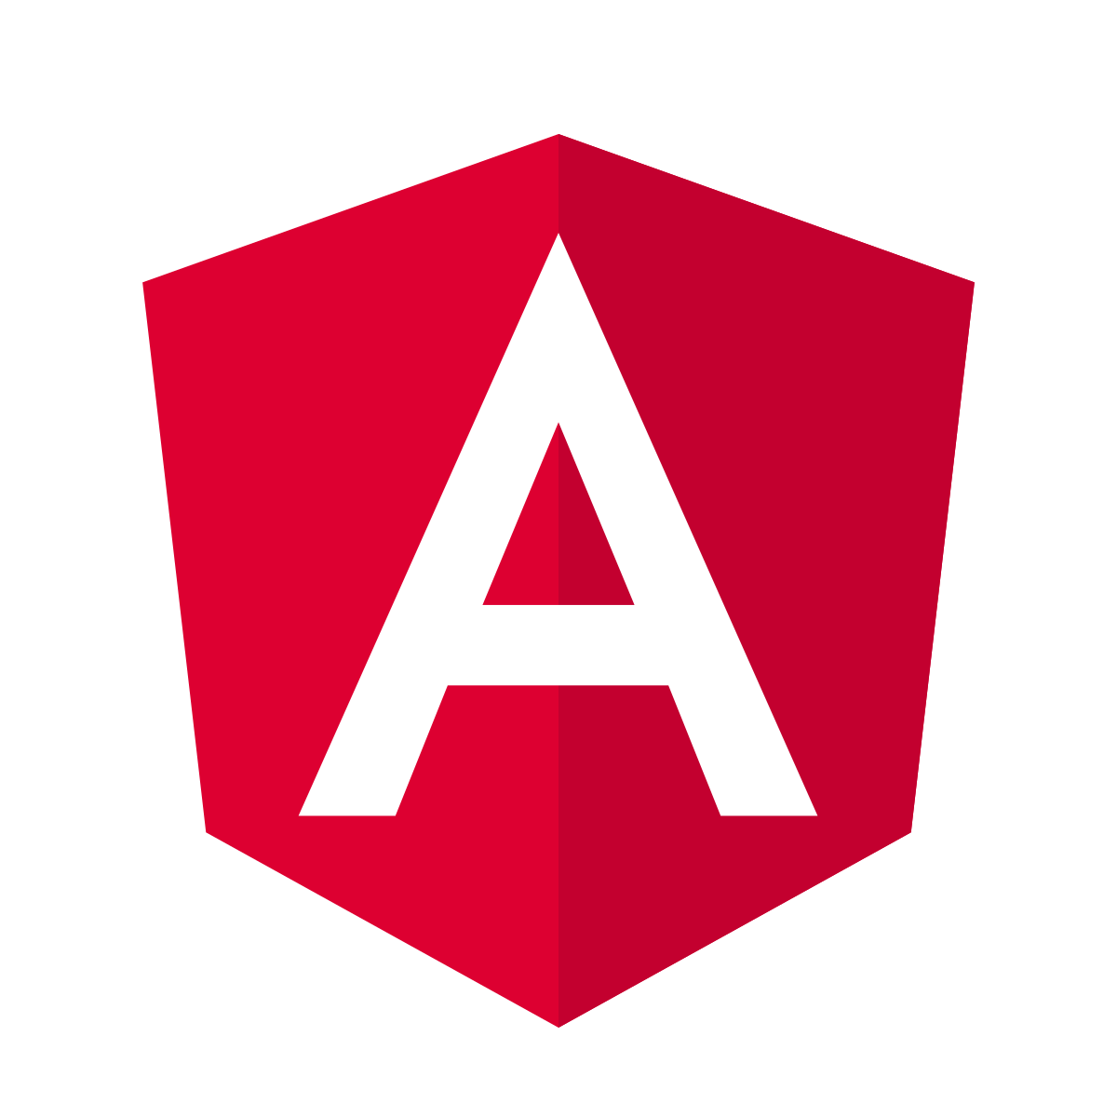
Angular
A TypeScript-based free and open-source framework.
Advantages
Do things the Angular way
MVC architecture implementation
Bi-directional data flow
High package availability
Disadvantages
Steep learning curve
Verbose and complex at times

Slide 9

Flask
A micro web framework written in Python
Advantages
Lightweight
Flexible
Very easy to use and understand
Strong documentation
Disadvantages
Not a lot of tools and/or functionality

Slide 10

Django
A Python based framework that follows MVC.
Advantages
Batteries Included
Large and active community
Built-in admin capabilities/interface
Very scalable in the long term
Disadvantages
Feels bloated for smaller projects
Sometimes too populated for larger projects (b/c MVC)

Slide 11
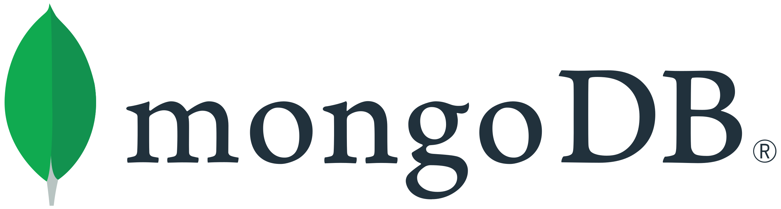
MongoDB
A NoSQL document-oriented database program.
Advantages
Simplicity
Easy installation and setup
Strong documentation
Ad hoc querying
Disadvantages
Does not support joins like a relational database
Uses multi-document ACID

Slide 12
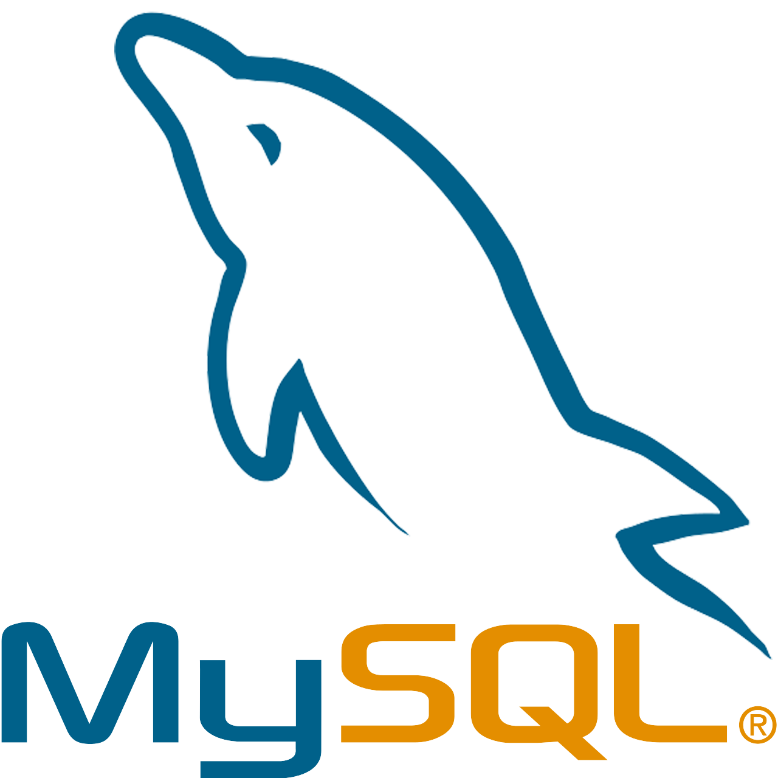
MySQL
A open-source relational database management system.
Advantages
Simple and easy to use (it’s just SQL)
Allows transactions to be rolled back
Scalable in the long term
Very large community
Disadvantages
Prone to data corruption (inefficient transactions)
Not efficient for very large databases

Slide 13
My Two Cents
Don’t try to get fancy
Thanks to BU’s oh so useful CS curriculum a lot of you may not have had exposure to many development techniques and that’s OK
Make sure everyone can contribute
To the cracked ones… don’t steal the show
To the unfamiliar… don’t be afraid to ask questions
There isn’t one right way to do this
Software engineers don’t often agree… but that’s what breeds innovation
Be aware of Parkinson’s Law (and Student’s Syndrome)
“Work expands so as to fill the time available for its completion.”

Slide 14
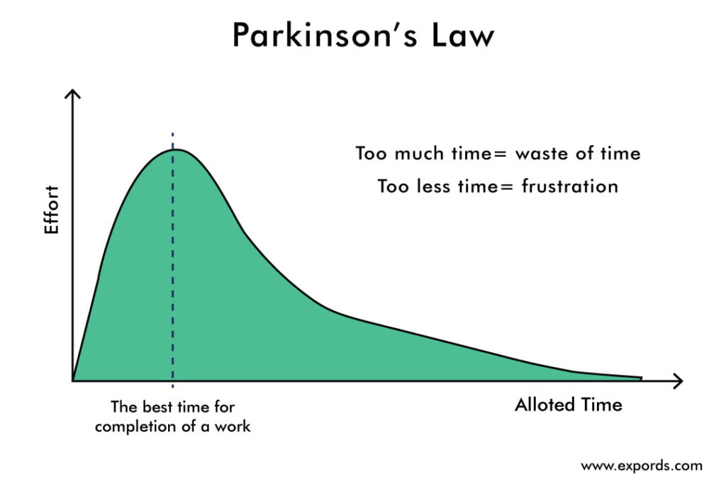
Parkinson’s Law

Slide 15
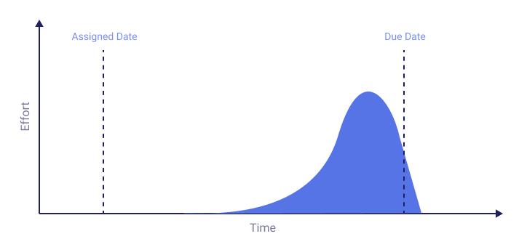
Student’s Syndrome

Slide 16

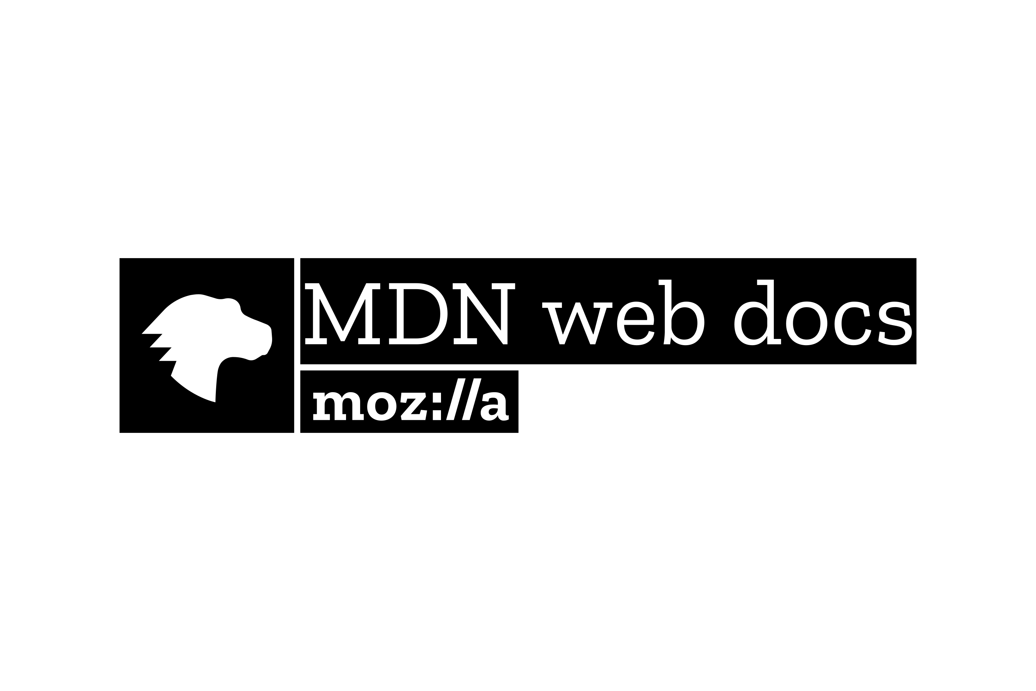
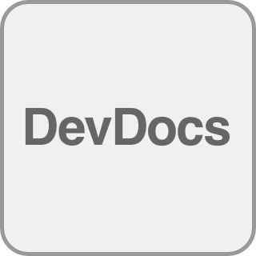
DEVELOPMENT RESOURCES
https://www.theodinproject.com/
https://developer.mozilla.org/en-US/
https://devdocs.io/

Slide 17
git add lab05.txt git commit –m “complete” git push origin master
Lab 05 – CS 411 @ Boston University
(dcmag@bu.edu)

