Slide 1
API 101: MAKING SOME CALLS
Lab 03 – CS 411 @ Boston University

Slide 2
API Terminology
API (Application Programming Interface)
A set of definitions and protocols for building and integrating application software
REST API (or RESTful API)
An API that conforms to the REST architectural style.
REST
Stands for “Representational State Transfer”
A client-server architecture made up of clients, servers, and resources, with requests managed through HTTP.

Slide 3
Request Terminology
GET
Used to read/retrieve data from a web server. HTTP status code of 200 (OK) on success.
POST
Used to send data (file, form data, etc.) to the server. HTTP status code of 201 on success.
PUT
Used to modify the data on the server. Replaces entire content at a particular location with data that is passed in the body payload.
PATCH
Similar to PUT request. It modifies part of the data, does NOT replace entire content.
DELETE
Used to delete the data on the server at a specified location.

Slide 4
LETS MAKE SOME…
API CALLS

Slide 5
Tasks for Today!
Solidify your APIs
Basically, choose at least two you want to move forward with and make sure they work
You can do this with Postman at first
Start writing some code!
Once you know your APIs work, with the language of your choice try to make a call to one (or both) of them
This should be a great starting point for your project
As per usual I’ll be coming around if you need help

Slide 6

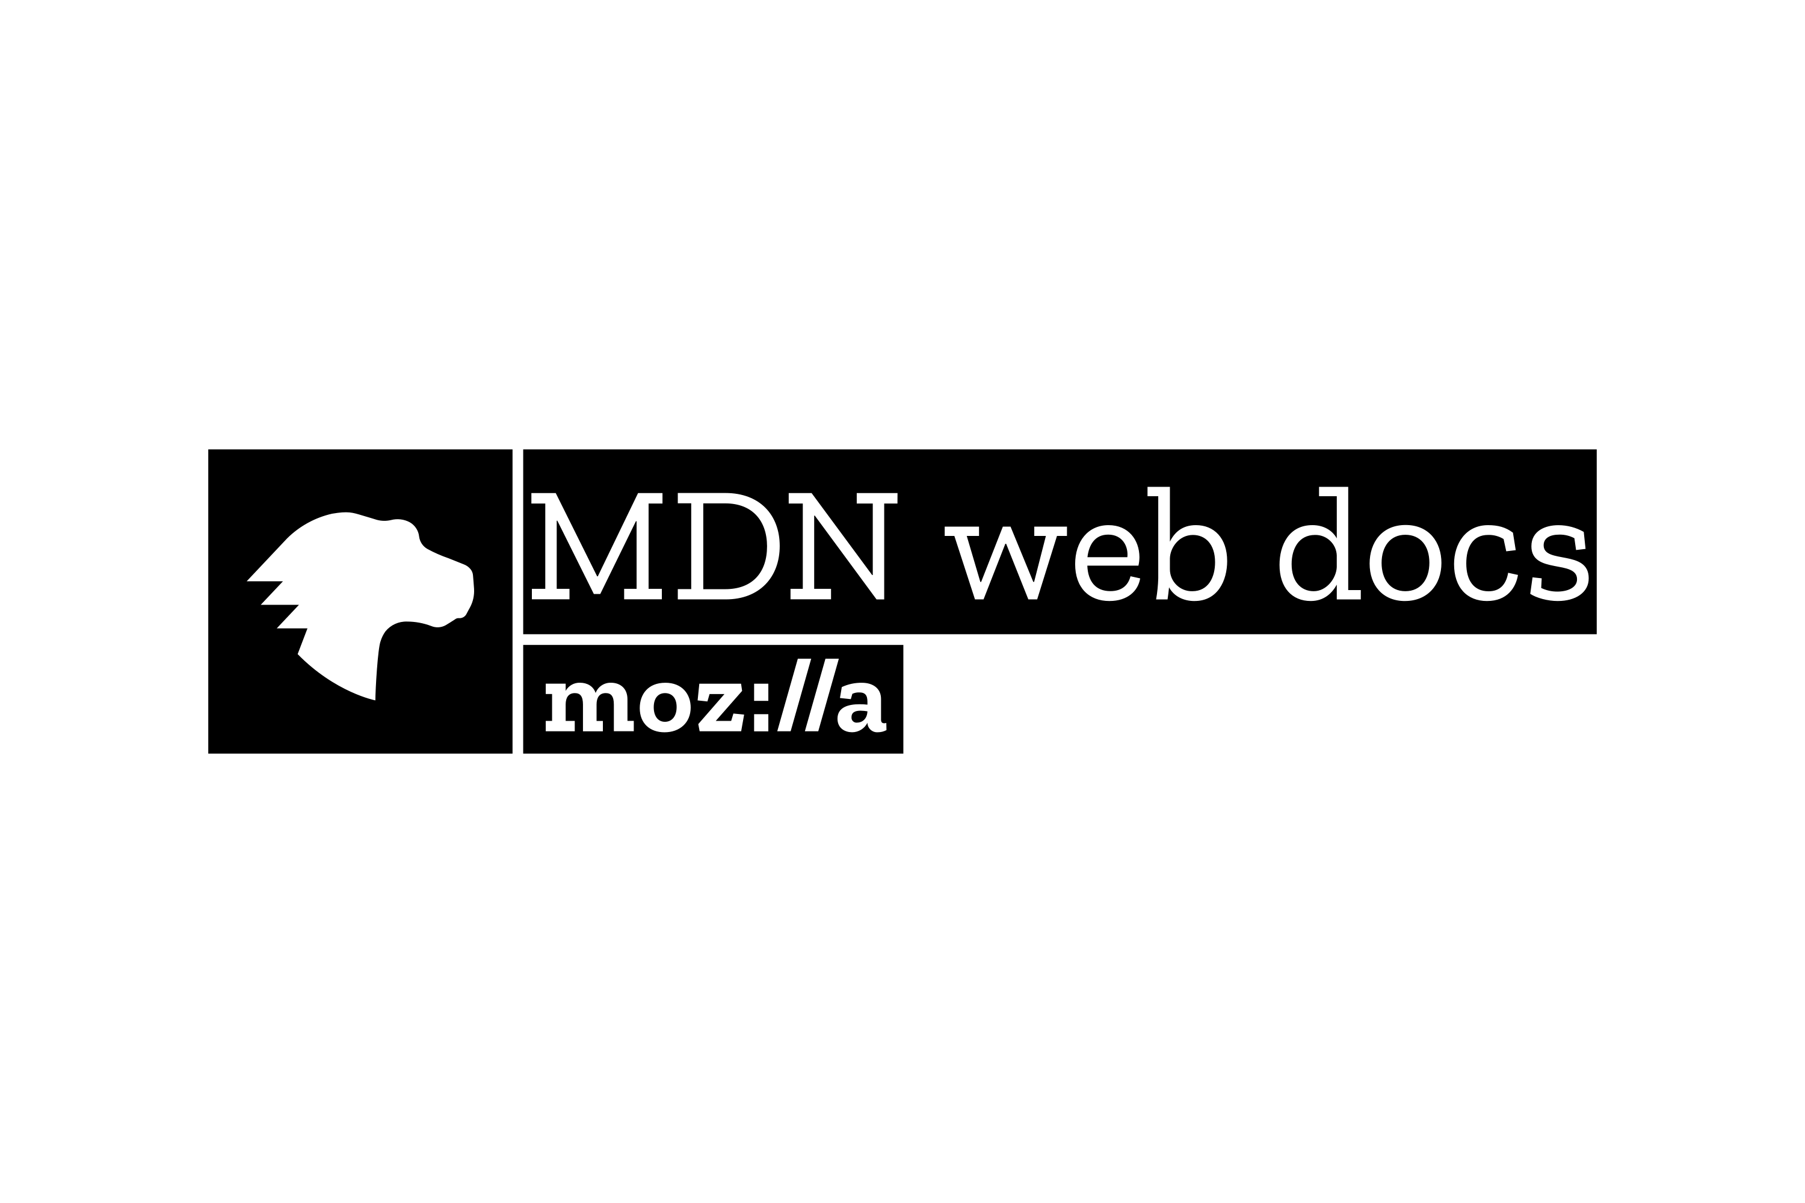

DEVELOPMENT RESOURCES
https://www.theodinproject.com/
https://developer.mozilla.org/en-US/
https://devdocs.io/

Slide 7
git add lab03.txt git commit –m “complete” git push origin master
Lab 03 – CS 411 @ Boston University
(dcmag@bu.edu)

