Slide 1
>$ find / -name “teams.md”
Lab 02 – CS 411 @ Boston University

Slide 2
A Quick Recap…
Installing Git, Setting up SSH Key, Understanding the Workflow
Git Bash -> Windows
Terminal -> macOS, Linux
DO NOT SHARE YOUR PRIVATE KEY
Complete work on <username> branch
New branch per feature! (e.g. `git checkout –b feature/<name>`)
Explore the Lab Repository!
https://github.com/dcmaglione/bu-cs411-fall23
Contains any resources shown and/or used during lab
If you have suggestions let me know!

Slide 3
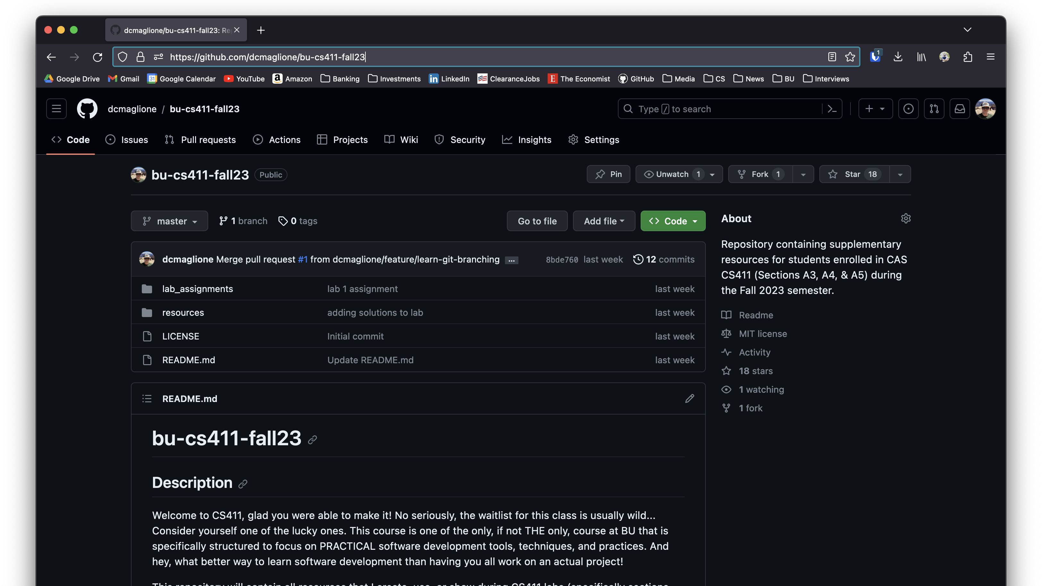

Slide 4
ASSEMBLE YOUR TEAMS!
Ladies and Gentlemen… The Moment You’ve All Been Waiting For…

Slide 5
Today’s Tasks!
First, please fill out this form so we know what your teams are!
https://docs.google.com/document/d/1I4q6jr8ZGGHIYZEd6wrJv17_xVewuF5dtWIzxwkPwzg/edit?usp=sharing
Next, I’m going to go over the expectation this semester and answer any questions.
I’ll also give you time to get familiar with your teammates and establish some methods of communication.
Find out what your team can and can’t do. In other words, play to each others' strengths!
Lastly, let’s get some ideas down! I’ll go over what was done in prior semesters, but it would be a good idea to start thinking now!

Slide 6
Project Requirements
It MUST have a decoupled architecture!
I.e., It must have a FRONT END and a BACK END
Make calls to TWO external API’s
These can literally be ANYTHING you want
I personally like https://data.gov/ because it’s simple and free!
(Ok well not exactly your tax dollars pay for it…)
Utilize a DATABASE, again dealers' choice here
Have OAuth, meaning allow users to signup and login
You actually need a database for this to store credentials

Slide 7







Get Those Comms Up Soldier!

Slide 8



RESOURCES! Oh… Uh… And me of course!

Slide 9
git add lab02.txt git commit –m “complete” git push origin master
Lab 02 – CS 411 @ Boston University
(dcmag@bu.edu)

