Slide 1
CS 101: HELLO WORLD!
Lab 01 – CS 411 @ Boston University

Slide 2



$ WHOAMI
Waterford, VA
Pursuing a BA/MS in CS
Incoming Staff @ JHU/APL
$ ./INTERESTS
Computers & Tech (duh!)
Reading (Non-fiction)
International Relations

Slide 3
SOFTWARE ENGINEERING != PROGRAMMING

Slide 4
Programming
The act of programming, in its simplest definition, is giving computers instructions to do something with some input in order to produce some output.
Software Engineering
The act of engineering software is about designing, writing, testing, and maintaining computer programs with the purpose of solving problems for many users. It is about creating robust and safe solutions that will withstand the test of time and will work for some of the unknown problems around the original obvious ones.

Slide 5
GIT 101: THE BASICS
git commit -m “the #1 distributed vcs”

Slide 6

WHAT IS GIT/GITHUB?
Decentralized VCS
Each developer has a copy of the code base
Concurrent work on a file is possible
Local versions (called branches) are embraced
Advantages
No locking of files
Concurrency
Simple branching
Disadvantages
Local branches must be merged
History can get complex

Slide 7

SETTING UP GIT/GITHUB
Head to https://github.com/ and create an account if you don’t already have one
Use your BU email for free access to GitHub Pro
https://github.com/git-guides/install-git
Use git version to verify if git is/was installed
$ git --version
https://docs.github.com/en/authentication/connecting-to-github-with-ssh
Setup an SSH Key

Slide 8
git add [file]
Stages content (file/folder) to current commit
Stages files as they are at the time… NOT a reference
Further changes must be re-added
E.g., git add main.py

Slide 9
git commit –m [“message”]
Git only records changes when explicitly told to
Saves the changes to the current local branch
Commit records the changes with a message detailing changes

Slide 10
git push [alias] [branch]
Pushes local branch changes to a remote branch
Typically: git push origin master
or git push origin main

Slide 11
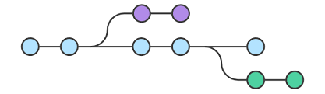
git checkout
Moves you from the branch you’re currently on to the one specified
Make sure your changes are staged before checking out

Slide 12
git status
Your best friend in git – sanity check
Typically used before commits/pushes
Prints a log of:
Current branch
Staged changes (files added)
Unstaged changes (files that have not been added)

Slide 13
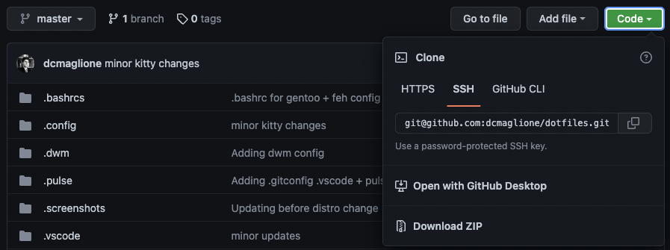
git clone [url]
Clones' full repository to your local machine
Should be used in directory where you want to store repository

Slide 14
git pull
Adds changes from a remote repository into the current local branch
Should be used throughout the development process for incorporating teammate’s code changes together
Kind of like cloning the repository but only adds files/lines of code that have been changed

Slide 15
ENOUGH TALKING LET’S GET SOME PRACTICE

Slide 16
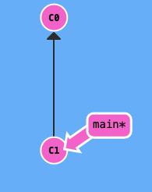
TODAY’S ASSIGNMENT
We will be using an online sandbox at https://learngitbranching.js.org to explore git and solve some simple problems.
Don’t worry, I’ll work through the first few with you all!
There are four problems in Parts 1 and 2, and two in Part 3
Read the instructions (trust me it’s helpful!)
Solve the problem
Copy the commands you type in whatever way you want (Google Docs, Word, Notepad, Emacs, idc)
Part 1: Problem 1 `git commit` `git commit`
You can include an image here of the fun little complete message if you want, but you don’t need to

Slide 17



GIT RESOURCES
https://education.github.com/git-cheat-sheet-education.pdf

Slide 18
git add lab01.txt git commit –m “complete” git push origin master
Lab 01 – CS 411 @ Boston University
(dcmag@bu.edu)

