Slide 1
GIT 101: THE BASICS
Lab 02 – CS 411 @ Boston University

Slide 2

WHAT IS GIT/GITHUB?
Decentralized VCS
Each developer has a copy of the code base
Concurrent work on a file is possible
Local versions (called branches) are embraced
Advantages
No locking of files
Concurrency
Simple branching
Disadvantages
Local branches must be merged
History can get complex

Slide 3

SETTING UP GIT/GITHUB
Head to https://github.com/ and create an account if you don’t already have one
Use your BU email for free access to GitHub Pro
https://github.com/git-guides/install-git
Use git version to verify if git is/was installed
$ git --version
https://docs.github.com/en/authentication/connecting-to-github-with-ssh
Setup an SSH Key

Slide 4
BASIC COMMANDS
git commit -m “added new commands”

Slide 5
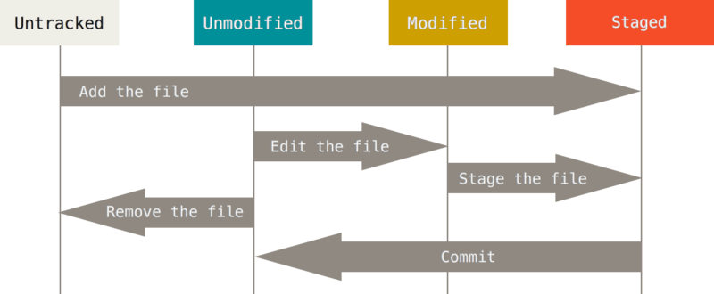
BUT FIRST… A visual overview!

Slide 6
git add [file]
Stages content (file/folder) to current commit
Stages files as they are at the time… NOT a reference
Further changes must be re-added
E.g., git add main.py

Slide 7
git commit –m [“message”]
Git only records changes when explicitly told to
Saves the changes to the current local branch
Commit records the changes with a message detailing changes

Slide 8
git push [alias] [branch]
Pushes local branch changes to a remote branch
Typically: git push origin master
or git push origin main

Slide 9
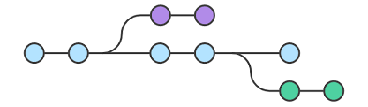
git checkout
Moves you from the branch you’re currently on to the one specified
Make sure your changes are staged before checking out

Slide 10
git status
Your best friend in git – sanity check
Typically used before commits/pushes
Prints a log of:
Current branch
Staged changes (files added)
Unstaged changes (files that have not been added)

Slide 11
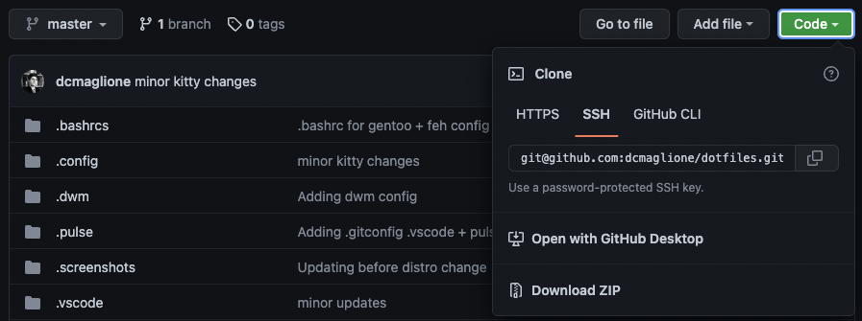
git clone [url]
Clones' full repository to your local machine
Should be used in directory where you want to store repository

Slide 12
git pull
Adds changes from a remote repository into the current local branch
Should be used throughout the development process for incorporating teammate’s code changes together
Kind of like cloning the repository but only adds files/lines of code that have been changed

Slide 13
Project Workflow w/ GitHub
There are two main ways to set up a repo on GitHub
Push existing local files to a new repo
Set up a new repo on GitHub and clone it
We’ll look at the second method, which is the simpler of the two
For the first method, a good tutorial is at
https://www.digitalocean.com/community/tutorials/how-to-use-git-effectively

Slide 14
Project Workflow: Setup for LEAD
All members create GitHub account if it doesn’t exist
One team member (LEAD) creates a repo
LEADS add MEMBERs to collaborators list (add collabs in the Settings page (gear icon))
MEMBERs accept email to invite to be collaborator
MEMBER navigates to GitHub repo, click on green ‘Clone on download’ button, copy URL displayed
MEMBER: From a terminal on your local machine, move to the directory you want your local repo to be
MEMBER: git clone <URL you copied earlier>

Slide 15
Project Workflow: Setup
MEMBER creates a personal branch
(i.e. dcmag would do `git checkout –b dcmag`)
MEMBER pushes personal branch to set up tracking
(`git push –set-upstream origin dcmag`)

Slide 16
Project Workflow: Doing Work
MEMBER: move to project directory on your machine
Switch to your personal branch
`git checkout dcmag`
Update with any changes made since last time you were working
`git pull origin master`
Create a new top/feature branch to do work on a specific item
`git checkout –b oauth`

Slide 17
Project Workflow: Doing Work
After completing work on the topic branch, merge it into your personal branch
`git checkout dcmag`
`git merge oauth`
Push your personal branch to the project’s GitHub repo
`git push`
Notify LEAD that your changes are ready to merge into the release branch with a pull request
Log onto GitHub navigate to project repo, click on New Pull Request
base: master <- compare: <your personal branch>
LEAD evaluates request, request comments, merges into masterSave files on local branch to remote repo

Slide 18
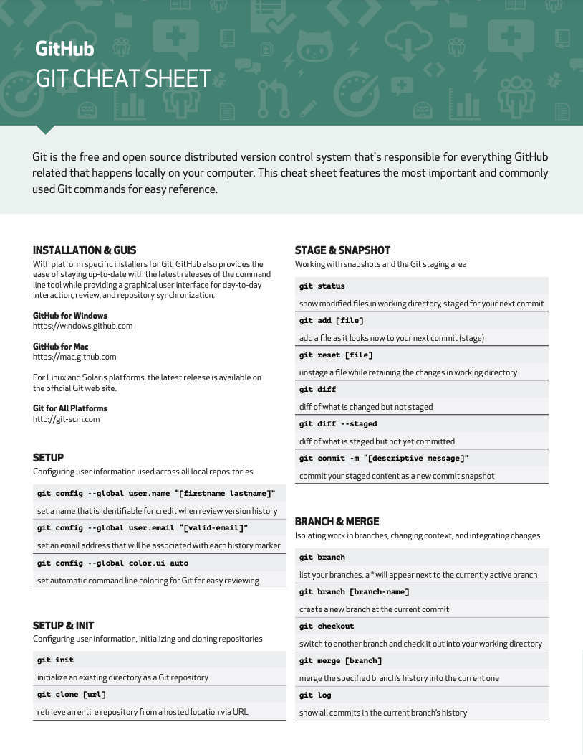


GIT RESOURCES
https://education.github.com/git-cheat-sheet-education.pdf

Slide 19
git add lab02.txt git commit –m “complete” git push origin master
Lab 02 – CS 411 @ Boston University
(dcmag@bu.edu)

