Slide 1
CS 101: HELLO WORLD!
Lab 01 – CS 411 @ Boston University

Slide 2



$ WHOAMI
Waterford, VA
Pursuing a BA/MS in CS
Incoming Staff @ JHU/APL
$ ./INTERESTS
Computers & Tech (duh!)
Reading (Non-fiction)
International Relations

Slide 3
SOFTWARE ENGINEERING != PROGRAMMING

Slide 4
Programming
The act of programming, in its simplest definition, is giving computers instructions to do something with some input in order to produce some output.
Software Engineering
The act of engineering software is about designing, writing, testing, and maintaining computer programs with the purpose of solving problems for many users. It is about creating robust and safe solutions that will withstand the test of time and will work for some of the unknown problems around the original obvious ones.

Slide 5
PREPARE FOR
THE (job) HUNT

Slide 6



APPLY APPLY APPLY
Speak…
Slowly
Loudly
Clearly
Ask Interesting Questions

Slide 7
YOU GOT THE JOB! … Now What?

Slide 8
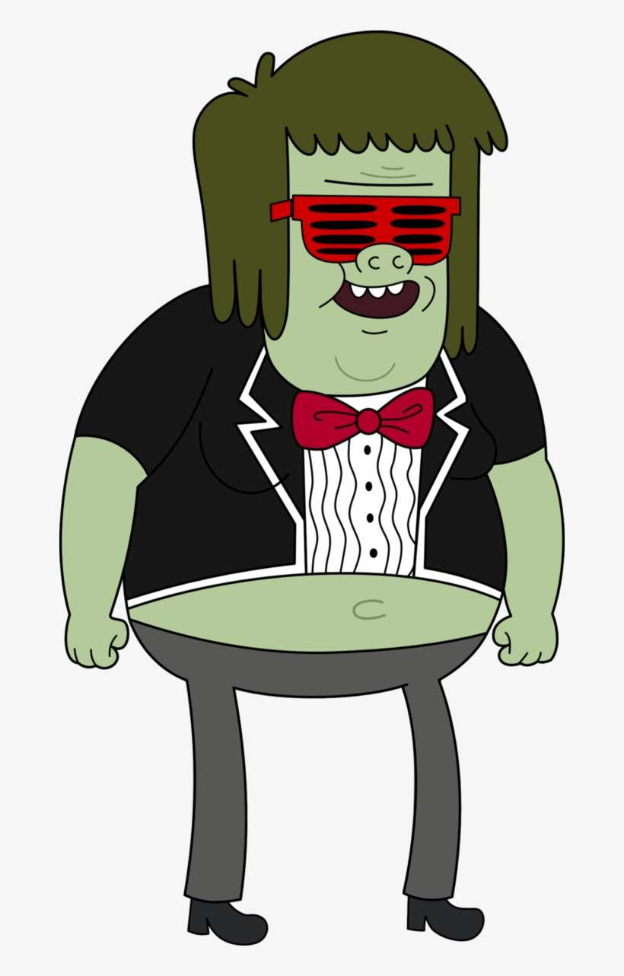
THREE. THINGS.
Deliver Results
Build your professional network
Communicate across technical boundaries

Slide 9
git add lab01.txt git commit –m “complete” git push origin master
Lab 01 – CS 411 @ Boston University
(dcmag@bu.edu)

