Slide 1
Bioinformatics Software development
Clean code

Slide 2
We would like to write good code

Slide 3
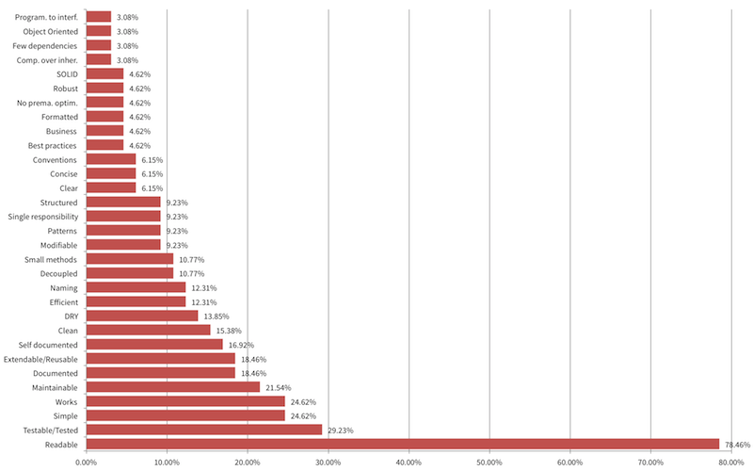
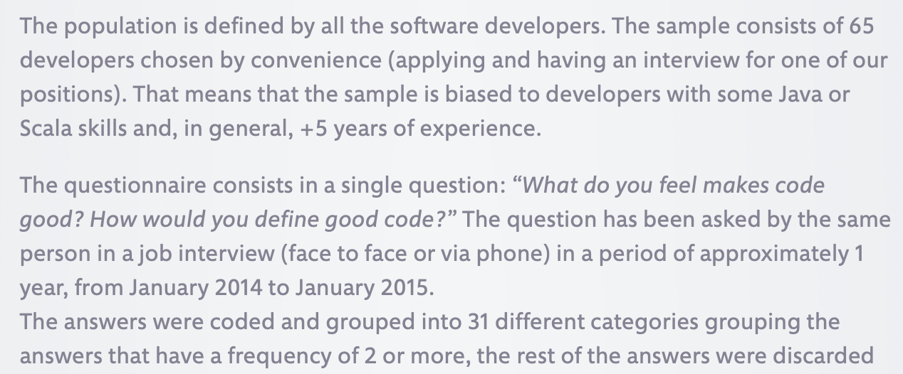
https://intenthq.com/blog/what-is-good-code-a-scientific-definition/
What makes code good?

Slide 4
Outline
Clean code
What is clean code?
Definition & motivation
Challenges in writing clean code
How to write clean code
Clean code principles
Tools for writing clean code
Pitfalls to avoid
Examples from existing libraries and the class projects
Happy path implementation – 10 min
Work on the happy path implementation
Apply 2 clean code principles to existing code in your project

Slide 5
What is clean code?
Analogies:
Clean code is code that is easy to understand and easy to change
Code is like humor. When you *have* to explain it, it’s bad
Clean code is just like a room that is well organized. You can easily find anything that you are looking for
Another metaphor is the newspaper. Clean code is arranged so that you can easily get a high-level idea what the code does (like reading newspaper headlines) and then decide what part you want to read about in more detail (jump to a lower-level method).
https://cvuorinen.net/2014/04/what-is-clean-code-and-why-should-you-care/

Slide 6
What is clean code?
“I like my code to be elegant and efficient. The logic should be straightforward to make it hard for bugs to hide, the dependencies minimal to ease maintenance, error handling complete according to an articulated strategy, and performance close to optimal so as not to tempt people to make the code messy with unprincipled optimizations. Clean code does one thing well.”
Bjarne Stroustrup, inventor of C++ and author of The C++ Programming Language
Martin, Robert C. Clean code: a handbook of agile software craftsmanship. Pearson Education, 2009.
https://www.oreilly.com/library-access/?next=/library/view/Clean-code-/9780136083238

Slide 7
What is clean code?
“I could list all of the qualities that I notice in clean code, but there is one overarching quality that leads to all of them. Clean code always looks like it was written by someone who cares. There is nothing obvious that you can do to make it better. All of those things were thought about by the code’s author, and if you try to imagine improvements, you’re led back to where you are, sitting in appreciation of the code someone left for you—code left by someone who cares deeply about the craft.”
Michael Feathers, author of Working Effectively with Legacy Code
Martin, Robert C. Clean code: a handbook of agile software craftsmanship. Pearson Education, 2009.
https://www.oreilly.com/library-access/?next=/library/view/Clean-code-/9780136083238

Slide 8
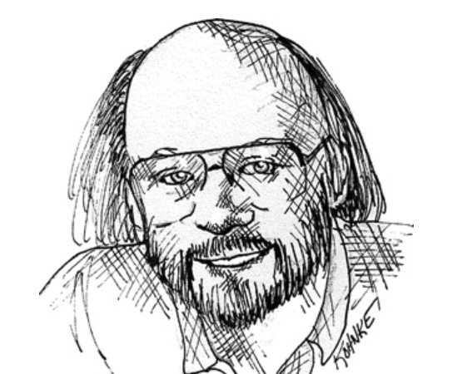
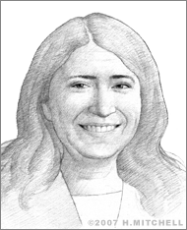
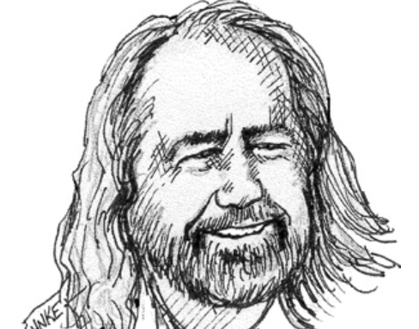
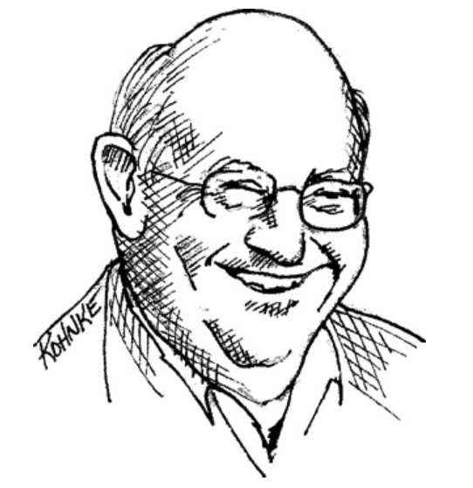
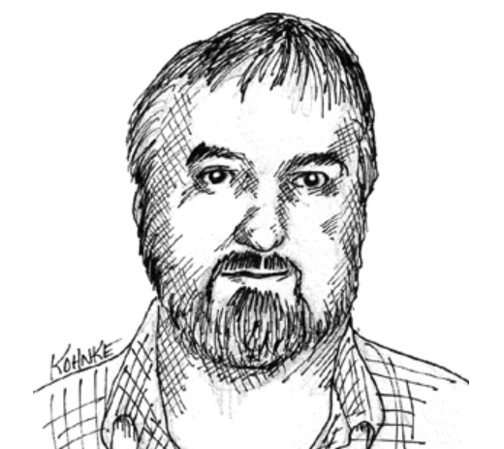
What is clean code?
“I like my code to be elegant and efficient. […] Clean code does one thing well.”
Bjarne Stroustrup, inventor of C++
“The stuff I design, if I’m successful, nobody will ever notice. Things will just work and be self-managing.”
Radia Pearlman, “the Mother of the Internet,”
IEEE fellow, inventor of Spanning-Tree Protocol (STP),
TRILL, and TORTIS, a programming language for children
“Clean code reads like well-written prose.”
Grady Booch, author of Object Oriented
Analysis and Design with Applications
“Clean code can be read and enhanced by a developer other than its original author. It has unit and acceptance tests.”
“Big” Dave Thomas, founder of OTI, godfather of the Eclipse strategy
“Clean code always looks like it was written by someone who cares”
Michael Feathers, author of Working Effectively with Legacy Code
Martin, Robert C. Clean code: a handbook of agile software craftsmanship. Pearson Education, 2009.
https://www.oreilly.com/library-access/?next=/library/view/Clean-code-/9780136083238
https://lemelson.mit.edu/resources/radia-perlman
https://www.mentalfloss.com/article/53181/inspiring-quotes-10-influential-women-tech

Slide 9
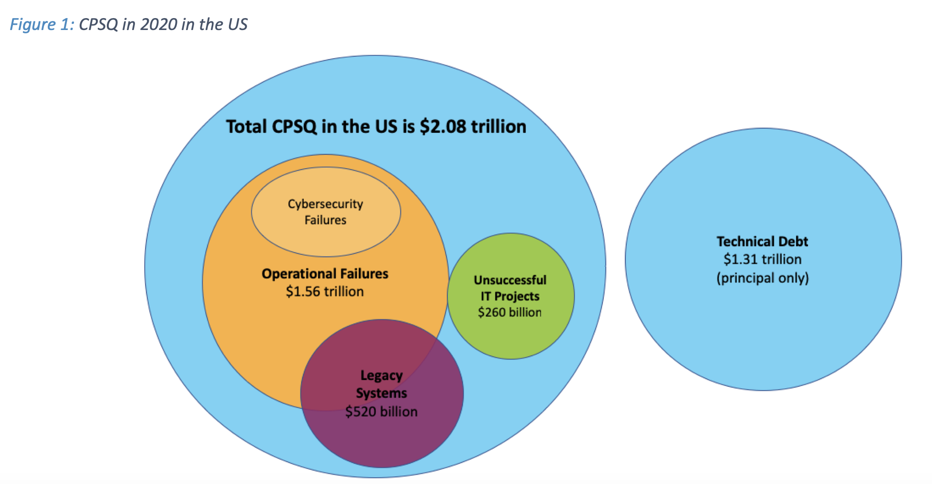
Why is it important to write good code?
Cost of Poor Software Quality (CPSQ)
https://www.it-cisq.org/cisq-files/pdf/CPSQ-2020-report.pdf

Slide 10
What are the benefits of clean code?
Analogies have been made that a programmer writing bad code is like a surgeon not washing their hands – the result has dire consequences – not always immediate though
Writing clean code results in a software product that is more:
Usable
Readable
Maintainable
Testable
Robust
Extensible
Comprehensible
Cost efficient
Write code that your future self would enjoy reading and changing after more than 6 months

Slide 11
Why doesn’t everybody write clean code?
Challenges in writing clean code
Lack of knowledge of what clean code is
Longer time to finish development and get a working product
Time constraints
Priorities that do not include clean code
Unclear requirements
Not enough experience in writing clean code
https://betterprogramming.pub/the-real-reason-its-difficult-to-write-clean-code-gamedevunboxed-5ccdb06ca33f

Slide 12
Clean code principles
It is easy to understand the execution flow of the entire application
It is easy to understand how the different objects collaborate with each other
It is easy to understand the role and responsibility of each class
It is easy to understand what each method does
It is easy to understand what is the purpose of each expression and variable
Classes and methods are small and only have single responsibility
Classes have clear and concise public APIs
Classes and methods are predictable and work as expected
Functions should not mix levels (high, low) of abstraction
Functions should not have side effects
Function output arguments are to be avoided and return values should be used instead
The code is easily testable and has unit tests (or it is easy to write the tests)
Tests are easy to understand and easy to change
https://cvuorinen.net/2014/04/what-is-clean-code-and-why-should-you-care/
Martin, Robert C. Clean code: a handbook of agile software craftsmanship. Pearson Education, 2009.
https://www.oreilly.com/library-access/?next=/library/view/Clean-code-/9780136083238

Slide 13
Clean code principles
DRY (Don't repeat yourself)
Every piece of knowledge must have a single, unambiguous, authoritative representation within a system.
KISS (Keep it simple)
Most systems work best if they are kept simple, rather than made complicated.
SoC (Separation of concerns)
SoC is a design principle for separating a computer program into distinct sections such that each section addresses a separate concern. A concern is a set of information that affects the code of a computer program.
SOLID
SOLID is a mnemonic acronym for five design principles intended to make software designs more understandable, flexible, and maintainable.
The Single-responsibility principle: "A class should have one, and only one, reason to change."
The Open–closed principle: "Entities should be open for extension, but closed for modification."
The Liskov substitution principle: "Functions that use pointers or references to base classes must be able to use objects of derived classes without knowing it."
The Interface segregation principle: "A client should not be forced to implement an interface that it doesn’t use."
The Dependency inversion principle: "Depend upon abstractions, not concretions.”
YAGNI (You Aren't Gonna Need It)
YAGNI is an Extreme Programming (XP) practice which states: "Always implement things when you actually need them, never when you just foresee that you need them."
Look at specific examples at the following links:
https://testdriven.io/blog/clean-code-python/
https://workat.tech/machine-coding/tutorial/introduction-clean-code-software-design-principles-nwu4qqc63e09

Slide 14
Clean code principles
It is easy to understand the execution flow of the entire application
It is easy to understand how the different objects collaborate with each other
It is easy to understand the role and responsibility of each class
It is easy to understand what each method does
It is easy to understand what is the purpose of each expression and variable
Classes and methods are small and only have single responsibility
Classes have clear and concise public APIs
Classes and methods are predictable, and work as expected
Functions should not mix levels (high, low) of abstraction
Functions should not have side effects
Function output arguments are to be avoided and return values should be used instead
The code is easily testable and has unit tests (or it is easy to write the tests)
Tests are easy to understand and easy to change
https://cvuorinen.net/2014/04/what-is-clean-code-and-why-should-you-care/
Martin, Robert C. Clean code: a handbook of agile software craftsmanship. Pearson Education, 2009.
https://www.oreilly.com/library-access/?next=/library/view/Clean-code-/9780136083238

Slide 15
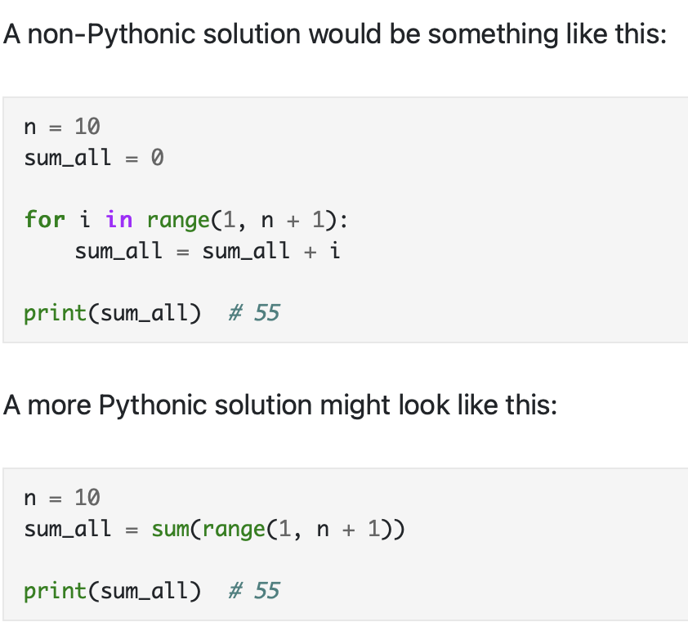
Tools for writing clean code – python
Write Pythonic code
Pythonic code is a set of idioms, adopted by the Python community. It simply means that you're using Python's idioms and paradigms well in order to make your code cleaner, readable, and highly performant.
Pythonic code includes:
variable tricks
list manipulation (initialization, slicing)
dealing with functions
explicit code
https://testdriven.io/blog/clean-code-python/

Slide 16
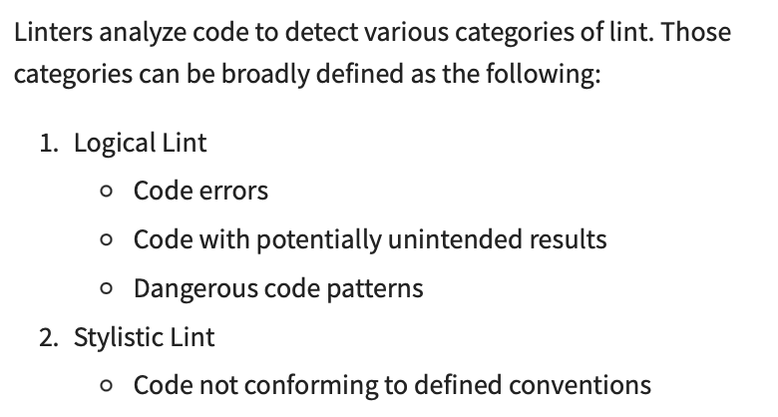
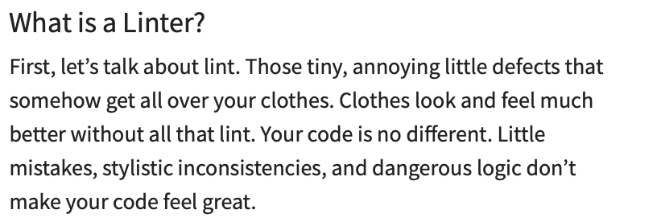
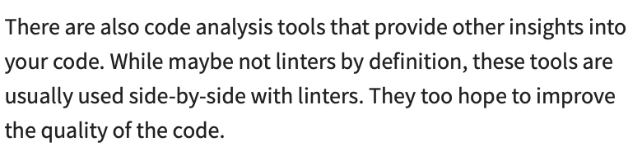
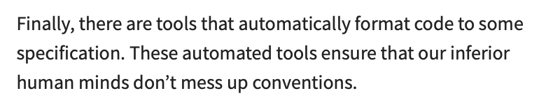
Tools for writing clean code – python
Leave the code cleaner than you found it
https://realpython.com/python-code-quality/

Slide 17
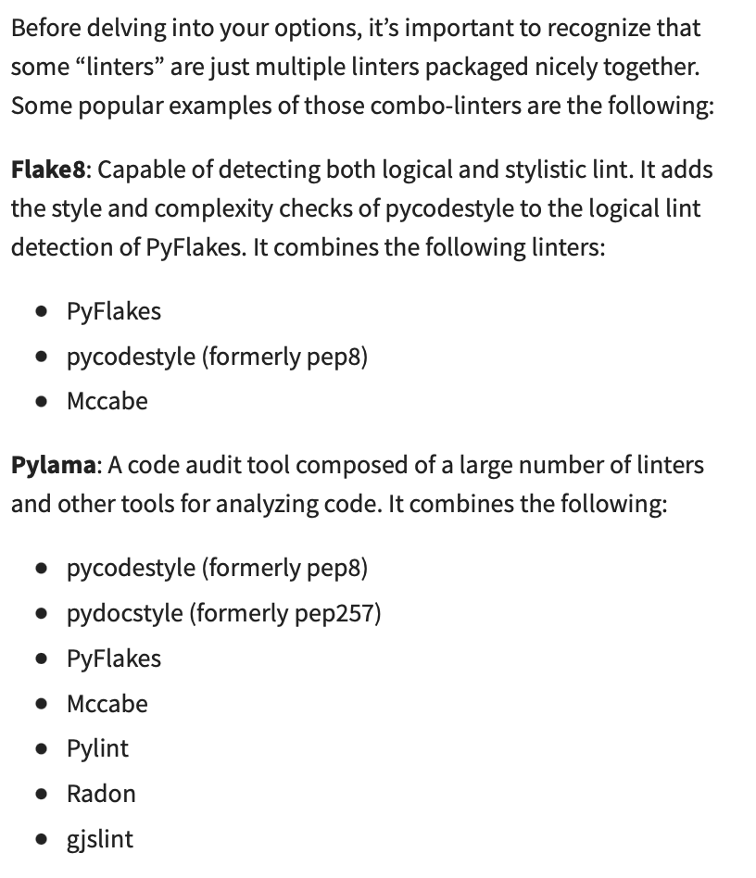
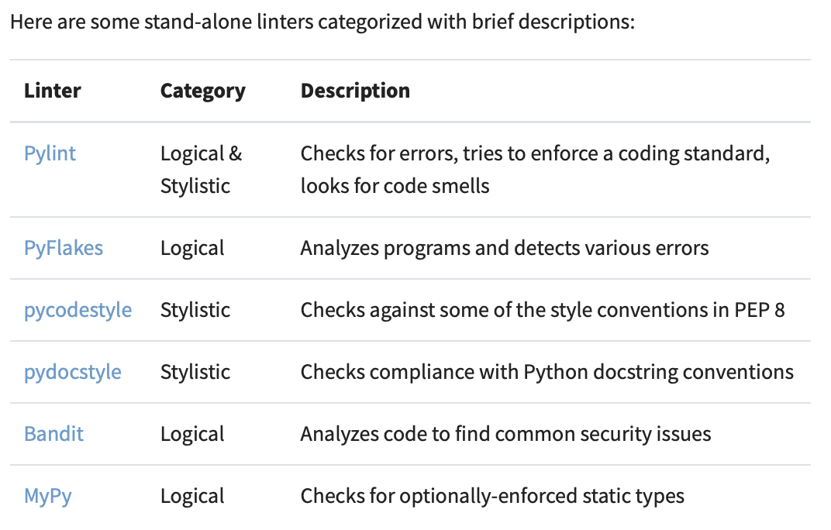
Tools for writing clean code
https://realpython.com/python-code-quality/

Slide 18
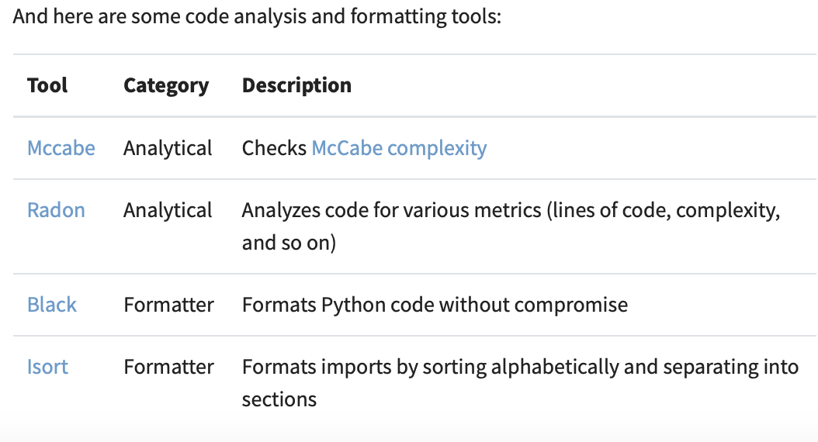
Tools for writing clean code
https://realpython.com/python-code-quality/

Slide 19
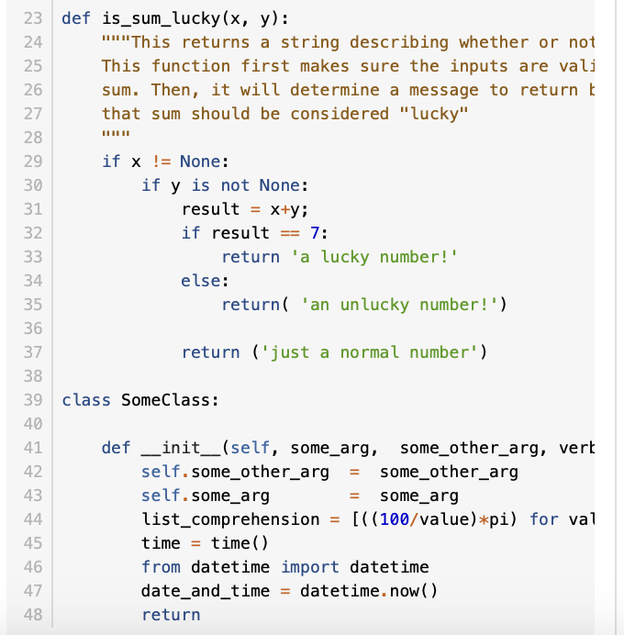
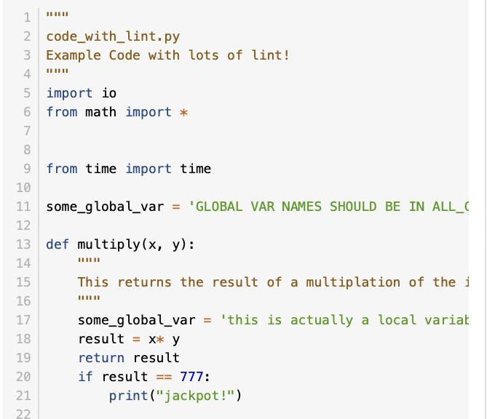
Tools for writing clean code – Example
Code to clean: code_with_lint.py
https://realpython.com/python-code-quality/

Slide 20
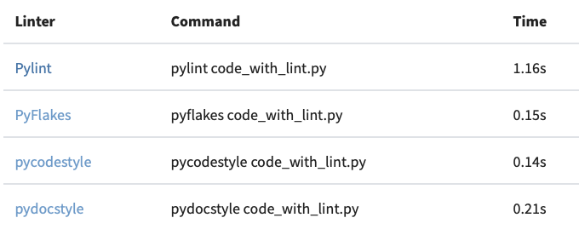
Tools for writing clean code – Example
https://realpython.com/python-code-quality/
In the terminal/gitbash/anaconda prompt:
Check tool:
type pylint
which pylint
– using one of the following commands should return a path to pylint
– if the commands above do not return anything you need to install pylint
Install tool:
pip install pylint
Run tool:
pylint filename.py

Slide 21
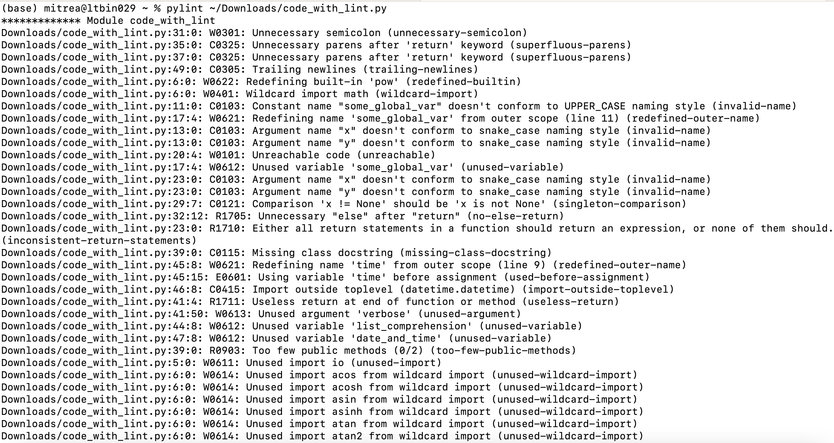
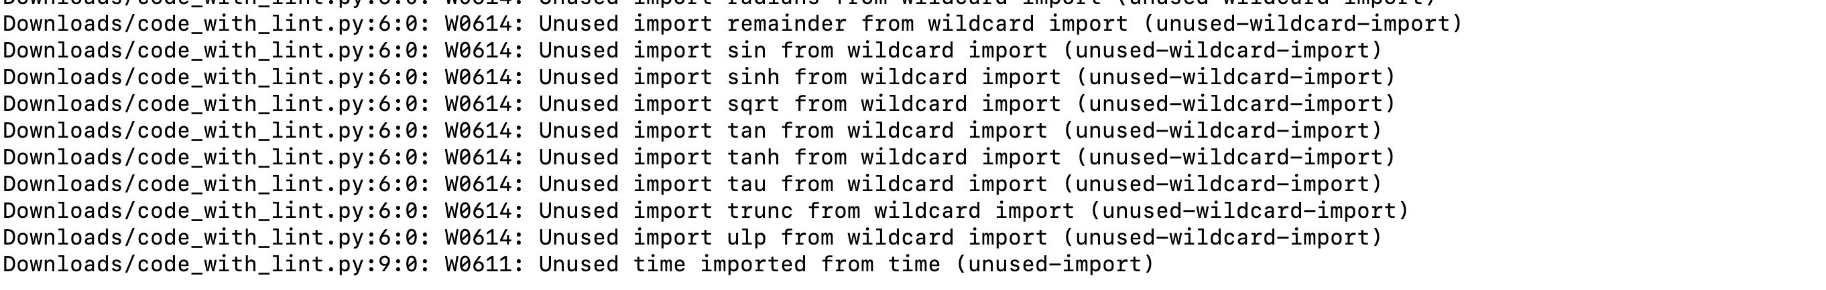
Tools for writing clean code – Example
https://realpython.com/python-code-quality/

Slide 22
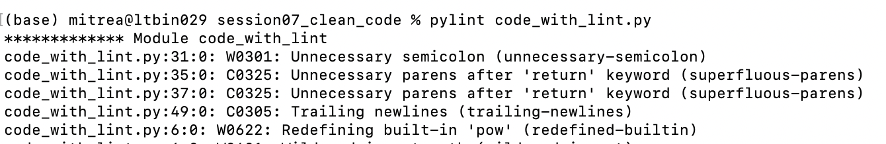
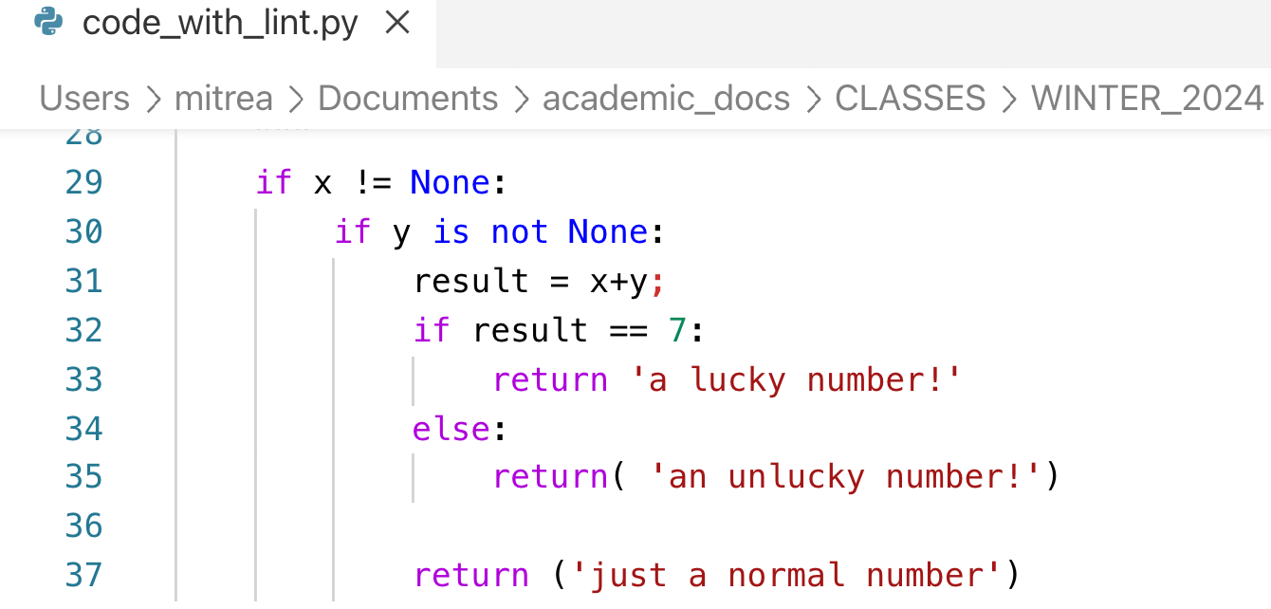
Tools for writing clean code – Example
https://realpython.com/python-code-quality/

Slide 23
Pitfalls to avoid in order to write clean code
Clean code is most at risk when:
There is a deadline pressure – which in academia is always
Try to prioritize and practice writing clean code
Looking for perfection – nothing is perfect
Try to achieve a very good level of clean code
If you spend 10 minutes looking for a way to improve a specific code block following clean code principles and do not find an issue to fix, then it is good enough
There is unnecessary complexity – simplify, simplify
The solution is too general – be specific
Examples of mistakes and how to fix them:
https://crocoblock.com/blog/writing-clean-code-tips/

Slide 24
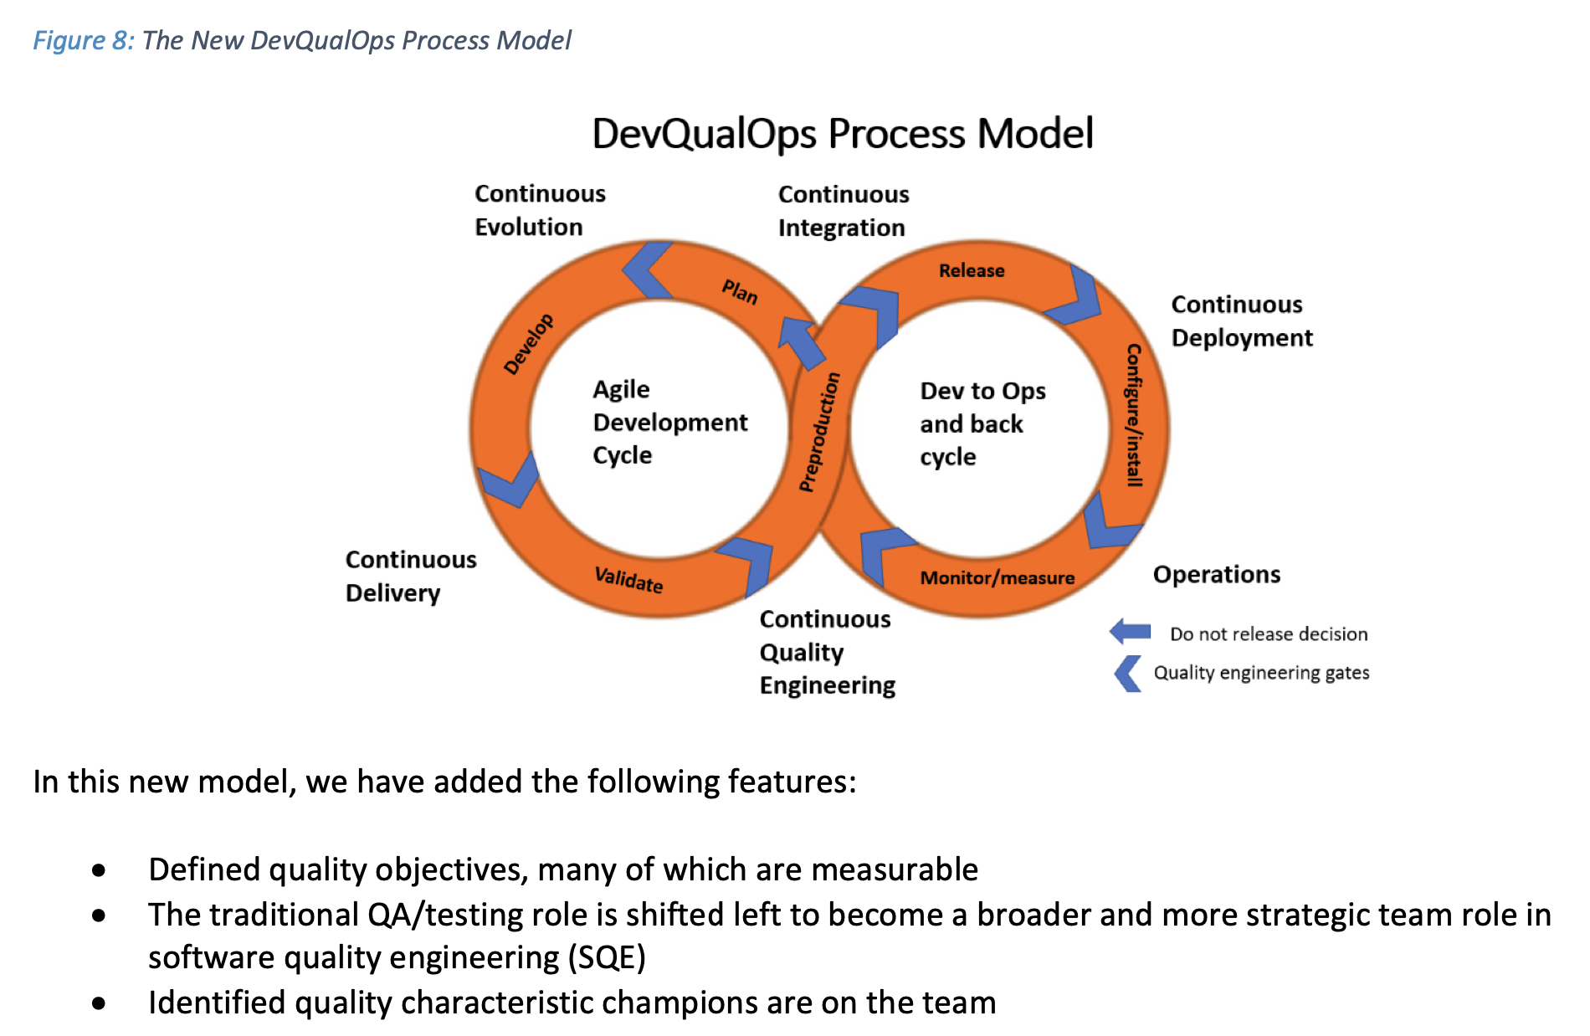
https://www.it-cisq.org/cisq-files/pdf/CPSQ-2020-report.pdf

Slide 25
How does this work in practice?

Slide 26
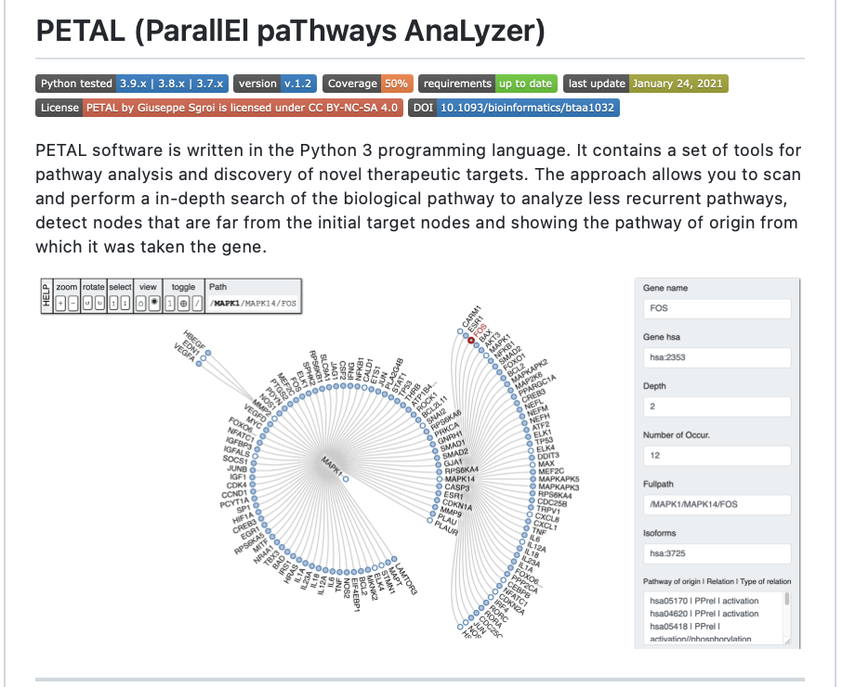
Examples from existing libraries
PETAL
(ParallEl
paThways
AnaLyzer)
https://github.com/Pex2892/PETAL

Slide 27
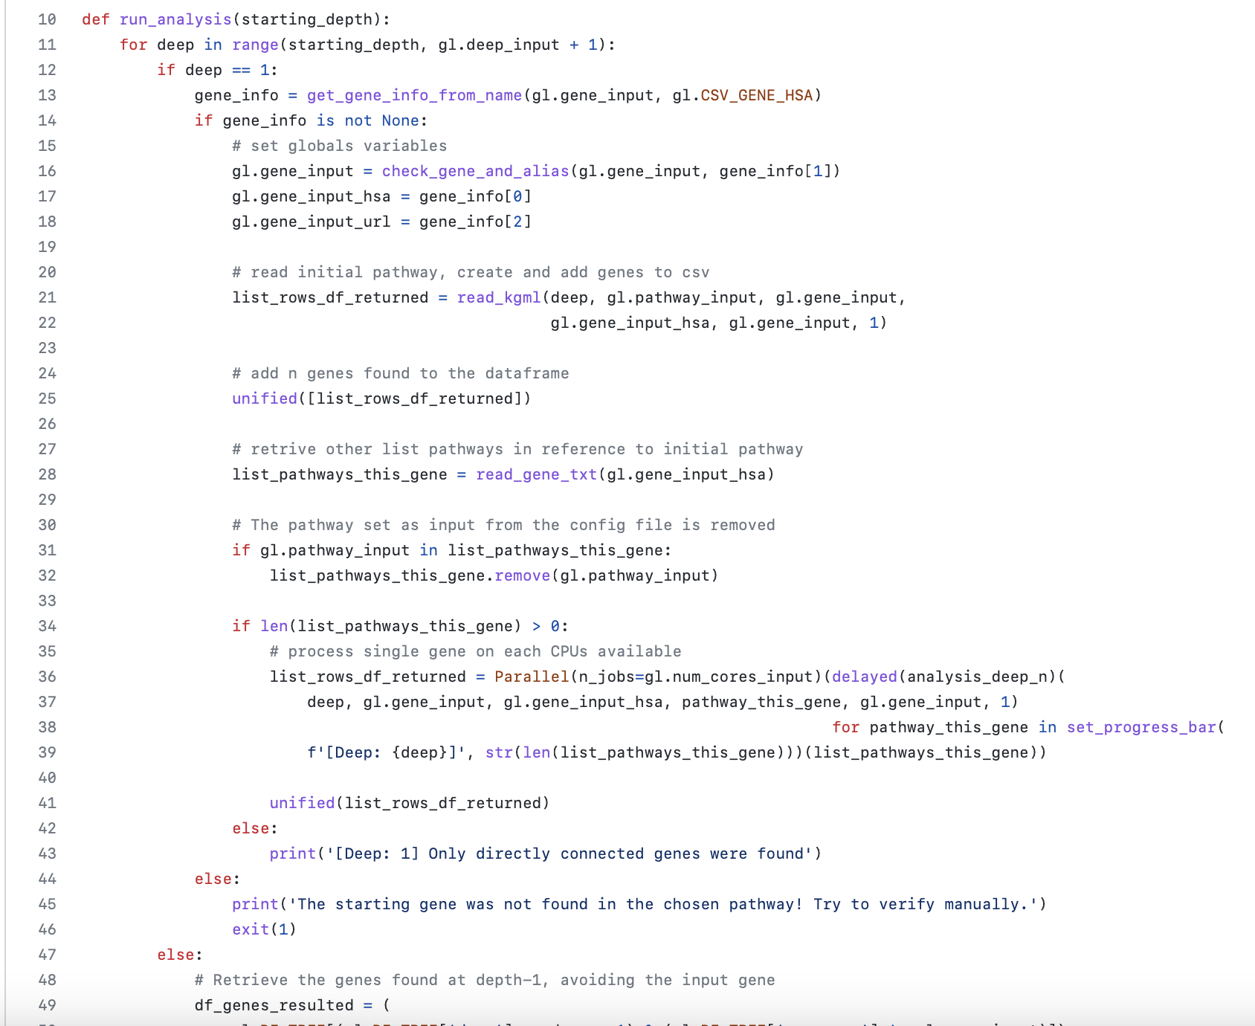
Examples from existing libraries
PETAL
(ParallEl
paThways
AnaLyzer)
Code with issues
Long function
Complex function
Commented code
Side effects
Untestable code
https://github.com/Pex2892/PETAL
https://github.com/Pex2892/PETAL/blob/master/analysis.py

Slide 28
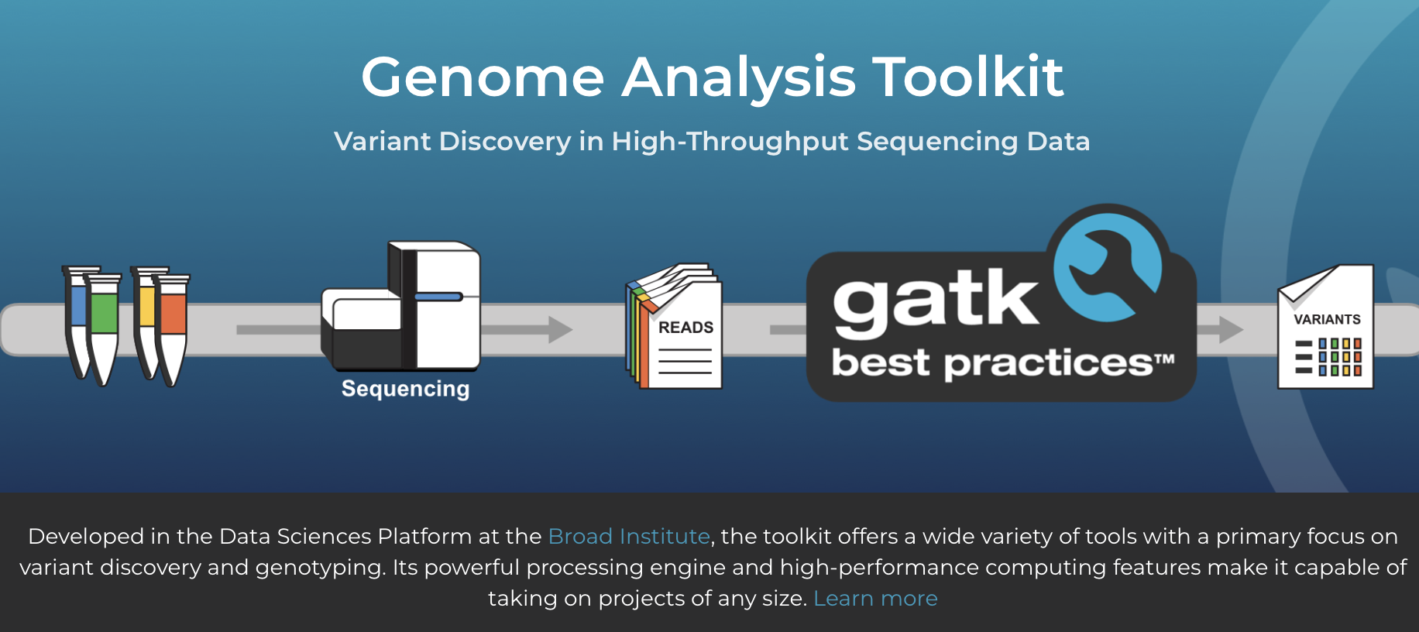
Examples from existing libraries
https://gatk.broadinstitute.org/hc/en-us
https://github.com/broadinstitute/gatk

Slide 29
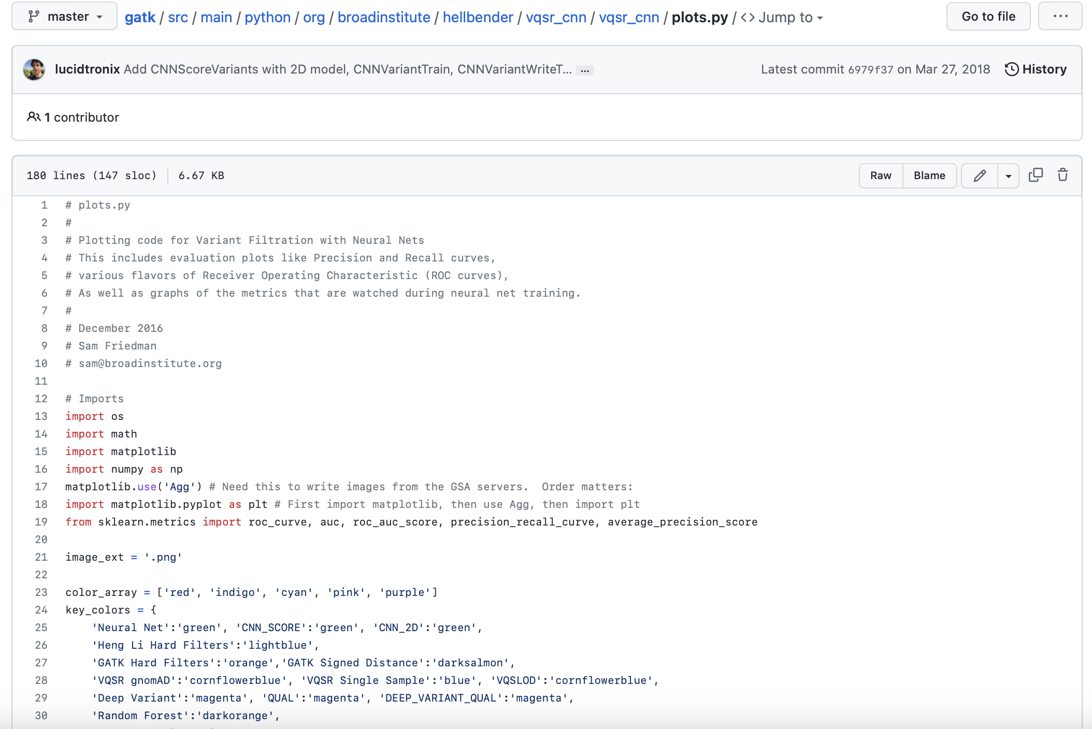
Examples from existing libraries
gatk
(Genome
analysis
toolkit)
Good code
Readable function
Nice organization
Good comments
No surprises – relevant comment
https://github.com/broadinstitute/gatk
https://github.com/broadinstitute/gatk/blob/master/src/main/python/org/broadinstitute/hellbender/vqsr_cnn/vqsr_cnn/plots.py

Slide 30
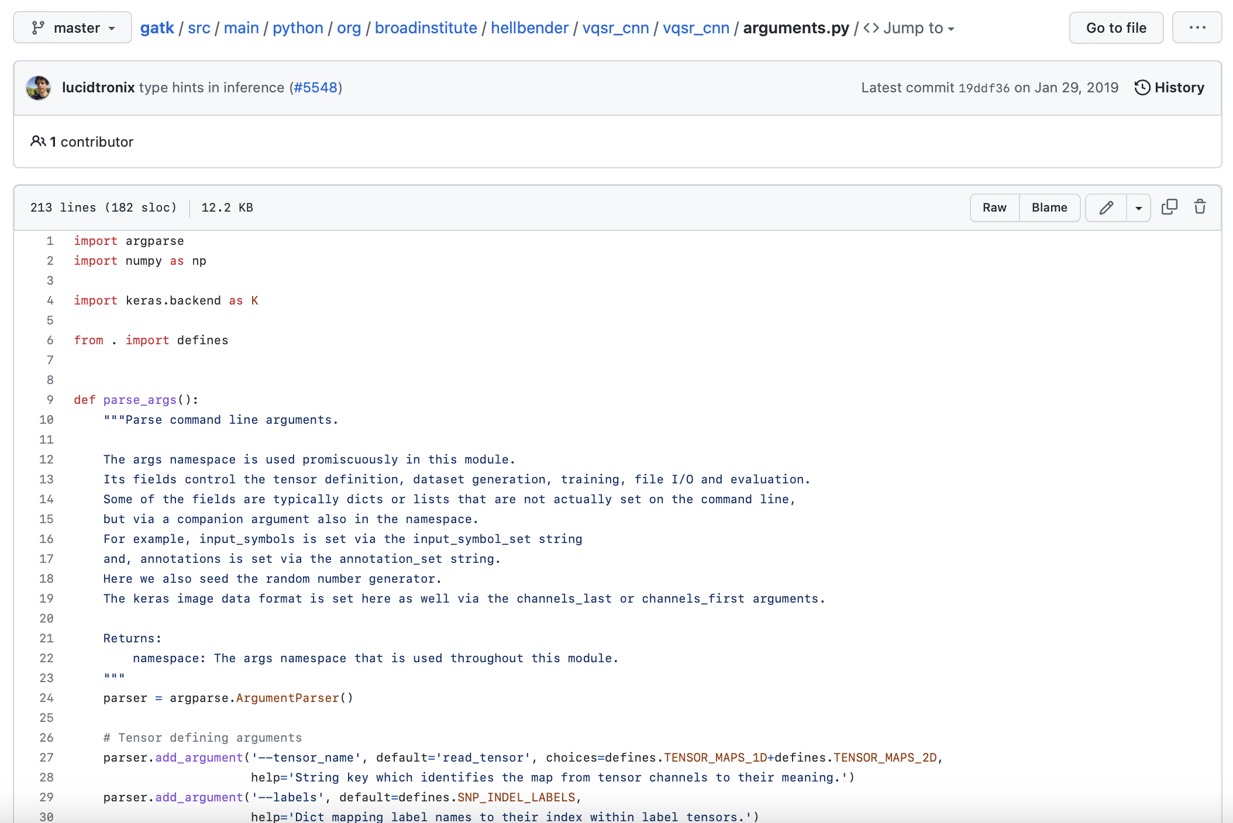
Examples from existing libraries
gatk
(Genome
analysis
toolkit)
Good code but some issues
Long function due to the number of arguments
Code is too general/flexible
https://github.com/broadinstitute/gatk
https://github.com/broadinstitute/gatk/blob/master/src/main/python/org/broadinstitute/hellbender/vqsr_cnn/vqsr_cnn/arguments.py

Slide 31
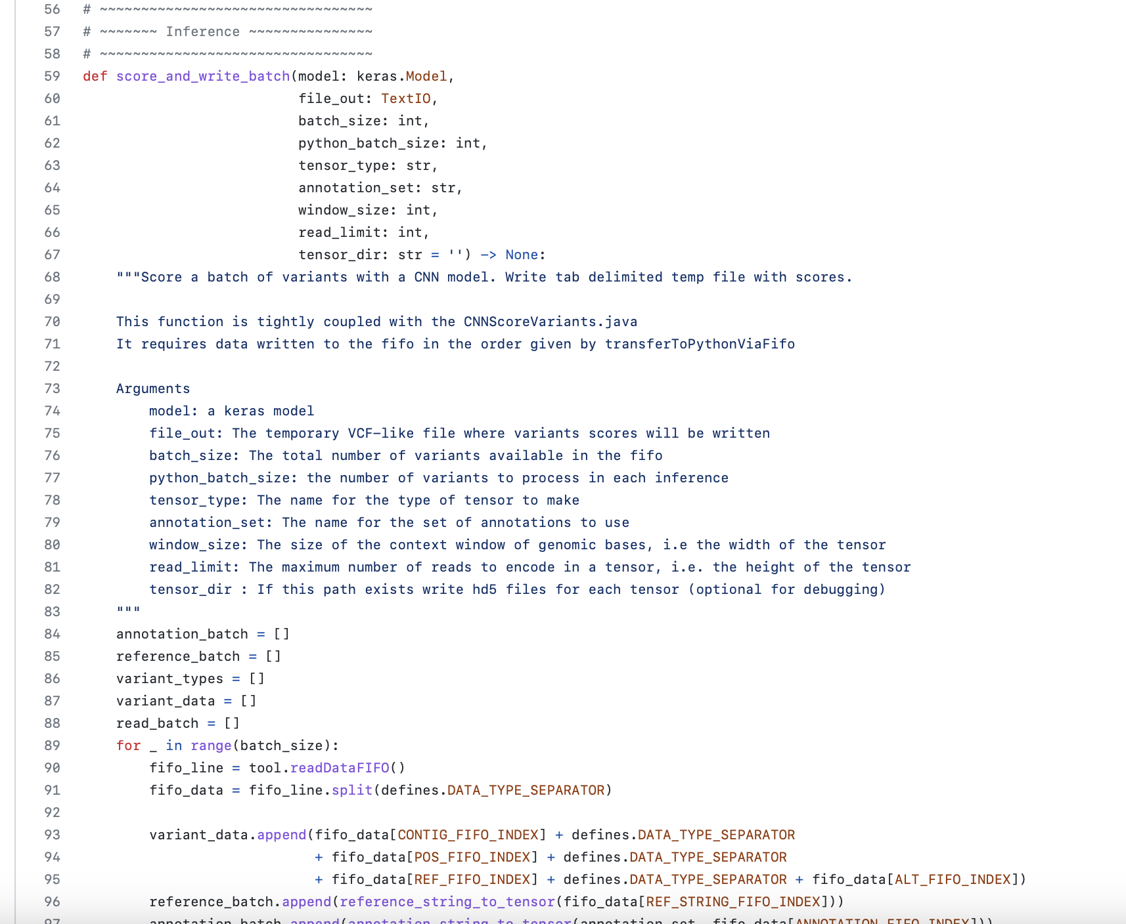
Examples from existing libraries
gatk
(Genome
analysis
toolkit)
Function doing two things
Score and write batch
https://github.com/broadinstitute/gatk
https://github.com/broadinstitute/gatk/blob/master/src/main/python/org/broadinstitute/hellbender/vqsr_cnn/vqsr_cnn/inference.py

Slide 32
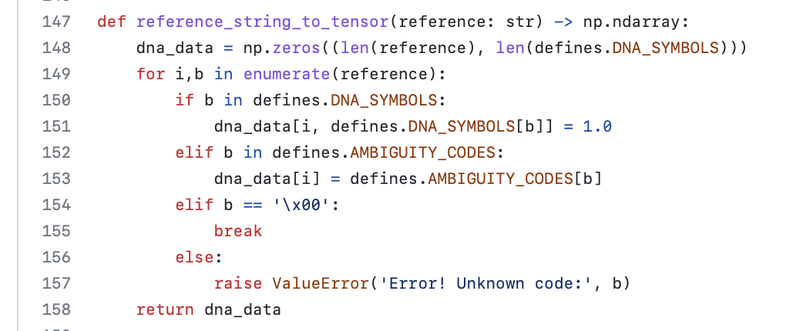
Examples from existing libraries
gatk
(Genome
analysis
toolkit)
https://github.com/broadinstitute/gatk
https://github.com/broadinstitute/gatk/blob/master/src/main/python/org/broadinstitute/hellbender/vqsr_cnn/vqsr_cnn/inference.py
Function started nicely and then used a constant value and a break

Slide 33
Resources
https://www.freecodecamp.org/news/clean-coding-for-beginners/
https://intenthq.com/blog/what-is-good-code-a-scientific-definition/
https://medium.com/@kevin.r.webster/what-is-good-code-11c401e8a1ec
https://workat.tech/machine-coding/tutorial/software-design-principles-dry-yagni-eytrxfhz1fla
https://garywoodfine.com/what-is-clean-code/
https://testdriven.io/blog/clean-code-python/
https://qntm.org/clean
https://realpython.com/python-code-quality/
https://www.freecodecamp.org/news/these-tools-will-help-you-write-clean-code-da4b5401f68e/
https://dzone.com/articles/clean-code-explanation-benefits-amp-examples
https://workat.tech/machine-coding/tutorial/introduction-clean-code-software-design-principles-nwu4qqc63e09
https://workat.tech/machine-coding/tutorial/solid-design-principles-8yu7bjegrxs5
https://cvuorinen.net/2014/04/what-is-clean-code-and-why-should-you-care/
https://www.sonarsource.com/blog/power-of-clean-code/
https://dzone.com/articles/clean-code-explanation-benefits-amp-examples
https://ropensci.org/blog/2020/04/21/rclean/
https://medium.com/swlh/clean-code-famous-quotes-6d62d396cfe0

Slide 34
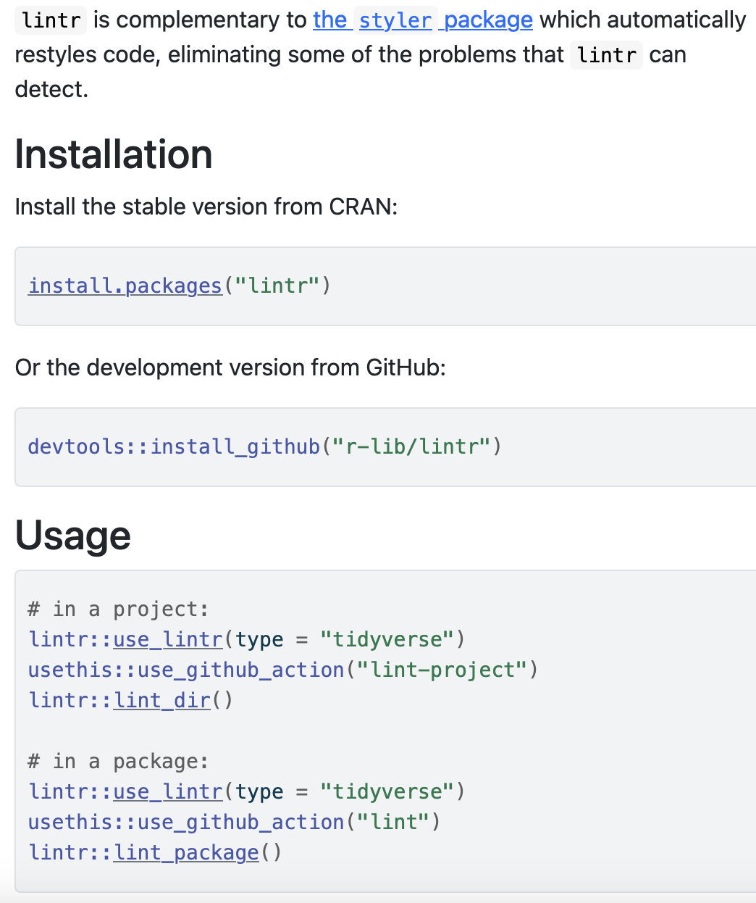
Tools for writing clean code – R
lintr provides static code analysis for R. It checks for adherence to a given style, identifying syntax errors and possible semantic issues, then reports them to you so you can take action.
https://lintr.r-lib.org

Slide 35
Watch lintr in action in the following animation:
https://lintr.r-lib.org

Slide 36
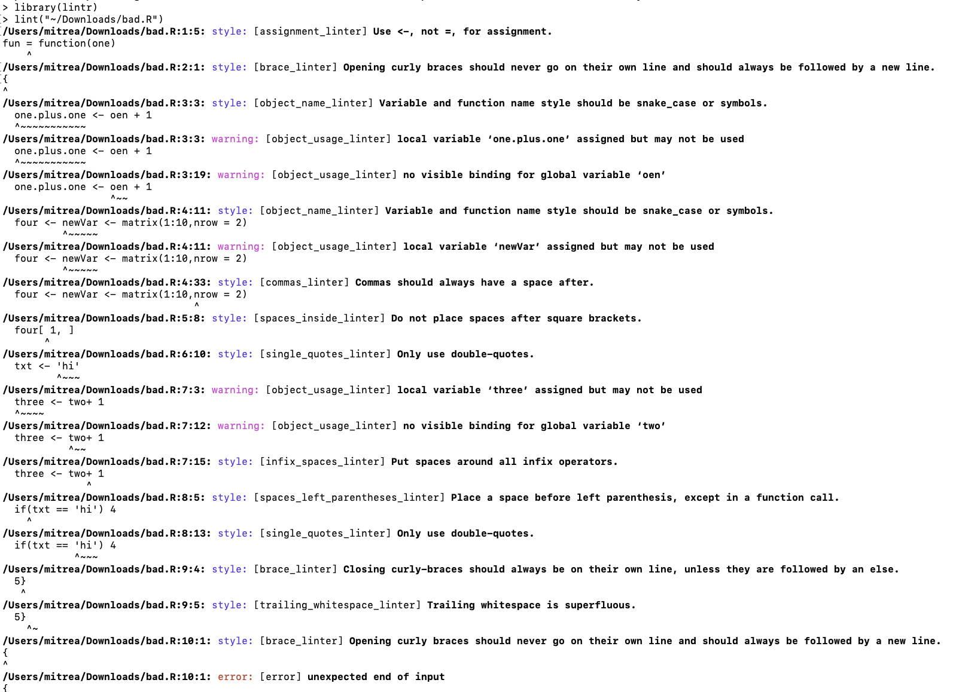

Check lintr output by running the tool yourself
In an R console run the following:
https://lintr.r-lib.org

Slide 37
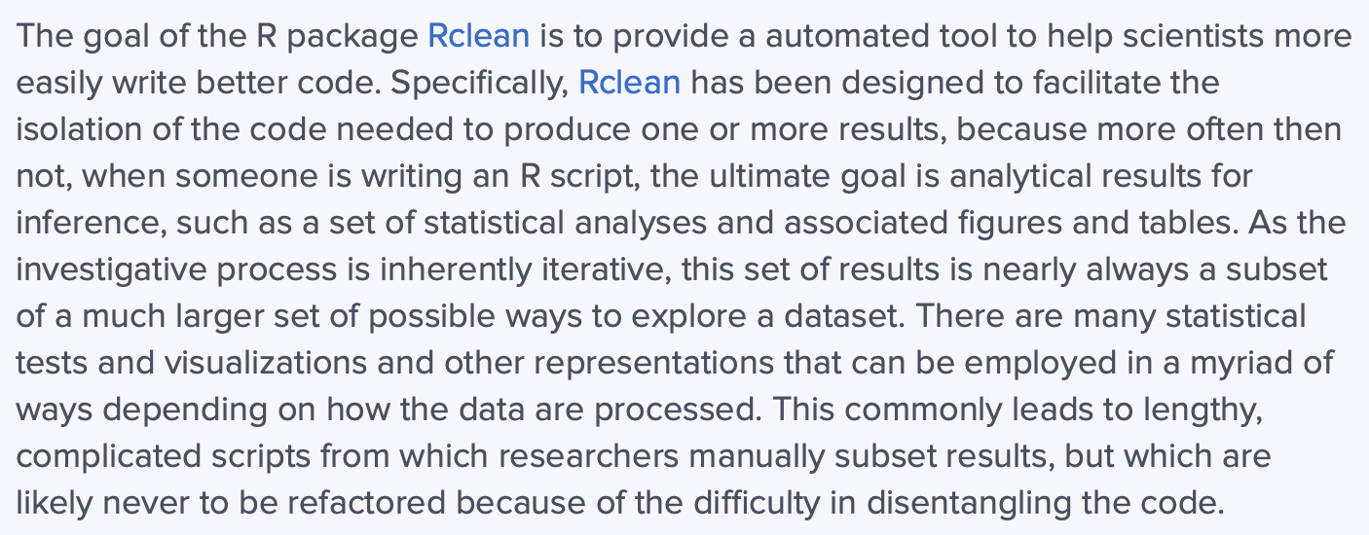
Tools for writing clean code – Rclean
https://ropensci.org/blog/2020/04/21/rclean/

Slide 38
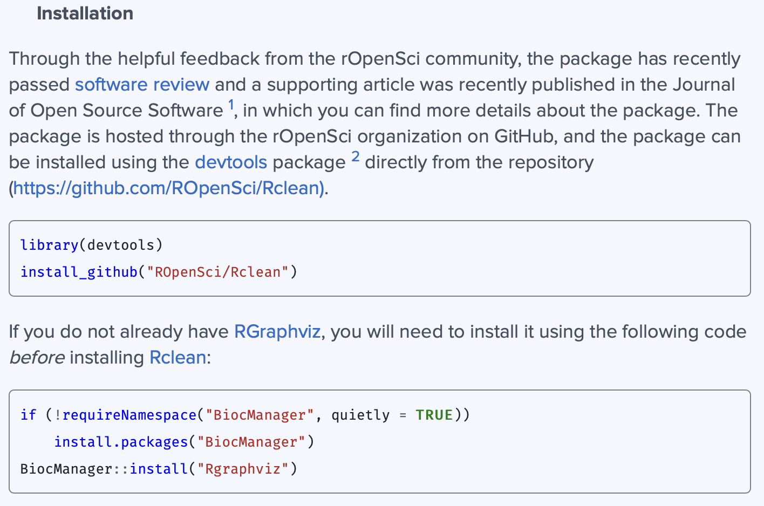
Tools for writing clean code – Rclean
https://ropensci.org/blog/2020/04/21/rclean/

Slide 39
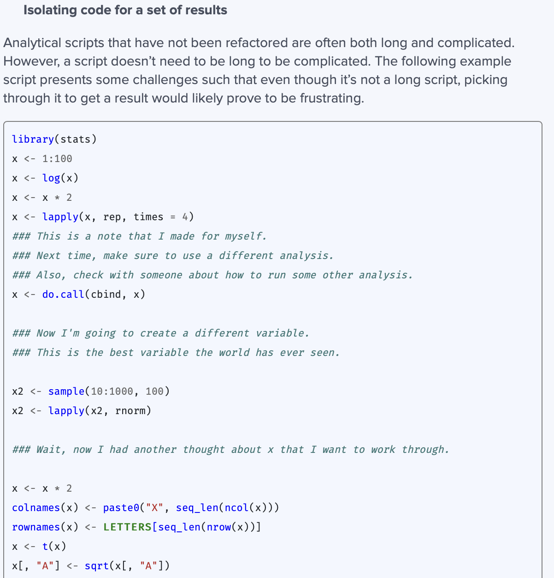
Tools for writing clean code
Rclean
long_script.R
https://ropensci.org/blog/2020/04/21/rclean/

Slide 40
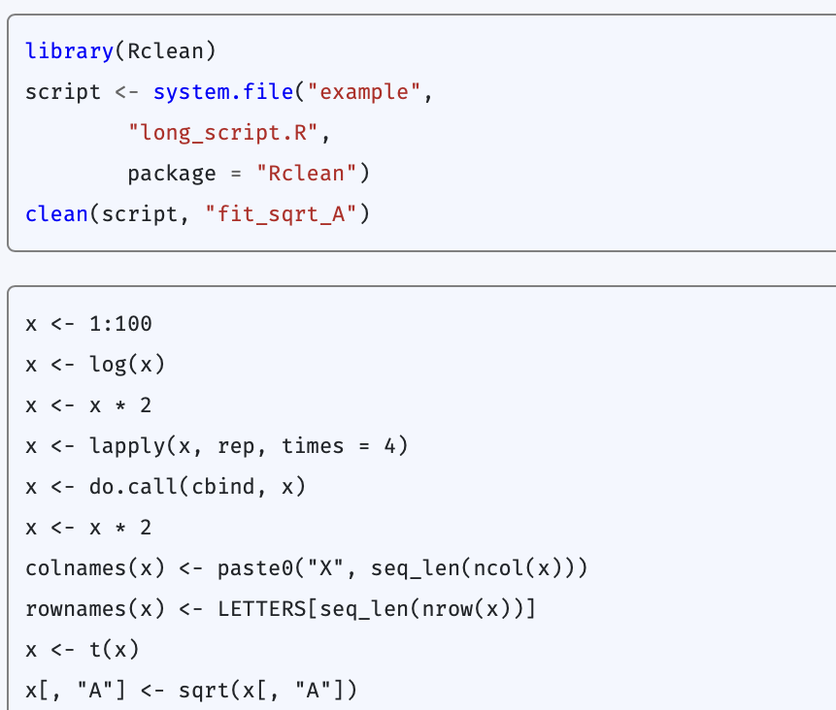
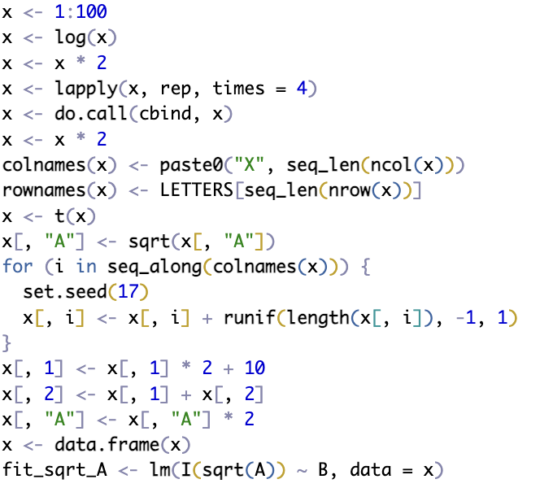
Tools for writing clean code
Rclean – extract code to compute fit_sqrt_A
BiocManager::install("Rgraphviz")
devtools::install_github("ROpenSci/Rclean")
install.packages("prettycode")
library(Rclean)
clean(script = "~/Downloads/long_script.R",
vars = "fit_sqrt_A")
https://ropensci.org/blog/2020/04/21/rclean/

