Slide 1
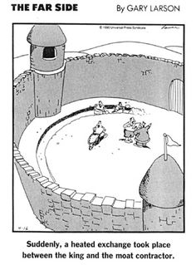
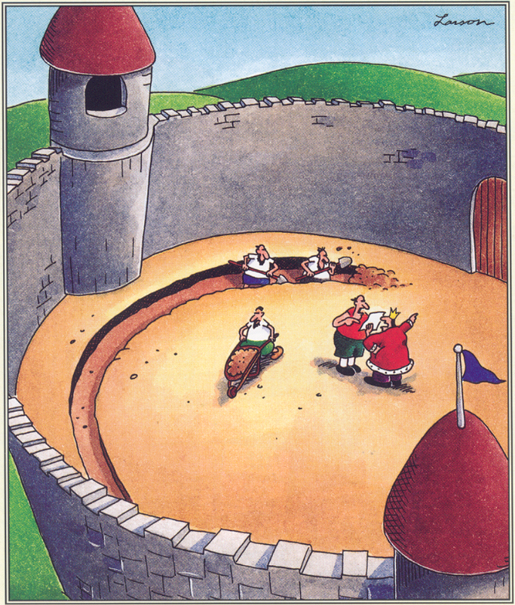
Suddenly, a heated exchange took place between the king and the moat contractor.

Slide 2

DCMB BioComputing BootCamp Day 3, Session I: Introduction to R
Armand Bankhead
bankhead@umich.edu
8/22/2018

Slide 3
Overview
What is R and Why Use it?
Ways to Use R
R as a Statistical Programming Language
Writing and Running R Scripts
Data Types
Data Structures
Vector and Matrix Operations

Slide 4

What is R?
R is a programming language used for statistical computing and data visualization
Originally designed as an open source alternative to the statistical programming language S
First designed and implemented by Ross Ihaka and Robert Gentlemen in 1993
R code is often freely shared in science using “packages” which are collections of R code
Bioconductor is a project that oversees a collection of bioinformatics packages (started in 2001)

Slide 5
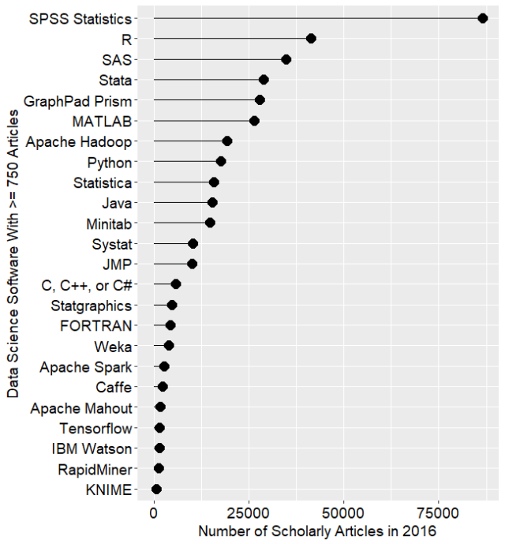
Why R?
Popular in the scientific community
Designed to handle large datasets
CRAN and Bioconductor open source package repositories
Easy to automate and work with interactively
R is a statistical computing language
R is a concise, powerful language—much can be accomplished with few lines of code
R can generate stunning graphics
Well evolved function arguments (if you want to do it you likely can)
Easy to enable others to reproduce your results
Good science should be reproducible!
It’s free!
https://en.wikipedia.org/wiki/R_(programming_language)
http://r4stats.com/articles/popularity/

Slide 6
Ways to Use R
R is available on a variety of platforms: Windows, Mac OS X, Linux
R interactive session: submit R functions directly to R using an R prompt
R command line: execute R scripts from the command line
R GUI: standard integrated environment for R
R Studio: integrated development environment for R

Slide 7
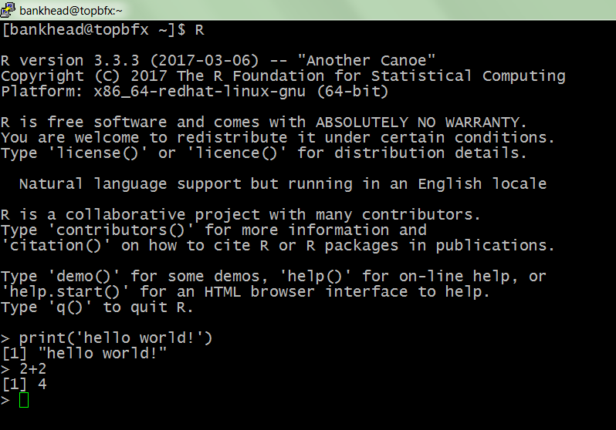
Ways to Use R: R Interactive Session
At the unix/linux command line prompt type R
Any R command should be executable from the command prompt
Useful as an interactive environment for convenience or fast iterative development

Slide 8
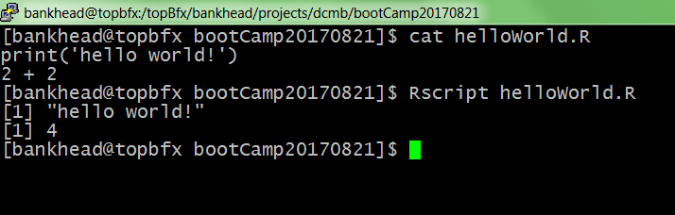
Ways to Use R: Command Line
R scripts can be executed from the command line using the Rscript command or R CMD BATCH
Ideal for automating long running scripts and breaking long scripts up into modular pieces
screen and nohup

Slide 9
Ways to Use R: RStudio
Today we will be using RStudio to run R
RStudio is a great visual environment for learning R. Some of the benefits of using RStudio include:
Integrated development environment (IDE) provides graphical buttons
Code completion
Interactive debugger to debug code
Improved window organization
Visible history

Slide 10
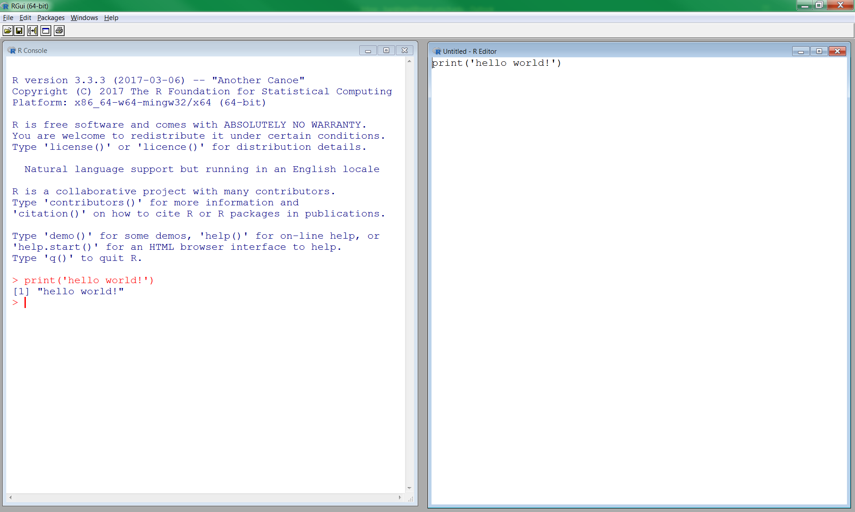
Ways to Use R: Standard R GUI vs. RStudio
Standard R GUI
R Studio
R Console
Code Editor
Same general functionality as RStudio, but simpler interface, steeper learning curve

Slide 11
R as a Statistical Programming Language
R can be used to directly call statistical functions directly from an interactive session
log2
sqrt
log10
rnorm
var
mean
median
min
max
https://cran.r-project.org/doc/contrib/Short-refcard.pdf

Slide 12
Some Simple R Commands
Do it Yourself!
R Prompt!
> 2 + 2
[1] 4
> 3^2
[1] 9
> sqrt(25)
[1] 5
> 2*(1 + 1)
[1] 4
> 2*1 + 1
[1] 3
> exp(1)
[1] 2.718282
> log(2.718282)
[1] 1
> log(10, base = 10)
[1] 1
> log(10
+ , base = 10)
[1] 1
> x = 1:50
> plot(x, sin(x))
Result of the command
Optional argument
Incomplete command
Order of operator
precedence
Exercise: Try these commands

Slide 13
Do it Yourself!
Help from within R
Getting help for a function
> help("log")
> ?log
Searching across packages
> help.search("logarithm")
Finding all functions of a particular type
> apropos("log")
[7] "SSlogis" "as.data.frame.logical" "as.logical" "as.logical.factor" "dlogis" "is.logical"
[13] "log" "log10" "log1p" "log2" "logLik" "logb"
[19] "logical" "loglin" "plogis" "print.logLik" "qlogis" "rlogis"

Slide 14
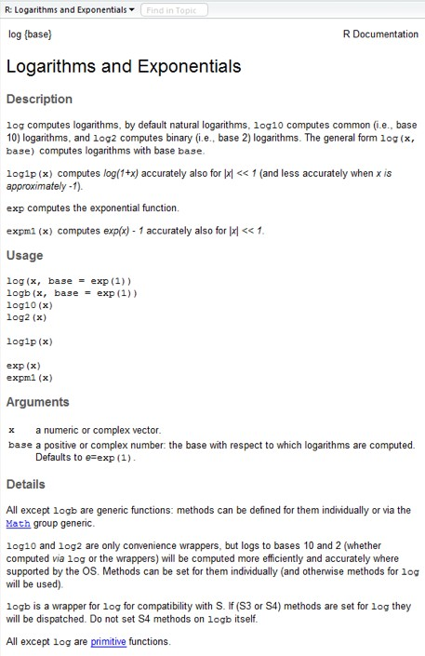
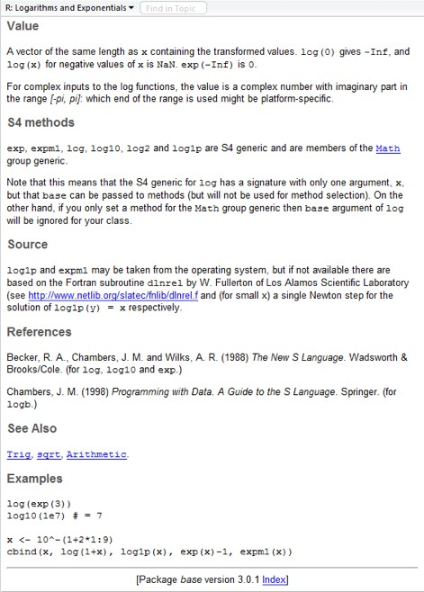
?log
What does the function return
What the function does in general terms
How to use the function
What does the function need
Discover other related functions
Sample code showing how it works

Slide 15
Error Messages
Sometimes the commands you enter will generate errors. Common beginner examples include:
Incomplete brackets or quotes e.g.
> ((4+8)*20 <enter>
+
This returns a + here, which means you need to enter the remaining bracket - R is waiting for you to finish your input.
Press <ESC> to abandon this line if you don't want to fix it.
Not separating arguments by commas e.g.
> plot(1:10 col=“red”)
Typos including miss-spelling functions and using wrong type of brackets e.g.
> exp{4}

Slide 16
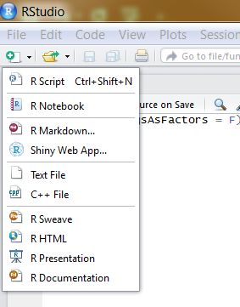
Writing and Running R Scripts
R scripts are simple text files that contain a series of R commands
R Scripts allow us to:
Execute a series of R commands
Provide a written history of our work so that it is reproducible
Share our work with others so that it is reproducible
Good science is by definition reproducible!
Comment your code! Use ‘#’ to include comments
How to create an R Script:
RStudio Select New Icon or type Ctrl-Shift-N
Edit a text file with your favorite text editor

Slide 17
Writing and Running R Scripts
Do it Yourself!
R scripts can be run in several different ways:
Using the source function in an interactive session
> source(‘helloWorld.R’)
In RStudio use the ctrl-alt-r shortcut
In Rstudio select Code -> Run Region -> Run All
From the unix command line use Rscript command
> Rscript helloWorld.R
Exercise: Write a helloWorld.R script and execute it using one of these approaches. Script should contain a single line of code:
print(“Hello World!”)

Slide 18
5 Basic Data Types in R
Do it Yourself!
numeric: decimal values, default
> x = 10.5
> class(x)
[1] “numeric”
integer: integer values
> y = as.integer(3)
> class(y)
[1] “integer”
complex: imaginary numbers
> z = sqrt(as.complex(-1))
> z
[1] 0+1i
> class(z)
[1] “complex”
Exercise: Store data in a variable and use the class() function to test what type of variable it is.
http://www.r-tutor.com/r-introduction/basic-data-types
Notes:
Complex # applications: studying electromagnetic fields, solving complex integration problems

Slide 19
5 Basic Data Types in R
Do it Yourself!
logical: TRUE or FALSE values. Also T or F
> x = 1
> y = 2
> z = x > y
> z
class(z)
[1] “logical”
character: a sequence of ascii character values. Characters may be surrounded by single or double quotes!
> x = “Joe”
> class(x)
[1] “character”
Exercise: store data in a variable and use the class() function to test what type of variable it is.
http://www.r-tutor.com/r-introduction/basic-data-types

Slide 20
Useful Character Variable Functions
paste() : combine together variables into a single character variable
strsplit() : split a character variable up using a delimiter
sub() : substitute a single regular expression match with a character sequence
gsub() : substitute multiple regular expression matches with a character sequence
grep() : search a vector of character variables for a regular expression pattern
Use help to find out more about how these functions work
e.g. ?paste

Slide 21
R Data Structures
R is designed to work with large amounts of data
Collections of variables may be organized into 6 data structures:
homogenous = all data types the same
heterogeneous = mix of data types
Dimension | Homogeneous Data | Heterogeneous Data
1 | Vector | List
2 | Matrix | Data Frame
N | Array | List

Slide 22
Data Structures: Vector
Vectors contain some number of values of the same type.
Vectors may be created using the combine ‘c’ function
Examples:
> days = c(‘mon’,’tues’,’wed’,’thurs’,’fri’)
> myNumbers = c(1.5,3,4.5,6,7.5)
Vectors may also be created as sequences using the ‘:’ operator
Examples:
> 1:5
[1] 1 2 3 4 5

Slide 23
Data Structures: Vector
> days = c(‘mon’,’tues’,’wed’,’thurs’,’fri’)
> myNumbers = c(1.5,3,4.5,6,7.5)
Vectors can be indexed using square brackets
> favoriteDay = days[5]
> favoriteDays = days[2:5]
Negative indexes return all but the value subtracted!
> favoriteDays = days[-1]
> favoriteDays
[1] “tues” “wed” “thurs” “fri”
Note: R data structures are ones-based. The first value in a vector is indicated by [1].

Slide 24
Data Structures: Vector
> days = c(‘mon’,’tues’,’wed’,’thurs’,’fri’)
> myNumbers = c(1.5,3,4.5,6,7.5)
Additional vector operations:
> sort(myNumbers)
[1] 1.5, 3, 4.5, 6, 7.5
> sort(myNumbers,decreasing=TRUE)
[1] 7.5, 6, 4.5, 3, 1.5
> rev(days)
[1] “fri” “thurs” “wed” “tues” “mon”
> length(days)
[1] 5

Slide 25
Data Structures: Matrix
Matrices are two dimensional data tables that contain the same data types
A data matrix may be created several ways:
> m1 = matrix(1,nrow=2,ncol=2)
> m2 = matrix(1:4,nrow=2,ncol=2)
> m3 = rbind(c(1,2),c(3,4))
Matrices may have row and column names
> colnames(m2) = c(‘A’,’B’)
> rownames(m2) = c(‘POS’,’NEG’)
> m2
A B
POS 1 3
NEG 2 4

Slide 26
Data Structures: Matrix
Do it Yourself!
> m4 = matrix(1:300,nrow=100,ncol=3)
> colnames(m4) = c(‘A’,’B’,C’)
> dim(m4)
100 3
We can access one or more values of a matrix by specifying row and column values
> m4[1,2]
[1] 101
> m4[1:2,1:2]
[,1] [,2]
[1,] 1 101
[2,] 2 102
R has head() and tail() commands like unix!
Exercise: Construct m4 and use head() and tail()

Slide 27
Vector and Matrix Operations
Do it Yourself!
R has a rich set of vector and matrix operators
> v1 = c(1,2,3)
> m1 = matrix(1:4,nrow=2,ncol=2)
Simple math operations are applied to all values
> v1 * 2
[1] 2,4,6
Standard functions are applied to each value
> log2(v1)
[1] 0.000000 1.000000 1.584963
Linear algebra transformations are well supported
t(m1) will return the transpose of m1
m1 * m1 will perform element-wise multiplication
m1 %*% m1 will perform matrix multiplication
Exercise: Use m1 * m1 and m1 %*% m1. How do the answers differ?

Slide 28
Special Values in R
Do it Yourself!
NA values are not available or missing values
Often functions will specify how to treat NA values
is.na() will return TRUE/FALSE
NaN values are not a number
is.nan() will return TRUE/FALSE
Inf and –Inf values are computationally too large or too small
is.infinite() will return TRUE/FALSE
> 2 ^ 1024
[1] Inf
NULL values are empty and often used to represent zero-length objects
is.null() will retrun TRUE/FALSE
> dim(c(1,2,3))
NULL
Exercise: Calculate 1/0 in R. Calculate log2(-1). Calculate log2(0). What does R return?
Notes:
as.integer(c(1,2,”asdf”))

Slide 29
Data Structures: List
A list is a “generic vector” that may contain a variety of data types and data structures
> y = list(1, 17, 4:5, “a”)
List values may be named
> y = list(a = 1, 17, b = 4:5, c = “a”)
> y
$a
[1] 1
[[2]]
[1] 17
$b
[1] 4 5
$c
[1] “a”

Slide 30
Data Structures: List
> y = list(a = 1, 17, b = 4:5, c = “a”)
A list value may be accessed using a single index
> y[[3]]
[1] 4 5
List values may be accessed using names
> y$b
[1] 4 5
Multiple list values may be accessed using an index but the result will be a list
> y[1:3]
$a
[1] 1
[[2]]
[1] 17
$b
[1] 4 5

Slide 31
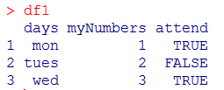
Data Structures: Data Frame
A data frame is a special kind of list containing multiple vectors of the same length
Vectors may contain multiple data types
This data structure is commonly used when reading, writing data
Data frames may be created using the data.frame function:
> days = c(‘mon’,’tues’,’wed’)
> myNumbers = c(1,2,3)
> attend = c(TRUE,FALSE,TRUE)
> df1 = data.frame(days,myNumbers,attend)

Slide 32
Data Structures: Data Frame
Do it Yourself!
Data frames represent a powerful hybrid between a matrix and a list
We can use indexes to access specific columns
We can use ‘$’ column names to access individual vectors
There are several data frame examples built into R
Exercise: Type mtcars at your R prompt. What columns does this data frame contain? What is the average mpg of all cars? (hint: use the mean() function)

Slide 33
References and Additional Resources
Slides Partially Sourced from Barry Grant and Hui Jiang
Gentleman, Robert. R Programming for Bioinformatics. CRC Press, 2009.
DataCamp. Online tutorials using R in your browser.
< https://www.datacamp.com/ >
R for Data Science. A new O’Reilly book that will teach you how to do data science with R, by Garrett Grolemund and Hadley Wickham.
< http://r4ds.had.co.nz/ >

