Slide 1
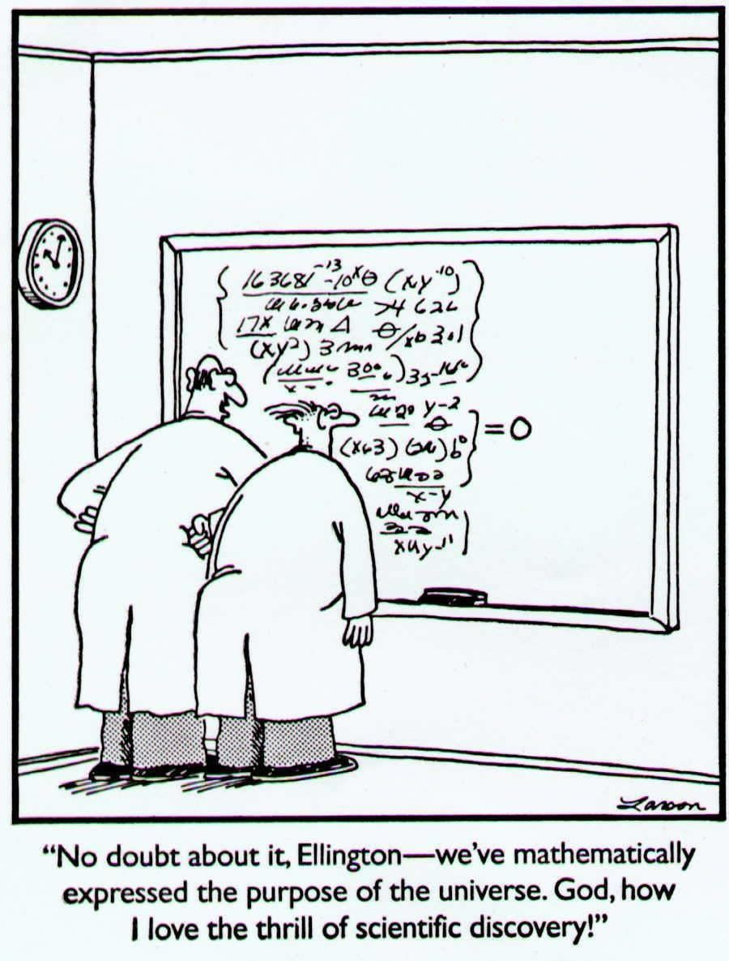

Slide 2

DCMB BioComputing BootCamp Day 3, Session IV: Working with Packages from CRAN and Bioconductor
Armand Bankhead
bankhead@umich.edu
8/22/2018

Slide 3
Overview
CRAN
Bioconductor
Package Installation
Package Documentation
Package Source Code
Example: BioMart bioconductor package

Slide 4
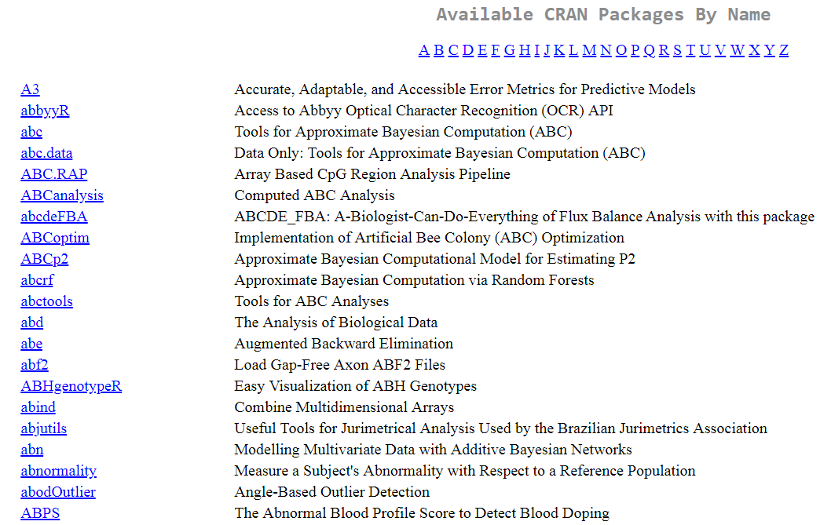
CRAN: The Comprehensive R Archive Network
CRAN is a website dedicated to hosting the R language and R packages
packages are shared collections of R code
There are currently 12,884 available packages
search via google
table (index) of available packages
CRAN Task Views
CRAN Package Table

Slide 5
What do R Packages Contain?
R code
Help pages
Data: example data sets included for demonstration purposes
Other documentation
vignettes: documents that integrate code and how to perform a specific task
tutorials
Code written in other languages (e.g. C, FORTRAN)
Directives used to help install the package

Slide 6
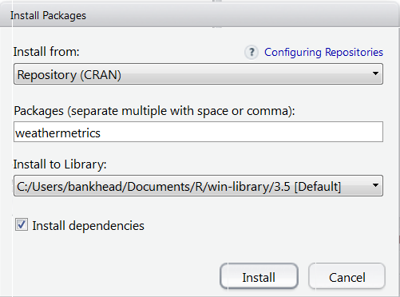
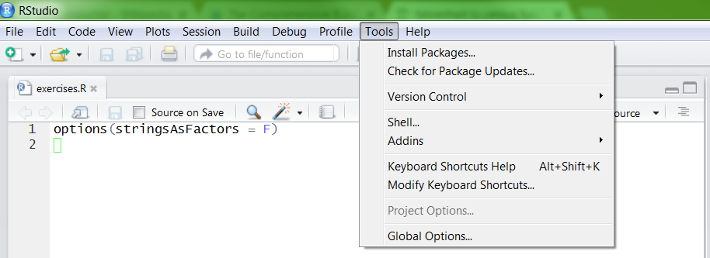
Ways to Install a Package
On the command prompt type:
> install.packages('weathermetrics')
In RStudio select Tools -> Install Packages from the top of the main screen

Slide 7
Useful Commands for Exploring R Packages
Try it out!
search() – lists packages currently loaded
sessionInfo() – lists packages with version #’s
packageDescription() – prints brief description
install.packages() - install an R package from CRAN
update.packages() – checks for package updates and installs updates if necessary
available.packages() – returns packages that are available from CRAN
installed.packages() – returns packages that are installed on the user’s system
Exercise: What packages are currently loaded? What packages are installed on your computer?

Slide 8

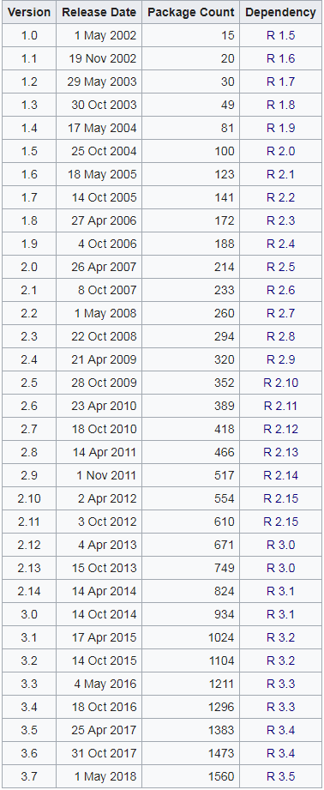

R packages and datasets for working with high-throughput genomic data
http://bioconductor.org
Bioconductor was started in Fall 2001
Two releases each year
v3.7 has 1,560 packages
Packages undergo formal initial review and continuous automated testing

Slide 9
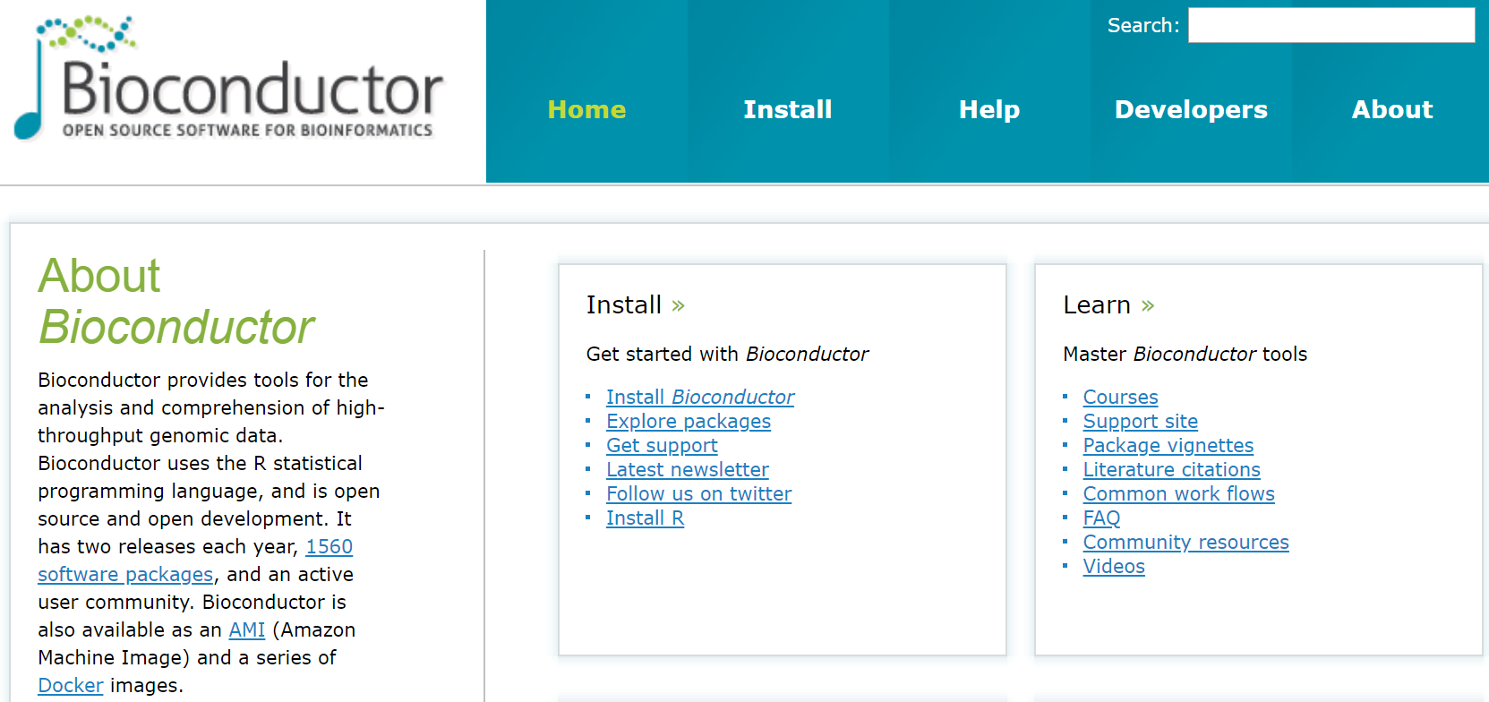
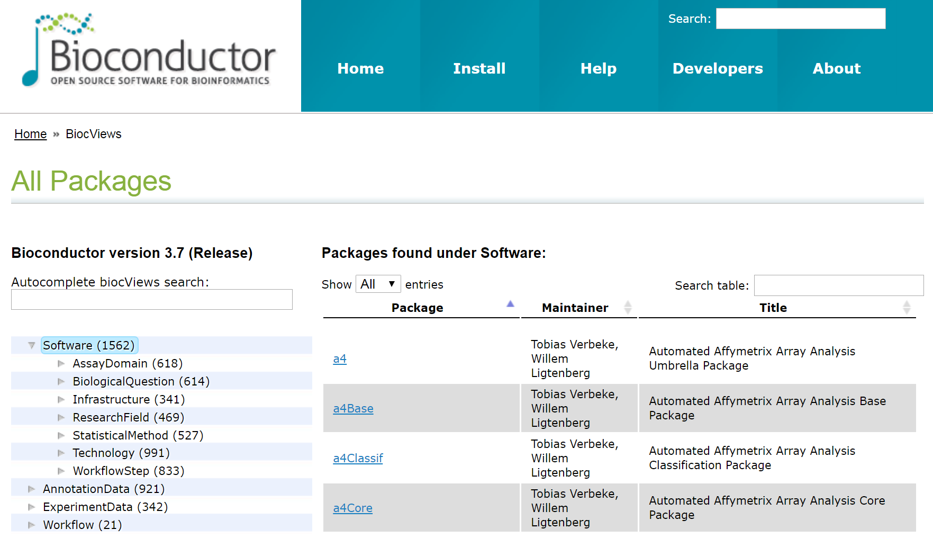
How to Install Bioconductor Packages
Try it out!
First install core packages:
> source("https://bioconductor.org/biocLite.R")
> biocLite()
Next install specific packages of interest:
> biocLite("biomaRt")
Exercise: Install Bioconductor. Install the biomaRt package. This may take time…

Slide 10

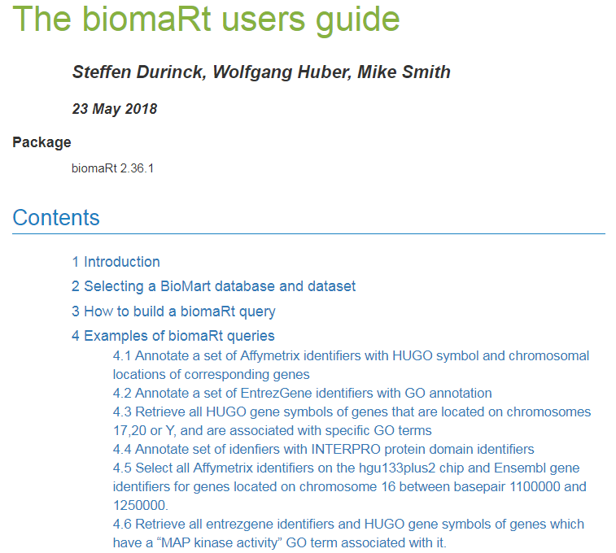
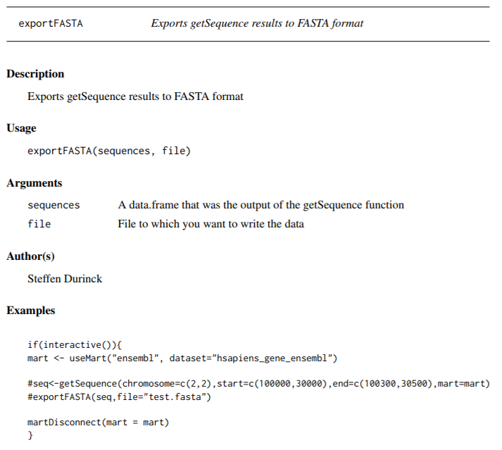
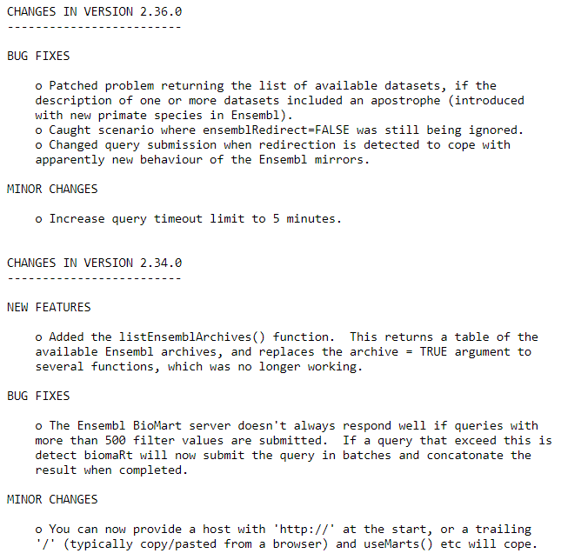
Package Reference Manuals, Vignettes, and News
Vignette
User’s Manual
Package News

Slide 11
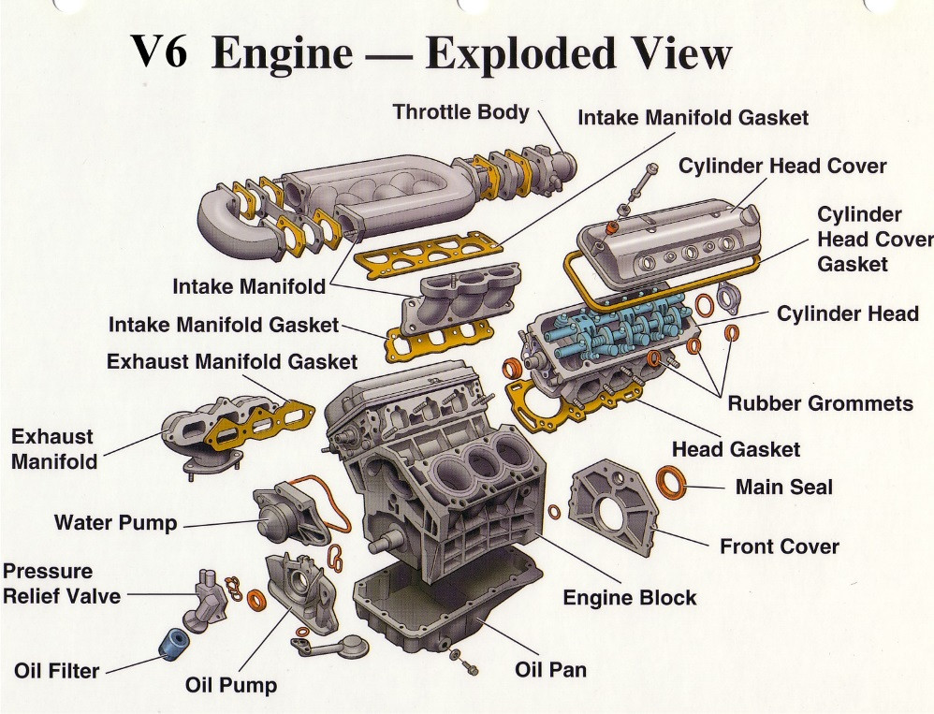
Package Source Code
What if you wanted to find out more about how a package is implemented?
By default the binary form of a package is downloaded and installed
Download the “source” version of the package to view the code
Notes:
https://mechanical-engg.com/gallery/image/1063-v6-engine-exploded-view/

Slide 12
Exercise: Download the source code package for weathermetrics and view the code for the function fahrenheit.to.celsius()
Try it out!
Here are two ways you can download the source code for the weathermetrics package:
Go to https://cran.r-project.org/web/packages/weathermetrics/index.html and download “Package source”
download.packages(pkgs = "weathermetrics", destdir = ".", type = "source")
Use gunzip or winzip to decompress the package
Use grep to find the file with fahrenheit.to.celsius
Open the file and find the function

Slide 13
biomaRt Allows Users to Search Across Genomic Annotation Databases
biomaRt is an R interface to the BioMart software suite (http://biomart.org) that is a repository of inter-connected genome annotation databases
Challenges in genome annotation are a widespread in the field of bioinformatics for several reasons:
Our understanding the genome continues to evolve
Many researchers investigating the genome across the globe may use slightly different conventions
Genome annotation is biased by historical nomenclature
Example: AKT1 also has an Entrez gene ID of 207 and Refseq transcripts called NM_005163.2, NM_001014432.1, NM_001014431.1
Example: AKT1 also has Ensembl transcripts called ENST00000555528.5, ENST00000349310.7, ENST00000407796.6
Durinck et al., Nature Protocols (2009)

Slide 14
Exercise: Retrieve Entrez and Ensembl IDs for AKT1, TP53, EGFR, PIK3CA using biomaRt
Try it out!
Load the package (biomaRt should already be installed from earlier in this session)
> library(biomaRt)
Select a mart and a dataset to query
> ensembl = useMart("ensembl“, dataset = "hsapiens_gene_ensembl")
Use the biomaRt vignette “How to build a biomaRt query” (Section 3) to construct a query
HINT: filters = c('hgnc_symbol')
HINT: attributes = c('hgnc_symbol','entrezgene','ensembl_gene_id‘)
HINT: inputValues = c('AKT1','TP53','EGFR','PIK3CA')
HINT: mart = ensembl

Slide 15
Closing Remarks/Advice
Comment your code
Short programs are better
Plan!
Be prepared to iterate
Make a change
Run
Make another change
Run
…

Slide 16
References
Gentleman, Robert. R Programming for Bioinformatics. CRC Press, 2009.
Slides Partially Sourced from Barry Grant

