Slide 1
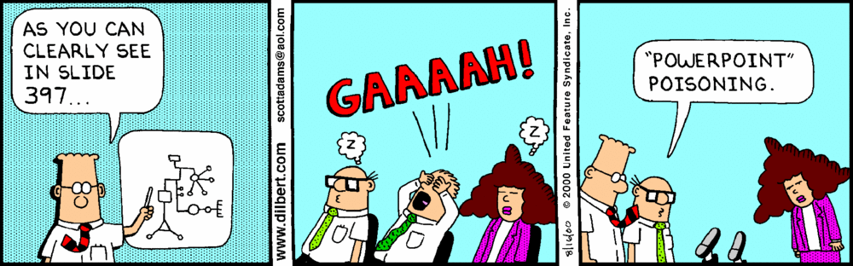

Slide 2

DCMB BioComputing BootCamp Day 3, Session II: R Control Structures and Functions
Armand Bankhead
bankhead@umich.edu
8/22/2018

Slide 3
Overview
Working Directory
Reading and Writing Data in R
Factors
Using Indexes
Merging Data Frames
Functions
Program Control Structures

Slide 4

Use Directory Structure to Organize Your Work
Imagine if all of your input data, code, output data, images files were all in the same directory!
Sounds like a mess!
There is no perfect/standard directory structure, but here are a few suggestions:
Create a unique directory for each project
Break your code up into parts
Write output (i.e. tables, images) to a separate sub-directory

Slide 5
The R Working Directory
Do it Yourself!
R executes commands from a ‘working directory’
scripts, input files, output files
absolute and relative directories may be specified
Use getwd() to display current working directory
> getwd()
[1] “C:/Users/bankhead/Documents”
Use setwd() to change your working directory
> setwd(“../Desktop/armandsFolder”)
Use dir() to list files and folders in your working directory
Exercise: Create a directory/folder outside of R and use the setwd() function to navigate to that directory

Slide 6
Writing Data To Text Files
Do it Yourself!
First lets create something to write as a text file
> m4 = matrix(1:300,nrow=100,ncol=3)
> colnames(m4) = c(‘A’,’B’,C’)
> m4 = data.frame(m4,D = c(rep(‘X’,50),rep(‘Y’,50)))
Use write.table() to write data to a file
Many arguments! Use ?write.table to find out more
> write.table(m4, ‘myData.txt’, quote=F, row.names=F, sep=“\t”)
> dir()
[1] “myData.txt”

Slide 7
Reading Data From Text Files
Do it Yourself!
Use read.delim() to read data from a file
> m5 = read.delim(‘myData.txt’)
> dim(m5)
> head(m5)
By default the first row is read in as column names
Our data appears to be read in correctly but R has converted our text data into something called a factor
> m5$D

Slide 8
Factors in R
Do it Yourself!
Factors are used to break complex data up into discrete categories
This comes in handy when we need to group samples for statistical analysis (e.g. fitting linear models)
Adding new values can generate errors!
By default R will convert non-numeric data into factors
Use options(stringsAsFactors=FALSE) in your scripts to over-ride!
> options(stringsAsFactors = FALSE)
> m5 = read.delim(‘myData.txt’)
> m5$D
Notes:
Fat

Slide 9
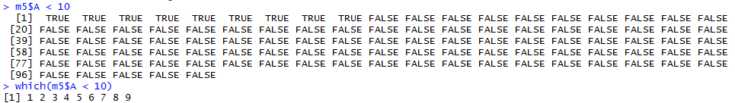
Using Indexes
Indexing is a powerful tool for filtering large data frames or matrices
There are two central ways to index:
Logical vectors:
> m5$A < 10
[1] TRUE TRUE TRUE ….
Integer vectors:
> which(m5$A < 10)
[1] 1 2 3 4 5 6 7 8 9

Slide 10
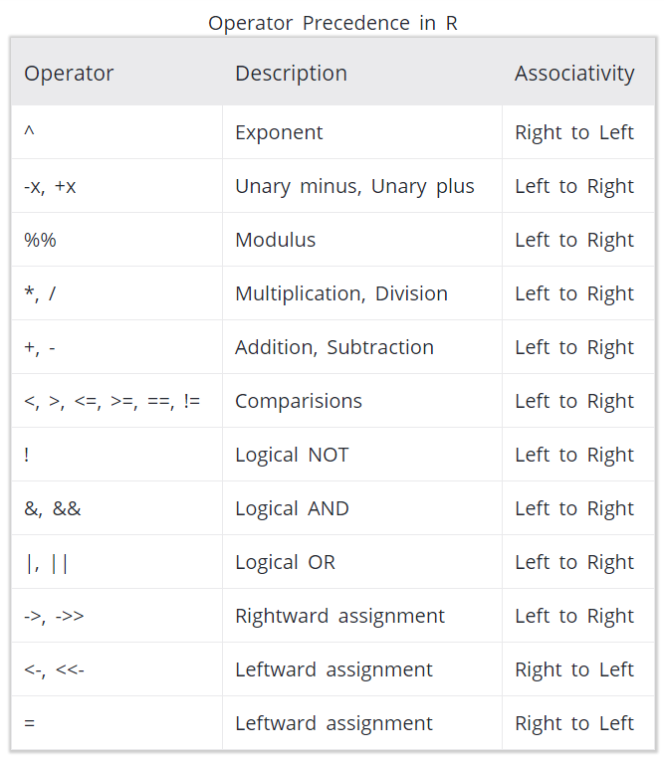
Using Indexes
We can combine multiple conditions use the &, |, and parens
> m5$A < 10 & M5$B > 205
> m5$A < 10 & M5$B > 205 | M5$D == ‘Y’
> m5$A < 10 | m5$D == ‘Y’ & m5$A < 55
Be aware of operator precedence
Use the sum command to count how many positive values survive
Indexes can be used to index vectors, matrices, or data frames
> idx = m5$A < 10 & m5$B > 205
> subMatrix = m5[idx,]
https://www.programiz.com/r-programming/precedence-associativity

Slide 11
Merging Data Frames
A common programming task in bioinformatics is to “join” two tables:
Joins are performed in R using the merge() function
Requires a common column between tables (e.g. gene) be specified using the “by” parameter
Multiple types of joins (e.g. inner, outer) are possible, use ?merge to find out more
Table X
Table Y
Table Z
Gene | RPKM
AKT1 | 100.03
EGFR | 32.18
Gene | Entrez
AKT1 | 207
EGFR | 1956
Gene | Entrez | RPKM
AKT1 | 207 | 100.03
EGFR | 1956 | 32.18
20,000
rows
…
…
…
…
…
…
…
ZXDA | 78.34
ZXDA | 7789
ZXDA | 7789 | 78.34

Slide 12
Merging Data Frames
Do it Yourself!
Use merge() to join together data from two different matrices or data frames
Important: both matrices must contain unique row identifiers to join on!
> df1 = data.frame(gene = c(‘AKT1’,’ERBB2’,’EGFR’), log2rpkm = c(5,.5,10))
> df2 = data.frame(gene = c(‘AKT1’,ERBB2’,’EGFR’), entrez = c(207,2064,1956))
> combined = merge(df1,df2,by=‘gene’)
Exercise: What happens if gene is not unique?
Add a duplicate gene name and find out.

Slide 13
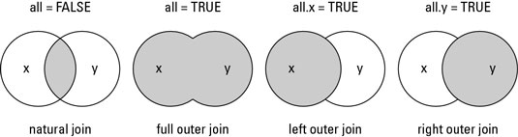
Merging Data Frames: Types of Joins
natural join: intersection of common rows
full outer join: union of rows
left outer join: all x rows represented
right outer join: all y rows represented
https://www.dummies.com/programming/r/how-to-use-the-merge-function-with-data-sets-in-r/

Slide 14
Functions
Functions allow us to break our R scripts up into modular pieces
Modular program design has already been discussed in unix (day1) and python (day2)
Benefits to our code include:
Program design
Readability
Re-use
Trouble-shooting
Functions are specified using the ‘function’ key word
myFunction = function(arg1,arg2,…) {
statements
}
When multiple arguments are specified R will match first by name, prefix matching arguments, then by position

Slide 15
Functions
Do it Yourself!
> sq1 = function(x) return(x * x)
> sq1 = function(x) x * x
> randomValues = rnorm(1000)
> randomValuesSquared = sq1(randomValues)
> myAnalysis = function(randomValues, randomValuesSquared) {
vector1 = randomValues
vector2 = randomValuesSquared
result = cor(vector1,vector2)
}
Exercise: Create an R script contains the myAnalysis function
What correlation value is generated?

Slide 16
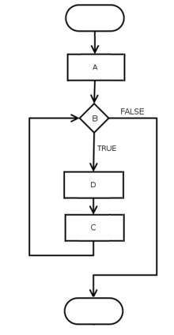
Program Control Structures
R program flow is not always a linear sequence of operations
Besides functions, program flow may be modified using control structures
apply
if/else/else if
for
while
Other important R commands that can alter program flow:
break – exit loop
next – skip to the next iteration
start
end
program flowchart

Slide 17
Program Control Structures: apply
Do it Yourself!
Use the apply function to iterate through a data.frame, matrix, or arrays
Use lapply() to iterate through lists or vectors
apply function takes at least 3 values
data frame/matrix
1 or 2 indicating rows or columns respectively
function to ‘apply’ to each value (standard or custom)
> m4 = matrix(1:300,nrow=100,ncol=3)
> rowMeans = apply(m4,1,mean)
> columnMeans = apply(m4,2,mean)
Exercise: Run the code above.
What data structures are rowMeans and columnMeans?
Are rows are average larger or columns?

Slide 18
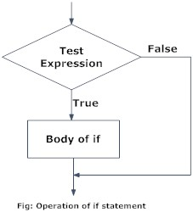
Program Control Structures: if/else/else if
‘if’ statements allow us to condition our program flow
basic syntax:
if(condition) {
statement1
}
else if(condition){
statement2
}
else {
statement3
}
conditions must be TRUE or FALSE
statements are a series of R commands
https://www.programiz.com/r-programming/if-else-statement

Slide 19
Program Control Structures: if/else/else if
Example if statement
m5 = read.delim(‘myData.txt’)
if(ncol(m5) == 4 && is.factor(m5$D)) {
print(‘factors!’)
}
else {
print(‘no factors!’)
}
Multiple conditions can be combined using:
II OR
&& AND
! NOT
() parens
https://www.programiz.com/r-programming/if-else-statement

Slide 20
Program Control Structures: for
‘for’ loops allow us to iterate our code
Basic syntax:
for(counter in vector) {
statements
}
‘vector’ can represent a list of numbers (e.g. 1:10) or arbitrary data types (e.g. c(‘mon’,’tues’,’wed’,…))

Slide 21
Program Control Structures: for
Example #1:
for(i in 1:5) {
print(i)
}
Example #2:
m5 = read.delim(‘myData.txt’)
for(column in 1:ncol(m5)) {
print(mean(m5[,column]))
}
‘break’ can be used to exit loop structure
We could have used apply!

Slide 22
Program Control Structures: while
while() loops allow iteration until a condition is met
Basic syntax:
while(condition) {
statements
}
To exit the loop structure
‘break’ can be used to exit loop structure
set condition to be false

Slide 23
Exercises
Do it Yourself!
Write a function that converts Fahrenheit to Celsius
input: temperature in Fahrenheit
output: temperature in Celsius
Write a program that builds a data frame containing degrees Fahrenheit to Celsius for -30 to 130 degrees Fahrenheit
Write the table from #2 to a tab-delimited text file
Notes:
CO2 dataset = relationship between plant CO2 uptake and impact of cold. Plants sourced from Mississippi and Quebec. Grass species Echinochloa crus-galli.

Slide 24
Bonus Exercise (if time!)
Do it Yourself!
The unique() function can be used to get the unique values in a vector
The CO2 data set contains 84 measurements from an experiment comparing the C02 uptake of Echinochloa crus-galli sourced from Quebec and Mississippi. Plants were measured chilled and nonchilled.
Using the CO2 data set determine if the average expression of chilled plants from Quebec is higher than plants from Mississippi.
Notes:
CO2 dataset = relationship between plant CO2 uptake and impact of cold. Plants sourced from Mississippi and Quebec. Grass species Echinochloa crus-galli.

Slide 25
Closing Remarks/Advice
Comment your code
Short programs are better
Plan!
Be prepared to iterate
Make a change
Run
Make another change
Run
…

Slide 26
References
Gentleman, Robert. R Programming for Bioinformatics. CRC Press, 2009.
Slides Partially Sourced from Barry Grant and Hui Jiang

