Slide 1

Case Study 1: Predicting Employee Attrition
Doing Data Science 6306 Drew Nunnally 03/03/2025

Slide 2
Project Overview
DDSAnalytics & Frito Lay Partnership
DDSAnalytics specializes in talent management solutions for Fortune 100 companies.
Frito Lay hired DDSAnalytics to analyze and predict employee attrition (turnover).
Project Goals
Identify factors leading to employee attrition.
Predict which employees may leave.
Estimate cost or savings impact of retention strategies.
Key Cost Insights
Replacing an employee can cost 50%–400% of their salary.
Providing incentives (about $200 per employee) may prevent attrition.
Data & Expectations
Dataset: CaseStudy1-data.csv (to be analyzed in R).
Pinpoint the top three attrition factors (supported by analysis).
Explore additional trends/observations with robust experimentation and visualization.

Slide 3

Data Description
Overall Structure: 870 rows, 36 columns
Variable Types: 9 character (categorical), 27 numeric
Missing Data: None detected
Highlights:
Age: Averages ~37 years, ranging from 18 to 60
Monthly Income: Averages ~$6,390, ranging up to nearly $20,000
Job Satisfaction & Environment Satisfaction: Four-level categorical scales
Other Factors: Distance From Home, Years At Company, and more

Slide 4
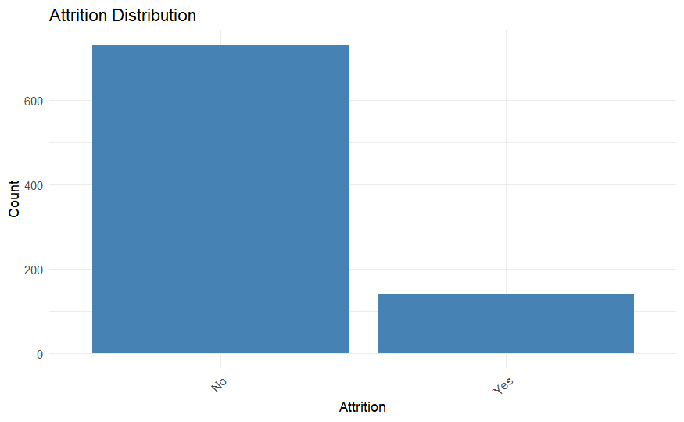
Initial Exploratory Data Analysis (1)
Notes:
No 730 and Yes 140

Slide 5
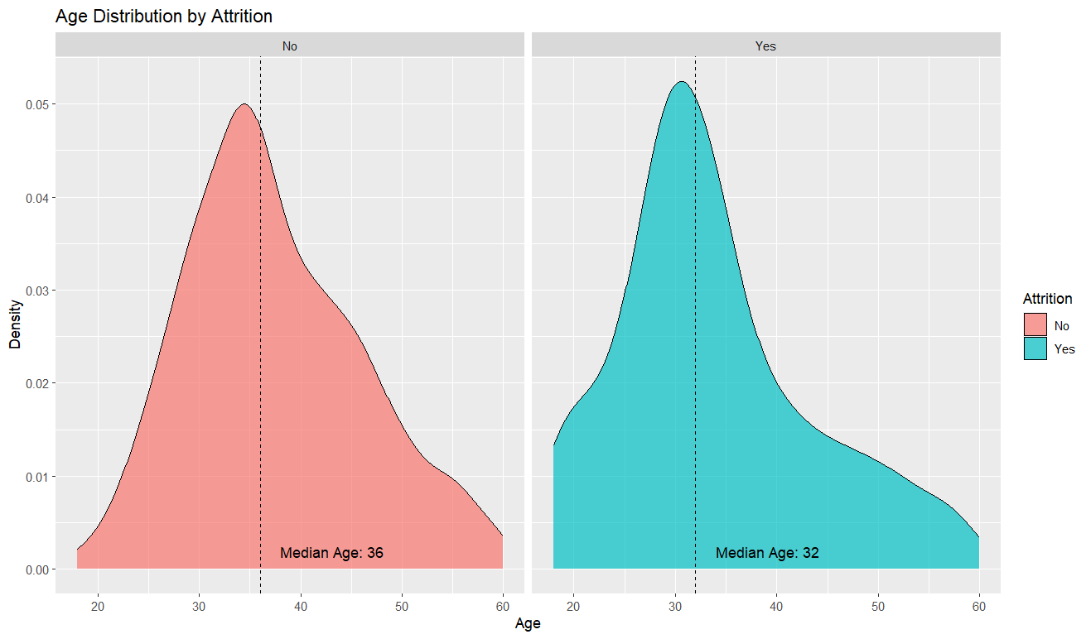
Initial Exploratory Data Analysis (2)

Slide 6
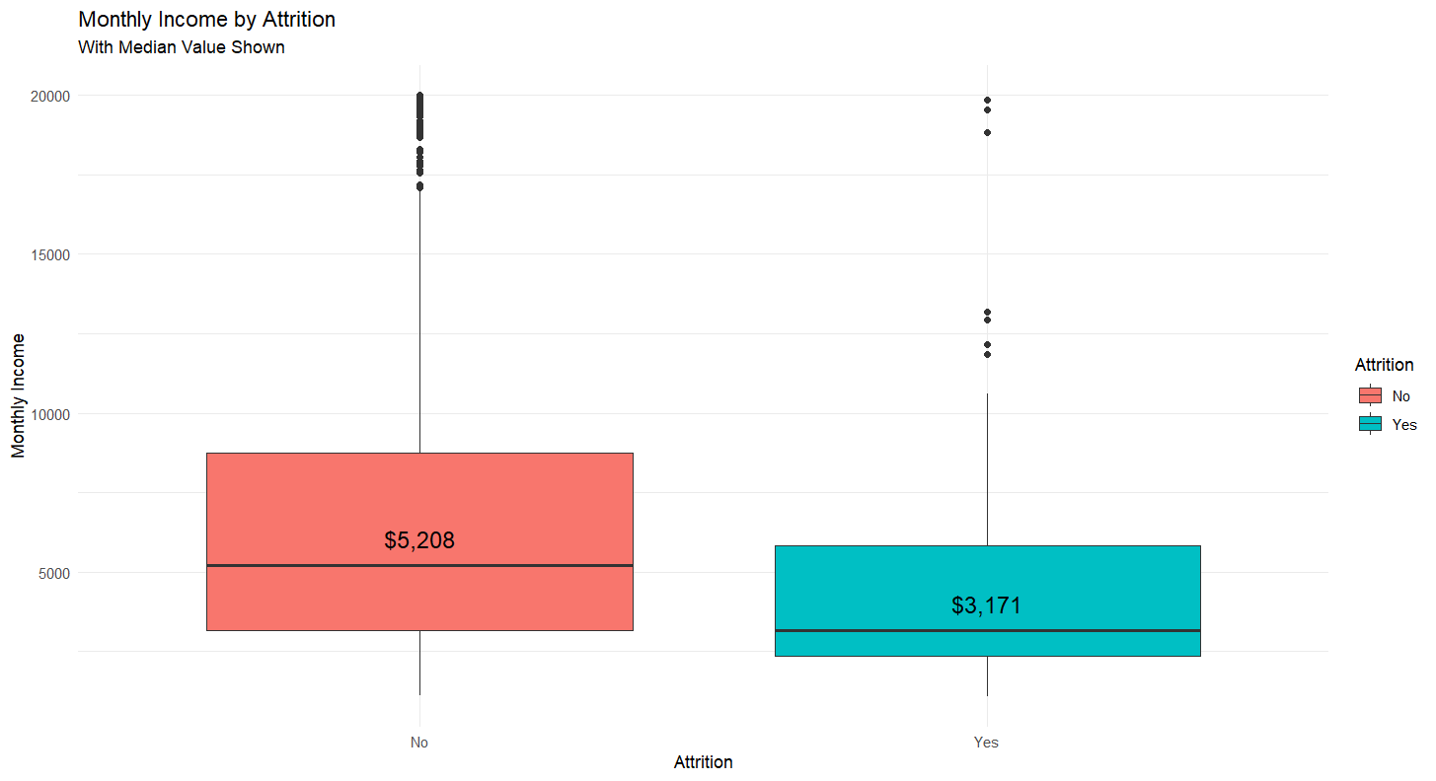
Initial Exploratory Data Analysis (3)

Slide 7
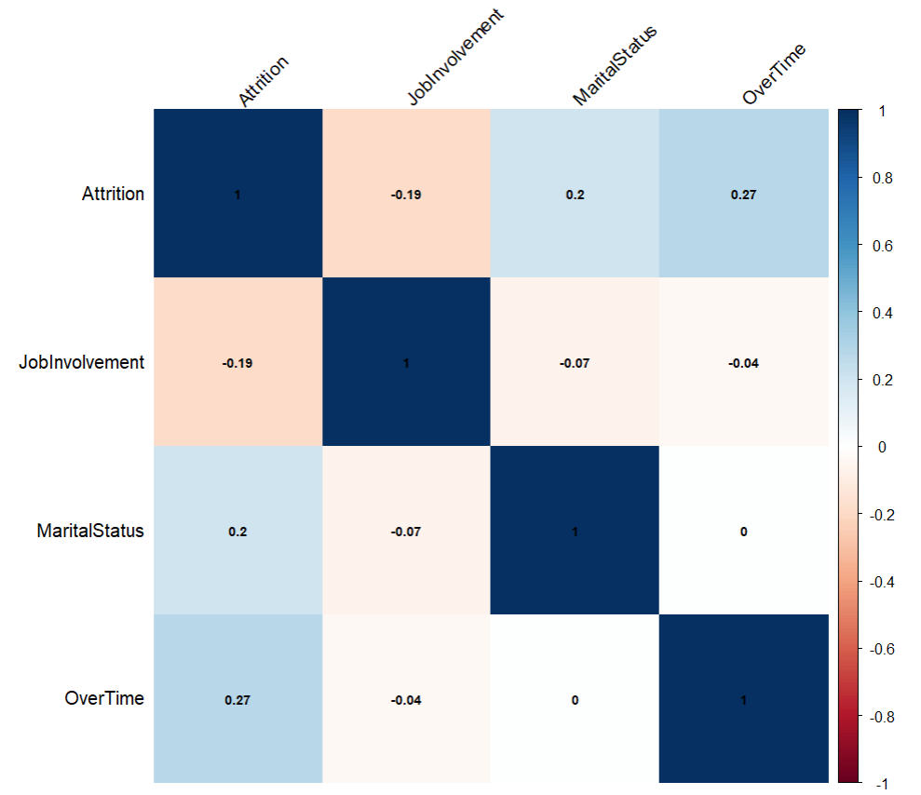
Top Contributing Correlation Analysis
Top 3 Variables contributing to Attrition

Slide 8
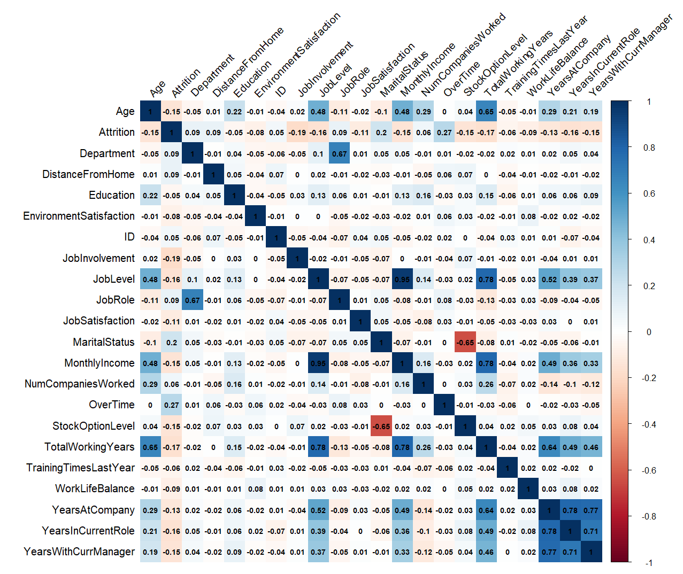
Predictor Correlation Analysis
Subset of values with correlation to Attrition (≥ 0.05 or ≤ -0.05). These columns will be used as features in our modeling

Slide 9
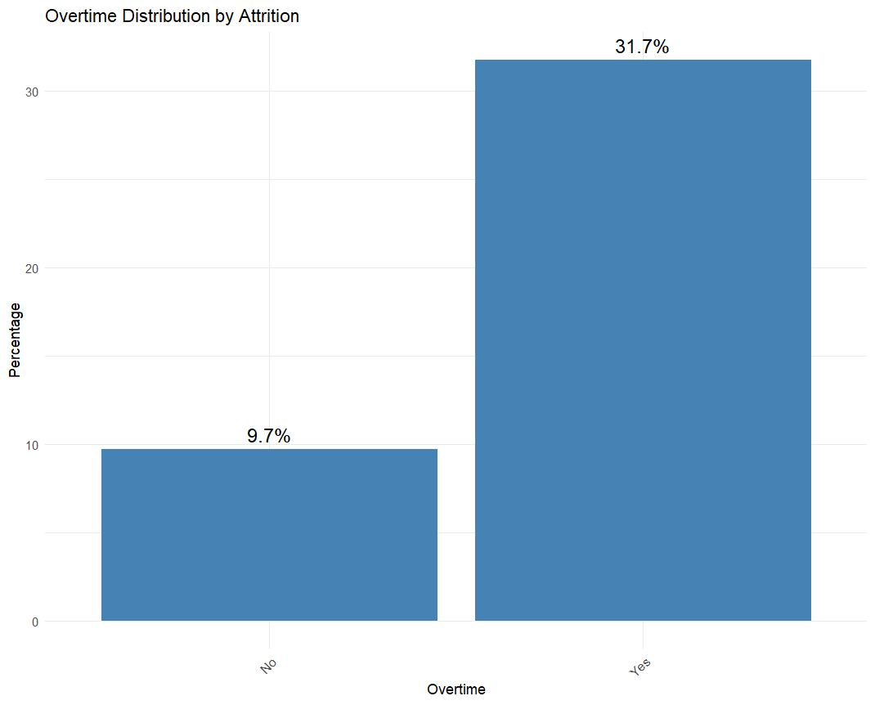
Top 3 Contributing Plots (1)

Slide 10
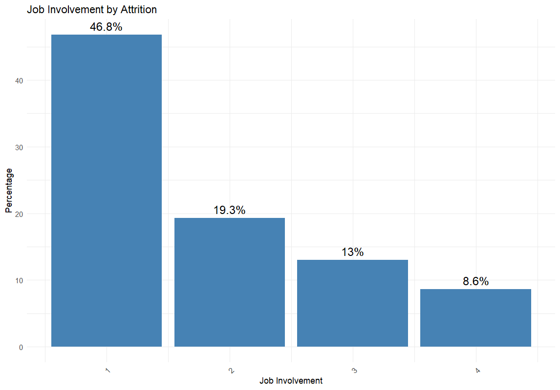
Top 3 Contributing Plots (2)

Slide 11
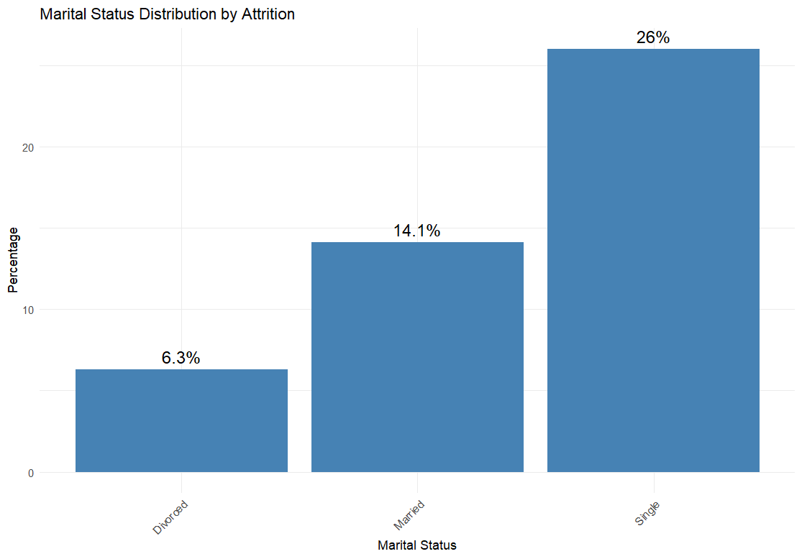
Top 3 Contributing Plots (3)

Slide 12
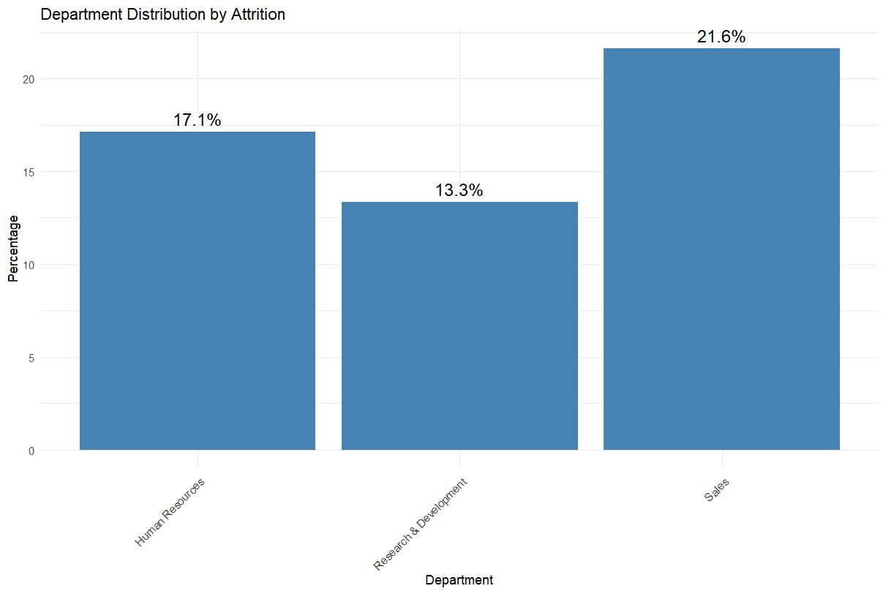
**Extra Interesting Find**

Slide 13

Modeling Approach
Data Preparation
Converted categorical variables into numerical factors.
Scaled numeric features (excluding ID and Monthly Income) for consistency.
Reordered columns to prioritize Attrition as the target variable.
Model Selection
K-Nearest Neighbors (KNN):
Ran 100 (seed) iterations with varying values of K (1-30).
Evaluated accuracy, sensitivity, and specificity.
Naive Bayes (NB):
Conducted 200 (seed) iterations.
Measured performance using confusion matrices.
Train/Test Strategy
70/30 split for training and testing.
Randomized multiple seeds for robust model validation.
Objective
Identify the best-performing model for attrition prediction.

Slide 14
Optimizing KNN Model
In our KNN model for predicting attrition, we addressed imbalanced data (~730 “No” vs. ~140 “Yes”) by adjusting the decision threshold, the probability cutoff used to classify employees as at risk, to improve sensitivity and reduce false negatives.
Key Points
Set 30% threshold
Loop through 100 different train/test splits
Test K values from 1 to 30
Prioritizing sensitivity helps catch potential quitters early, reducing high attrition costs
Without Threshold
Predicted | Actual
 | Quit | Did Not Quit
Quit | 40 | 31
Did Not Quit | 100 | 699
Threshold | Accuracy | Sensitivity | Specificity
No | 85% | 28% | 96%
Yes | 70% | 83% | 68%
With Threshold
Predicted | Actual
 | Quit | Did Not Quit
Quit | 117 | 234
Did Not Quit | 23 | 496
Sensitivity: The proportion of actual positives correctly predicted.
Specificity: The proportion of actual negatives correctly predicted.

Slide 15
Optimizing NB Model
In our Naive Bayes model for predicting attrition, we addressed imbalanced data (~730 “No” vs. ~140 “Yes”) by adjusting the decision threshold—the probability cutoff used to classify employees as at risk—to improve sensitivity and reduce false negatives.
Key Points
Tested Various Thresholds (20% chosen)
Loop through 100 different train/test splits
Prioritizing sensitivity helps catch potential quitters early, reducing high attrition costs
Without Threshold
Predicted | Actual
 | Quit | Did Not Quit
Quit | 83 | 70
Did Not Quit | 57 | 660
Threshold | Accuracy | Sensitivity | Specificity
No | 85% | 59% | 90%
Yes | 73% | 74% | 72%
With Threshold
Predicted | Actual
 | Quit | Did Not Quit
Quit | 103 | 201
Did Not Quit | 37 | 529
Sensitivity: The proportion of actual positives correctly predicted.
Specificity: The proportion of actual negatives correctly predicted.

Slide 16

Cost Analysis & Savings
We estimated attrition costs by considering each person’s total monthly income and applying a turnover cost ranging from 50% to 400% of their salary (monthly income). For employees flagged as at risk but who ultimately did not quit, we added a $200 “intervention” cost. The tables compare baseline (no intervention or model used) with each model’s approach, showing how both the KNN and Naive Bayes models reduce overall attrition costs and yield significant savings.
KNN Model
Description | Low Cost | High Cost
Baseline (Actual) | $333,535 | $2,668,280
KNN | $123,145 | $493,756
Savings | $210,391 | $2,174,524
Savings % | 63% | 81%
NB Model
Description | Low Cost | High Cost
Baseline (Actual) | $333,535 | $2,668,280
Naive Bayes | $212,934 | $1,277,868
Savings | $120,602 | $1,390,412
Savings % | 36% | 52%
Winner!

Slide 17
Recap & Recommendations
We began by performing an Exploratory Data Analysis (EDA) and correlation analysis to identify key factors influencing attrition. Next, we tested multiple models (KNN and Naive Bayes) in a loop of 100 train/test splits, adjusting thresholds to handle imbalanced data and prioritize sensitivity. Finally, we evaluated the costs of turnover (using 50–400% of monthly income plus a $200 intervention cost) to compare each model’s potential savings against a no-intervention baseline.
Key Insights
Data was imbalanced (~730 “No” vs. ~140 “Yes”).
Threshold tuning increased sensitivity, reducing missed quitters.
Cost analysis revealed significant savings with both KNN and Naive Bayes.
Recommended Model
KNN consistently demonstrated higher cost savings and robust performance across different cost scenarios, making it our top recommendation for identifying at-risk employees and reducing attrition costs.

Slide 18
Questions?

Slide 19
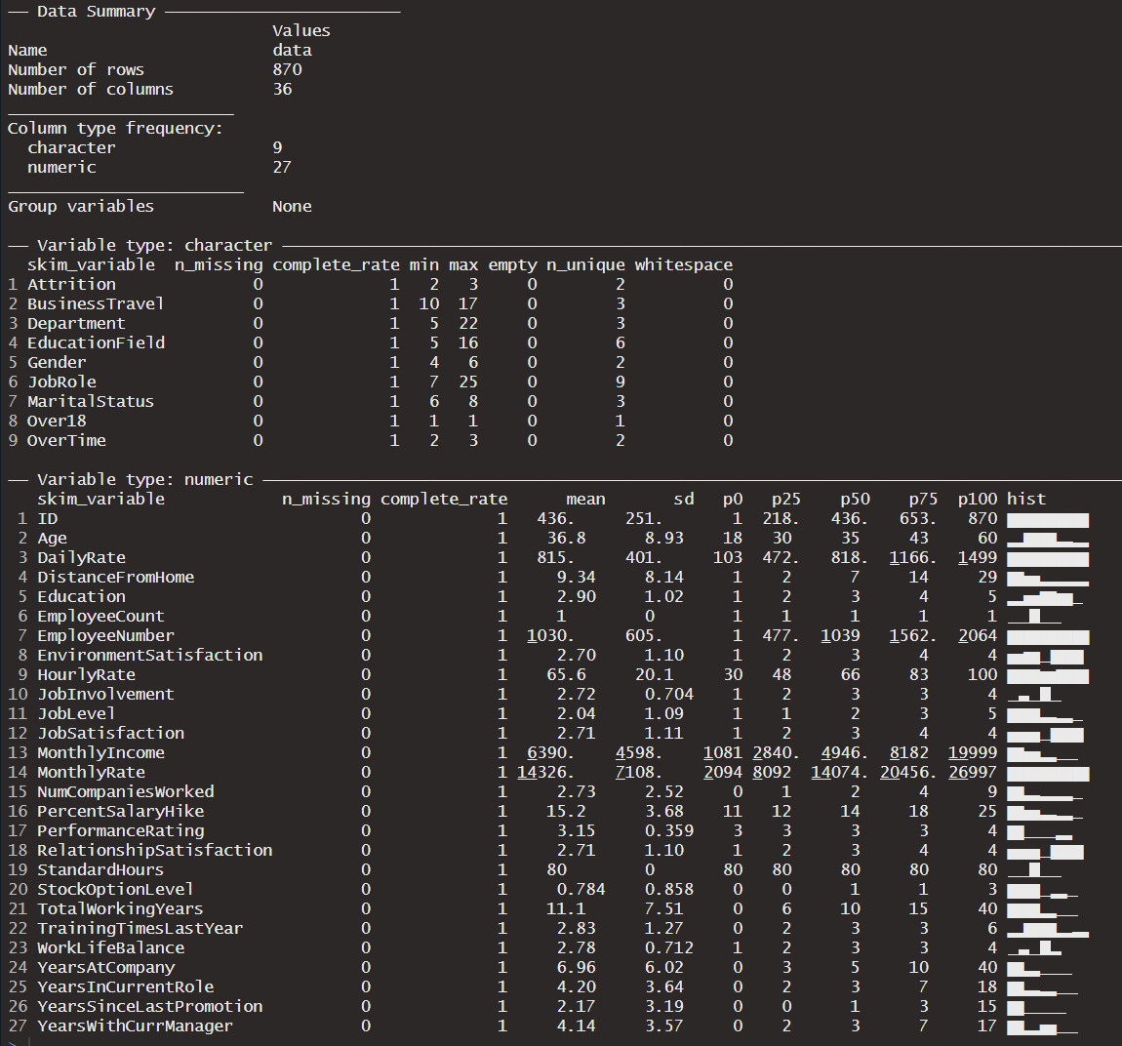
Technical Notes
Raw Data Overview

Slide 20
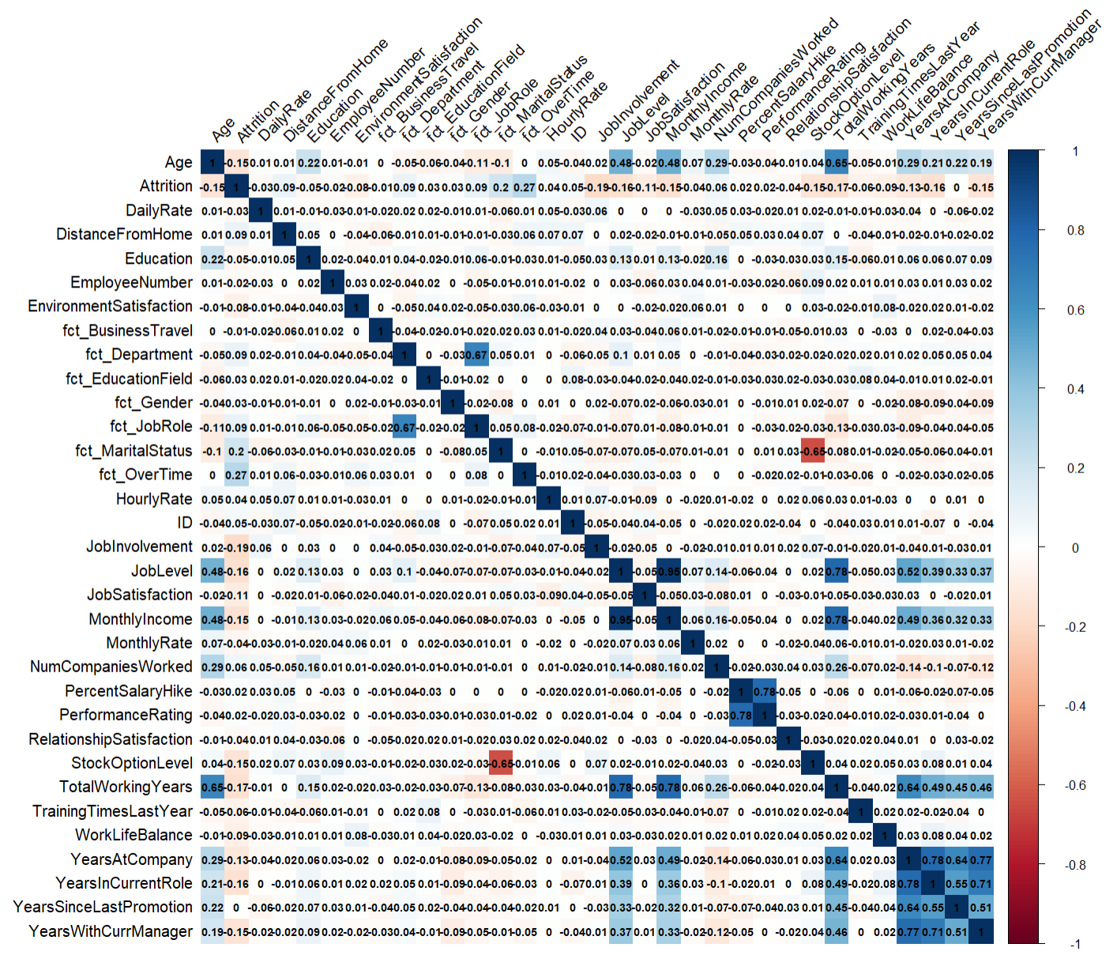
Technical Notes
Full Corr Matrix

