Slide 1

DC-SRAP Working Group: Activities 2023/2024
DCMI Community Updates
Tuesday 22nd Oct. 2024
Alasdair MacDonald

Slide 2

SRAP Working Group
Active since 2021, with the objective of developing Dublin Core Metadata Terms (DCMT) to support the description of scholarly resources, such theses/dissertations and academic papers and improve the interoperability of metadata
Current Chair is Osma Suominen (National Library of Finland) with Jan Ashton (British Library), Karen Coyle and Alasdair MacDonald (University of Edinburgh)
Continued with fortnightly meetings and discussions, with 53 meetings to date
Summary of progress since the DCMI 2023 update

Slide 3
SRAP Drafts and Documents
GitHub repository: https://github.com/dcmi/dc-srap
Current draft of SRAP: https://dcmi.github.io/dc-srap/srap-profile
SRAP as a DCTAP table (CSV): https://dcmi.github.io/dc-srap/srap.csv
Examples: https://dcmi.github.io/dc-srap/examples/
Original draft available as a Google Doc: https://docs.google.com/document/d/1t8y_3fNrf1rATlYohB6LhPPgr7Ltt3e2/edit

Slide 4
Representing papers published in journals/monographs: dct:isPartOf
shapeID | propertyLabel | propertyID | valueNodeType | valueDatatype | valueShape | valueConstraint | valueConstraintType | note
Periodical | Class | rdf:type | IRI |  |  | bibo:Periodical bibo:Journal |  | Class (always bibo:Periodical or one of its subclasses)
 | Title | dct:title | literal | xsd:string |  |  |  | A name given to the resource. Titles in different languages provided separately
 | Publisher | dct:publisher | IRI BNODE |  | Organization |  |  | Name of the publisher
 | ISSN | bibo:issn | literal | xsd:string |  |  |  | The International Standard Serial Number, ISSN, an identifier for the printed version of serial publications.
 | E-ISSN | bibo:eissn | literal | xsd:string |  |  |  | The International Standard Serial Number, ISSN, an identifier for electronic versions of serial publications.

Slide 5
Representing papers published in journals/monographs
shapeID | propertyLabel | propertyID | valueNodeType | valueDatatype | valueShape | valueConstraint | valueConstraintType | note
SRAPResource | Volume | bibo:volume | literal | xsd:string |  |  |  | A volume number of the periodical where this article was published
 | Issue | bibo:issue | literal | xsd:string |  |  |  | An issue number of the periodical that this article was published in
 | Start page | bibo:pageStart | literal | xsd:string |  |  |  | Starting page number within a continuous page range.
 | End page | bibo:pageEnd | literal | xsd:string |  |  |  | Ending page number within a continuous page range.
 | Is Part Of | dct:isPartOf | IRI BNODE |  | Periodical Book |  |  | A related resource in which the described resource is physically or logically included.
 | Presented At | bibo:presentedAt | IRI literal |  |  |  |  | Conference, workshop or other scientific event where the scholarly resource was presented.

Slide 6
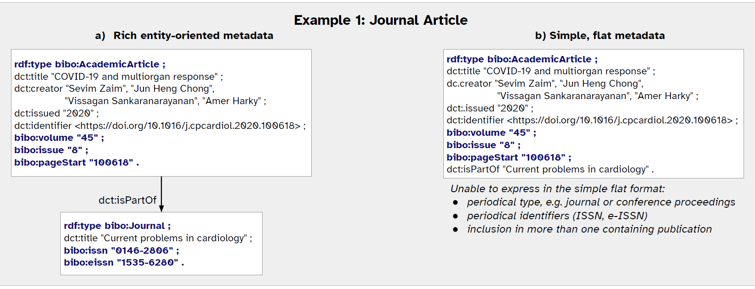
Examples of rich and simple data models
https://dcmi.github.io/dc-srap/examples/

Slide 7
Representing grants and funding
shapeID | propertyLabel | propertyID | valueNodeType | valueDatatype | valueShape | valueConstraint | valueConstraintType | note
Grant | Class | rdf:type | IRI |  |  | schema:Grant |  | The class will always be schema:Grant
 | Funder | schema:funder | IRI literal |  |  |  |  | The name or identifier of the funder; use the Organization shape if additional information is desired.
 | Funder | schema:funder | IRI BNODE |  | Organization |  |  | Information about the funder.
 | Grant identifier | schema:identifier dct:identifier | literal | xsd:string |  |  |  | An identifier for the grant or other funding.
Unresolved issue: Academic department where research was undertaken

Slide 8
Shapes for Organisation and Person
shapeID | propertyLabel | propertyID | valueNodeType | valueDatatype | valueShape | valueConstraint | valueConstraintType | note
Organization | Class | rdf:type | IRI |  |  | foaf:Organization |  | The class will always be foaf:Organization.
 | Role | srap:role | IRI |  |  | http://id.loc.gov/vocabulary/relators/ | IRIstem | The role of the organization in the context of the publication, expressed using MARC relators.
 | Identifier | dct:identifier | IRI literal |  |  |  |  | Identifier for the organization
 | Name | foaf:name | literal | xsd:string |  |  |  | Name of the organization

Slide 9
Shapes for Organisation and Person
shapeID | propertyLabel | propertyID | valueNodeType | valueDatatype | valueShape | valueConstraint | valueConstraintType | note
Person | Class | rdf:type | IRI |  |  | foaf:Person |  | The class will always be foaf:Person.
 | Role | srap:role | IRI |  |  | http://id.loc.gov/vocabulary/relators/ | IRIstem | The role of the person in the context of the publication, expressed using MARC relators.
 | Affiliation | schema:affiliation | IRI BNODE |  | Organization |  |  | An organization to which an agent was affiliated when the resource was created.
 | Name | foaf:Name | literal | xsd:string |  |  |  | Name of person
 | Identifier | dct:identifier | IRI literal |  |  |  |  | Identifier for the person, such as ORCID

Slide 10
Reviewing publication lifecycle dates
shapeID | propertyLabel | propertyID | valueNodeType | valueDatatype | valueShape | valueConstraint | valueConstraintType | note
SRAPResource | Date Published | dct:date | Literal | xsd:date |  |  |  | Date associated with the resource. Use more specific dates if available.
 | Date Issued | dct:issued | literal | xsd:date |  |  |  | Date of formal issuance of the resource.
 | Date Modified | dct:modified | literal | xsd:date |  |  |  | Date on which the resource was changed.
 | Date Accepted | dct:dateAccepted | literal | xsd:date |  |  |  | Date of acceptance of the resource.
 | Embargo Date Range | srap:embargoDateRange | literal | xsd:date |  |  |  | A period of time during which the resource is under embargo.
Issue: xsd:date is only valid for a single date and not a range of dates

Slide 11
Thank you
Alasdair.MacDonald@ed.ac.uk

