Slide 1
Identifiers for Historical Versions of Metadata Terms
Thomas Baker
Meeting of the DCMI Architecture Working Group
DC2004, Shanghai, 2004-10-13

Slide 2
DCMI Term Documentation
DCMI Metadata Terms (latest information)
  http://dublincore.org/documents/dcmi-terms/
Historical versions of all terms
  http://dublincore.org/usage/terms/history/

Slide 3
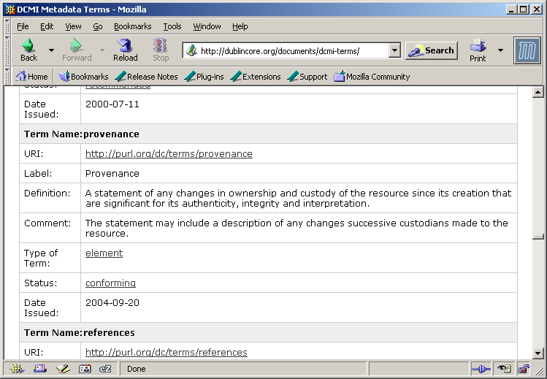
DCMI Metadata Terms

Slide 4
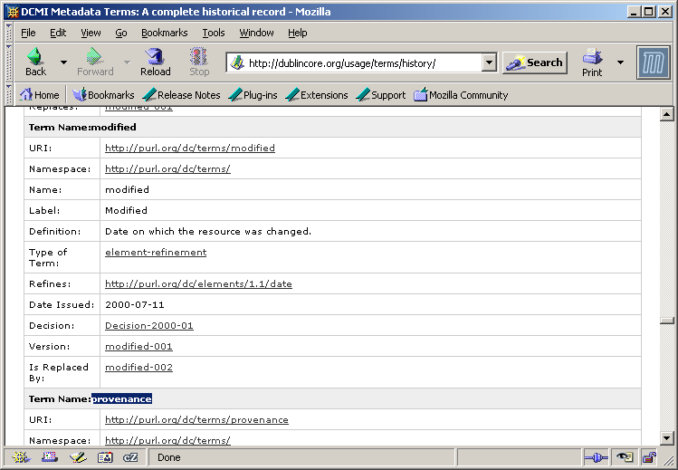
Historical Record

Slide 5
Problem
What is a “version” of a term in the context of the Abstract Model?
How do identifiers for versions get assigned and by what policies are they maintained?

Slide 6
Current Practice
Identifying Terms and Versions
By DCMI Namespace policy, permanent identifier is assigned to new terms:
  http://purl.org/dc/dcmitype/Image
In practice, identifiers are also assigned to successive term descriptions:
  http://dublincore.org/usage/terms/history/#Image-002
  http://dublincore.org/usage/terms/history/#Image-002

Slide 7
One application of version URIs
Citations in Translations
Translation of dc:title into Japanese
  Only the human-readable parts are different:
    Label
    Definition
    Comment
  Is “about” the term:
    http://purl.org/dc/elements/1.1/title
  IsTranslationOf a specific version:
    http://dublincore.org/usage/terms/history/#title-003

Slide 8
Questions
Does this approach make sense? If so…
  Should the identifiers be covered by DCMI Namespace Policy?
  Should the URIs continue to be (in effect) anchors to locations in HTML documents?
  What is the conceptual explanation of this approach?

Slide 9
1
Metadata
Vocabulary
1
isDescribedBy
hasTerm
m
m
0-1
Term
0-1
replaces
Vocabulary
Description
1
1
1
isDescribedBy
isPartOf
m
0-1
Term
Description
replaces
m
1
0-1
1
replaces
Document
m
isPartOf
1
Human-readable
Document
Schema
Document

Slide 10
thomas.baker@izb.fraunhofer.de

