Slide 1

www.kim-forum.org

Slide 2
KIM
Competence Center for Interoperable Metadata
Dublin Core Conference 2007, Singapur
Christine Frodl (German National Library)
Stefanie Ruehle (State and University Library, Goettingen)

Slide 3
KIM Project
Project partners
  Niedersaechsische Staats- und Universitaetsbibliothek (SUB) Goettingen
  Deutsche Nationalbibliothek (DNB)
in cooperation with
  Universitaet Wien
  Hochschule fuer Technik und Wirtschaft (FH-HTW) Chur
  Eidgenoessische Technische Hochschule (ETH) Zuerich
funded by
  Deutsche Forschungsgesellschaft
Project schedule
  1 October 2006 – 30 September 2008
Notes:
obligatorisch

Slide 4
KIM Goals
to improve
  interoperability of metadata in German-language countries
to support
  the development of interoperable metadata profiles
to promote
  the development of interoperable metadata standards
to exchange knowledge
  with national and international projects and organisations
Notes:
obligatorisch

Slide 5
About KIM
Information platform
  For metadata users and metadata developers in science, governmental organisations and industry
Communication platform
  Knowledge exchange with national and international projects and organisations
Service provider
  Teaching and training offers
  Advisory service and support in the development of interoperable metadata formats
Affiliate of the Dublin Core Metadata Initiative (DCMI)
  KIM as DCMI Affiliate for the German-speaking metadata community (Germany, Switzerland, Austria)
Notes:
obligatorisch

Slide 6
Information platform
Information about
  national and international metadata standards
  cross-application integration of metadata
  interoperable design of metadata formats
  Dublin Core
  international standards
Notes:
optional

Slide 7
Communication platform
Knowledge exchange with
  National and international projects
  National and international organisations
  National and international metadata experts
Affiliation to the Dublin Core Community
  establish a relationship between the German-speaking metadata community and the Dublin Core Community
  cooperate with the Dublin Core bodies
  collaborate with Dublin Core metadata experts
Notes:
optional

Slide 8
Service provider
eTutorials
  e-learning modules about metadata and interoperability for education, training and advanced training
Translations
  of relevant English-language documents into German
  currently: Dublin Core Metadata Element Set, Version 1.1
  (http://www.kim-forum.org/material/index.htm)
KIM DINI Technology Watch Report
  Newsletter about up-to-date national and international as well as interdisciplinary developments of standards and standards work within the scope of digital information technology
Glossary
  Bi-lingual (German-English) glossary with relevant terms on interoperability and metadata
Notes:
obligatorisch

Slide 9
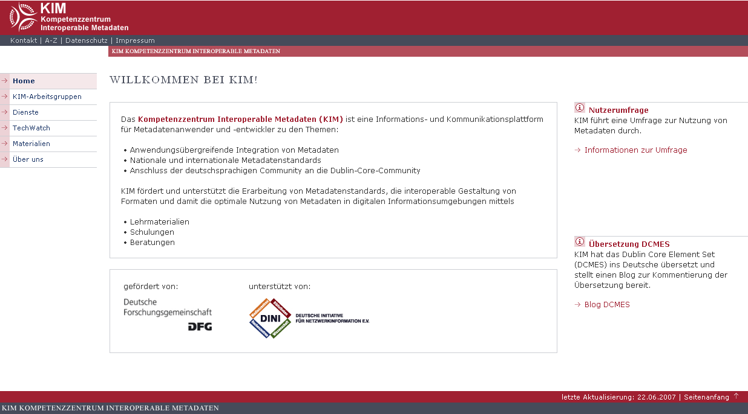
www.kim-forum.org
Notes:
optional

Slide 10
Competence Center for Interoperable Metadata
www.kim-forum.org
Stefanie Ruehle Christine Frodl
State and University Library German National Library
Goettingen Office for Library Standards
Research and Development Department Frankfurt am Main
sruehle@sub.uni-goettingen.de c.frodl@d-nb.de
  Das Copyright für dieses Dokuments liegt bei KIM.
  Eine unautorisierte Übernahme des ganzen Beitrags oder von
  Beitragsteilen ist nicht zulässig. Für nicht-kommerzielle Ausbildungs-
  zwecke kann der Beitrag kopiert werden, solange eindeutig die
  Urheberschaft kenntlich gemacht wird. Eine kommerzielle Nutzung
  der Materialien ist hiermit ausdrücklich untersagt.
  E-Mail: info@lists.kim-forum.org
  www.kim-forum.org

