Slide 1
Using DC Library Application Profile for The European Library
Sally Chambers
The European Library
Metadata Working Group

Slide 2
The European Library
www.The EuropeanLibrary.org launched March 2005
Single access point to search the digital and non-digital collections of the national libraries of Europe
290 collections (171 searchable)
30 of the 47 European National Libraries collections searchable via The European Library
The European Library accesses the collections by:
  Federated searching (dynamic searching)
  Harvesting via OAI-PMH into a central index
Local metadata records mapped to The European Library Application Profile for objects for display in The European Library

Slide 3
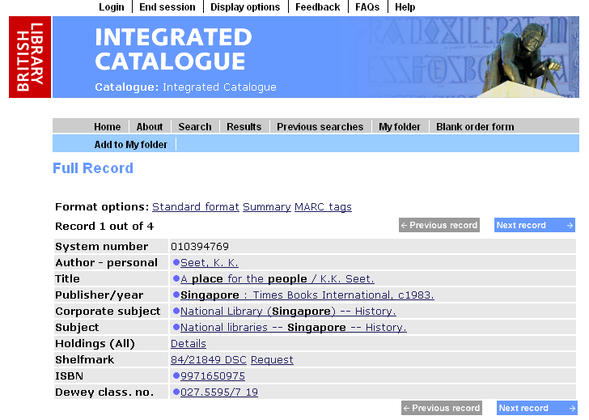
Record in the British Library

Slide 4
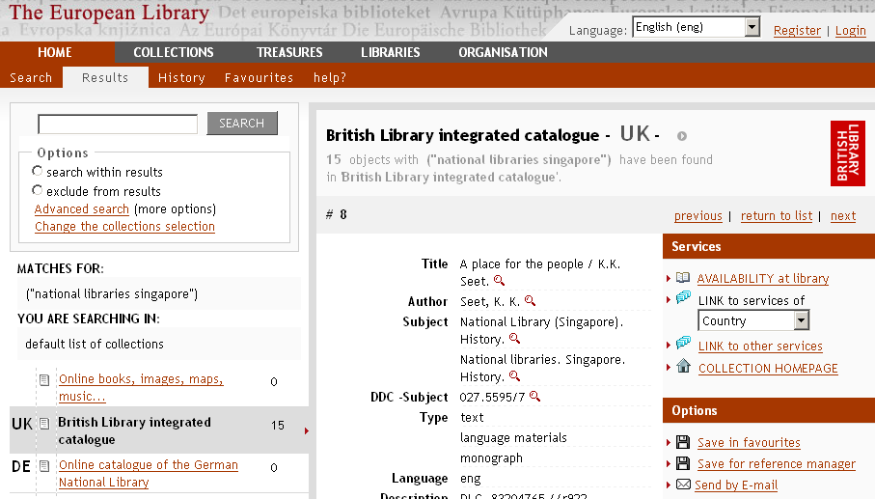
(Same) record in The European Library

Slide 5
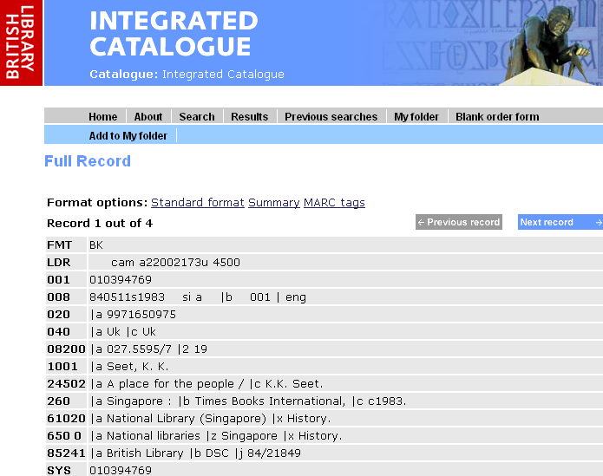
Local (MARC21) record

Slide 6
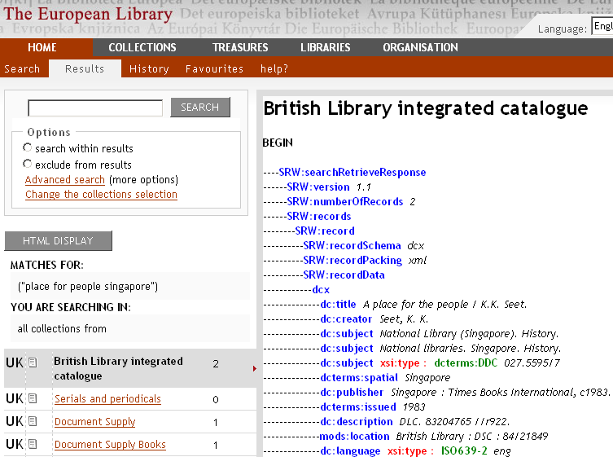
Record in TEL AP format

Slide 7
TEL Application Profiles
The European Library Application Profiles
  Objects
  Collection Descriptions
Use DC Library Application Profile terms with some “TEL” metadata terms added:
  RecordID
  Thumbnail
  OAIRecordID
  RecordURL
  Record Schema

Slide 8
TEL Term: RecordId
Type: Property
Qualified name: tel:recordId
Source Definition:The unique identification of the record in the source database
Guidelines: The recordId is used for referencing the original record, linking by reference and for
administrative purposes. In some cases it will allow records to be indexed without storing
them centrally. It can be used in OpenURL for use by local services.
Functionality: “Available in Library”

Slide 9
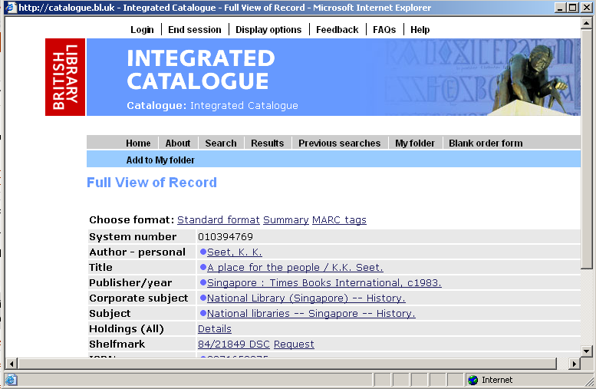
“Available in Library” functionality
<tel:recordId xsi:type="dcterms:URI">http://catalogue.bl.uk/F/?func=direct-docset&doc_number=010394769&l_base=BLL01&from=TELgateway </tel:recordId>

Slide 10
Supporting partner libraries
Metadata Registry
  Central storage place for all the terms used in The European Library
  Guidance on how particular terms are used in The European Library
  Mappings from local metadata formats (e.g. MARC 21, UNIMARC) to TEL Application Profiles
Handbook
  “Preparing your metadata” and “Describing your collections” modules

Slide 11
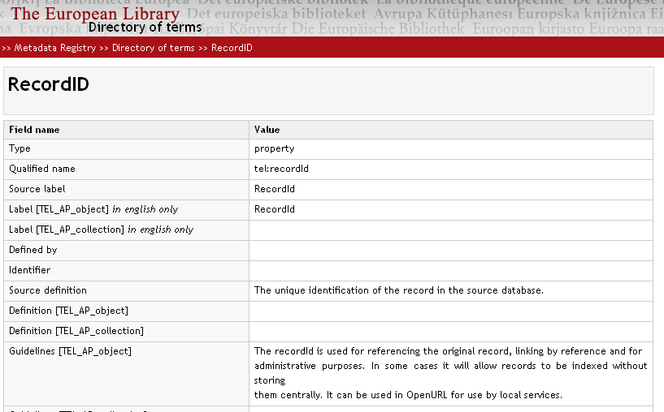
RecordID in Metadata Registry

Slide 12
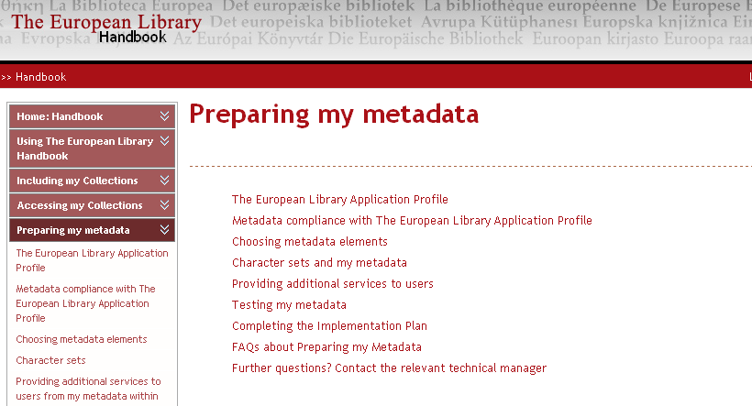
Handbook: Preparing my metadata

Slide 13
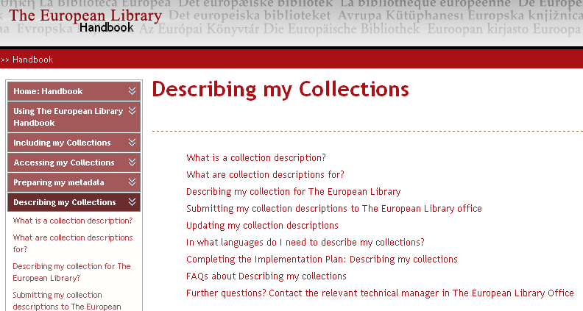
Handbook: Describing my collections

Slide 14

Further information
The European Library
www.theeuropeanlibrary.org
The European Library Metadata Registry
www.theeuropeanlibrary.org/metadataregistry
The European Library Handbook
www.theeuropeanlibrary.org/handbook
The Metadata Working Group
metadata@theeuropeanlibrary.org

