Slide 1
Dublin Core in
Multiple Languages
Thomas Baker
Sixth Dublin Core Workshop
Library of Congress, Washington DC
Tuesday, 3 November 1998

Slide 2
History
DC3, Canberra, March 1997 break-out group
Follow-up
  DC4, Helsinki, October 1997
  International Symposium, Tsukuba, Japan, Nov. 1997
  EU-NSF Metadata WG, Washington, February 1998
  Digital Library Workshop, Tsukuba, March 1998
GMD, Germany, May 1998
IJWDL at AIT, Thailand, Sepember 1998
ECDL2, Heraklion, Crete, September 1998
DC6, Washington DC, November 1998

Slide 3
Dublin Core is expressible in any modern language
The reference language of the international Dublin Core community is English; DC-English is the canonical result of an international process.
But Dublin Core elements are in principle expressible equally well in any modern language.

Slide 4
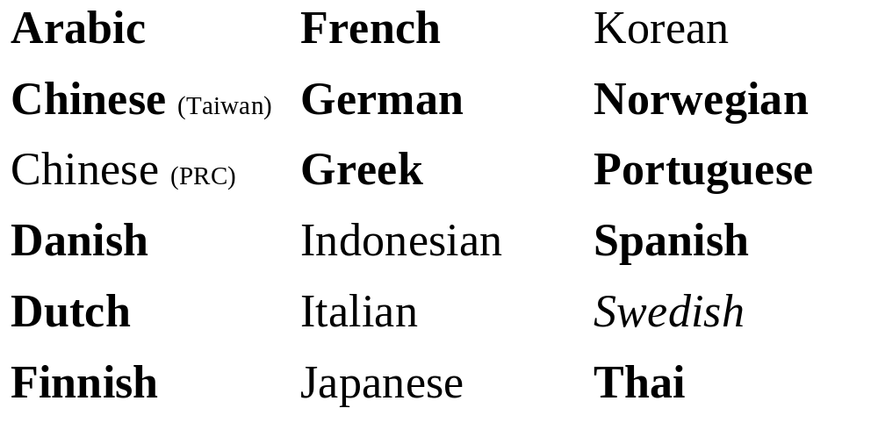
DC-Multilingual (Nov 1998)

Slide 5
Dublin Core should have a single namespace
Versions of DC should share a single namespace
Interoperability among versions of Dublin Core is achieved by sharing machine-readable tokens that stand for the elements (“labels”).
Tokens look like English words but stand for universal elements.

Slide 6
A distributed registry of
Dublin Core in multiple languages
Central Registry (http://purl.org/dc), a Java servlet, maintains an RDF-formatted list of DC versions, their languages, and their URIs.
Local Registries (Beijing, Bangkok, Berlin...) maintain DC schemas (in RDF format) and register their URIs with the Central Registry.

Slide 7
Users query the
Central Registry
Web Client
Central Registry
Local Registry
(1) request
(4) url connection
Homepage
Dublin Core
in RDF
Java Servlet
(7) output
(5) Dublin Core
(2) language
(3) uri
Parameter:
url of HTML
language
(6) human-readable parts
in Dublin Core
Web page
List of Dublin
Core in RDF
HTML
(11) MHTML
document
(8) parameter
MHTML Gateway
in Japan
(9) url
(10) HTML

Slide 8
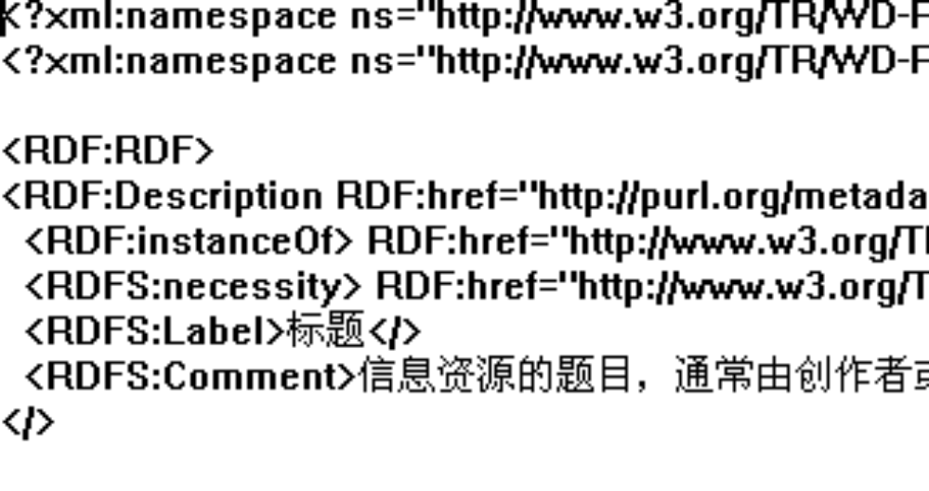
DC-Chinese in RDF

Slide 9
Shows three technologies
Dublin Core (in multiple languages)
Resource Description Framework (RDF)
Multilingual HTML (MHTML)
  Not everyone has fonts for Japanese and Thai and it may take awhile for Unicode to become ubiquitous.
  MHTML, developed at ULIS (Japan) displays fonts on Java-enabled browsers.

Slide 10
Compliance with RDF
DC-Multilingual intends to with the RDF specifications as they evolve.
Each new version of an RDF schema should have its own URI -- What are the implications for versions of DC-Japanese?
Should Finnish users access DC-Finnish through the Dublin Core namespace at http://purl.org/dc/elements/1.0?

Slide 11
Starting simple
(like Dublin Core)
First link versions of Unqualified Dublin Core.
Add substructure as it is approved by DC community.
Good big systems begin as good small systems.

Slide 12
Maintaining global interoperability
Challenge: maintain global interoperability across local implementations.
Share and negotiate semantics across languages: an extension originally defined in Thai could be used internationally.
We need a process for this before the proliferation of incompatible sub-elements compromises global interoperability.

Slide 13
Period of experimentation
We invite metadata-using institutions in many countries to create versions of DC in various languages.
Eventually we may need peer review to evaluate quality and institutional commitment to maintaining a version in the long term (“certification”).
The main challenges do not relate to the technology, but to policy and process.

Slide 14
Potential directions
Turn the position paper into a requirements document for a registry.
Extend the registry beyond schemas to user guides and localized tools.
Clarify the process for announcing local extensions to the world, reviewing them as a community, and incorporating them into the shared DC namespace.

Slide 15
Addresses
http://purl.org/metadata/dublin_core
http://www.cs.ait.ac.th/~tbaker/DC-Multilingual.html
Mailing list: dc-international@cs.ait.ac.th
Mailing list archive: http://dlforum.external.forth.gr/dcm
thomas.baker@cs.ait.ac.th

Slide 16
DC-Multilingual
The sum of instantiations of DC in various languages
DC-Swedish
DC-English
DC-French
DC-Danish
DC-Thai
DC-Japanese
DC-German
DC-Multilingual
DC-Indonesian
DC-Finnish
DC-Chinese (China)
DC-Norwegian
DC-Chinese (Taiwan)
DC-Greek
DC-Korean
DC-Spanish
DC-Portuguese

