Slide 1

6th Dublin Core Workshop
Washington DC, USA, 2-4 November 1998
Australian Government Metadata
Dr Renato Iannella
DSTC
Australia
renato@dstc.edu.au
Notes:
1
1
1
1
1

Slide 2
Australian Government Locator Service
Single Seamless Entry Point
  Across all Jurisdictions/Agencies
  Across all Levels of Government
Adopted Dublin Core + 2
  metadata only (not like GILS)
Qualified DC based on:
  “core” of various other proposals
  needs of Australian Government stakeholders

Slide 3
Plus Two
Availability
  Locator Scheme - Resource Delivery
  Non-Digital Resources
  Eg: Postal Address, Phone Numbers, etc...
Function
  Governments provide “functions”
  Thesauri will be source for Function
    Eg: “Strategic Management - Customer Service”
  Link to Govt record keeping regimes

Slide 4
Example Qualified AGLS
Creator, Publisher, Contributor, Availability
  PersonalName
  CorporateName
  Jurisdiction
    Commonwealth, NSW, Vic, Qld, SA, ACT, Tas, WA, NT
  Contact
  Email
  X.500
    GOLD Directory
Type
  Item
  Collection
  + Fixed List of values
Relation
  PartWhole
  Version
  Reference
  Based
  Requires

Slide 5
AGLS Resources/Testbeds
AGLS Homepage:
  http://www.naa.gov.au/govserv/agls/
Business Entry Point
  http://www.business.gov.au/
Queensland Government Pilot
  http://purl.org/dstc/hotmeta

Slide 6
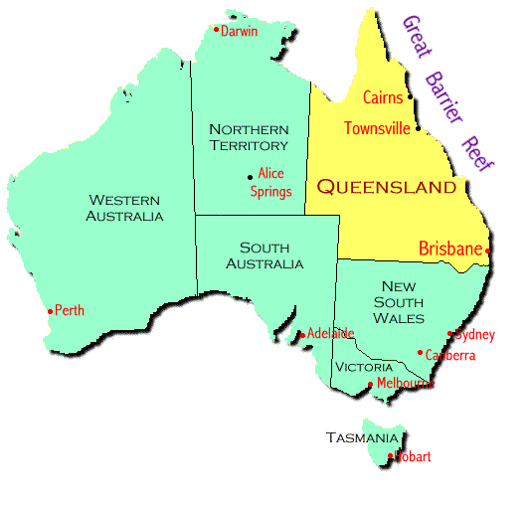
HotMETA - Qld Pilot Stats
78 Web Sites (Depts)
14,327 URLs
2,415 DC (17%)
188 AGLS (1.4%)
0.0007 DC records per capita!

Slide 7
And the Survey Says...
17 Responses
Records Scratch = 44,403
Records Legacy = 836,300
  most auto generated
Time (ave) = ~11 mins/record
DC 1.0 = 8 Projects
DC 2.0a = 9 Projects
0.05 DC Records per Capita!

Slide 8
And the Survey Says...
Build md creation into publication process
  Motivations for Authors to supply metadata
  Don’t rely on Authors providing good metadata
Don’t fudge DC - add local tags
Difficult finding controlled vocabulary that is relevant to users
Lack of desktop Tools and sharing implementation experience

Slide 9
Other Issues...
Item V Collection
Type
  Different Types - Beyond the Document
  Eg: An online Govt service
    “pay a bill”
Date
  Still not sure which date!
  Confuse with “admin” date
  Does it work for a “service”?
  Stress Date.ValidTo is important

Slide 10
Random Issues
Subject
  To what level?
For Cultural Community
  What to put into Creator
Title - where to put series titles
Do you change the Metadata?
  Govt Agency (publisher) changes name…
  Change metadata? What about searchers?

Slide 11
DC6...
Strong message to community for DC 2.0
  workplan and deliverables to achieve 2.0 standard
  “short period of time”
  versioning

