Slide 1
The Semantic Web
A proposed practical strategy for the DCMI
Makx Dekkers,
Managing Director, Dublin Core Metadata Initiative
mail@makxdekkers.com

Slide 2
What is the Semantic Web?
A vision of possibilities
“The Semantic Web is an extension of the current web in which information is given well-defined meaning, better enabling computers and people to work in cooperation.”
-- Tim Berners-Lee, James Hendler and Ora Lassila, The Semantic Web, Scientific American, May 2001

Slide 3
Semantic Web aspects
Machines talking to machines - semantics need to be declared
Federating domains - enabling complex tasks based on information from various sources
Wide scope - from home to global
Robust - imperfect understanding
That sounds familiar - isn’t that what DCMI tries to achieve, too?

Slide 4
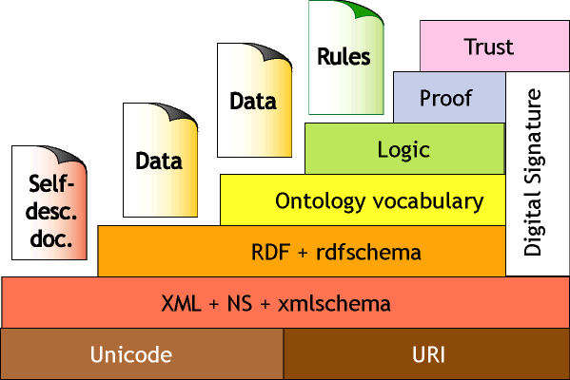
Semantic Web Architecture
Schemes
Metadata
Tim Berners-Lee
http://www.w3.org/2000/Talks/1206-xml2k-tbl/Overview.html

Slide 5
Semantic Web needs
Conventions about semantics
Conventions about infrastructure
The Web for connectivity
A whole lot of machinery to be developed
Integration of ‘legacy’ solutions at affordable cost

Slide 6
Semantic Web problems
From vision to implementation: how can it be explained to decision makers?
Leadership: everyone is waiting for the Semantic Web Activity at W3C to tell us what it means in practice
Understanding: how can we begin to create common directions?

Slide 7
Should we care?
Yes:
  Our common, simple metadata language addresses the same vision
  We don’t want to find solutions in isolation
  We can benefit from industry take-up
But:
  There is a risk that the Semantic Web will not fly, and our community cannot afford to fail

Slide 8
How can we help?
Understanding
  Continue to work with a cross-domain focus
  Continue to build bridges to other communities
Implementation
  Demonstrate practical implementation of some of the technologies
  Guidance and best practice documentation
Contribute our experience to W3C

Slide 9
Proposed DCMI strategy
Priority #1: to meet the practical needs of our community
Monitor Semantic Web developments and use what we can practically apply
Not necessarily push the boundaries; engage in reseach where it helps us
Promote the Dublin Core as the solution for the Semantic Web metadata layer

Slide 10
Practical steps
Define the Dublin Core terms as an RDF schema (as one of the options)
Build the DCMI Registry on the basis of RDF
Maintain good relations with the Semantic Web activity at W3C
Promote the Dublin Core in the Semantic Web activity, not the other way round (i.e. we should not prescribe the use of RDF)

