Slide 1


Bridging the Gaps:
Adaptive Approaches to Data Interoperability
Michael K. Bergman
keynote presentation at
DC-2010 Conference
Pittsburgh, PA
October 22, 2010

Slide 2


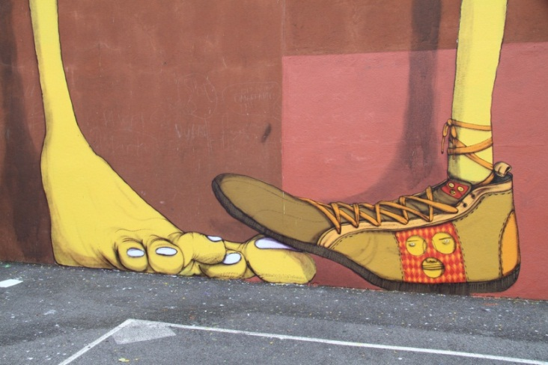
The Iconoclast Cometh

Slide 3
Outline of Talk
Linked Data
Data Web, Structured Data and Semantic Web
Players and Roles → DCMI
Conclusions

Slide 4
Three Overall Assertions
<LinkedData> <isA> <ValuableTechnique>
<DataWeb> <hasNeedOf> <Semantics>
<DCMI> <hasRole> <Unique>

Slide 5
Linked Data

Slide 6
Three Linked Data Assertions
<LinkedData> <isA> <PreferredTechnique>
<Techniques> <doNotSolve> <RootChallenges>
<RDF> <hasBestRoleAs> <CanonicalDataModel>

Slide 7
Three More Linked Data Assertions
<LinkedData> <hasGrowing> <Triples>
<LDUsers> <wronglyUse> <ManyPredicates>
<LinkedData> <hasLack> <MajorUptake>

Slide 8
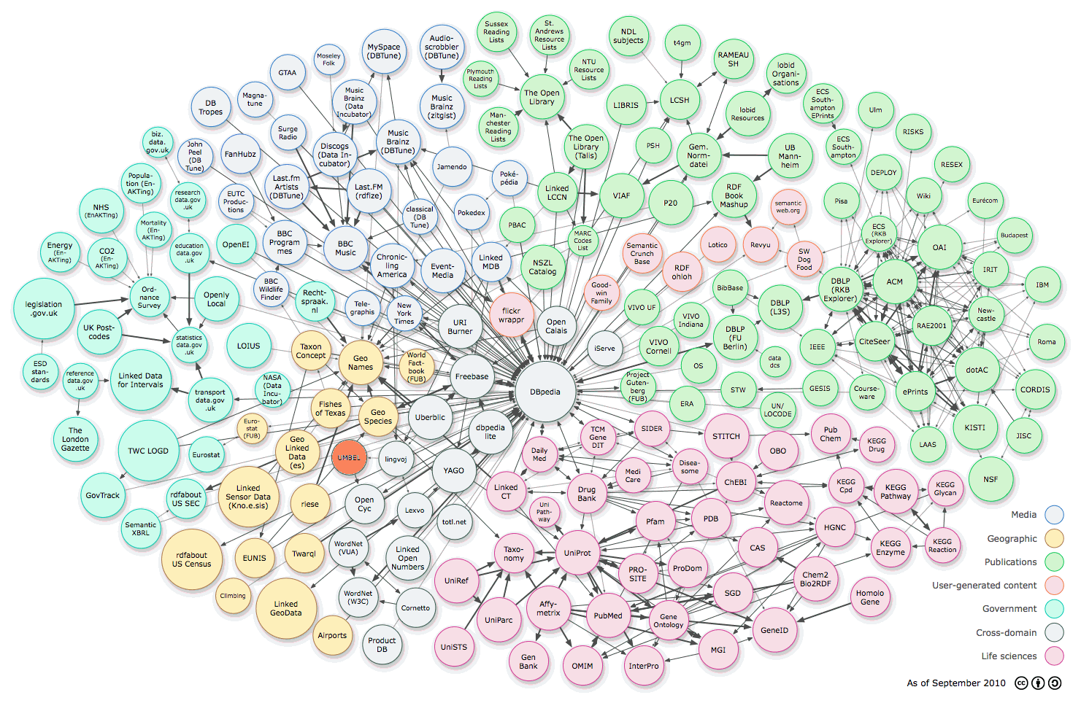
25 Billion Linked Data Triples

Slide 9
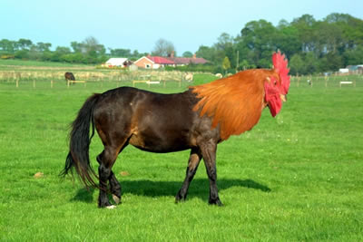
Bad Results from sameAs Misuse
Notes:
Predicate Role
Reference Concepts (“is About”) Role
DCMI PerfectlySituated

Slide 10
The State of Linked Data
Growing, but not as fast as promise would suggest
Not used much, except curated settings
Few actual dataset linkages
NO true interoperability, except curated (life science, some others)
Difficult to publish
If done right, best form to consume

Slide 11
Data, Structure and Semantic Web

Slide 12
Three Structured Data Web Assertions
<Heterogeneity> <isA> <Reality>
<LinkedData> <isOnly> <TinyContributor>
<Semantics> <isThe> <MissingLink>

Slide 13
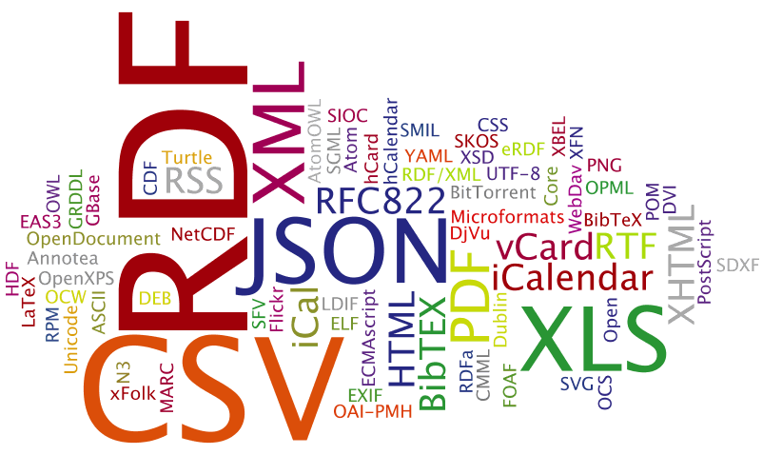
Hundreds of Formats in the Wild

Slide 14
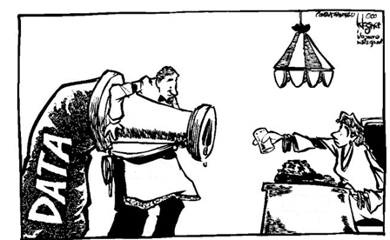
How to Aliquot the Firehose ?

Slide 15
Three Semantics Assertions (+ Axiom)
<ReferenceVocabs> <organize> <MassiveContent>
<LinkingPredicates> <gather> <RelatedContent>
<intersectionOf>
<SemanticContent> <enables> <MeaningfulWork>

Slide 16

Reference Vocabs Help Organize Chaos

Slide 17
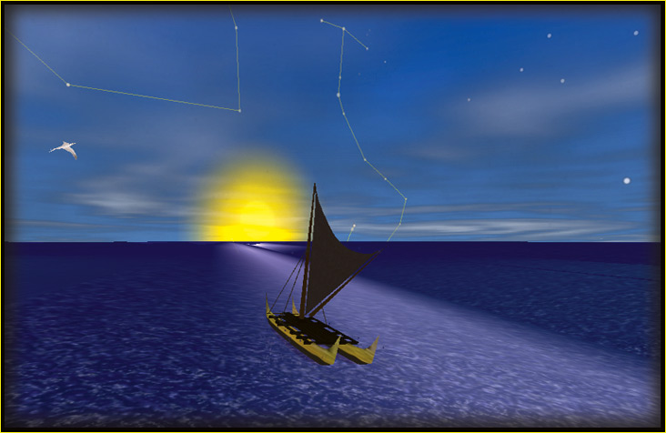
Fixed References Help Orient
Notes:
Predicate Role
Reference Concepts (“is About”) Role
DCMI PerfectlySituated

Slide 18
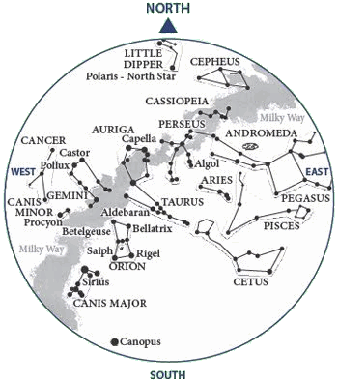
Concepts are the Fixed References
Notes:
Predicate Role
Reference Concepts (“is About”) Role
DCMI PerfectlySituated

Slide 19
Design Aspects of Reference Concepts
Truly are concepts, the idea of a thing
Labels are language independent (à la SKOS):
  Preferred, human-readable label (prefLabel)
  Many, alternate synonyms, jargon, etc. (altLabel)
  Misspellings (hiddenLabel)
  → all combined for tagging, IE purposes
MUST have definition: what does this concept mean ?
Organized into coherent structures (graphs)
  Inferencing
  Discovery and navigation
Act as both classes and instances (RDF / OWL-speak)
MUST have persistent URIs

Slide 20

Mappings Get Stuff into the Right Room

Slide 21
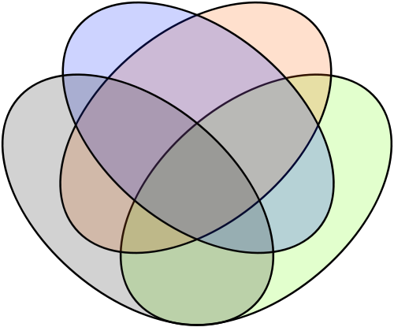
Many Mappings Should be Approximate
skos:broadMatch
skos:related
ore:similarTo
umbel:isAbout
vmf:isInVocabulary
skos:closeMatch
lvont:nearlySameAs
umbel:isLike
umbel:hasCharacteristic
lvont:somewhatSameAs
rdfs:seeAlso
ore:describes
map:narrowerThan
skos:narrower
map:broaderThan
skos:broader
dc:subject
link:uri
foaf:isPrimaryTopicOf

Slide 22
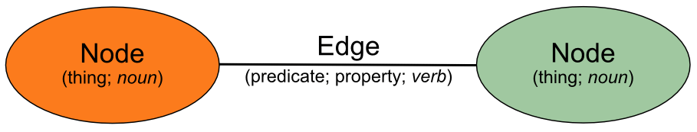
Some Conditions for Interoperability
<Interoperability> <needsMapping> <Predicates>
<Interoperability> <needsReference> <Nouns>

Slide 23
Three Major Players

Slide 24

World Role
<World> <hasRole> <ContentAndStructure>
Notes:
Predicate Role
Reference Concepts (“is About”) Role
DCMI PerfectlySituated

Slide 25
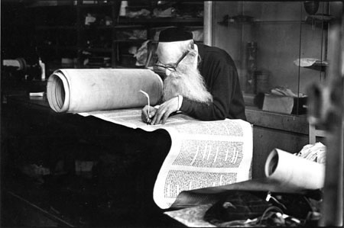
W3C Role
<W3C> <hasRole> <Standards>
Notes:
Predicate Role
Reference Concepts (“is About”) Role
DCMI PerfectlySituated

Slide 26

DCMI Role
<DCMI> <hasRole> <ReferenceMetadata>
Notes:
Predicate Role
Reference Concepts (“is About”) Role
DCMI PerfectlySituated

Slide 27
Three Going Forward Assertions
<LinkedData> <hasNeedOf> <MapPredicates>
<DataWeb> <hasNeedOf> <ReferenceConcepts>
<DCMI> <hasUniqueRole> <BothRequirements>
Notes:
Predicate Role
Reference Concepts (“is About”) Role
DCMI PerfectlySituated

Slide 28
DCMI: the Unique Franchise
DCMI already has unique authority in:
  dc:subject
  dc:subject qualifiers
  initial Open Registry effort
  core foundational properties
DCMI has unique experience in:
  diverse vocabularies
  cataloging and classification
  semantics

Slide 29

Reference Authority - Needed DCMI Role
<RefMetadata> <notSameAs> <OneRingRulesAll>

Slide 30
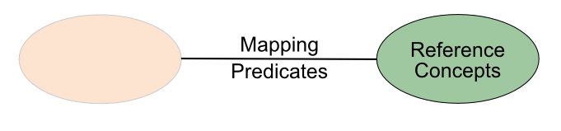

Reference Metadata is Not a Third Rail

Slide 31
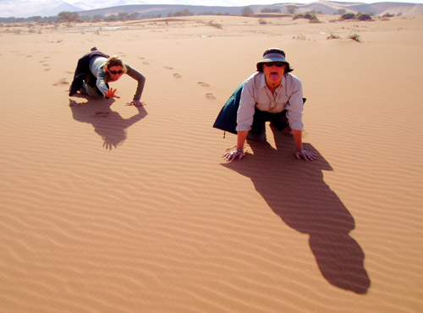
The Web is Parched for Semantics
Reference vocabularies
Persistent URIs
Re-use of vocabs
Vetting ranking
Alignment services (?)
Annotation services (?)
RDFa injection (?)
Open source frameworks

Slide 32




We’re also Ready to Help
+
+ + + ???

Slide 33

A First Exemplar: FactForge
A “reason-able” view to linked open data
  Pre-loaded semantic repository: reasoning, querying, exploration
Ontologies
  Dublin Core, SKOS, RSS, FOAF
Datasets
  DBpedia, Freebase, Geonames, UMBEL, MusicBrainz, Wordnet, CIA World Factbook, Lingvoj
Very large scale
  1.2B explicit + 0.9B inferred → 10B retrievable statements
  Managed by BigOWLIM
Free public service with many features:
  Auto-suggest
  Query and explore through Forest, RelFinder and Tabulator
  RDF search
  SPARQL end-point

Slide 34
Next Step, RENDER
New EU project
Large-scale LOD interoperability, methods
Players:
  Ontotext
  Google (EU)
  Wikimedia (DE)
  Structured Dynamics
Generalizing the FactForge approach
Basis for possible follow-ons ??

Slide 35
Possible Ontotext + SD Contributions
Mapping services to all comers (“vocabulary neutrality”)
Tagging services
Software + systems for other tagging services
Possible technical support for Metadata Registry
Lead / support for possible EU grant-seeking efforts
↓↓↓
If DCMI willing to partner, Ontotext + SD willing to contribute in a neutral, open source manner

Slide 36
Ontotext + SD Links
FactForge
  http://www.factforge.net
PROTON
  http://proton.semanticweb.com
Ontotext
  http://www.ontotext.com
UMBEL
  http://www.umbel.org
Structured Dynamics
  http://structureddynamics.com

Slide 37
Conclusion

Slide 38
Main Assertions Re-visited
Interoperability on the Web not working:
  Not (generally) fulfilled by linked data in current state
  Predicates for approximate mappings lacking
  Reference vocabularies essential as connecting nodes
DCMI is the best (only?) player to plug these gaps
We are willing to help find the resources + right process to help plug the interoperability gap

Slide 39

DCMI Interoperability Services ?

Slide 40
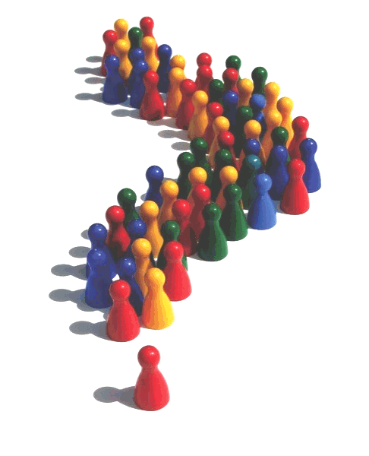

Slide 41
Q & A

Slide 42
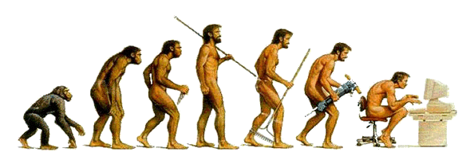
Contacts & Information
Michael K. Bergman
  CEO
  319.621.5225
  mike@structureddynamics.com
  blog: www.mkbergman.com
Web Sites
  structureddynamics.com
  citizen-dan.org (community indicator systems)
  openstructs.org (open source software)
  techwiki.openstructs.org (open license technical documentation)
  umbel.org
  umbel.structureddynamics.com (UMBEL Web services)

