Slide 1


DC 2002 - Florence, October 14th 2002
the things I work on (and/or think about)
Herbert Van de Sompel
Los Alamos National Laboratory – Research Library

Slide 2
outline
Open Archives Initiative
NISO OpenURL
and ... something on work of the LANL Digital Library Research & Prototyping team

Slide 3

the Open Archives Initiative
http://www.openarchives.org

Slide 4
core motivation
libraries are there to faciliate access to scholarly information
we were trying hard, but ...

Slide 5
library position
optimizing the output
P
U
B
D I S
L
I
B
A
R
the input is far from optimal
Notes:
Informatieketen – verbindt auteurs met lezers. Als systeembibliothekaris: optimizeer toegang tot de collectie. Ik begon me belachelijk te voelen, want de input was verre van optimaal. Dus daar ben je: de output aan het optimiseren van een systeem met verre van optimale input. Dus: ik wou daar iets aan veranderen en vond dat de prioriteit in bibliotheekautomatisering (en bibliotheken) moest veranderen van systemen voor toegang tot informatie naar systemen die een minder gestremde doorstroming van informatie konden realiseren. Er moest dus iets gaan gebeuren aan de bron: reposition libraries.

Slide 6
the journal system
serials crisis: increasing journal prices limit, rather than broaden, access to scholarly research
IP drain: faculty signs away copyright
publication delay: journal system can not cope with increasing volume of scholarly output
criticism of peer-review: suppresses ideas, outcome criticized
inertia: system is self-stabilizing

Slide 7
core motivation
libraries are there to faciliate access to scholarly information
we were trying hard, but ...
could there be other (better) ways?

Slide 8
preprint systems
xxx e-print archive
(Physics - 1991 - Los Alamos - Ginsparg)
RePEc
(Economy - Surrey U - Krichel)
NCSTRL
  (Computer Science - Cornell U - Lagoze)
NDLTD
    (Theses - Virginia Tech - Fox)
CogPrints
    (Cognitive Sciences - Southampton U - Harnad)
Notes:
Zulke systemen waren zich beginnen ontwikkelen buiten de bibliotheken. Het Los Alamos arXiv was het meest notoire voorbeeld, maar er waren ook andere, zoals NCSTRL, RePEc, NDLTD, CoGPrints etc.

Slide 9
core motivation
libraries are there to faciliate access to scholarly information
local perspective
global perspective
libraries as institutions are there to guarantee access to information
Notes:
First one has a service connotation. The second one has a service connotation in the analog world. But not necessarily in the digital networked world. So, the question becomes: how can libraries as a global concept fulfill their true raison-d’etre in the most optimal manner? Maybe no longer service, but rather gathering? Libraries as watchdogs: make sure there is information to be served

Slide 10
alternative library position?
capture & share the input…
using the global network
L
I
B
?
A
R

Slide 11
action!
economy
scholarly
communication
technology
sociology
law

Slide 12
action!
economy
establish a technological basis that
allows addressing the other issues.
technology
sociology
law

Slide 13
action!
UPS Prototype [1999]:
  Van de Sompel, Krichel, Nelson
  cross-repository searching
  SFX linking
  insights regarding lack of interoperability
  recommendation: metadata harvesting
launch Open Archives Initiative
  Ginsparg, Luce, Van de Sompel
Notes:
In 1999 not too many libraries were thinking along those lines. So, all the action has been about preprint in general.
Prototype showed (via SFX) how actors were the same in preprint and journal system
The Open Archives Initiative has been set up to create a forum to discuss and solve matters of interoperability between electronic preprint solutions, as a way to promote their global acceptance.

Slide 14
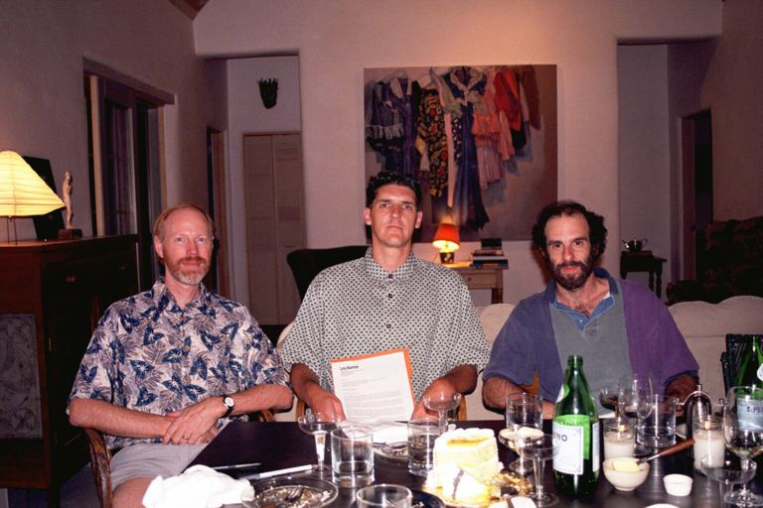
Luce * Van de Sompel * Ginsparg
Notes:
Dat grote dingen niet altijd even ernstig starten wodt geilustreerd door deze foto. Gepubliceerd in een US tijdschrift na weg-editen van glazen en flessen.

Slide 15
since then …
OAI:
  Lagoze, Van de Sompel and lots of great people
  Santa Fe Convention [2000]
  OAI-PMH v.1 [2001]
  OAI-PMH v.2 [2002]
OAI-PMH:
  simple, generic protocol to harvest structured data
  HTTP based
  responses are valid XML instance documents
  unqualified Dublin Core as mandatory metadata format /use of other metadata formats encouraged

Slide 16
since then …
scholarly communication:
  deconstructed communication system
  SPARC white paper on institutional repositories
awareness
certification
rewarding
A
value chain
R
registration
archiving

Slide 17

and … ?
OAI-PMH:
  successful
  used in different communities (scholarly communication, library collections, museums, e-learning, ...)
  project funding opportunities
  fundamental piece of information infrastrucuture (Clifford Lynch)
great
Notes:
Did all this work resort some results? Success: Molinas/Google. Fundamental piece of information infrastructure (Lynch)

Slide 18
and … ?
scholarly communication:
  OAI-PMH and associated tools make moving to action easier
  work of the OAI has helped raise awareness:
    some national forums discussing transformation of scholarly communication
    OAI Workshop CERN
  modest attempts to new communication models (Caltech, CDL, BMC, ...)
  the big change didn’t happen
so & so

Slide 19
should we still act?
the initial motivations remain valid
consortium buying starts to reveal its inherent dangers
the IP issue becomes ... scary
  increasing amount of IP cases
  copyright debate steered by intermediaries (Big Media), no longer something between creators and consumers

Slide 20
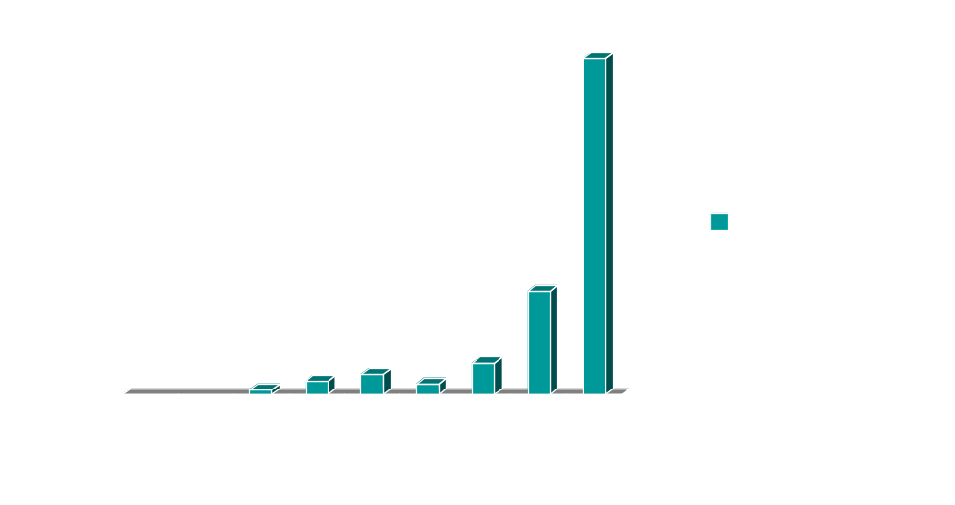
occurrences of the phrase “intellectual property” per 100,000 U.S. Federal Cases
“Professor Hank Greely” Cited in Lessig, L. The future of ideas: the fate of the commons in a connected world. NY, Random House, 2001. P. 294.
Notes:
Scholarly info should not be part of an IP framework controlled/directed by big media. The notion of exclusive rights is not really the thing that is required, there. Creative Commons. The one slide sent to you depicts number of references to "IP" per hundred thousand cases and suggests that in the
1990-1999 decade there were 86.37 references per 100,000 cases.

Slide 21
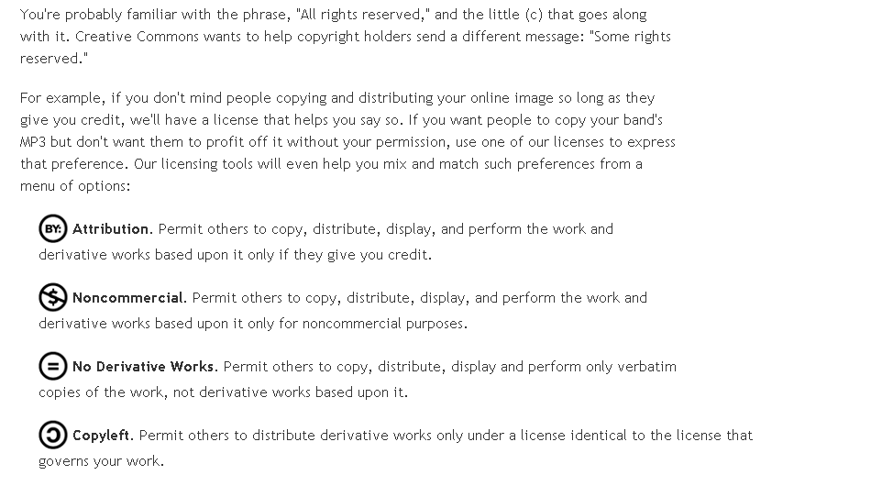
seems to resonate better with scholarly communication

Slide 22
should we still act? yes!
the OAI will go back to its eprint roots
build upon the OAI-PMH to move beyond interoperability at the level of discovery:
  references
  usage logs
  cerfitication metadata
  rights metadata
some of the work conducted by OAI, some coordinated with other projects

Slide 23
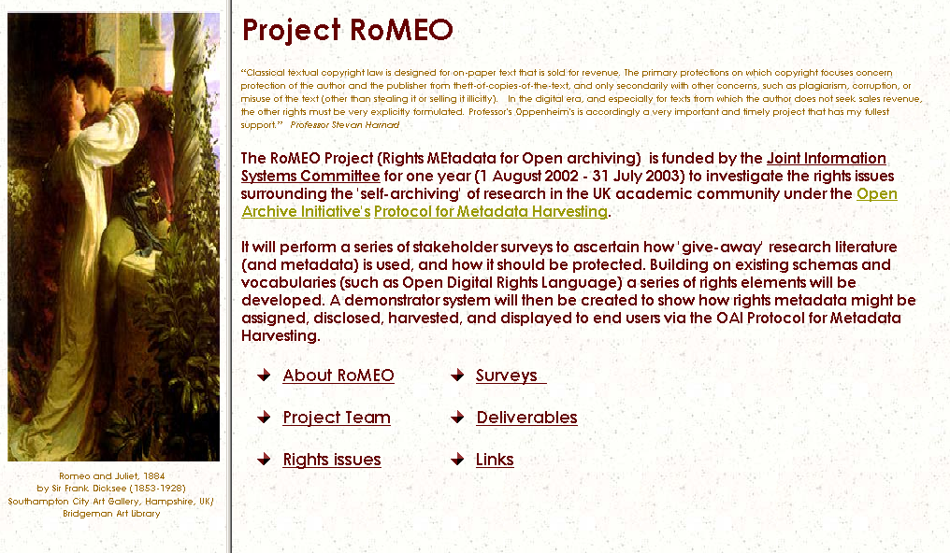

Slide 24
NISO OpenURL
http://library.caltech.edu/openurl/
http://www.openurl.info

Slide 25
core motivation
libraries are there to faciliate access to scholarly information
we were trying hard, but ...

Slide 26
linking
A&I
e-print
FTXT
interlink related information
OPAC
FTXT
A&I

Slide 27
linking
A&I
e-print
FTXT
information providers linking it their way
OPAC
FTXT
A&I

Slide 28
problems
links not context-sensitive
  appropriate copy problem
  didn’t cover complete collection
links dependent on business agreements between information vendors
libraries no say in linking => in danger of loosing part of the “organizing information” task
Notes:
If you agree that:
Libraries are about organizing information
* links organize information
Then: a big portion of the lib’s task went down the drain

Slide 29
core motivation
libraries are there to faciliate access to scholarly information
we were trying hard, but ...
could there be other (better) ways?

Slide 30
conventional linking
resource
resource
link source
link destination
.
reference
link to referenced work
link
resolution of
metadata into link

Slide 31
OpenURL linking
transportation of
metadata & identifiers
resource
Operated by Library
link source
.
link
destination
link
OpenURL
resolver
reference
OpenURL
link
destination
link
appropriate
link
destination
link
hook
link
destination
link
resolution of
metadata & identifiers into services
provision of hook

Slide 32
the OpenURL framework
A&I
OpenURL
by value or by reference
delivery of metadata on
users’ request
local
OpenURL
resolver
FTXT
OPAC
OpenURL
OpenURL
OpenURL
linking server
describes context
FTXT

Slide 33
deployment of the OpenURL framework
draft OpenURL specs early 2000
lots of interest from libraries, information providers
adopted by important information providers
NISO standardization of OpenURL started 2001
Integration of OpenURL framework and DOI-based linking
SFX server marketed by Ex Libris
other parties start marketing OpenURL resolvers (e.g. Fretwell-Downing, Endaevour, Openly, ...)
great

Slide 34
draft OpenURL syntax
so & so
http://www.mysfx.org/menu?
id=doi:10.111/12345&
genre=article&
aulast=Weibel&aufirst=Stu&ISSN=35345353
&year=2001&volume=14&issue=3&spage=44&
pid=2829393&
sid=OCLC:Inspec
Specific for web-based scholarly information
Hardwired metadata tags
Not extensible

Slide 35
generalizing
context: web-based information
can something like the OpenURL framework be extended to resources that are referenced on the Web in general?
  all kinds of referenced resources
  provide context-sensitive services about referenced resources
the Bison-Fute model (Van de Sompel, Beit-Arie - 2001)
=> basis for NISO standardization

Slide 36
draft OpenURL syntax
http://www.mysfx.org/menu?
id=doi:10.111/12345&
genre=article&
aulast=Weibel&aufirst=Stu&ISSN=35345353
&year=2001&volume=14&issue=3&spage=44&
pid=2829393&
sid=OCLC:Inspec&
Resolver
Referent
Referrer

Slide 37
draft OpenURL syntax
Entities explicitly present in OpenURL:
  Referent (subject of the OpenURL)
  Resolver (OpenURL resolver)
  Referrer (the service writing the OpenURL)
Entities stuffed into pid of OpenURL:
  Requester
  Referring Entity
  Service Type

Slide 38
NISO OpenURL ContextObject
Information construct that contains descriptions of
Referent (the thing that is being referenced)
Entities that make up the context in which the referent is referenced:
  ReferringEntity (the object that references the referent)
  Requester (the party initiating the transportation of the ContextObject)
  ServiceType (goal of transportation)
  Resolver (the system that can be target of transportation of the ContextObject)
  Referrer (the system providing the ContextObject)

Slide 39
draft OpenURL syntax
http://www.mysfx.org/menu?
id=doi:10.111/12345&
genre=article&
aulast=Weibel&aufirst=Stu&ISSN=35345353
&year=2001&volume=14&issue=3&spage=44&
pid=2829393&
sid=OCLC:Inspec&
identifier
identifier
metadata
private data, pointer to metadata
identifier

Slide 40
draft OpenURL syntax
Referent can be described:
identifiers
by-value metadata ~ name=value pairs ~ fixed formats
pid
  private data
  pointers to metadata
Resolver described by means of:
  BASE-URL ~ identifier in http namespace
Referrer described by means of:
    sid ~ serviceId:dbaseID syntax ~ identifier

Slide 41
descriptors ~ NISO standardization
Entities in the ContextObject can be described by means of the following descriptors:
  identifiers ~ many namespaces
  by-value metadata ~ many namespaces
  by-reference metadata ~ many namespaces
  private data
=> extensibility to all kinds of genres of referenced resources via Registry

Slide 42
ContextObject representation
ContextObject is an abstract notion
  Can be represented in different ways
  Different representations can apply different constraints to the abstract ContextObject notion:
    Key/Value
    XML
    RDF

Slide 43
NISO ContextObject representation
Key/Value representations
  property list format
  &-delimited, URL-encoded list of Key/Value pairs
XMLrepresentations (XML Schema definition)
  XML representation that matches Key/Value constraints

Slide 44
Key/Value representation
rft_id = ori:doi:10.1126/science.275.5304.1320&
rft_id = ori:pmid:9036860
rft_val_fmt = ofi:pl:jarticle
aulast = Bergelson
auinit = J
year = 1997
volume = 275
spage = 1320
epage =1323
rfe_id = ori:doi:10.1006/mthe.2000.0239
rfr_id = ori:dbid:elsevier.com:ScienceDirect
req_id = uri:mailto:jane.doe@caltech.edu
ctx_ver = z39.88-2002
ctx_tim = 2002-03-20T08:55:12Z
Referent
ReferringEntity
Referrer
Requester
admin
Notes:
Zeker iets zeggen over DC hier.

Slide 45
XML representation
Click here

Slide 46
So, what’s this NISO OpenURL?
Transportation of ContextObject
via HTTP(S) GET/POST == OpenURL
ContextObject may be transported using other protocols (OAI-PMH, SOAP, …). But that’s not an OpenURL

Slide 47
DC 2002 - Florence, October 14th 2002
questions?
Herbert Van de Sompel
Los Alamos National Laboratory – Research Library

