Slide 1
A Registry of Collections and their Services: from Metadata to Implementation
Ann Apps
MIMAS,
The University of Manchester, UK

Slide 2
Outline
Purpose of JISC Information Environment Service Registry (IESR)
IESR content description
Types of technical services described
IESR’s interfaces
Implementation of IESR
Future of IESR

Slide 3
Why IESR?
JISC Information Environment:
  Collections of resources for researchers, learners, teachers in UK
Single central catalogue - m2m access
  Improve awareness and access
Funded by the JISC:
  MIMAS, UKOLN, University of Liverpool
  Prototype Registry developed at MIMAS

Slide 4
IESR for Portals
Portal: amalgamated set of resources
  cross-searching, harvesting
IESR provides:
  Discovery of resource collections
  Details of access to collections
Using IESR, portal could:
  Cross-search including collections
  Link to collection web pages
  Harvest IESR data

Slide 5
IESR Content
Descriptions of:
  Collections of resources
  Informational Services that provide access
  Agents: Owners / Administrators
  Transactional Services
Supplied by resource providers
Quality check by IESR content manager

Slide 6
IESR Entities
Collection
provides
access
owns
Service
Agent
administers

Slide 7
IESR Identifiers
Every entity has a URI
Assigned on registration in IESR
Provide identification for resources in IE
Links between entities in IESR
PURL-based Object Identifier (POI)
Example:
http://purl.org/poi/iesr.ac.uk/105636559-25788

Slide 8
IESR Collection Metadata
Based on RSLP Collection Description
Simplification for electronic resources
Backbone subject scheme (Dewey)
Some additional IESR terms
  hasService: IESR id (service)
  usesControlledList
Owner: IESR id (agent)

Slide 9
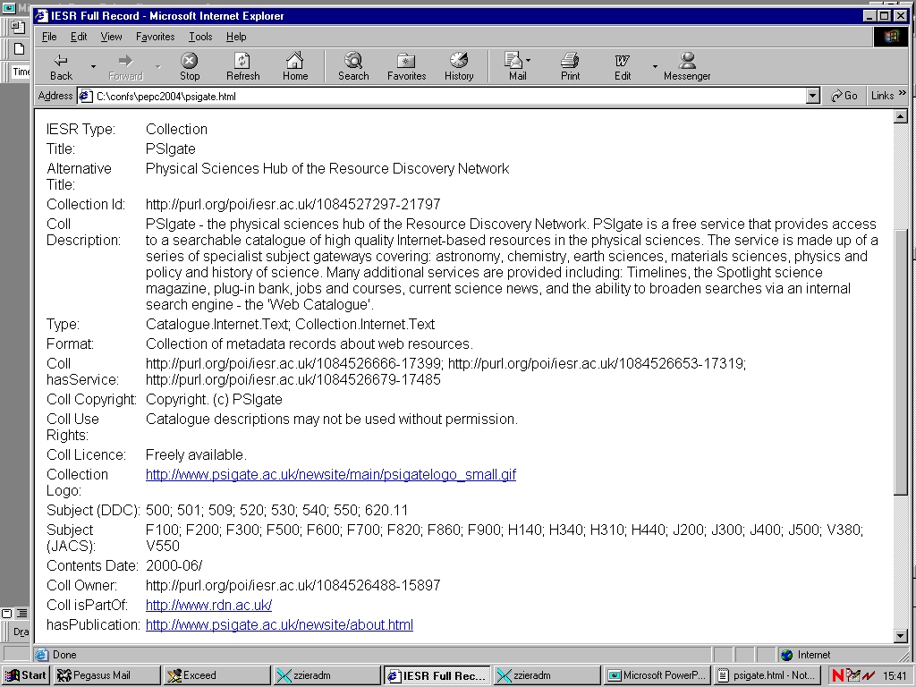

Slide 10
IESR Service Metadata
More than RSLP CD ‘locator’
Bespoke IESR scheme, uses open standards
Single access method:
  Z39.50, SOAP, OAI-PMH, Web/CGI
Location URL
Interface property for some service types
Administrator: IESR id (agent)

Slide 11
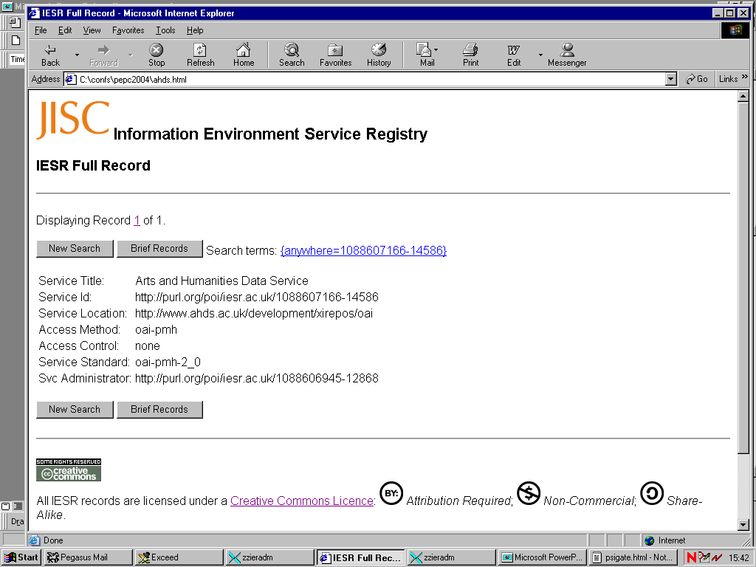

Slide 12
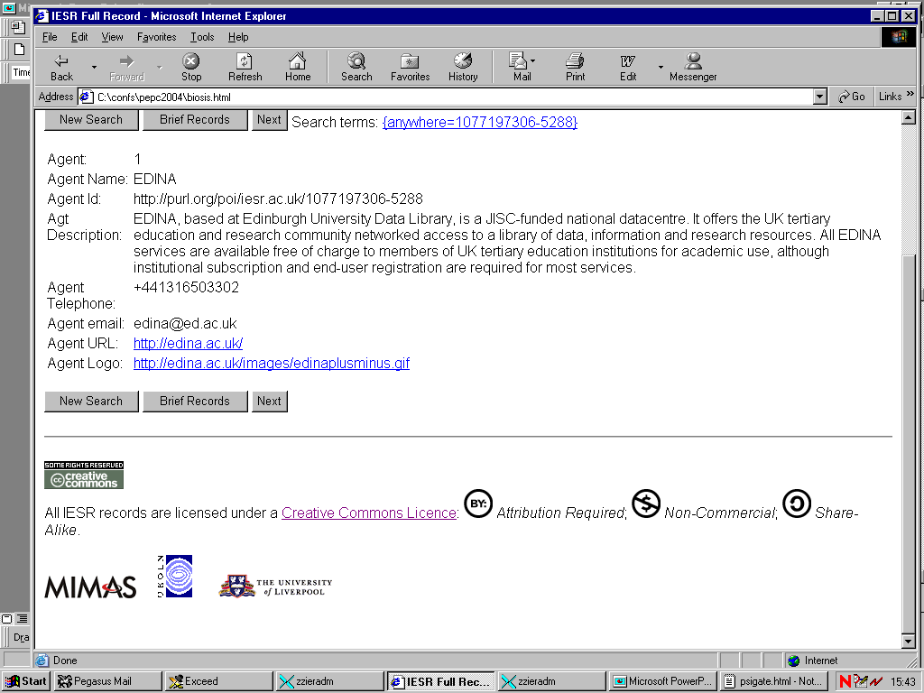

Slide 13
IESR Administrative Metadata
Included with every entity
Data suppliers can include:
  creator / contributor, creation dates,
  language, source
IESR includes:
  latest modification date
  rights

Slide 14
IESR Creative Commons Licence
All IESR records licensed under a Creative Commons licence:
  Non-commercial (freely available)
  Share-alike (maintain same licence)
  Attribution-required (attribute provenance)
Suppliers agree to this licence
http://creativecommons.org

Slide 15
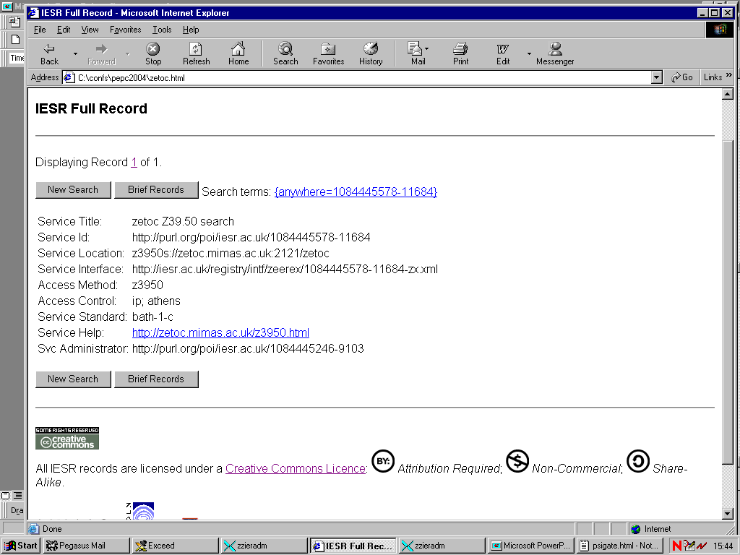

Slide 16
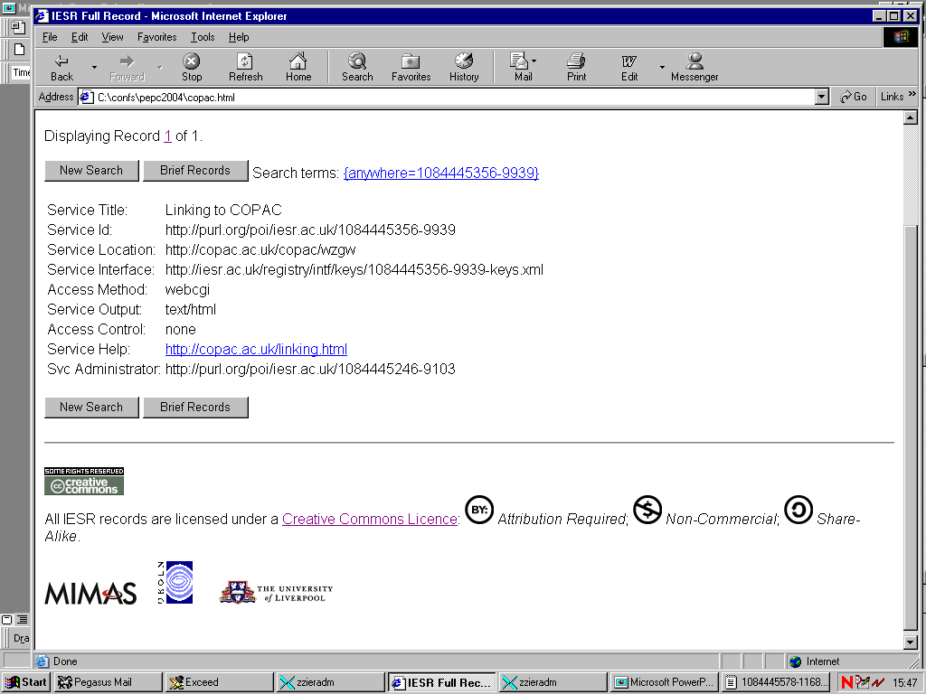

Slide 17
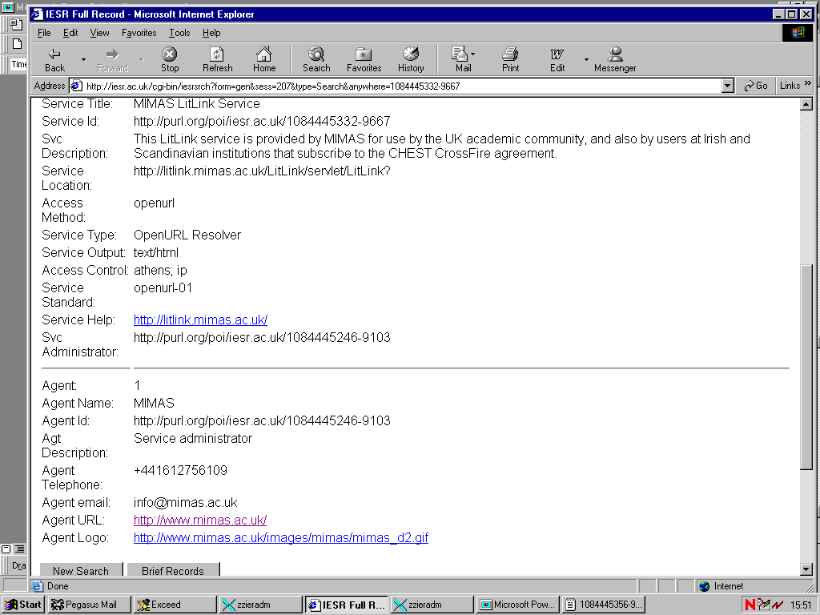

Slide 18
Other Service types
SOAP:
  Locator: access URL
  Interface: WSDL
OAI-PMH:
  Locator: BaseURL
  Interrogate service (Identify) for more details
Web page: Locator: URL

Slide 19
IESR Interfaces
Z39.50: Bib-1 Search
  SUTRS (B & F), GRS1, XML (DC and IESR)
OAI-PMH (soon):
  XML (DC and IESR)
Web Services SOAP (SRW) later
Web Search

Slide 20
IESR XML
Composite Collection record:
  Collection
  All services that provide access
  All agents:
    Owners of collection
    Administrators of services
Composite Transactional Service record:
  Service and all administrator agents

Slide 21
IESR Data Supply
Descriptions provided as single entities
Currently data provided using templates
  XML
  Excel
  Entities correlated using local identifiers
Web form data entry interface soon

Slide 22
IESR Implementation
Cheshire II:
  Advanced information retrieval system
  Data held as XML with indexes
  Customisable Z39.50 interface
  Rudimentary Web interface
IESR data: composite collection records
Database re-indexed overnight after change

Slide 23
IESR Meta-Registry
Records entities and relationships
Holds ‘master’ copies of entities
Controls build of registry
Provides browse interface
Provides single entity records

Slide 24
IESR Content
Collections from main JISC IE data providers
Collections: 258; Agents: 172
Services: 305
  OAI-PMH: 4; OpenURL: 2; RSS: 7
  SOAP: 1; Z39.50: 20; WebCGI: 5
  WebPage: 256

Slide 25
M2M Interfaces
IESR aims to provide middleware service in m2m world
Few collections in JISC IE have m2m interfaces
Institutional repositories of learning materials and e-prints under development
Portals can link to resource websites.

Slide 26
IESR Future
In second 14 month phase of project (until Feb 2005)
Hope for further funding from JISC - eventually a service
More content and beyond JISC IE
Further interfaces
Will enhance information landscape

Slide 27
IESR Details
Web site: http://www.iesr.ac.uk
Search IESR: http://iesr.ac.uk/registry/
Helpline: iesr@mimas.ac.uk
Ann Apps: ann.apps@manchester.ac.uk

