Slide 1
a methodology for metadata modelling
- depth for a flat world
Andreas Aschenbrenner

Slide 2
motivation
metadata "model":
. object .
title
creation_date
creator
nationality
format
...

Slide 3
graphic model
consists_of
employed_by
Object
Creator
title
creation_date
...
name
nationality
...
Item
location
file_size
format
...

Slide 4
EER toolbox
relation
Object1
Object2
one-to-one
attribute-1
attribute-2
...
attribute-1
attribute-2
...
c
o
n
n
e
c
t
i
v
i
t
y
unary
1 : 1
d
e
g
r
e
e
binary
1 : n
m : n
ternary
mandatory
optional

Slide 5

metadata modeling experiences I
NLNZ Preservation Metadata Model, November 2002

Slide 6
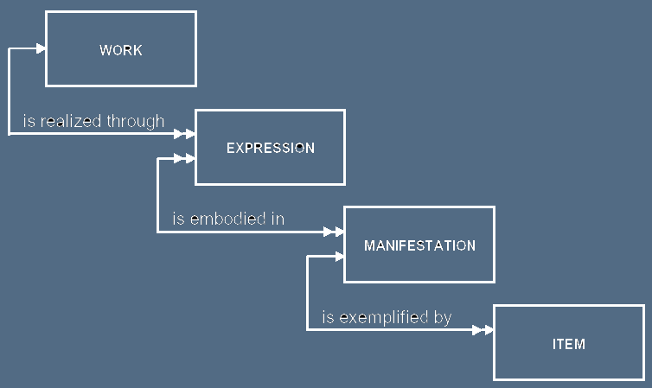
metadata modeling experiences II
IFLA Functional Requirements for Bibliographic Records, September 1997

Slide 7
metadata modeling experiences III
Resource
“Literal”
Property
Statement
RDF Data Model Statement -
Thomas Baker: RDF Schemas. May 2000.

Slide 8
goals
→ raise quality
→ manage complexity over time
→ facilitate communication
→ enable comparison
→ highlight synergies, reduce costs

Slide 9
references
...
17. Results of the Harmony Project. http://www.metadata.net/harmony/. Of particular interest in this context: Carl Lagoze, Jane Hunter. The ABC Ontology and Model. In: Journal of Digital Information 2(2), November 2003.
18. Heidi Gregersen, Christian S. Jensen. Temporal Entity-Relationship Models - A Survey. In: IEEE Transactions on Knowledge and Data Engineering, May 1999; v.11, n.3, pp 464-497.
19. Daniel L.Moody, Graeme G.Shanks. Improving the quality of data models: empirical validation of a quality management framework. In: Information Systems 28(6), 2003; pp 619-650; ISSN 0306-4379.
20. Lex Wedemeijer. Long-term evolution of a conceptual schema at a life insurance company, Annals of cases on information technology, Idea Group Publishing, Hershey, PA, 2002.
21. Reinhard Schuette, Thomas Rotthowe. The Guidelines of Modeling - An Approach to Enhance the Quality in Information Models. In: T.W. Ling, S. Ram, and M.L. Lee (Eds.). ER’98, LNCS 1507, pp. 240−254, 1998. Springer-Verlag Berlin Heidelberg 1998.
22. S.Castano, V. de Antonellis, M.G.Fugini, B.Pernici. Conceptual schema analysis: techniques and applications. In: ACM Trans. Database Systems 23(3); 1998; pp 286--333; ISSN 0362-5915.
...

Slide 10
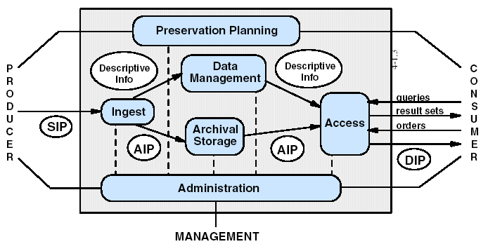
OAIS Functional Model
Reference Model for an Open Archival Information System (OAIS). January 2002. CCSDS 650.0-B-1.

Slide 11
employed_by
Creator
Affiliation
Object
name
nationality
name
address
consists_of
title
creation_date
quirk
executed_in
Process
Item
description
file_size
location
Technology
discovered_in
HW_spec
SW_spec
type
Quirk
description
image
audio
text
resolution
sample_rate
pages
TIFF
JPEG
tiff_type
compression_rate
exemplary model

Slide 12
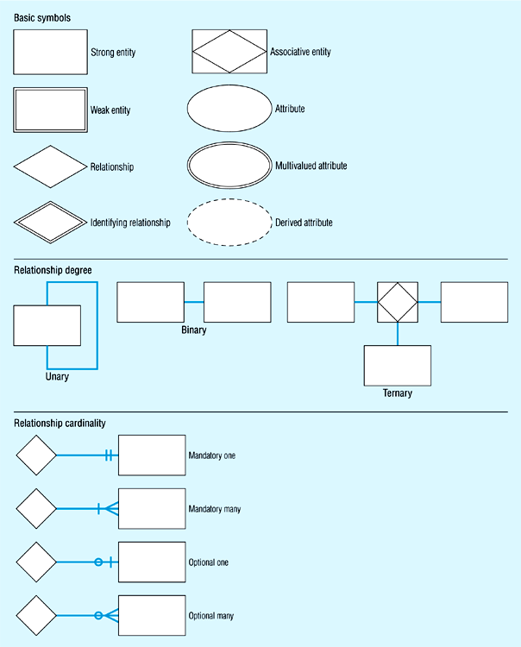

Slide 13
