Slide 1
Metadata Generation and Accessibility Auditing
Liddy Nevile
La Trobe University, Australia
Mail liddy@SunriseResearch.org

Slide 2
Testing for accessibility
Partly automated
Partly manual
Not 100% effective
also 'pages' have their content changed frequently.

Slide 3
Case Study
Using software to manage and assist in the process of developing database of metadata about accessibility
  La Trobe University
  A typical site audited in 2004
  Accessibility is tested for two reasons:
    to determine compliance and
    to help increase accessibility.

Slide 4
Audit Preparation
Identify Players
  Permission and support – access to files.
Identifying Standard
  W3C ‘standards’
  National, regional and local standards
  Different ways of interpreting them
And local guidelines – testing to see if guidelines give desired result

Slide 5
Mapping the Content
Scope the audit
Define Compliance
Generate a site map

Slide 6
Astra Site-Management
  Of 48,084 URIs:
  14,432 were available (the http server returned them)
  32,826 were 'unread', probably unprocessed files, eg images
  2 were unavailable, maybe because of server problems
  174 had 'access denied' responses, and there were
  650 404 errors (broken links).

Slide 7
SiteManager:
found 37,919 local links (URLs) and 10,165 external links
Generated a comprehensive report using a fast connection
In 17 minutes
From this result, it is obvious that there is a lot to be gained from the exercise.

Slide 8
Site Map

Slide 9
More detail
Easy to identify specific or ranges of pages for auditing

Slide 10
Migrating data
Extract information
Use spreadsheet for macros
Use database for bulk handling
Save file of URIs as text for AccVerify.
Note: the information could be made available for other purposes.

Slide 11
Useful information gathered
FileName, PageName, Annotation, URL, Last Modified, File Size, Load Size, Incoming Links, Outgoing Links, Broken Links.

Slide 12
Set up Content Audit
Parameters of particular interest:
  the standards against which the evaluations were to be made,
  the type and format of report to be generated
Schedule automatic testing
Note the same software could be used for completely different things with different filters and algorithms.

Slide 13
Testing Content
Automate such questions as:
  Does the content contain an image - yes / no identifies need to test further for ALT tag
  If there is ALT tag, does it have a typical default value, such as "insert ALT text here"
but it requires a human to determine if it is a meaningful ALT tag

Slide 14
Effectiveness of testing
Automated testing is good for failures
But it is possible for inaccessible content to pass many automated tests
E.g it is important to know both the format and genre of content because ‘text’ may be in an image format and so inaccessible to a screen reader
ie the relationship between genre and format is important

Slide 15
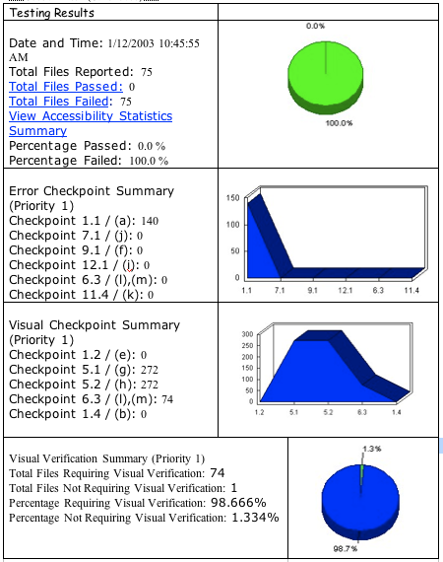

Slide 16
Test results
Date and Time: 1/12/2003 10:45:55 AM
Total Files Reported: 75
Total Files Passed: 0
Total Files Failed: 75
View Accessibility Statistics Summary
Percentage Passed: 0.0 %
Percentage Failed: 100.0 %

Slide 17
Error Checkpoint Summary
Checkpoint 1.1 / (a): 140
Checkpoint 7.1 / (j): 0
Checkpoint 9.1 / (f): 0
Checkpoint 12.1 / (i): 0
Checkpoint 6.3 / (l),(m): 0
Checkpoint 11.4 / (k): 0

Slide 18
Visual Checkpoint Summary
Checkpoint 1.2 / (e): 0
Checkpoint 5.1 / (g): 272
Checkpoint 5.2 / (h): 272
Checkpoint 6.3 / (l),(m): 74
Checkpoint 1.4 / (b): 0

Slide 19
Visual Verification Summary
Total Files Requiring Visual Verification: 74
Total Files Not Requiring Visual Verification: 1
Percentage Requiring Visual Verification: 98.666%
Percentage Not Requiring Visual Verification: 1.334%

Slide 20
Interpreting the Evaluation
Of 100 pages selected for careful testing
none passed the automated test (doesn’t mean it was not close to satisfactory)
Gross evaluation result was interesting but finer detail was of real significance
Many times a single object was in many pages, so what mattered was how easily those single objects that contained errors could be repaired.

Slide 21
Repairing Inaccessible Content
Once shown an accessibility flaw, the user can switch from the evaluation software to repair management software and be led through the process of correcting the problem
ie metadata about the object can be linked to metadata about the problems and related solutions and techniques

Slide 22
The Metadata's Role
Detailed information is necessary for evaluation, repair, and management of evaluation process and post-evaluation management decisions (e.g. in the test case, a few errors in templates caused a vast number of problems)
The metadata can be in a metadata repository for on-going accessibility management

Slide 23
Form of metadata
Accessibility experts want to know who (or what) did evaluation and when so special metadata format is used.
  This format is known as Evaluation and Reporting Language (EARL) and was developed by W3C for this purpose.
  An EARL statement is simply an RDF statement accompanied by information about when it was made and by whom or what.

Slide 24
As Wendy Chisholm said:
This information is stored in EARL so that other tools can make use of it.
  E.g a search engine can be selective, and,
  As no single tool tests well for all aspects of accessibility, having results in EARL format enables sharing of the task.

Slide 25
AccLIP and AccMD
AccLIP and AccMD are two profiles, one for a user and one for a resource
Accessibility is defined as the matching of user’s needs and preferences and resources they can access.

Slide 26
Conclusion 1
Metadata tools will make generating metadata about accessibility easier. The pressure for compliance will drive the adoption of such tools. To that end, the WG has developed user profiles and matching resource profiles for a new accessibility term.

Slide 27
Conclusion 2
Crucial to the success of the overall effort to make Web resources more accessible is the availability of the metadata. Once available, it can be re-purposed to satisfy not only the needs of those who care about compliance for regulatory reasons, but for those who work to ensure that resources are matched to users' needs and preferences.

Slide 28
Note re Tools
AccVerify is just one of the tools that generate EARL statements for English speakers See also
    the Accessibility Checker
    Accessibility Valet Demonstrator and
    Wave 3.5
There is also significant development work going on in non-English speaking countries.

Slide 29
Thank you.

