Slide 1
Metadata element sets in the CISMeF Quality-Controlled Health Gateway
B. Thirion ª, M. Douyèreª , LF. Soualmia ^{a, b}, B. Dahamna, JP. Leroy, SJ. Darmoni ^{a, b}
ª L@sTICS, Rouen University Hospital & Medical School, France
^{b} Perception, Information and System Lab, INSA Rouen & Rouen University, France

Slide 2
Definition: quality-controlled subject gateway
Quality-controlled subject gateways were defined by Koch as Internet services which apply a comprehensive set of quality measures to support systematic resource discovery.
Considerable manual effort is used to process a selection of resources which meet quality criteria and to display a extensive description and indexing of these resources with standards-based metadata.
Regular checking and updating ensure optimal collection management.
The main goal is to provide a high quality of subject access through indexing resources using controlled vocabularies and by offering a deep classification structure for advanced searching and browsing.

Slide 3
Introduction
The objective of CISMeF is to describe and index the main French-speaking health resources to assist health professionals during the search of electronic information and knowledge available on the Internet.
CISMeF was a project initiated by the Rouen University Hospital (RUH) (over 20 grants)
URL: www.chu-rouen.fr/cismef or www.cismef.org
Date of creation: February 1995 => CISMeF = dinosaur
In October 2004, the number of indexed resources totaled over 13,500 with a mean of ~ 50 new resources each week.
Every working day, 30,000 unique machines
CISMeF team: five librarians, 2 medical informaticians, 1 engineer, 3 PhD students

Slide 4
Introduction (cont.)
Each of the following phases proposed by Koch, which characterise a typical quality-controlled subject gateway, are implemented in CISMeF:
  (a) selection and collection development, based on the Net Scoring, list of 49 criteria to assess quality of health information (URL: http://www.chu-rouen.fr/netscoring),
  (b) collection management,
  (c) intellectual creation of metadata (done by experts),
  (d) resource description (an extensive and documented metadata set), and
  (e) resource indexing (using a controlled vocabulary system).

Slide 5
Introduction (cont.)
CISMeF uses two standard tools for organising information: the MeSH (Medical Subject Heading) thesaurus from the US National Library of Medicine (enhanced version) and
several metadata element sets,
  (a) the Dublin Core metadata format to describe and index all the health resources included in CISMeF,
  (b) some elements from IEEE1484 Learning Object Metadata for teaching resources,
  (c) specific metadata for evidenced-base medicine resources which also qualify the health content, and
  (d) the HIDDEL metadata set is used to enhance transparency, trust and quality of health information on the Internet in the EU-funded MedCIRCLE project.

Slide 6
Methods
Description of IEEE 1484 Learning Objects Metadata (LOM) for teaching resources:
The IEEE 1484 Learning Object Metadata (LOM) (URL: http://ltsc.ieee.org/doc/wg12/LOM_WD6_4.pdf)
Version 6.4 contains around 80 elements in the following nine categories: General,. Lifecycle, Meta-metadata, Technical Educational, Rights, Relation, Annotation, Classification.
LOM metadata includes the 15 DCMI elements

Slide 7
Methods
Description of EBM (Evidence-Based-Medicine) metadata element set: CISMeF uses two specific metadata elements for EBM resources and more broadly ‘sensitive’ information.
Sensitive information is defined as information found in documents published on the Internet, which could be used in a medical decision
These two metadata elements are:
  (a) indication of level of evidence which we proposed to be the main criterion chosen for the quality of the health information content and
  (b) the method used to calculate the level of evidence as more than twenty are currently used in the literature.
CISMeF explicitly indicates if level of evidence is mentioned for each indexed 'sensitive' document. This criterion is easily searchable using the Doc'CISMeF search tool.

Slide 8
Methods
Description of "Health Information, Disclosure, Description and Evaluation Language" (HIDDEL):
HIDDEL is a standard vocabulary/metadata language developed in the MEDCIRCLE project (URL: http://www.medcircle.info).
HIDDEL is used to enhance transparency, trust and quality of health information on the Internet.
HIDDEL is designed to be used by 1) information providers to describe and disclose properties of e-health services (self-rating) and 2) third-parties, e.g. by subject gateways, to express third-party opinions about health information providers.

Slide 9
Results
The fifteen Dublin Core elements are optional
Resources included in CISMeF are described by the 11 following items of the 15 taken from DC:
  author or creator, date, description, format, identifier, language, publisher, resource type, rights, subject and keywords, and title.
CISMeF does not (yet) use the other DC fields:
  contributor, coverage, relation, source
The following eight fields are added in the metadata and are specific to CISMeF:
  CISMeF resource types, institution, city, province or state, country, target, type of access, cost and sponsorship

Slide 10
Metadata in Education
CISMeF is one of the search tool of the French Medical Virtual University (FMVU) Consortium which was created to test various tools and methods required to build a virtual university (URL: http://www.umvf.org).
To describe and index teaching resources, this consortium decided to use in its search tools only the 11 elements of the LOM Educational category because they are the most specific.
Also, a feasibility study showed that: the CISMeF team spends an average of 30 minutes to describe and index a teaching resource with the Dublin Core set and needs 30 minutes more for the LOM Educational subset.

Slide 11
DC.Audience
DCMI propose an element DC.Audience to develop and promote a set of basic principles for the development and application of modular interoperable metadata for dissemination to the global education and training communities.
DC.Audience maps with several elements of the LOM Educational subset.
The CISMeF metadata element set will use DC.Audience.
The FMVU Consortium is now studying the use of Sharable Content Object Reference Model (SCORM).

Slide 12
The use of HIDDEL in CISMeF
CISMeF is a member of the MedCIRCLE project which is a collaboration of trusted European health subject gateways, medical associations, accreditation, certification, or rating services, which share the common goal of evaluating, describing, or indexing health information.
The MedCIRCLE project is funded by the European Union under the Action Plan for Safer Use of the Internet
This project began in March 2002 and last 18 months till December 2004.
As a quality-controlled subject gateway, CISMeF uses HIDDEL only as a third-party.
Some elements of the HIDDEL are similar to Dublin Core (e.g. HIDDEL.Identity and DC.Author).
Most of the HIDDEL elements are common with the Net Scoring previously used by CISMeF whereas some are already present in the CISMeF database (e.g. HIDDEL.policies).

Slide 13
The use of HIDDEL in CISMeF
CISMeF focuses this rating on the main French publishers of health resources (national agencies, medical societies, universities and hospitals) which are included in the CISMeF database.
In CISMeF, the main publishers (N=330) have a MedCIRCLE seal with a link to the MedCIRCLE central repository where HIDDEL metadata elements are displayed.
CISMeF applies full transitivity from these publishers: each document from one MedCIRCLE rated publisher which is indexed in CISMeF also receives the MedCIRCLE seal of the publisher with the same link to MedCIRCLE central repository.
The HIDDEL language is integrated in the CISMeF database and in the CISMeF pages via RDF into HTML.

Slide 14
Results (cont.)
From Feb. 1995 to June 2000, CISMEF used only static HTML. As CISMeF uses the MeSH to index resources, every HTML page is based on a MeSH term.
In Oct. 2004, CISMeF used ~ 10,500 MeSH terms (46% of the MeSH thesaurus).
Table 1 gives the Dublin Core elements used in the metadata of each CISMeF MeSH Page (paralysis as an example). These elements are manually written in and updated an Oracle database by the CISMeF team, then automatically generated (every night).
Since June 2000, birth of Doc’CISMeF, search tool => automatic HTML to generate one HTML page for every indexed resource.
Table 2 gives the Dublin Core and the CISMeF elements used in each CISMeF resource page. These elements are automatically written from the Doc’CISMeF database.

Slide 15
Example of a description of a document indexed in CISMeF
Protocol For The Investigation Of Acute Flaccid Paralysis And Suspected Paralytic Poliomyelitis http://www.hc-sc.gc.ca/hpb/lcdc/bid/di/polio_e.html Working Group on Polio Eradication and the Division of Immunization Bureau of Infectious Diseases, Laboratory Centre for Disease Control, Health Canada, Ottawa [publisher Health Canada ; Background Surveillance, Case Definitions, Investigation and Reporting of Cases, Management of Close Contacts, Reporting of Incidental Finding of Wild Poliovirus, References ; document in English and French ; creation date: April 1997 ; last update: July 1997 ; last visit: January 2000] -Ca
keywords: paralysis; poliomyelitis
resource type: practicel guideline; technical report

Slide 16
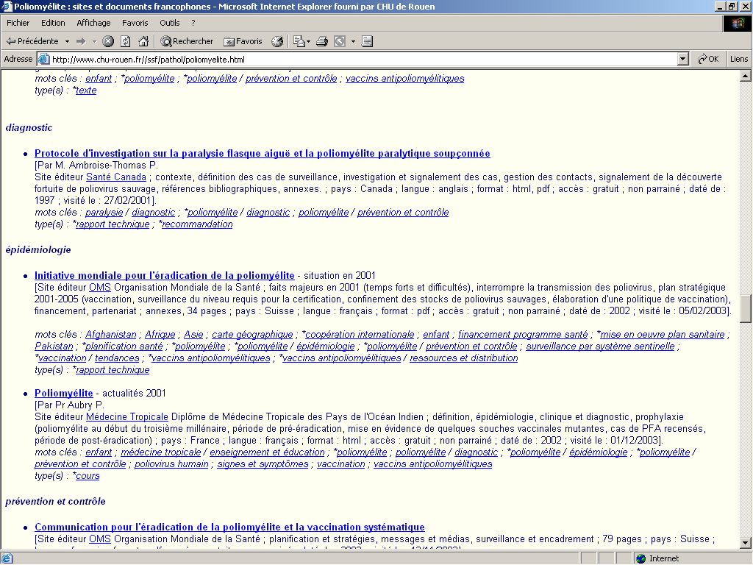

Slide 17
Table 1: Dublin Core metadata elements used in a CISMeF Mesh Page
<META http-equiv="Content-Type" CONTENT="text/html; charset=iso-8859-1">
<META NAME="DC.Creator" CONTENT="&eacute;quipe CISMeF : St&eacute;fan Darmoni; Magaly Douyère; Jean-Philippe Leroy; Saïda Ouazir; Josette Piot; Benoit Thirion; Badisse Dahamna" >
<META NAME="DC.Identifier" SCHEME="IMT" CONTENT="/ssf/pathol/poliomyelite.html" >
<META NAME="DC.Language" SCHEME="RCF1766" CONTENT="fr" >
<META NAME="DC.Publisher" CONTENT="Centre Hospitalier Universitaire de Rouen" >
<META NAME="DC.Subject" SCHEME="MESH" CONTENT="poliomyelitis; diagnosis; epidemiology; prevention and control; transmission" >
<META NAME="DC.Subject" SCHEME="MESH" CONTENT="poliomyélite; diagnostic; épidémiologie; prévention et contrôle; transmission" >
<META NAME="DC.Title" CONTENT="Poliomyélite : sites et documents francophones" >
<META NAME="DC.Type" SCHEME="DCMIType" CONTENT="text" >
…
<link rel="schema.CISMeFType" href="http://www.chu-rouen.fr/documed/typeressource.html">
…
These DC are common to all MeSH pages in CISMeF

Slide 18
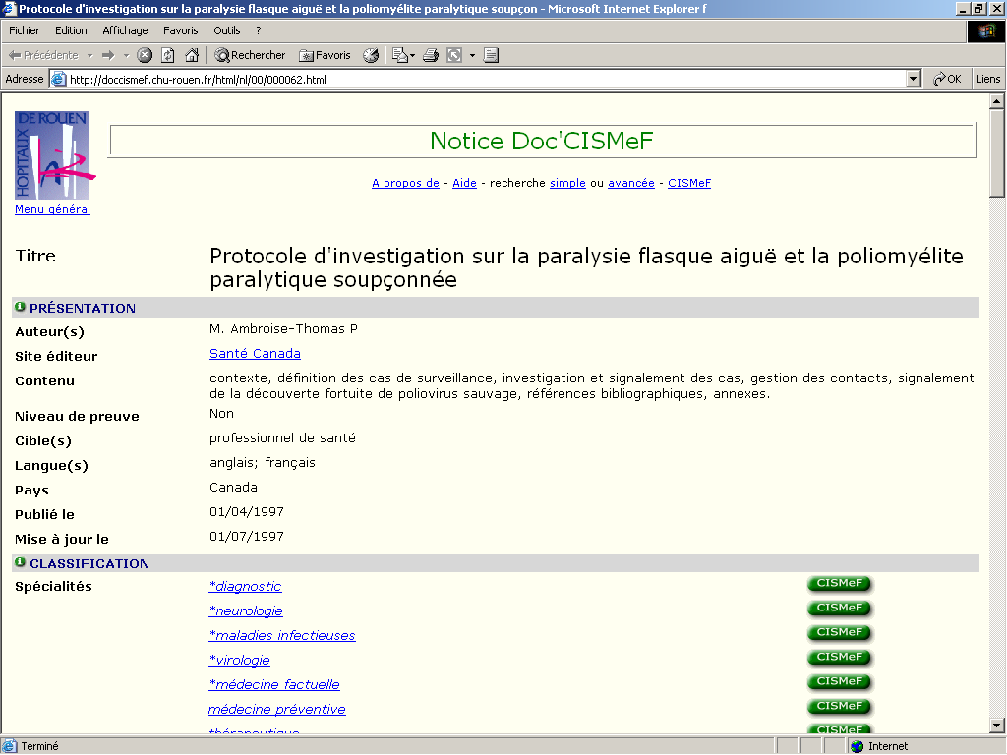

Slide 19
Table 2: Dublin Core metadata elements used in a Doc ’CISMeF resource page
<rdf:RDF
xmlns:rdf="http://www.w3.org/1999/02/22-rdf-syntax-ns#"
xmlns:rdfs = "http://www.w3.org/2000/01/rdf-schema#"
xmlns:dc = "http://purl.org/dc/elements/1.1/"
xmlns:dcterms = "http://purl.org/dc/terms/"
xmlns:cismef="http://doccismef.chu-rouen.fr/cismef.xml#">
<rdf:Description rdf:about="http://www.hc-sc.gc.ca/hpb/lcdc/bid/di/polio_f.html">

Slide 20
<dc:Creator>
<rdf:Seq
rdf:_1="M. Ambroise-Thomas P" />
</dc:Creator>
<dc:Date>
<dcterms:DateScheme rdf:_1="WTN8601">
<dcterms:created rdf:_1="1997-04-01"/>
</dcterms:DateScheme>
</dc:Date>
<dc:Description>
<rdf:Bag rdf_1="contexte, définition des cas de surveillance, investigation et signalement des cas, gestion des contacts, signalement de la découverte fortuite de poliovirus sauvage, références bibliographiques, annexes."/>
</dc:Description>

Slide 21
Tools to retrieve health information
level 1: search engine, general or more specialized searches: MedHunt-Ch [http://www.hon.ch/];
level 2: catalogue and index without thesaurus: Medical Matrix-Us [http://www.medmatrix.org/] and MedWebPlus-Us [http://www.medwebplus.com/];
level 3: catalogue and index with thesaurus, such as the UMLS (Unified Medical Language System) metathesaurus and MeSH thesaurus:
DDRT-Se [http://www.mic.ki.se/Diseases/], CliniWeb-Us [http://www.ohsu.edu/cliniweb/], OMNI (Organizing Medical Networked Information-Uk) [http://omni.ac.uk/] and HON (Health on the Net-Ch);
level 4: catalogue and index with thesaurus, metadata, and description of sites. CISMeF and Healthinsite-Au [http://www.healthinsite.gov.au/].

Slide 22
Discussion
CISMeF use DC differently according to "browse" (CISMeF MeSH Page, table 1) or "search" (Doc’CISMeF resource page, table 2) strategy chosen by the end-user
The choice of the Dublin Core was prompted by its institutional origin and its notoriety in the academic world
Several other health sites are now using the Dublin Core:
  Australian Department of Health and Aged Care [http://www.health.gov.au/],
  Better Health Channel [http://www.betterhealth.vic.gov.au/],
  National Health and Medical Research Council [http://www.nhmrc.health.gov.au/],
  WHO (World Health Organization) [http://www.oms.ch/]
  and US NLM (National Library of Medicine) was interesting by DC [http://www.nlm.nih.gov/archive/20040810/tsd/cataloging/metadata/index.html]

Slide 23
Discussion (cont.)
The use of metadata is one main criterion to assess the quality of health information on the Internet
The use of metadata implies the necessity to structure information.
The quality of metadata description may indirectly reflects the quality of online information

Slide 24
Conclusion
To help healthcare professionals and health consumers to more easily locate high-quality health information on the Internet, catalogues must use standard tools especially metadata to describe and index resources

Slide 25
