Slide 1
CANOE:
A Course Assembly and NOrmalization Tool for E-learning
Collin Hsu ( Xu Han )
collin@seu.edu.cn
Dept. Computer Science & Engineering,
Southeast University, Nanjing, China

Slide 2
Need for E-learning Metadata
Reusability and interoperability problems in Web-based courses.
  Standardization in content format alone is not enough!
Metadata is important for
  accurate search and discovery,
  and facilitates widely sharing.
Requirement for standardization in
  Learning resource metadata (for reusability and sharing)
  course content package (for portability across different learning systems)
  IEEE LOM, ADL SCORM, IMS

Slide 3
Practical Problems Faced
Large volumes of courses being exist without conformant to public standards – legacy courses.
  How to deal with many existing legacy courses? Any approach taking full advantage of existing legacy courses?
Not been so easy to create standardized course for common instructors (“SCORM dummies”).
  How to make it as easy as possible for common instructors to create standardized courses?
Normalization: legacy courses → standardized courses
High-Level User View: standard-specific details being
abstracted away from user interface

Slide 4
What’s CANOE
CANOE is a Course Assembly and NOrmalization tool for E-learning.
Course Normalization
  for example, to convert a course into to a SCORM conformant course.
Course Assembly
i.e. to build a SCORM conformant course from
existing learning resources.
Metadata Annotation (for each learning resource)
Content Package Generation (for a whole course)

Slide 5
CANOE's Role in Producing Standardized Courses
Three points:
Dedicated to perform course normalization.
Designed for non-professional users.
Aims at rapid course development.
CANOE is not a metadata and content package editor!
CANOE is a light “canoe” with which non-professional users ( like SCORM dummies ) could find it useful to save them from building standardized equivalents.

Slide 6
Features
Course Normalization
Export a SCORM conformant course from an existing legacy course.
High-Level User View
Independent of specific e-learning standards, eliminating the need for the author to understand the standards to which the course being created is conformant.

Slide 7
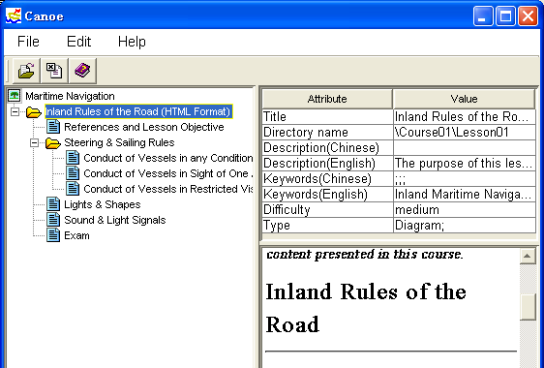
High-Level User View
“Standards are not meant to be visible to end users!” [*]
No <organization>, <item>, <resource> tag is presented to the user.
[*] Erik Duval, Wayne Hodgins. Making Metadata Go Away: “Hiding Everything but the Benefits”, DC2004, Oct. 2004.

Slide 8
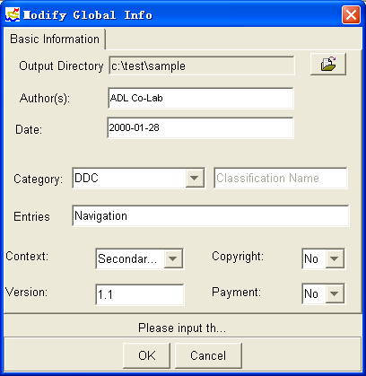
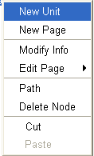
High-Level User View(cont.)
No SCORM jargon can be seen on the user interface of CANOE.
Unit: responds to Content Aggregation in SCORM.
Page: responds to SCO (Sharable Content Object) in SCORM.

Slide 9
High-Level User View(cont.)
Simplified SCORM Content Model
Unit
Unit
Page
Unit
Page
Unit
Page

Slide 10
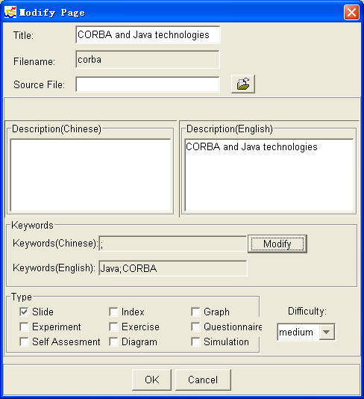
User-friendly Metadata View
Extract useful information, if available, from learning content.

Slide 11
Normalization in CANOE
SCO-Level Normalization
Course Normalization

Slide 12
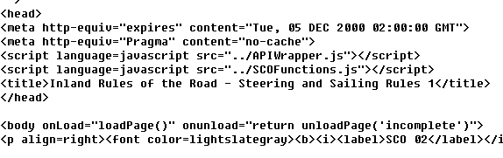
SCO-Level Normalization
Turn an HTML to be a SCORM conformant SCO.
Part of the scripts required for interacting with the LMS (Learning Management System).

Slide 13
Course Normalization
Export a SCORM conformant course from an existing legacy course.
Problem: How to generate course content structure automatically from a legacy course.

Slide 14
Course Normalization(cont.)
Generating content structure according to file naming convention
0103.htm (Section 1.3)
0205.htm (Section 2.5)
0306_2.htm (Section 3.6.2)
regular expression
(\d{2})(\d{2})[_\d]{0,}.htm

Slide 15
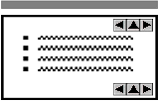
Course Normalizaion(cont.)
Generating content structure according to the inter-page links
Section 3.1
Section 3
Section 3
Section 3.1
Section 3.2
Section 3.2
Course with hierarchical Inter-page links
Generated content structure

Slide 16
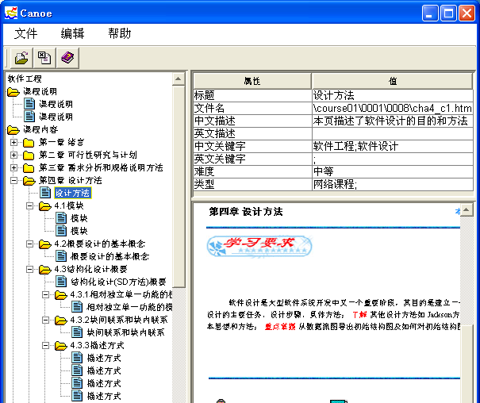
Demo Snapshot – Normalization Result
(After manual modification on the normalization result)

Slide 17
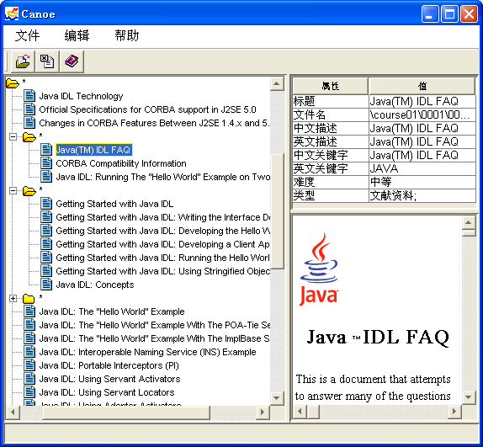
Demo Snapshot – Normalization Result
The result of normalizing J2SE 1.5 JDK Documentation

Slide 18
Thank you! 谢谢！
Contact:
Collin Hsu ( Xu Han )
collin@seu.edu.cn (expires next year)
collin@w3china.org
collin@semanticweb.org.cn
Honghan Wu xobject@seu.edu.cn
Yuzhong Qu yzqu@seu.edu.cn
Dept. Computer Science & Engineering,
Southeast University, Nanjing, China.

