Slide 1



Searching for the Future of Metadata
Looking in the wrong places for the wrong things?
by: Wayne Hodgins
October 12, 2004

Slide 2

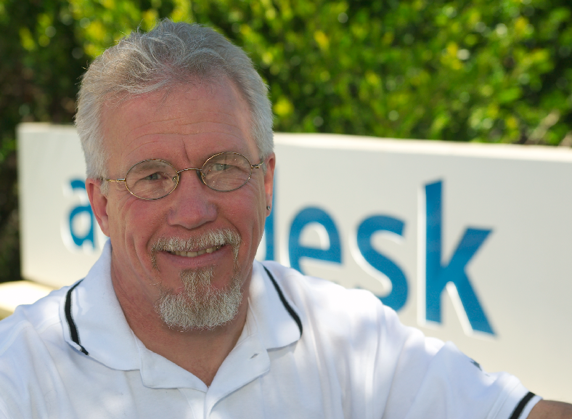




wayne.hodgins@autodesk.com
Autodesk Strategic Executive Services
Strategic Futurist
Director:
Worldwide Learning Strategies
Strategic Executive Services
President & Co-Founder
Learnativity.org
Strategic Advisor
ADL Initiative
Chair,
IEEE Learning Technology Standards Committee
Learning Object Metadata
Notes:
Wayne is regarded one of the most thought provoking visionaries and globally sought after keynote speakers and strategic consultants in areas such as future directions in information and data models, metadata, standards, learning and human performance Improvement. Known by many as "Mr. Metadata" and commonly referenced as the "father“ of Learning Objects, having conceived the conceptual model and term over 10 years ago, Mr. Hodgins serves on advisory boards for many industry and government groups, Commissions and associations worldwide. He was heavily recruited from Vancouver, B.C. Canada, to join Autodesk in 1988 after almost 15 years in secondary, post secondary and industry education where he held positions of teacher, lecturer, department head, trainer Counselor and principal in Canada and Europe.
As a “Strategic Futurist” Mr. Hodgins sits on advisory boards for many industry and government groups, commissions and associations in Canada, USA, Latin America, Asia and Europe and is in great demand to lead major industry wide task forces. He is widely recognized as the global spokesman for the learning technology standards community and its many organizations including ISO, IEEE, IMS, ARIADNE, GEM, etc. He is currently the elected Chair of the IEEE P 1484 Standards Working Group for Learning Object Metadata, a key advisor and contributor to the Advanced Distributed Learning initiative from the US Dept. of Defense and asked to be the Special Advisor and Strategic Futurist for the Commission on Technology and Adult Learning.
Recent interviews and articles from Wayne have appeared in: Forbes, PBS, CNN, C-NET, Training & Development, University Business, e-CFO (Chief Financial Officer), OnLine Learning, and InfoWeek.

Slide 3




creativecommons.org
Attribution-NonCommercial-ShareAlike 1.0
You are free:
to copy, distribute, display, and perform the work
to make derivative works
Under the following conditions:
Attribution. You must give the original author credit.
Noncommercial. You may not use this work for commercial purposes.
Share Alike. If you alter, transform, or build upon this work, you may distribute the resulting work only under a license identical to this one.
For any reuse or distribution, you must make clear to others the license terms of this work.
Any of these conditions can be waived if you get permission from the author.
Your fair use and other rights are in no way affected by the above.

Slide 4







 | A Spotter's Guide to Shared Content
The "SOME RIGHTS RESERVED" logo is the first sign that a work is licensed using Creative Commons. Artists then mix and match from a menu of choices to specify conditions for sharing.
ATTRIBUTION: Any reuse, such as inclusion of a song in a movie, must credit the original artist.
NONCOMMERCIAL USE: Revenue-producing uses, such as advertising or corporate presentations, require negotiation with the artist.
NO DERIVATIVES: The work may be shared but not modified, adapted, or changed in any way.
SHARE ALIKE: It's OK to share the work, but only under the same licensing terms established by the original artist.
SAMPLING: Others may sample, "mash up," or creatively transform the work, but it can't be used in advertising.
PUBLIC DOMAIN: No rights reserved. Artists relinquish all rights to a work, making it public property.

Slide 5
Looking in the Wrong Places?

Slide 6




Searching…

Slide 7

Helping…

Slide 8

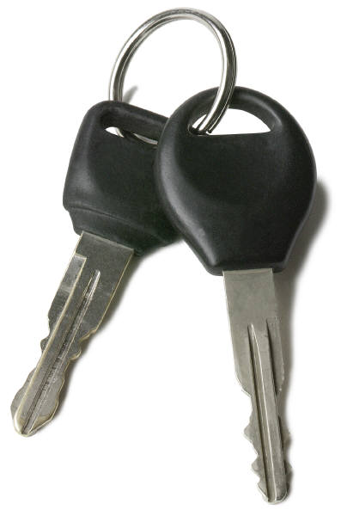
Remembering…….

Slide 9

Looking in the Right Place?
????

Slide 10

Looking in the Right Place

Slide 11

Looking where the light is!!

Slide 12
A few words about LEARNING

Slide 13


Vision for learning …
Learner-Centric
Unlimited
Content Sourcing
Dynamic
Prescription
High
Vision
Performance-Centric
Dynamic Role-Based
Content Updating
Learning Assessment
Business
Outcomes
Productivity
Costs
Employee retention
Module-Centric
Chunking of Content
Dynamic Processes
Creating Learner Accountability
for Results
Portal-Centric
Audience-Specific
Content
Competencies
and Roadmaps
Content-Centric
Dispersed Content
Catalogs
Generic Audience
Establishing
the Foundation
Low
Low
Learning
Outcomes
Absorption
Time to competency
Penetration/audience
High
Notes:
Notes re Cisco implementation from , Tom Kelly & Wayne Hodgins
Cisco began with a content focus.. Each product group, functional group, and corporate function has it’s own website…. Result? 10 million web pages. An employee could not find the information they needed unless they knew where to look.
Portal Centric -We aggregated information based on communities with common needs/interests: Field E-Learning Connection - 78% of AM’s and SE’s utilize this portal regularly because it brings them easily to 80% of what they need to know to do their job. Also a Partner E-Learning Connection, Manufacturing, Leadership Development, etc.
Module Centric - utilizing a corporate supported Meta Data Framework (common nomenclature) for tagging content making it easily searchable.
Performance Centric - tying job requirements, training history and development plans together with Performance Appraisals to systemically manage intellectual capital, employee development, with documented and reportable results
The end goal is Learner Centric- personalized content based on a profile and dynamically displayed on a “My Development” page instead of having to go to the portals. (like the My Yahoo page many of us use today).
All of this is in various stages of development today… targeted implementation of Learner Centric Q1 FY02

Slide 14

Getting SMALL Part I The Vision
meLearning!
  Markets of one: Billions of Markets
Personalized Learning Experiences for every person every day
  all 6.2 billion of us -- every day!!
Just for me and just right:
  Time, place, amount, device, medium, way…
  On demand, adaptive
Learning in ALL forms:
  Formal AND informal
  not just online, on computer, on screen

Slide 15

The Vision “thing”
In a word …………
PERSONALIZi0N
  Personalized Products
  Personalized Service
  Personalized Learning
  Personalized Content
MASS PERSONALIZi0N

Slide 16
Just the “Right Stuff”
Just the right CONTENT, to
Just the right PERSON, with
Just the right PARTNERS, at
Just the right TIME, on
Just the right DEVICE, in
Just the right CONTEXT, and
Just the right WAY

Slide 17
“C-ing” the Future
Content
  Evolving toward a supply chain model
  Repositories, discovery, assembly
Context
  Location based learning
  Subjective metadata, collaborative filtering, social recommender systems
Convergence
  ERP, ECM, HCM, KM, ……….
Competencies
  Are following similar exponential curve and revolution as content
  Link to content objects

Slide 18
Looking but not seeing?
Would YOU know
the future of metadata
if you saw it??

Slide 19
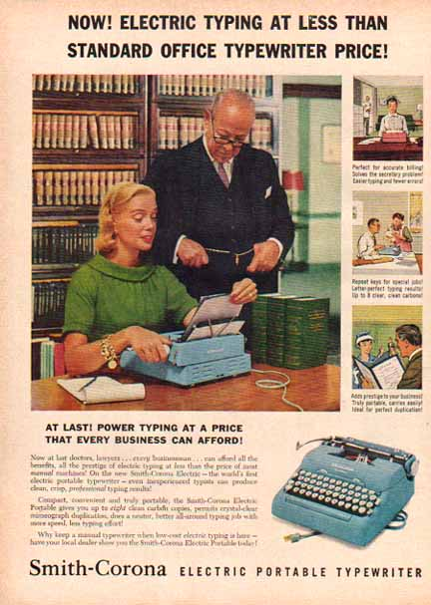

Disruptive
Innovation!
There’s one in YOUR future!!
And another one right behind it!

Slide 20
Observations:
We / YOU have done a GREAT job; Congratulations!
  Where metadata = data about data
The low hanging fruit is just about all gone
Have we delivered on the promise of metadata?
  In the opinion of the END beneficiaries!

Slide 21
Drivers for Change:
Modularity:
  The next BIG thing is getting very small……..

Slide 22
Metadata Missing in Action
People, Places and things
  Every line on every map?
  Every steak from every cow?
  In the car, drivers seat
Contextual:
  The environment and conditions during use
  Before, during and after creation of the resource

Slide 23

Today Tomorrow
Data about data
Categorization:
  File names, directories
Manual entry
Forms
Metadata Experts only
Finished assemblies (books)
Text
Library Cards
Objective metadata
Attributes of EVERY thing
Dynamic Organization:
  Metadata centric, indexes
Automated metadata
Save button (or none)
The rest of us
  “Mass Contribution”
Words (inside the book)
Pictures, sounds, 3D models
Full life cycle
Subjective metadata

Slide 24
Today Tomorrow
Pre use metadata
MD publishing
Producer/Consumer
Static content assemblies
Homogeneous
Monolithic
Intelligent
Direct
Explicit metadata
Full life cycle:
  Insitu, in use, pre, post
MD harvesting (eg RSS)
ProSumers
Dynamic
Heterogeneous
Micro granular
Stupidly smart
Inferred, clues
Patterns & recommenders

Slide 25
What if??
Every metadata ELEMENT has a GUID?
Every RFID tag is a “server”?
Every printed word has metadata?
There are no forms?
Metadata is entered ONLY ONCE?

Slide 26
Grand Challenges
Capturing Context
Mass contribution
Mass customization

Slide 27

Future starts with E??
Expand:
  Definition of metadata to include every person, place & thing
Educate:
  Ourselves about the needs and the “art of the possible”
Eliminate:
  Exposed metadata
  Manual only generation
Extract:
  From clues, inference, patterns
  Metadata mining for clues & patterns
  From content itself
  From context, especially of use
Enable:
  finding the “RIGHT” stuff
  Mass customization
  Mass contribution
  Capturing context

Slide 28
The next Big thing is …..
Getting very very small !!!
wayne.hodgins@autodesk.com

Slide 29
Getting SMALL Part II Small Components
The next BIG thing is getting really small
    VERY small standard components
    Dynamically assembled into “just the right” solutions
    “standardized uniqueness”
Applies to Code, content, competencies, equipment, …….
Notes:
Getting it just right
Courage to change ourselves
Constructive Destruction

Slide 30

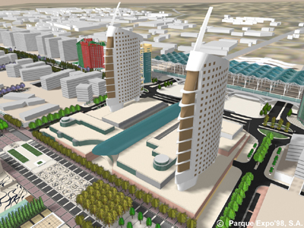
It’s a Component based World
80-90% of the materials in a building are pre-made components
Building Design is an “assembly” project!
Code is now all Object Oriented
Content is following next
Applies to PEOPLE too!
ONLY possible with adoption of common STANDARDS!

Slide 31
Content Object Model
Common Content
Application Specific Profiles
“Raw” Data & Media
ASSETS
Information Blocks*
Application
Objects
(Learning Object, Support, Reference, Marketing)
Aggregate
Assemblies
(Lessons, Support Solutions, etc)
Collections
(Courses, Stories,)
Audio
Process
Text
Procedure
Principle
Procedure
Principle
Objective
Objective
Theme
Concept
Concept
illustration
Process
Summary
Fact
Fact
Animation
Overview
Overview
ELO
Enabling
Learning
Object
TLO
Terminal
Learning
Object
Summary
ASSETS
Simulation
* Based on work of Dr. Robert Horn
see slide notes below
©1992 Learnativity
Notes:
* Based on work of Dr.RobertHorn http://www.stanford.edu/~rhorn/a/topic/stwrtng_infomap/tocStructrdWriting.html%20
IMPORTANT TERMINOLOGY:
ELO
Enabling Learning OBJECT
Replacement for the previously used RIO term.
ELO is defined as the aggregation of Assets required to satisfy one and only one Enabling (learning) ObjectIVE (EO).
an ELO also = SCO (SCORM Shareable Content Object)
As defined in SCORM 2004 (and previous) definition that a SCO is an aggregation of one or more Assets.
TLO
Terminal Learning OBJECT
Replacement for the previously used RLO term.
defined as the aggregation of ELO’s required to satisfy one and only one Terminal (learning) ObjectIVE (TO)

Slide 32
Content Object Model
Common Content
Application Specific Profiles
“Raw” Data & Media
ASSETS
Information Blocks*
Application
Objects
(Learning Object, Support, Reference, Marketing)
Aggregate
Assemblies
(Lessons, Support Solutions, etc)
Collections
(Courses, Stories,)
Audio
CONTEXT
Process
Text
Procedure
Principle
Procedure
Principle
Objective
Objective
Theme
Concept
Concept
illustration
Process
Summary
Fact
Fact
Animation
Overview
Overview
ReUSABILITY
ELO
Enabling
Learning
Object
TLO
Terminal
Learning
Object
Summary
ASSETS
Simulation
* Based on work of Dr. Robert Horn
see slide notes below
©1992 Learnativity
Notes:
* Based on work of Dr.RobertHorn http://www.stanford.edu/~rhorn/a/topic/stwrtng_infomap/tocStructrdWriting.html%20
IMPORTANT TERMINOLOGY:
ELO
Enabling Learning OBJECT
Replacement for the previously used RIO term.
ELO is defined as the aggregation of Assets required to satisfy one and only one Enabling (learning) ObjectIVE (EO).
an ELO also = SCO (SCORM Shareable Content Object)
As defined in SCORM 2004 (and previous) definition that a SCO is an aggregation of one or more Assets.
TLO
Terminal Learning OBJECT
Replacement for the previously used RLO term.
defined as the aggregation of ELO’s required to satisfy one and only one Terminal (learning) ObjectIVE (TO)

Slide 33
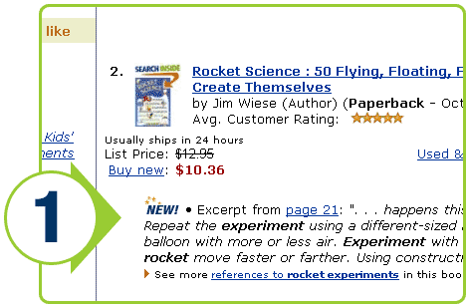
Amazon Inside the Books
Notes:
How It Works
A significant extension of our groundbreaking Look Inside the Book™ feature, Search Inside the Book™ allows you to search millions of pages to find exactly the book you want to buy. Now instead of just displaying books whose title, author, or publisher-provided keywords match your search terms, your search results will surface titles based on every word inside the book. Using Search Inside the Book is as simple as running an Amazon.com search. For example:
1. Let's say that you're interested in finding books about "rocket experiments." Just as you do today, type "rocket experiments" into our search box and click the GO! button. You'll get a list of the books that contain that term in the author's name, the book's title, or in the book's text. Books participating in our Search Inside the Book feature with "rocket experiments" in their text will show an excerpt with your search term highlighted. To see all references to "rocket experiments" within a particular book, click the "See more references to 'rocket experiments' in this book" link.

Slide 34
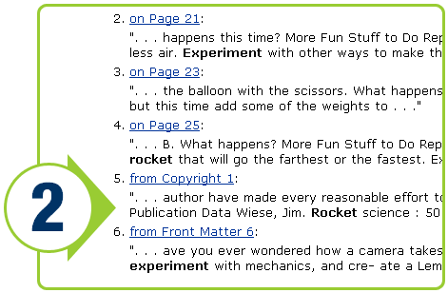
Amazon Inside the Books
Notes:
2. This link will take you to an index page for the book you selected, where you will see excerpts from all the pages where "rocket experiments" appears. This is a great way to quickly and easily browse sections of the book that are relevant to your search. If you want to see a specific page from the book in its entirety, simply click on the link to that page.

Slide 35
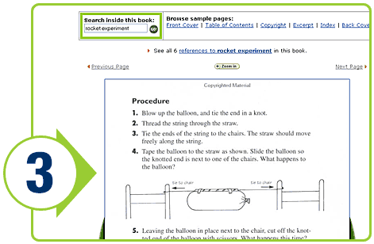
Amazon Inside the Books
Notes:
3. At this point, one of two things will happen. If you are a registered, recognized Amazon.com customer, you will go directly to the page you selected. If you are not a recognized customer, we will ask you to sign in or create an Amazon.com account (if you're not already a customer). Once you have signed in or set up an account with us, we'll take you directly to the page you selected. Once there, you'll see that "rocket experiments" is highlighted throughout the page and that you can browse forward and back two pages. Additionally, you'll find a navigation bar above the page that allows you to search for other terms in the book and browse other pages. Of course, you can always purchase the book by adding it to your Shopping Cart or by using 1-Click ordering, and we'll deliver the book to your door.
Try Some Searches
Resistojet
Curse of the Bambino
Product price elasticity
Rocket experiments for kids
Multnomah Falls
Open web joist
Santa Anita racetrack

Slide 36
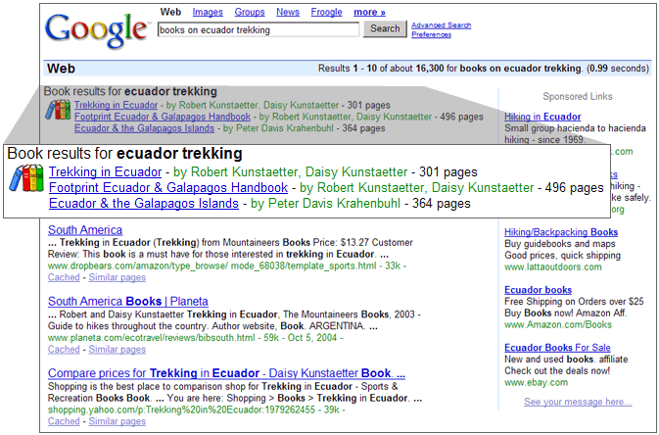
Google Print (Beta)

Slide 37
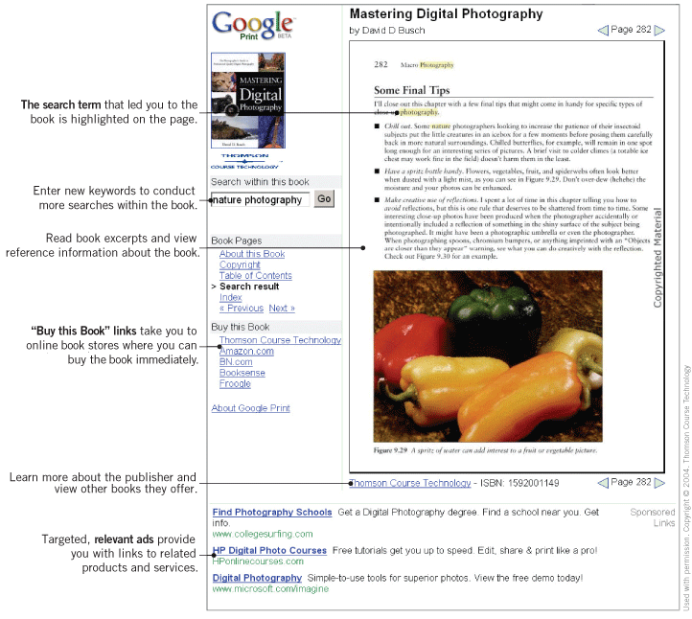
Example Google book page

Slide 38
OCLC “WorldCat” program
http://www.oclc.org/worldcat/open/default.htm

Slide 39
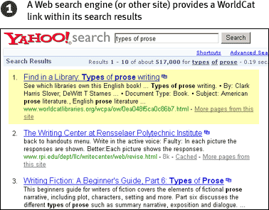

Slide 40
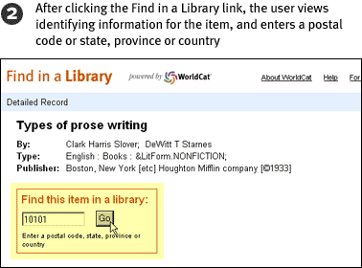

Slide 41
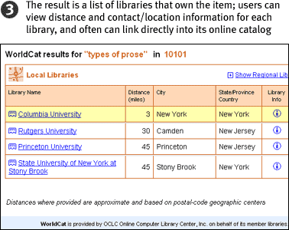

Slide 42

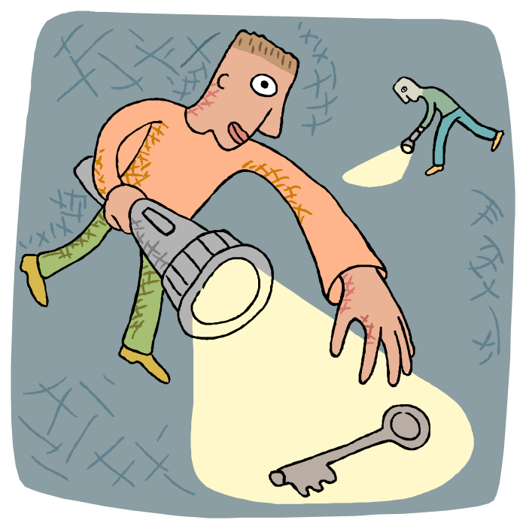

Personalization

Slide 43
xie xie!
Thank
You!!
Questions, Critiques, Comments
Or to book Speaking engagements
wayne.hodgins@autodesk.com

Slide 44
Coming Next from ADL:
CORDRA!
  Content
  Object
  Repository
  DISCOVERY and
  RESOLUTION
  Architexture

Slide 45
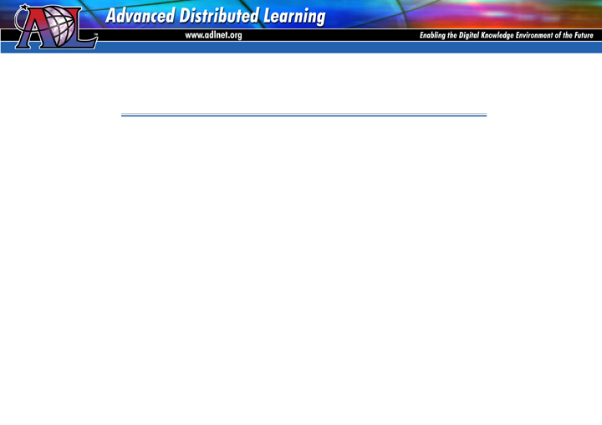
CORDRA
Context
Delivery
Discovery
Retrieval
Identification
Location
Resolution

Slide 46
Metadata Matters!
Fishing or Catching?
More Finding; Less Searching
Subjective metadata Services to get it “just right”
  Pattern recognition
  Social recommender systems
How could YOU provide value around this?
  Federated Searches & Repositories
  Destroy some myths

Slide 47
Metadata Myths
It’s all objective
It’s all manually created
Forms are how to gather
It’s all up to the originators
It all has to come from the same source/standard
there is one metadata record per asset
Metadata records are what you are looking for

Slide 48
“Constructive Destruction”
Tearing down the old to re-create the new:
Filing and storage systems
“shrink wrapped” software applicaitions
Metadata forms
Organization by functional departments (org charts)
Documents and Files
Courses, Lessons
Testing & Certification

Slide 49




Turtles all the way down!
Story in Stephen Hawking book “A Brief History of Time”,
"You're very clever, young man, very clever," said the old lady. "But it's turtles all the way down.“
For me, it is “metadata all the way down”!
Notes:
In his book “A Brief History of Time”, astrophysicist Stephen Hawking relates a story about a well-known scientist who gave a public lecture on astronomy:
He described how the earth orbits around the sun and how the sun, in turn, orbits around the centre of a vast collection of stars called our galaxy.
At the end of the lecture, a little old lady at the back of the room got up and said: "What you have told us is rubbish. The world is really a flat plate supported on the back of a giant tortoise."
The scientist gave a superior smile before replying, "What is the tortoise standing on?"
"You're very clever, young man, very clever," said the old lady. "But it's turtles all the way down."

