Slide 1
Research on Interoperability of Metadata in Classification Schemes——Construction of automatic mapping system between CLC and DDC
Jianbo Dai Hanqing Hou Ling Cao
Mail: hqhou@njau.edu.cn

Slide 2
Introduction
Metadata interoperability between different classifications
Necessity
Importance
State-of-art
Renardus ,HILT,and other Subject information gateway ect.

Slide 3
Module of Mapping System
Data processing module
Automatic mapping module
Batch processing module
The module of geography subdivision processing
System maintenance module

Slide 4
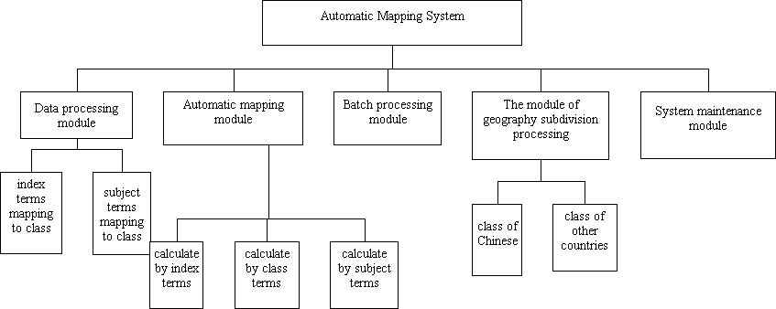

Slide 5
The Principle of Automatic Mapping System (1)-theory basis
The consistence of structure of class schemes
the similarity of concept expression of classes between CLC and DDC

Slide 6
The Principle of Automatic Mapping System (2)- Feasibility
Class concept can be expressed by several words usually;calculate the semantic similarity between the concept elements
get the whole similarity through the calculation of similarity of concept elements

Slide 7
The Principle of Automatic Mapping System (3)- Max Similarity Value
only the comparison between the parts, which play the same role, is available
calculate the overlap degree of the concept of class, namely semantic similarity, then decide the mapping relationship of class.

Slide 8
Construction of Automatic Mapping System
Regulation of Automatic Mapping
The Choice of Mapping Methods

Slide 9
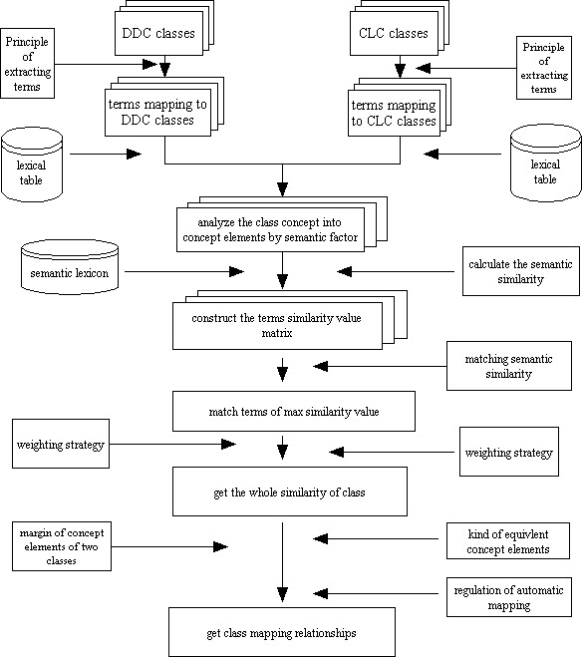

Slide 10
Application of Automatic Mapping System
    Mapping between two classes
    Construction of concordance
    Cataloging of MARC
    Class number conversion in subject information gateway
    Information retrieval in internet

Slide 11
THE END
Thanks for All

