Slide 1
Managing digital objects and their metadata: challenges and responses
Douglas Campbell and Adrienne Kebbell
National Library of New Zealand Te Puna Mātauranga o Aoteaora
DC-2004 Conference, 12 October 2004

Slide 2
Agenda
Our situation
Digital Preservation Frameworks
Digital Objects
  Complex objects
  Identifiers
  File naming
Metadata
  Frameworks
  Descriptive metadata
  Preservation metadata
  Structural metadata
  Automatic extraction
  Modularity
Integration
  Business process workflows
Notes:
Case study of our experiences trying to build DL and preserve digital stuff
Snapshot of our current thinking, paper written in May
Going to skim over a lot to give flavour of the paper

Slide 3
National Library of New Zealand
Te Puna Mātauranga o Aoteaora
Collect, maintain, and make accessible literature and information resources that relate to New Zealand and the Pacific
Alexander Turnbull Library:
Preserve New Zealand's documentary heritage for generations to come
Develop and deliver services for schools to support teaching and learning
Apply the partnership responsibilities of the Treaty of Waitangi to all activities

Slide 4












Notes:
Digital products
Complex environment – working towards a single generic access method

Slide 5
National Digital Heritage Archive
National Library Act 2003 gives legal deposit of electronic materials to the National Library
Archive development funded by Government
Working towards “Trusted Digital Repository” certification
Notes:
RLG/OCLC
They base requirements on the OAIS model

Slide 6
Part 1
Digital Preservation Framework

Slide 7
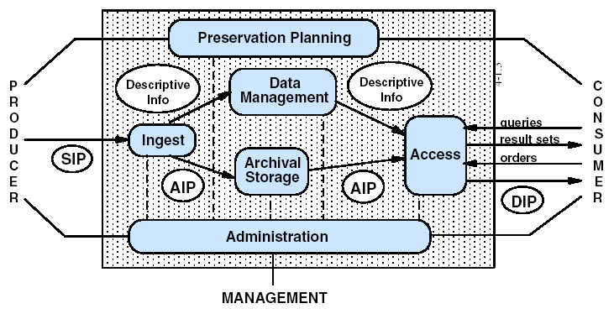
Open Archival Information System (OAIS) Model
KEY:
SIP – Submission Information Package (Ingest)
AIP – Archival Information Package (Archive)
DIP – Dissemination Information Package (Access)
Notes:
Consultative Committee for Space Data Systems

Slide 8
Metadata
Digital Objects
Applying OAIS – building our framework
metadata conversion
search
Rights
manage
Access
Catalogues
export
Selection
describe
Technical Info
Preservation Info
legal deposit
or donated
extract
manage
acquire
Harvest or Digitise
retrieve
Digital Object Workbench
load
Digital Store
Identity
Prepare
Arrange
Authenticate
Create derivatives
Archive
Migrate
Manage media
Notes:
Practicalities of implementing the parts of OAIS
Similar to Figure 6 in paper, though haven’t figured out where to include identifiers!
Cover this quickly now – we’ll revisit it at the end
Prepare – format migration eg. from obsolete
Manage – staff access (not just users)

Slide 9
Part 2
Digital Objects

Slide 10
Digital objects are complex
Website – hundreds of files
CD-ROM – hard-coded operation
Diskette of accounts spreadsheets and correspondence –dissimilar but related
Self-contained single file, eg. MS Excel
Dependent multiple files, eg. HTML + GIFs, or EXE + DLLs
Self-contained multiple files, eg. Series of MS Word letters
Notes:
Part 1 is managing digital objects
Survey objects – 30 representative

Slide 11
Classifying the “conceptual object”
Simple digital object
  A single file
  MS Word document, TIFF image
Digital object group
  A set of independent but related files described as a group
  Disk of 100 MS Word letters
Complex digital object
  A group of dependent files intended to be viewed as a single conceptual object, often with only one entry point
  Website, CD-ROM
Notes:
Group – from archival descriptive practice
Also group of complex (eg. series of website snapshots)

Slide 12
Simple Digital Object
Complexity of components
1 Original file [Word]
1 Simple Object
eg. text document
1 PID for 4 files
1 Descriptive Record
1 Preservation Object Record
(for PM Word file)
1 Preservation Master file
[Word]
2 Access files
[PDF + XML]
Complex Digital Object
100 Original files [HTML + gif]
1 Object Pres Data
100 File Data
NN Process Data
NN Metadata Modification Data
1 Complex Object
eg. Web Site of 80 html files + 20 gifs
1 PID for 300 files
1 Descriptive Record for 300 files [HTML + gif]
100 Preservation Master files
[processed for local delivery]
100 Access files
[HTML + gif]
Object Group
200 Original files
[Word]
1 Object Pres Data
200 File Data
NN Process Data
NN Metadata Modification Data
1 Object Group
eg. 200 letters from a donor
1 PID for 800 files
1 Descriptive Record for 800 files [Word, XML, PDF]
200 Preservation Master files
[Word]
400 Access files
[PDF + XML]
Notes:
Even simples are complex when convert format/derivatives
Though still simple – complex has 200 files
To keep track, we need to assign identifier to each – up next
PID for the conceptual and file ids for all the files

Slide 13
Identifiers
Key characteristics of identifiers to consider:
Granularity – Question: What do we need to identify? Answer: Whatever we need to identify!
Intelligence – Unanticipated changes may render intelligent identifiers inaccurate, though dumb identifiers place a reliance on external metadata
Actionable – Need to separate identity from location,
eg. two URLs may be two locations of the same entity
Persistence – Depends mostly on your commitment
Extensibility – Be generic, follow standards, application independent
Notes:
Internal Identifier (IID) – running number

Slide 14
Persistent Identifiers
Persistence means different things to different communities, we separate them into:
Persistent Identifier (PID) – assigned at the “conceptual” level of an object, persists in perpetuity
Persistent Locator (PL) – file locator, persists only for the life of the file
We guarantee PIDs, but PLs to the “best current format” will become inoperative over the decades as formats become obsolescent
Notes:
Provide original bitstream, but also transient formats so easy for current-day audience to view
Waiting for ideal international solution
Seamus quote

Slide 15
File naming conventions – Plan “A”
Plan A: Make filenames unique by including role code, eg:
DO – Digital Original
DD – Digital Derivative
PM – Preservation Master (best attempt to replicate in a currently accessible format)
AF – Access Format
TN – Thumbnail
Filename: IID_role_instance.extension, eg. 1234_af_01.doc

Slide 16
File naming conventions – Plan “B”
Plan B: “Virtualisation”
Decouple locator and location
Location and disk partitioning managed dynamically internally, delivered externally via persistent locator
  /1234 (to access the default format)
  /1234?role=TN&size=150
Locator may be HTTP, SOAP, etc.
Provides additional opportunities such as transparent “on the fly” format conversions or correcting the MIME type reported
Notes:
Problem is storing files in the file system, partition sizing, disk reorganisation

Slide 17
Work
Novel
FRBR
Expression
Manuscript
Published
Manifestation
Book
Item
Preservation
Lending
Manifestation
Word v5
PDF
XML
Component
Chap 1
Chap 2
Chap 1
Chap 2
Chap 1
Chap 2
XML
XSL
XML
XSL
Item
AS
AS
PM
PM
AF
AF
AF
AF
AF
AF
DO
DO
Notes:
Identifier GRANULARITY
Tried to select a “simple” complex object
Quick FRBR lesson – found lots cat records for same book (editions, translations)
Adds abstract layers so can see a work “Romeo & Juliet” then drill down to copies
Physical novel to see the layers – work/exp is abstract, man/comp is concrete (MARC recd), green is tangible (holding)
For digital – FRBR focused on differences in intellectual content/format – so identify Word/PDF/XML, then multiple formats under, whereas we think of original, master, access
Isn’t static - Here DO/PM/AS same version of Word – when AS moves to Word XP, becomes new manifestation
Even worse when look at continuing resources:
Serials – each issue is a work, serial is a super-work, archive newspapers have 3 manifs (print/microfilm/digitised)
Web sites – each snapshot harvest is expression of same work (integrating - content same, just edited), … and 100s of files
FRBR gives big pic, not developed at low level – need model for digital files – role codes next

Slide 18
Part 3
Metadata

Slide 19
Metadata Framework
Four key categories of metadata for digital objects:
Resource discovery – finding and identifying
Structural – presenting in context (eg. pages in a book rather than bunch of files, navigation, etc)
Rights management and Access control – protection of property rights, authentication and authorisation
Technical and Administrative – properties of the objects, how they were created, changes made, etc.
Notes:
Part 2 is Metadata
Kenney and Rieger’s “Moving Theory into Practice”

Slide 20
Metadata Framework
Metadata Standards Framework for National Library of New Zealand
Community / Sector
Specific Application Profiles
Community / Sector
Specific Application Profiles
XML
RDF
Following International Guidelines
Generic or Global
Access
Dublin Core
Library
Education
Archival
Government
NZGLS
DC-Gov
GILS
AGLS
MARC
DCQ
MODS
METS
DC-Ed
LOM
EAD
ISAD(G)
Local
Notes:
Use appropriate standard as applicable, but map to DC for resource discovery
EAD for archival, MARC for published, METS for structural (LOM)
Vendor: When it comes to standards, we’re [quote] more Catholic than the Pope

Slide 21
Descriptive metadata
Digital Resource Description (DRD) Application Profile
Lightweight alternative to METS for simple objects based on Qualified DC
XLink extensions to differentiate links to the multiple derivative files
Local refinements for different identifier types,
eg. local id, persistent id, locator
RDF/XML encoding syntax
Used in our “Discover” and “Matapihi” products
Notes:
Also Metadata Schema Description Language to maintain APs – need to link into CEN work

Slide 22
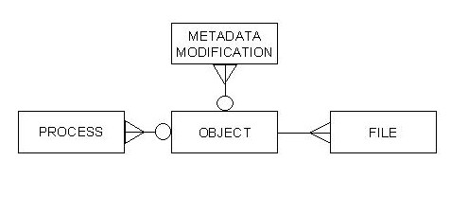
Preservation metadata
NLNZ Preservation Metadata (2002)
  Object – preservation info for object, eg. ID, software needed
  File – preservation info for a file, eg. format, size
  Process – record of actions taken, eg. format migration
  Metadata modification – record of changes to above metadata
Notes:
Functional objectives
Know enough about the files so can take appropriate actions to preserve them
Ensure can render/interpret in future despite technology changes

Slide 23
Structural metadata
Metadata Encoding & Transmission Standard (METS)
METS record
Header
Descriptive
Administrative
Content Files
Structural Map
Structural Links
Behaviour
Notes:
DRD can’t cater for complex structure or rights.
METS provides this
Particularly like the Structural Map part – first strong mechanism for tracking across all purposes
MPEG21 – closed, expensive, but following it

Slide 24
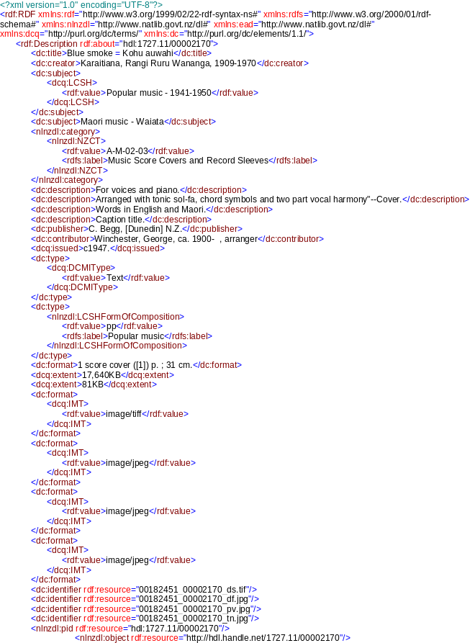
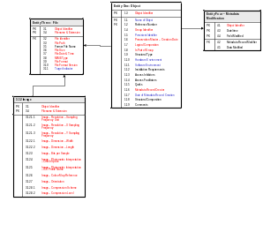
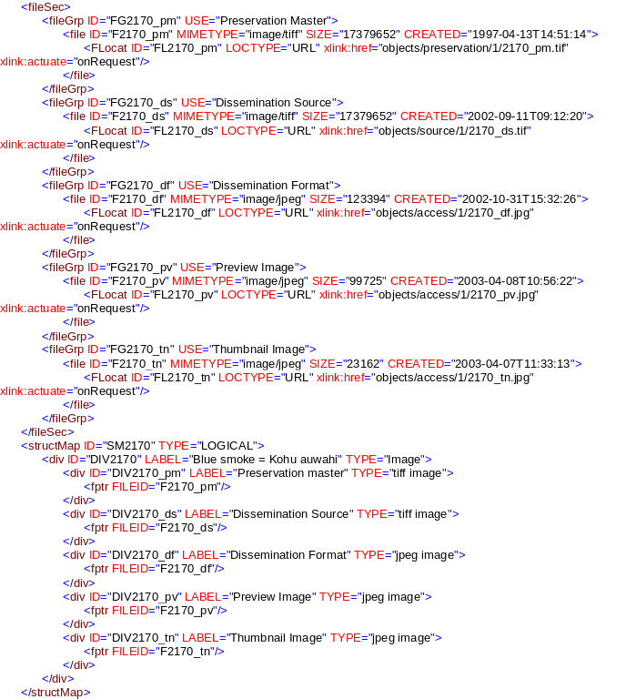
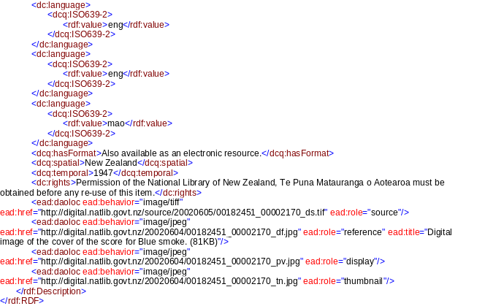
Metadata Pieces for a Single TIFF Image
DCQ Description
Preservation
METS File Group and structural Map

Slide 25
NLNZ Metadata Extraction Tool
Automatic metadata extraction is essential
Extracts embedded metadata from 15 common file formats (eg. TIFF, JPEG, MS Word, PDF) and file details for other formats
Built in Java, outputs in XML (customisable using XSLT)
Graphical interface or command line batch
10,000 JPEG files per hour
Finalist in UK Pilgrim Trust’s 2004 Preservation Awards

Slide 26
Metadata modularity
Metadata Conversion Engine
DC XML
Picture Australia
CROSSWALK
MARC
ISAD(G)
DC RDF/XML
Matapihi
Descriptive
Records
NZGLS
Govt Portal
DRD RDF AP
Discover
Additional
Data
METS
Digital Archive
DC RDF/XML
Notes:
Crosswalking is a reality given budget constraints
Lesson is follow standards – hard-coded in DC for PicOz but didn’t work in Discover, so follow DCMI guidelines strictly so common, known base
Currently Perl, Java, XSL scripts
Would like to work on a “Metadata Crosswalk Definition Language” to capture crosswalk algorithms

Slide 27
Part 4
Business Processes

Slide 28
Integration into the business
We’re moving from an era of “pilots” to implementation
Integrating into existing staff workflows rather than establishing a separate unit
Documenting the business process workflows
Notes:
Part 3 integration

Slide 29
Part 5
Tying it all together

Slide 30
Metadata
Digital Objects
The Digital Archive Environment
metadata conversion
search
Rights
manage
Access
Catalogues
export
Selection
describe
Technical Info
Preservation Info
legal deposit
or donated
extract
manage
acquire
Harvest or Digitise
retrieve
Digital Object Workbench
load
Digital Store
Identity
Prepare
Arrange
Authenticate
Create derivatives
Archive
Migrate
Manage media
Notes:
Practicalities of implementing the parts of OAIS
Similar to Figure 6 in paper, though haven’t figured out where to include identifiers!
Cover this quickly now – we’ll revisit it at the end
Prepare – format migration eg. from obsolete
Manage – staff access (not just users)

Slide 31
Digital Preservation Reportcard 2004
Digital preservation has come a long way in 5 years:
From “overwhelmingly daunting” to “potentially achievable”
A lot of thought, pilots, developments around the world
Improvements needed:
Tools are still at the emerging stage
Workflows/social side is sometimes forgotten
Identifier scheme for PIDs - major outstanding issue

Slide 32
Questions…?

Slide 33
Managing digital objects and their metadata: challenges and responses
Douglas Campbell and Adrienne Kebbell
National Library of New Zealand Te Puna Mātauranga o Aoteaora
DC-2004 Conference, 12 October 2004

