Slide 1

FINDEX
Meta Information System
for
Substances
Matthias MENGER / Petra JAHNKE
Federal Environmental Agency
Bismarckplatz 1 / 10781 Berlin / Germany
matthias.menger@uba.de
MENGER– DC04 Shanghai / 13.10.2004 / <number>

Slide 2



Starting Situation
multiple heterogeneous information systems
each system for specific purpose / user
no awareness of existing data / systems
no information to make data comparable
confidential systems closed for ‘ordinary’ users
MENGER– DC04 Shanghai / 13.10.2004 / <number>

Slide 3
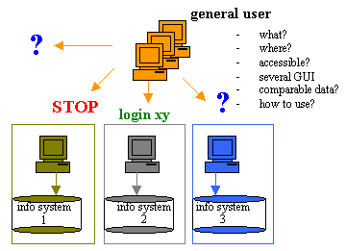
Difficulties
=> difficult to compare data
=> time consuming to get a quick overview
MENGER– DC04 Shanghai / 13.10.2004 / <number>

Slide 4
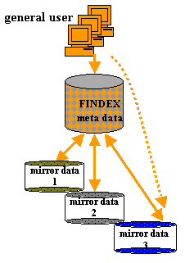
Goal
one point of access with one GUI
provide quick overview of available data
harmonisation of meta information for search
make data more comparable
no interference with original systems!
search in the original context
MENGER– DC04 Shanghai / 13.10.2004 / <number>

Slide 5
Concept
create a harmonised substance ‘meta data pool’
covering most important information of a substance:
  ident data (name, chemical structure, formula, other identifier)
  characteristics + their availabilty in the sub-systems
these meta data links to detailed data
detailed data are provided in their original context
detailed data are replicated in ‘mirror’ data pools
MENGER– DC04 Shanghai / 13.10.2004 / <number>

Slide 6
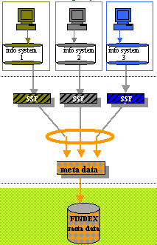
Creation of ‘Meta Data Pool’
data in original system
data in the same syntax
converter for semantic
ident + characteristics and their quantity + references to mirror data = meta data
registration merges meta data
MENGER– DC04 Shanghai / 13.10.2004 / <number>

Slide 7
Registration + …
designed to…
  identify the same substance across all underlying systems
  merge identical substances to only one substance
  create harmonised meta information
based on…
  definition what a substance is (3 types)
  rules how to handle different types of substances
  harmonised data model covering important characteristics
MENGER– DC04 Shanghai / 13.10.2004 / <number>

Slide 8
… + Meta Information
quick overview concerning one substance:
  ident-data (name, chemical structure)
  characteristics (fields) of all sub-systems
      accessibilty
      quantities in each sub-system
  link to detailed ‘mirror’ data in original context
MENGER– DC04 Shanghai / 13.10.2004 / <number>

Slide 9
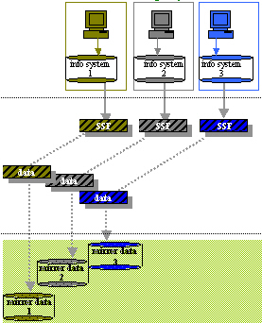
Creation of ‘Mirror Data Pools’
data in original system
data in the same syntax
mirror data in one syntax BUT in their original context (semantic) containing all detailed data
MENGER– DC04 Shanghai / 13.10.2004 / <number>

Slide 10
Example Data => FINDEX
FINDEX
Sub-System 1
Stoff
F0001
Benzol
Stoff
4711
Benzol
benzene
Merkmal X1
Inh. n”
P1-Regno
4711
Merkmal X1
Inh. n’
P1-Regno
4712
Merkmal X1
Inh. n
P2-Regno
1000
Stoff
4712
benzene
X´
10
3
P1
4711
X1
Merkmal X1
1
P1
4712
X1
Sub-System 2
2
P2
1000
X2
Inh. m
4
P2
1000
X3
Stoff
1000
Benzol
benzene
Merkmal X2
Inh. k’
ident data
availabilty of characteristic
Merkmal X2
Inh. k
Merkmal X3
Inh. l’’’
Merkmal X3
Inh. l”
Merkmal X3
Inh. l’
Merkmal X3
Inh. l
MENGER– DC04 Shanghai / 13.10.2004 / <number>

Slide 11
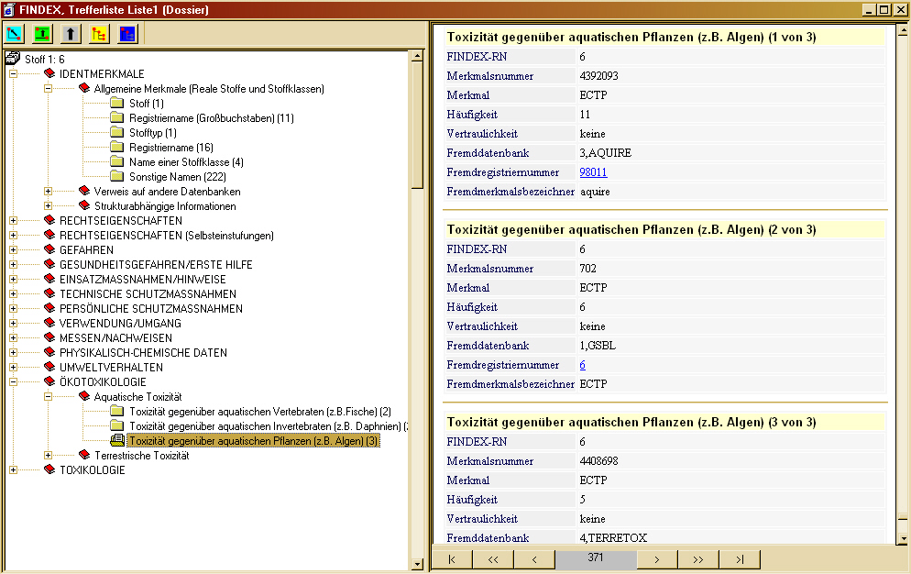
Mapping Result
link to detailed data
ident data
characteristics
quantity in mirror data
quantity
[non-]confidential
MENGER– DC04 Shanghai / 13.10.2004 / <number>

Slide 12
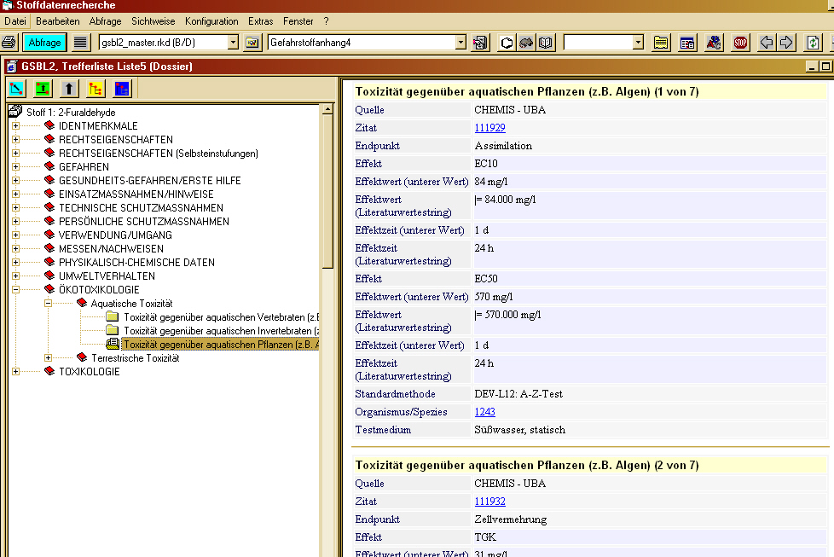
Link to Detailed Data
sub-system
ident data
sub-system
characteristics
detailed data
in their
original context
MENGER– DC04 Shanghai / 13.10.2004 / <number>

Slide 13
Benefits…
awareness + accessibility of relevant data for all user!
make relevant ‘hidden’ data available
provide quick + comparable overview!
    show data availability + level of confidence
    direct access to detailed data
original systems are kept untouched!
    no authorization / security problems
    no performance loss
share important data of partly confidential systems!
one-stop-search in one GUI with single sign-in!
MENGER– DC04 Shanghai / 13.10.2004 / <number>

Slide 14
Thank You …
…for your interest!
visit our websites
www.gsbl.de
www.umweltbundesamt.de
matthias.menger@uba.de
MENGER– DC04 Shanghai / 13.10.2004 / <number>

