Slide 1

Data Integration Framework in Peer-to-Peer based Digital Libraries
Hao Ding, Ingeborg T. Sølvberg
IDI/NTNU
Oct. 12th, 2004, Dublin Core Conference
Shanghai, China
Notes:
Thank session chair for the introduction and also thank you, the audience, for your patience before the coffee break. As you can see, I modified my presentation title slightly since
I am going to present the project as a whole and hopefully, I can receive me comments from the audience.

Slide 2
Agenda
Background & Motivations
Objectives
Assumptions
Approaches
Conclusions and Questions
Notes:
Let’s first look into the agenda for the talk. I will spend the first 5 minutes for the motivations, objectives and assumptions.
Then another 20 minutes is to be spent on the approaches done and to be done. The conclusions comes finally.

Slide 3
Backgrounds & Motivations
Huge volumes of data and information are available in Digital Libraries (DL).
Inclination to access these resources.
Some facts:
  According to a conservative estimate, the number of DLs is more than 10⁵. [Norbert Fuhr 03]
  Google indexed over 4.28 billion web pages; - from Google press release.
  But, any single engine is prevented from indexing more than one-third of the “indexable web”. - from Science.Vol.285, Nr.5426.
Notes:
There

Slide 4
Backgrounds & Motivations (Con’d)
But…limited searching strategies in dealing with distributed and heterogeneous resources.
Notes:
Bulky data is available, but even higher volumes of data is ‘hidden’.

Slide 5
Backgrounds & Motivations (Con’d)
The Semantic Web alleviates the problem but is still not sufficient.
  Advantages:
    brings structure to the meaningful Web.
    enhances content with metadata,
    and adopts ontologies to enable content machine processible and interpretable.
  Disadvantages (from the searching perspective):
    Single-point-of-failure threat
    Out-dated cached collections
    C/S architecture does not favor scalability
Special needs on seamless integration of distributed data, services and computational resources in a global system.
Notes:
Here we just present the problems and we will put it aside for a while and present the research directions in the Approach section.
Next, let us have a look at the objectives we want to achieve according to the problems.

Slide 6
Backgrounds & Motivations (Con’d)
Peer-to-Peer (P2P) overlay network.
  Advantages:
    alleviate the problems in C/S architecture
    scale easily
    Increase system accessibility
  Unsolved issues:
    Reliability
    Resource management
    Security & Privacy
Scenario: Federated Digital Libraries.
  Physically distributed subsystems.
  Heterogeneous metadata schemas.
Notes:
advantages: P2P network helps increase system accessibility, by distributing the indexing and query processing tasks to multiple computing nodes.
Still, P2P network does have some unsolved issues, but we will not concentrate on it in current phase.
To be more practical, we will base our research in federated DL scenario. In such scenario, the ….

Slide 7
Agenda
Background & Motivations
Objectives
Assumptions
Approaches
Conclusions and Questions

Slide 8
Objectives
Objective (in general):
  Integrating semantically related metadata information over Peer-to-Peer based Digital Libraries

Slide 9
Objectives
Intermediate Objectives:
  P2P-based DLs testbed construction.
  Resource selection strategies in P2P network.
  Leverage XML IR functionality into general P2P networks.
  Alleviate the effects generated by heterogeneities in metadata schemas.
    Related works
    Problems
  Design schema mapping mechanisms which is able to be integrated in XML IR.
    XML – syntax based
    Semantic Web languages: RDF, DAML+OIL, OWL.
  Ontology engineering
    Ontology construction: domain-specific vs. large & complex
    Ontology mapping
  Information filtering and re-ranking returned records.
  Prototype Implementation – P2PIR
  Analyze the implementation results and evaluate the applicability of our approaches.
Notes:
Both of the SW and P2P offer promising visions, but it also raises many scientific difficulties.

Slide 10
Agenda
Background & Motivations
Objectives
Assumptions
Approaches
Conclusions and Questions

Slide 11
Assumptions
Problems not considered in current approaches:
  Resource representation in P2P network.
    Collections are assumed to be XML formatted.
    No considerations on granular access to varied resources.
  Metadata Annotation
  Automated trust negotiation among peers.
  Security and Privacy
  Reliability
  Resource management
Notes:
IR techniques that must work in a reasonable time with the huge amounts of distributed data presented on the whole network.
What is the meaning of ‘reliability? Check Hector’s ppt.

Slide 12
Agenda
Background & Motivations
Objectives
Assumptions
Approaches
Conclusions and Questions

Slide 13
Approach
Related Work
Prototype design and implementation
  from the P2P architecture and IR perspectives
  from the semantics perspective

Slide 14
Approach – Survey on Related Works [ICEIS 2004]
WWW and Search Engines
  Keywords only
Distributed databases
  Better performance when the number of nodes in the system is not large
Data Warehousing
  Schema: A global mediated schema
  Content: seldom updated
Data Integration
  Global As View (GAV): V(s) = f(s₁,s₂,…,s_{n})
  Local As View (LAV): V(s) = f ⁻¹(s₁) + f ⁻¹(s₂) +…+ f ⁻¹(s_{n})
  Both As View (BAV) / GLAV.
Notes:
We chose the peer-based data management architecture. Currently, there are many projects and works are carried out on Peer computing in database community, IR community and so on.
One of reasons may be that the peer-based architecture is supposed to be more scalable and flexible.

Slide 15
Approach – Survey on Related Works
P2P based Data Management (PDM)
System architectures:
  A centralized server–based: maintaining a global index
    eg., Napster
  Pure Peer-based: Flooding and gossiping
    eg., Gnutella, The chatty Web
  Distributed Hash Tabled (DHT)-based:
    eg., Chord, CAN
Notes:
Centralized: single point of failure.
Pure peer: broadcasting queries and answers on the network. Many evaluation works have indicated that the performance become unbearable when the number of queries exceed the limitation.
DHT method is the widely used one. Each keyword is a key in the DHT. It just supports the keyword search.

Slide 16
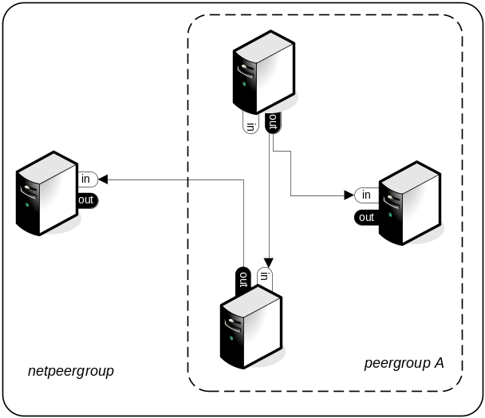
Approach – General Framework
Hybrid:
  Super-peer based P2P network.
  Figuratively, ”super-peer” ≈ ”peer community”
JXTA:
  appropriate for searches of distributed data sources that actively produce data, such as the news website or some DL systems.
  Schemas (by “Services”) are open to the communities.
  Mapping is done locally. (LAV)

Slide 17
Approach- P2P Network
Design and Implementation
Super-Peer based P2P network
  Platform Implementation:
    Adopting JXTA API 2.0:
      Peergroup, peer, pipe, service advertisement
      XML-based messaging
      Pipe-based communication
    Extending
      Hilbert Space Filling Method for service discovery
  Flexibility and scalability
  Interfaces for combining IR functionalities

Slide 18
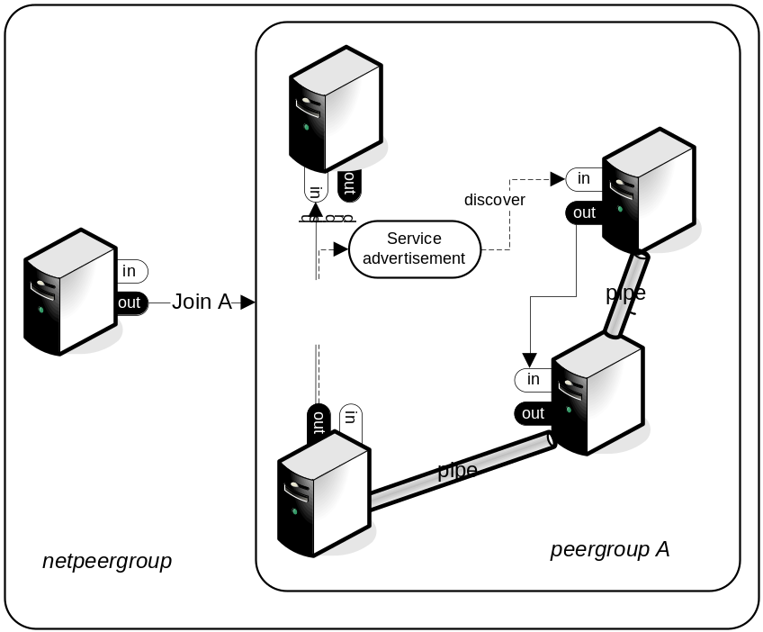
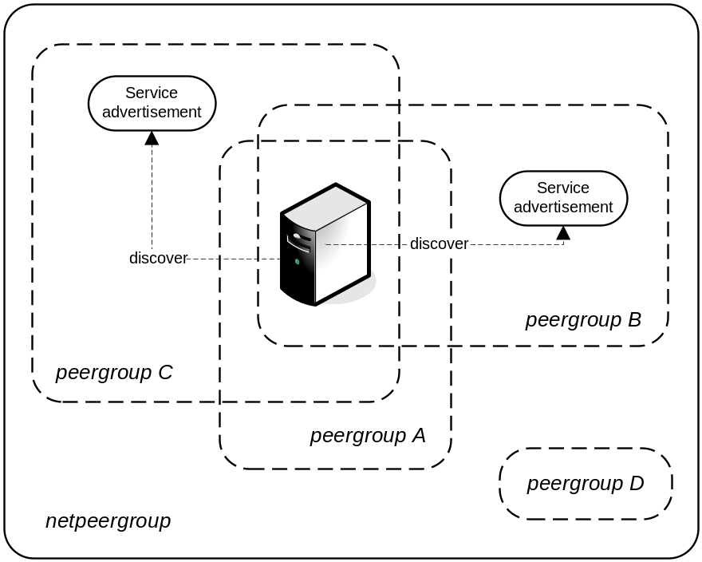
Approach - P2P Network
Flexibility and scalability
Notes:
Our work is different from Edutella

Slide 19
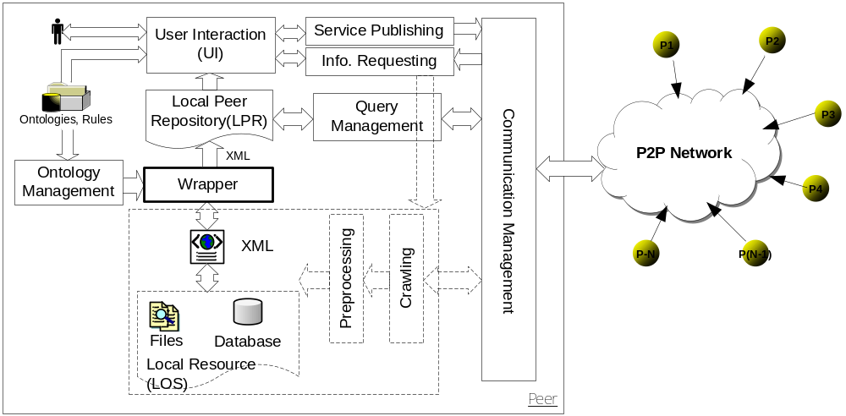
Approach- P2P Network
Local peer achitecture

Slide 20
Approach – Semantics
Two issues:
  Support semantic searching
    So far, no P2P-based systems consider semantic search.
  Support Multi-keywords searching
    Few P2P systems support such functionality.

Slide 21
Approach – Semantics (con’d)
Example: A fragment of an XML-tagged document from Financial Times Collection in TREC 4
<DOC>
<DOCNO>FT911-376</DOCNO>
<HEADLINE>
FT 13 MAY 91/Survey of Cardiff(2):Selling on the road - The financial sector
</HEADLINE>
<BYLINE>By ANTHONY MORETON </BYLINE>
<TEXT>
Although the day-long event was one of a series that will ...(Omitted)</TEXT>
<PUB>The Financial Times </PUB>
<PAGE>London Page 16 Photograph The Bank of Wales was set up in
1972, and moved to its new building in September (Omitted).
</PAGE>
</DOC>

Slide 22
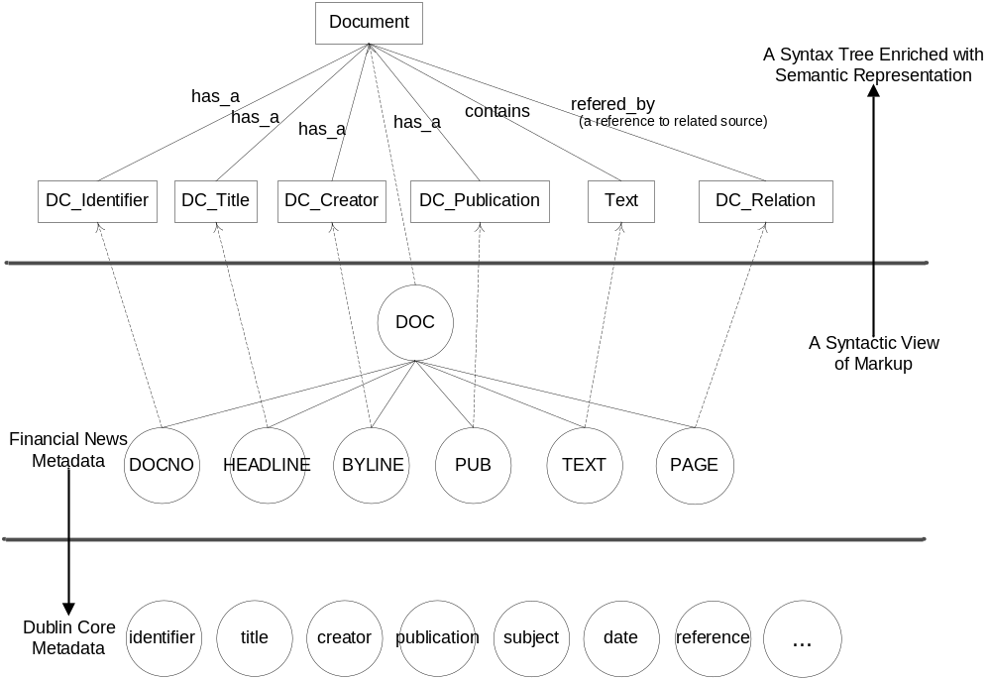
Approach – Semantics (con’d)
Notes:
Certain markup language is needed to express the meaning

Slide 23
Approach – Semantics (con’d)
Types of Data and Meaning Markup
Form
Structure
Meaning
Function
Usage
Data about
Style
Type
Definition
Document
Type
Definition
Information
Type
Definition
Knowledge
Type
Definition
Workflow
Type
Definition
Formalism
CSS
XML
RDF
OWL
?
Cases
Static
Dynamic
Bold
Centred
Align Left
Blink
Title
Paragraph
Heading1
Play
Subject
isPartOf
Date
After_value
Utility
affectedBy
Receive
Protect
Actor
Receival
Maintenance
Archival
Standard
Layout
Outline
Content
Behaviour
Process

Slide 24
Approach – Semantics (con’d)
Currently, working on solutions:
  Compare and evaluate two different methods:
    XML Declarative Description (XDD) based methods [IEEE Intelligent Sys. J., May/June 2001. ]
    RDF/OWL based methods
Notes:
The RDF/OWL based method has been presented in the paper, and I will not spend more time on that. Because of the limited description power of RDF, we have to think of other mechanisms to
Enrich such power. And finally we found prof. Vilas’s work on XDD.

Slide 25
Approach – Semantics
Brief Introduction to XDD.
  Data Structure of XML expressions is given by:
    is the set of all XML expressions
    is the subset of that comprises all ground XML expressions in .
    is the set of all specializations that reflect the data structure of the XML expressions in , and
    is the specialization operator, which determines for each specialization s in the change of each XML expression in caused by s.
Notes:
ground expression : one that may contain active subexpressions but no free variables

Slide 26

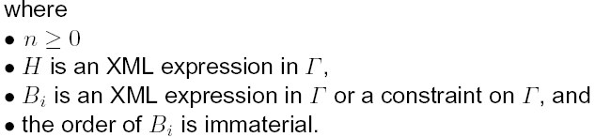
Approach – Semantics
Brief Introduction to XDD. (Con’d)
  An XDD description is a set of XML clauses, which has the form

Slide 27
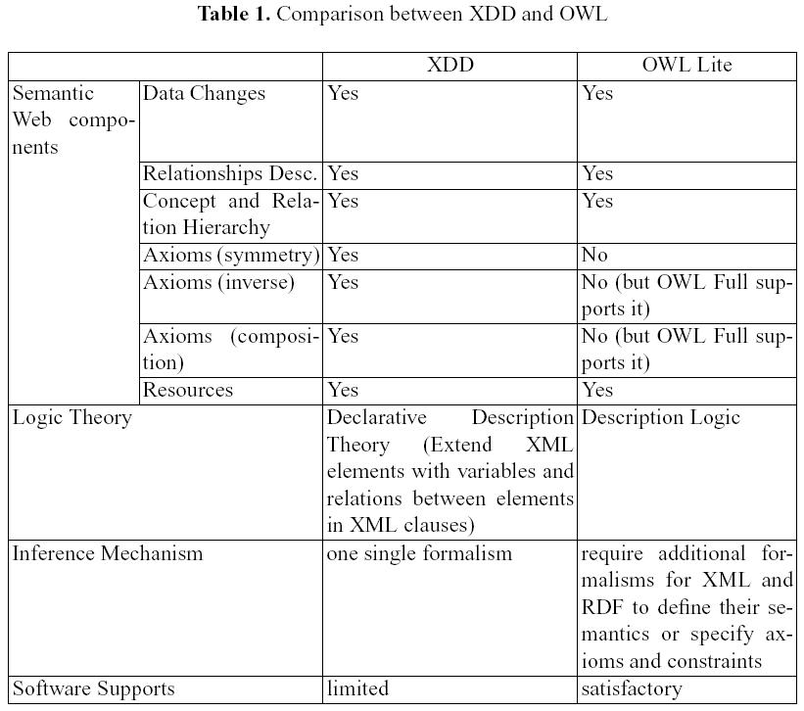
Approach – Semantics
Comparison between XDD and OWL Lite
Notes:
The complete OWL Full inference engine is not finished yet. So, in order to have more expressive power, we should adopt a powerful language, such as XDD to carry the work.

Slide 28
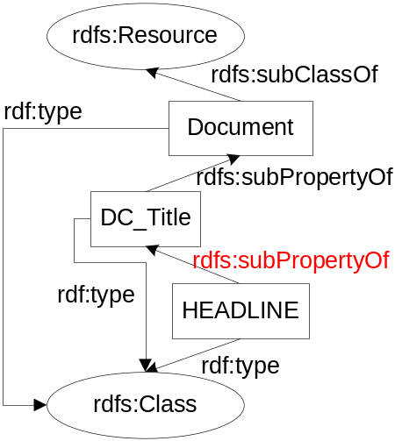
Approach – Semantics (con’d)
Examples – “relation”:
<rdf:Description about = “Document” >
<rdf:type resource = “rdfs:Class” />
<rdfs:subClassOf rdf:resource = “rdfs:Resource” />
</rdf:Description>
<rdf:Description about = “DC_Title” >
<rdf:type resource = “rdfs:Class” />
<rdfs:subPropertyOf rdf:resource = “Document” />
</rdf:Description>
<rdf:Description about = “HEADLINE” >
<rdf:type resource = “rdfs:Class” />
<rdfs:subPropertyOf rdf:resource = “DC_Title” />
</rdf:Description>

Slide 29
Approach – Semantics (con’d)
Examples – “inverse”:
<rdf:Description about = $S:author >
<rdf:type resource = “#BYLINE” />
<Publication resource = $S:docid />
</rdf:Description>
<rdf:Description about = $S:documentID >
<rdf:type resource = “#DOCID” />
<Creator resource = $S:author />
$E:D_properties
</rdf:Description>
Other examples

Slide 30
Approach-IR
Given Query i on Peer B which is from Peer A created in Schema A.
Searching Phases:
  Relationship matchmaking: mapping table, predefined rules, ontologies
  Query reformulation: in Schema B.
  Result Generation: in format of Schema A.
  Results re-ranking in Peer A.

Slide 31
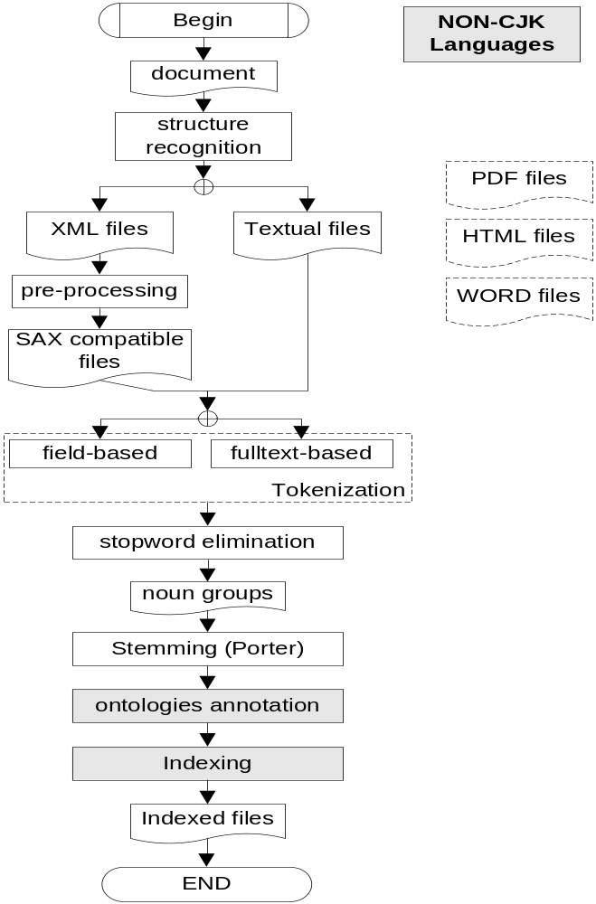
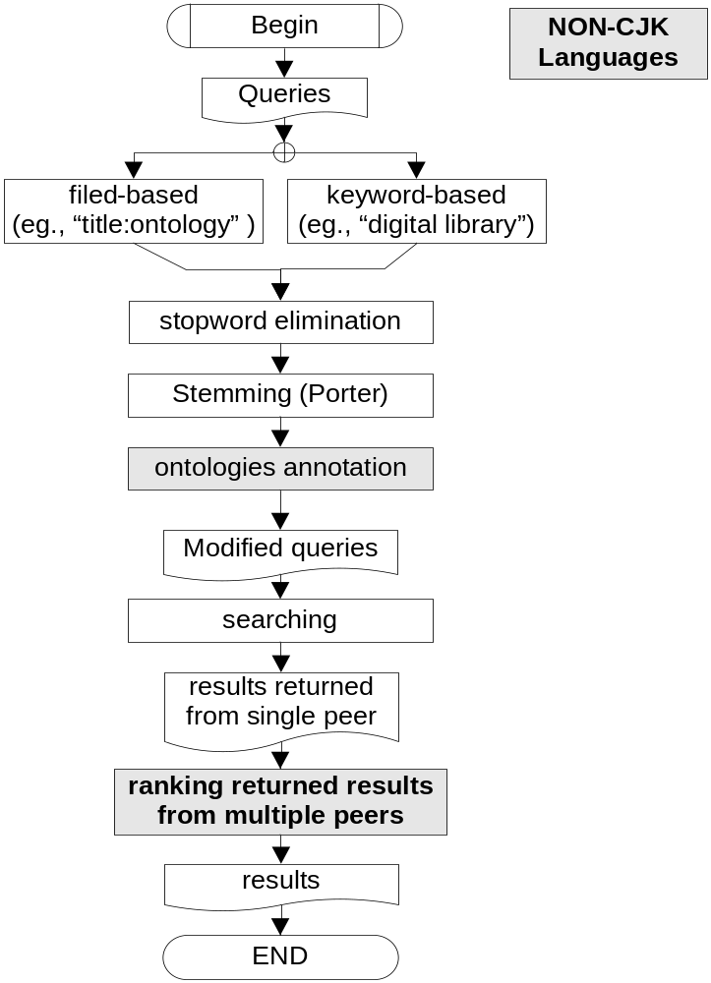
Indexing
Searching

Slide 32
Application – IR (con’d)
Indexing:
An example in indexing collections:
public class IndexFiles {
//Usage：: IndexFiles [dataSource] [indexFileSources] ...
public static void main(String[] args) throws Exception {
String indexPath = args[0];
IndexWriter writer;
//adopting predefined analyzer to construct a new IndexWriter //(3rd arg. Indicates whether the index will be appended or not.
writer = new IndexWriter(indexPath, new SimpleAnalyzer(), false);
for (int i=1; i<args.length; i++) {
System.out.println("Indexing file " + args[i]);
InputStream is = new FileInputStream(args[i]);
//Construcing a Document Obj with 2 Fields: path and body //Field: path, no index + store
//Field: body, index+store
Document doc = new Document();
doc.add(Field.UnIndexed("path", args[i]));
doc.add(Field.Text("body", (Reader) new InputStreamReader(is)));
//input the document into the index (IndexWriter)
writer.addDocument(doc);
is.close();
}
//close the IndexWriter
writer.close();
}
}

Slide 33
Application – IR (con’d)
IR component:
  Support field-based search as well – for structured files
  Enhanced indexing format
doc(field1,field2,…) doc(field1,field2)

Slide 34
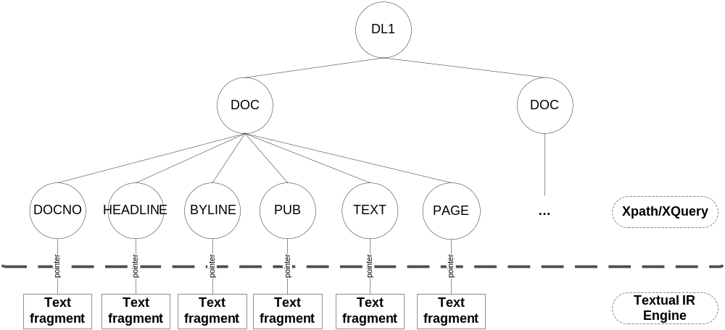
Application – IR (con’d)

Slide 35
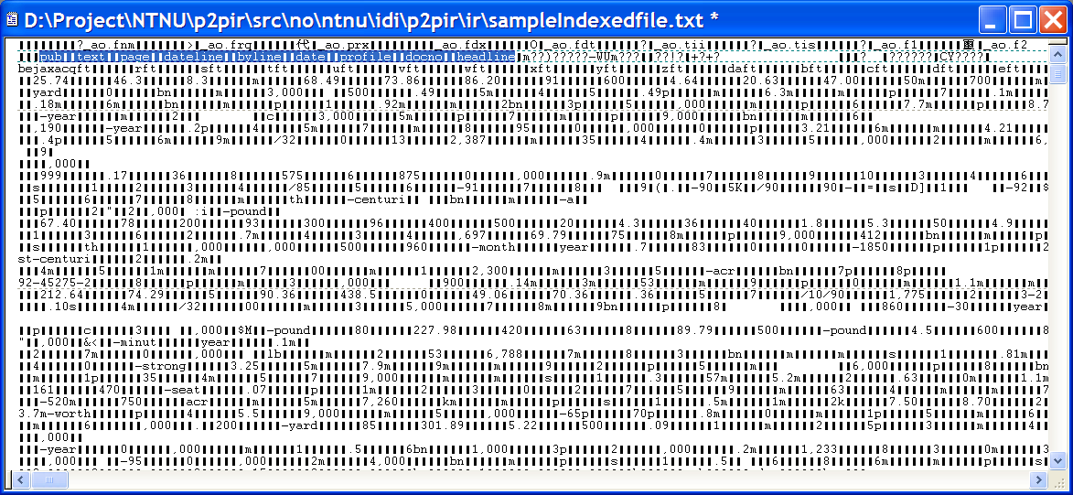
Application – IR (con’d)

Slide 36
Approach – Ontology Engineering
Ontology Construction
  Domain specific: Finance, Tourism, Biomedicine
  Tools: Protégé 2000.
Ontology in P2PIR
  In indexing:
    As to XML files: ontology mapping in corresponding tags. eg., <dc: title>, <dc:creator>, etc.
    As to full text: ontology extraction – domain specific approach is scheduled. – pending.
  In searching: (semi)automatic parsing is needed.

Slide 37
Approach – Ontology Engineering
Ontology parsing and querying
  RDQL – Rdf Data Query Language: like SQL used for DB.
Notes:
RDQL – Rdf Data Query Language: like SQL used for DB.
JENA: an open source inference engine.
DAML API.
ARP parser.

Slide 38
Agenda
Motivation
Objectives
Assumptions
Approaches
Conclusions and Questions

Slide 39
Conclusions
A data Integration Framework in P2P-based DL is presented.
Objectives and assumptions
Arguments for our proposed approaches.
More works need to be done.
  Inference engine implementation
  Query reformulation and optimization

Slide 40
Questions?

