Slide 1
Everything Around the Core
Practices, policies, and models around Dublin Core
  Thomas Baker, Fraunhofer-Gesellschaft
  DC2004, Shanghai Library
  2004-10-11

Slide 2
This Talk
Everything but the Core itself
DCMI Model of Practice
  Grammatical principles and abstract model
  Policies for identifying metadata terms
  Documentation of metadata terms
  Processes for maintenance
  Taken together, a model for declaring and maintaining a metadata vocabulary

Slide 3
Towards a data model
1995: “catalog card for the Web”
  Asking “what information belongs on the card?”
Circa 1997, a shift:
  “How will machines make sense of this?”
  “What is the data model?”
  “How does DC relate to other vocabularies?”

Slide 4
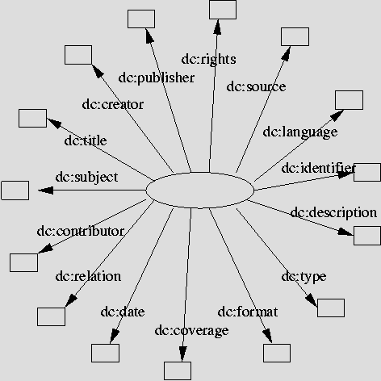
Hedgehog Model
A Single Resource with Properties
Property
Property
Property
Property
Property
Property
Property
Property
Resource
Property
Property
Property
Property
Property
Property
Property

Slide 5
Simple set of principles
A typology of metadata terms
  Core properties (15 elements, eg dc:description)
  Sub-properties (33, eg dct:abstract)
  Resource types (12, eg dcmitype:Collection)
  Encoding schemes (17, eg dct:LCSH)
Dumb-Down Principle
  Lossy reduction of more complex metadata to a simpler, familiar form for rough interoperability

Slide 6
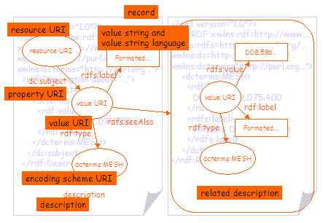
Towards an Abstract Model
Source: Powell et al, “DCMI Abstract Model”,
http://www.ukoln.ac.uk/metadata/dcmi/abstract-model.

Slide 7
is instantiated
as
record
is grouped
into
description
set
description
description
description
has one
or more
statement
statement
statement
has one
property
has one
value string
value
is a
OR
is represented
by one or more
representation
rich value
representation
representation
is a
OR
is a
related
description

Slide 8
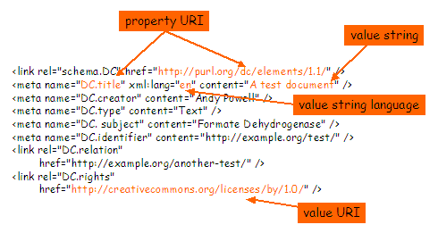
...a basis for comparing syntax alternatives
Example of Simple Dublin Core in XHTML

Slide 9
A Namespace Policy
A naming convention: all DCMI terms identified using three namespaces:
  http: //purl.org/dc/elements/1.1/ - “the Core”
  http://purl.org/dc/terms/ - all other terms
  http://purl.org/dc/dcmitype/ - Type vocabulary
  Example: http://purl.org/dc/elements/1.1/title
A longevity policy: stability of URIs and terms
  Minor “editorial” corrections have no effect on URIs
  “Semantic” changes must trigger a change of URI

Slide 10
Archival history with audit trail
Vocabularies evolve:
  Long-term need to reconstruct the set “as of” a date
  Audit trail for changes in the vocabulary
Each change in a Term Declaration triggers a successive Version with a version identifier
  http://dublincore.org/usage/terms/history/#Image-002
Each identified Version associated with Decision
  http://dublincore.org/usage/decisions/#Decision-2003-02
Each Decision linked to original proposals, decision texts, and supporting documentation
Architecture Working Group meeting on Wednesday

Slide 11
Publishing Term Declarations
Multiple publication formats needed
  Web pages for human consumption
  RDF schemas for expressing relationships between terms in machine-processable form
Workflow
  Web pages and schemas from one common source
  XML-tagged source data + XSLT scripts – simple and effective
Future needs
  Express versioning model machine-processably?
  More expressive ontology languages?
Semantic Web session, Monday afternoon

Slide 12
Publishing Application Profiles
Declare how DCMI and non-DCMI terms selected, used, and constrained for a particular purpose
APs a linguistic fact [see also DOI, IEEE/LOM, MARC21...]
  For negotiating a particular metadata format
  For recognizing emerging semantics “around the edges”
  To define good practice and avoid reinventing the wheel
Multiple publication formats needed (again!)
  “DCAPs” as a normalized (Web) document format
    Eg, identifying terms that have no URIs
  DCAPs in RDF for machine processing
    ftp://ftp.cenorm.be/public/ws-mmi-dc/mmidc116.htm

Slide 13
Dublin Core Registries
Indexed databases of metadata elements
  Include information about metadata terms, translations of terms, and (potentially) application profiles
  Federations of vocabulary maintainers share model for declaring and relating terms
Service Providers, existing and potential
  Tsukuba: annotate DCMI term URIs with translations, usage notes, other vocabularies of interest to Japan
  FAO (a UN agency): agricultural development
  DCMI (OCLC): Web-services interface
Registry Working Group meeting on Thursday morning

Slide 14
Editorial Review
DCMI Usage Board reviews proposals for new terms, usage clarifications, Application Profiles
  Public comment period, evaluate for demonstrated buy-in and conformance to principle, assign status
Biases of the current Usage Board
  Keep DCMI vocabularies small and generic
  Recognize and reuse existing, complementary vocabularies maintained by others
Usage Board 8th meeting in Shanghai, 9-10 October

Slide 15
Example
MARC Roles as Refinements of dc:contributor
MARC Relator terms (Library of Congress)
  More specific “roles”: Director, Choreographer…
Model: Library of Congress makes assertions
  “marc:director is a sub-property of dc:contributor”
DCMI Endorses the assertions:
  “DCMI agrees that marc:director is a sub-property of dc:contributor”
A general model for negotiating and expressing the relationship between different vocabularies?

Slide 16
Identifying controlled vocabularies
Vocabulary Encoding Schemes
  Term dcterms:LCSH says that the value of dc:subject is a Library of Congress Subject Heading
  Need identifiers (URIrefs) designating other controlled vocabularies
  Creating URIrefs for world’s vocabularies a huge task!
New DCMI approach (October 2004):
  Explain how maintainers can create URIrefs for their own vocabularies
    http://www.ukoln.ac.uk/metadata/dcmi/term-identifiers-guidelines/
  Maintainers submit URIrefs for review – DCMI endorses

Slide 17
Sustainability of standards communities
1994-2004: new digital library standards
  Standards communities: a few key organizers, wider circles of participants, establishment of brand
  DCMI model: “lightweight but not weightless”
    Sustain core functions to adapt and remain relevant
Broadening stakeholder community beyond OCLC
  National and regional affiliates, corporate sponsors

Slide 18
Metadata is language
People (or clever algorithms) making assertions about resources
DC a pidgin: small vocabulary of generic terms
  Simplifying complex metadata to a few core terms may often be the best one can do
Formally expressing relationship between DC and these other metadata vocabularies will help “interoperability”
  Need broadly understood grammars and conventions for declaring terms
  Without such conventions, the Semantic Web will not “make sense”

Slide 19
thomas.baker@izb.fraunhofer.de

