Slide 1
Metadata Management System
DC2004: International Conference on Dublin Core
and Metadata Applications 2004
Shanghai Library, China
Norhaizan Mat Talha
Malaysia

Slide 2

Presentation Outline
Introduction
Metadata Implementation
Metadata Management System
Future Directions

Slide 3

Background
Malaysian Grid for Learning (MyGfL) is an initiative to provide e-learning technologies and solutions to support the life-long learning agenda in Malaysia through the use of ICT.
MyGfL shall host metadata of selected learning content available on the Internet and also some actual learning content in its repository. This content are then made available and accessible to the public through MyGfL portal.
To enhance resource discovery in MyGfL portal, each of the content will have its own metadata record.
Implementing metadata would result in a more consistent and well-structured descriptions of content available in the portal.

Slide 4
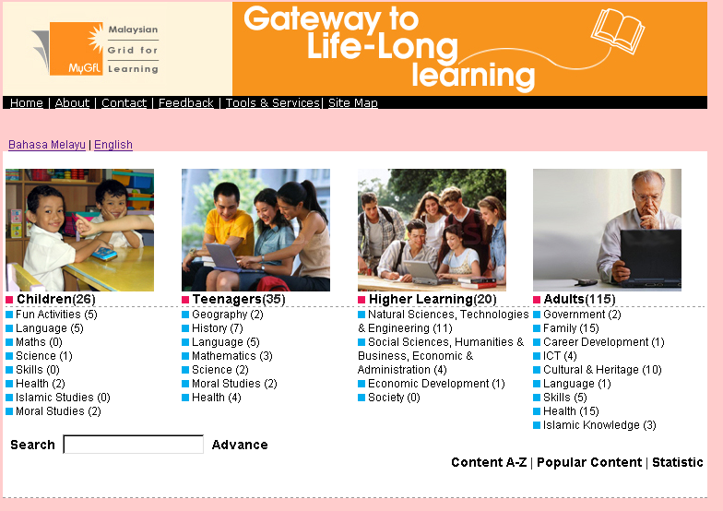
MyGfL portal

Slide 5


Content
MyGfL shall host both free and commercial content. MyGfL content types are :
  Web Resources - information and knowledge resources on the web that support learning.
    Dublin Core metadata standard was adopted here.
  Learning Objects - instructional content that supports the objectives and promotes the achievement of the learning outcome.
    SCORM 1.2 (IEEE LOM) was adopted here.
MyGfL also hosts metadata of learning content in its metadata repository.

Slide 6

MyGfL Framework
Integrating Platform
MyGfL User Interface
Search
Engine
MyGfL
Thesaurus
Repository
Content
Repository
MMS
Search
Tagging
Metadata
Management
System
MyGfL
Metadata
Repository
Tagging
OAI
Server
Metadata
Repository
Harvest
Content
Provider
Learning
Support
System
MyGfL
Content
Repository
Course
Content
Repository
Course
Provider
User
Management
System
MyGfL
Learner Profile
Repository
Register
Learner

Slide 7
MyGfL Guidelines
Objectives
  to guide MyGfL content providers to conform to a set of standards and guidelines for content development
  as a single point of reference to all relevant e-Learning standards
  to achieve Interoperability, Reusability, Manageability, Accessibility and Discoverability of MyGfL content and systems
Scope
  Content Guidelines for Learning Objects
  Content Guidelines for Web resources
  Technical Guidelines for Courseware Mgmt Systems
    http://www.mygfl.net.my/mygfl/documents/MyGfL_Guidelines.pdf

Slide 8
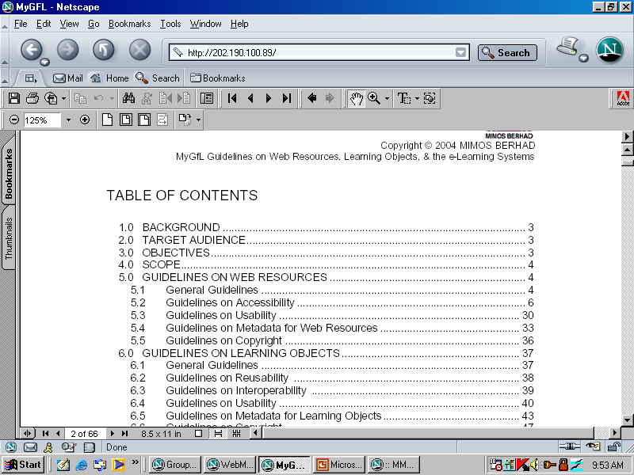
MyGfL Guidelines on Web Resources, learning object and e-Learning Systems

Slide 9


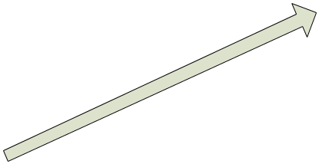

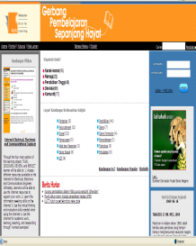

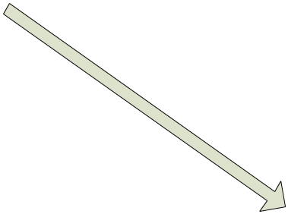


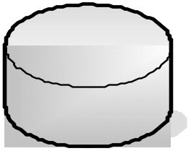
How Metadata Works in MyGfL
Content Providers who have digitized content hosted on their website
Link
Content
Repository
Search / Browse
Content Providers who have both digitized content and metadata hosted on their website
Portal
Link
Learners
Content
Repository
Metadata
Repository
Metadata
Repository

Slide 10

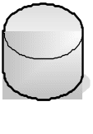
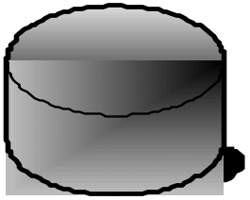

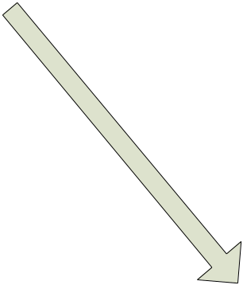



Sharing of Metadata
Content Providers who have both digitized content and metadata hosted on their website
Content Providers who have digitized content hosted on their website
Content Providers who have digitized content but not hosted on their website
Share metadata
Meta-tag content
Meta-tag content
Upload content into MyGfL content hosting
server
MyGfL
Web Service
e-Learning
implementers
Metadata Repository
Content Repository

Slide 11
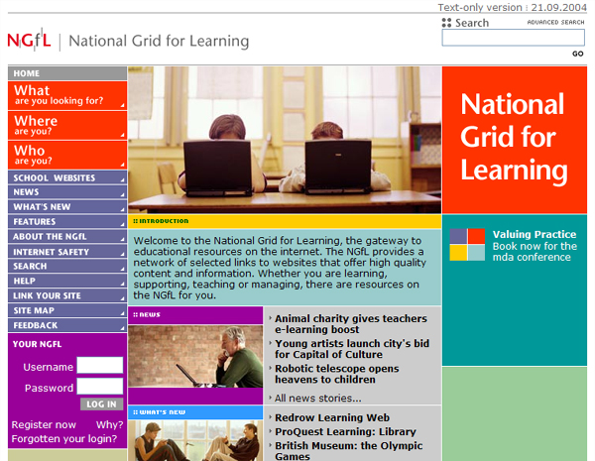
Similar World Wide Initiative
National Grid for Learning, UK
NGfL portal is the gateway to educational resources on the internet
Provides a network of selected links to websites that offer high quality content and information
Funded by the Department for Education and Skills and managed by the British Educational Communications and Technology Agency (Becta)
http://www.ngfl.gov.uk

Slide 12

Metadata Implementations
The MyGfL portal design emphasis on the target audience and their subject of interest as a basis to the placement of content within the portal.
Only the resource’s description will be displayed. Full metadata record will be displayed only if requested.
DC. description and DC.keywords are bilingual (English and Bahasa Malaysia).
Search results display records in both languages.
DC.keywords control vocabulary uses UNESCO thesaurus.

Slide 13
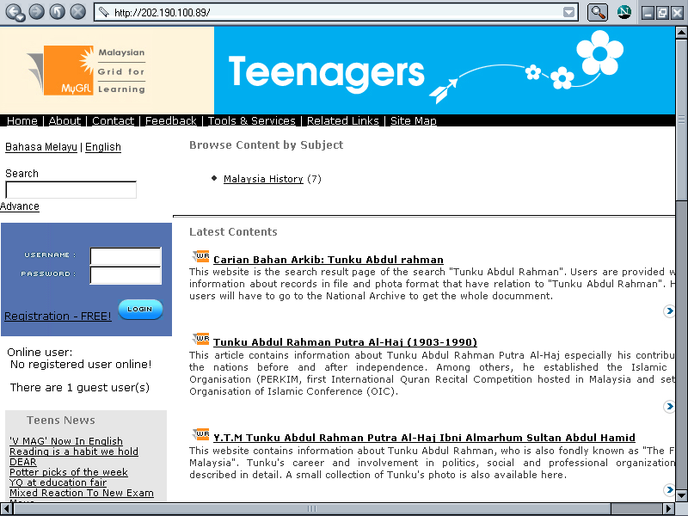
Metadata Implementations

Slide 14
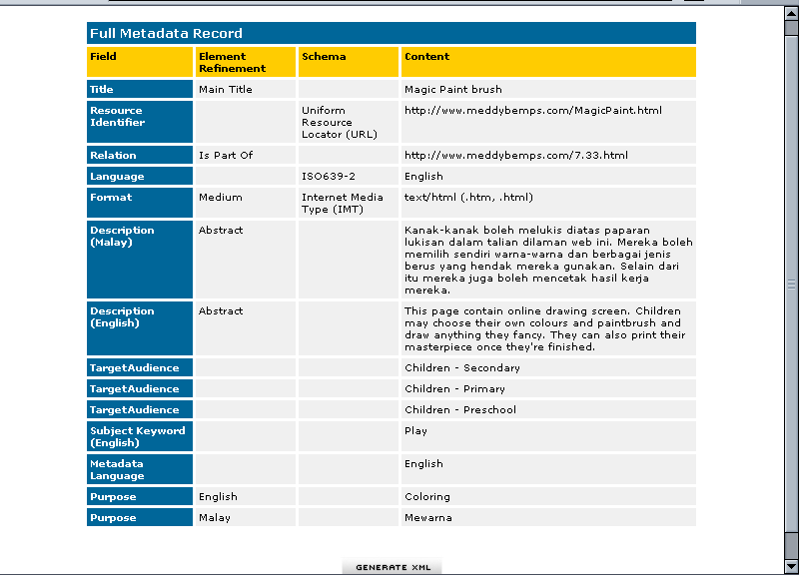
Full metadata records

Slide 15
Metadata Management System (MMS)
Designed and developed specifically for creating, harvesting and maintaining metadata records.
Comprises of Metadata Editor and Metadata Harvester
The MMS is both a tool and system to:
      Create metadata for their resources
      Manage and maintain the metadata.
      Grab metadata from other resources.
      Store the metadata records created.

Slide 16
Metadata Editor
Designed to be simple and easy to use.
Guided by definition and explanation of each element.
Add and generate metadata .
View the the saved, submitted, approved, rejected and achieved metadata records.
Save for more editing or submit to metadata QA.

Slide 17
Metadata Harvester (in progress)
Automated collection of predefined metadata from other repository
Share metadata with other repository
Based on Open Archive Initiative (OAI) protocol

Slide 18
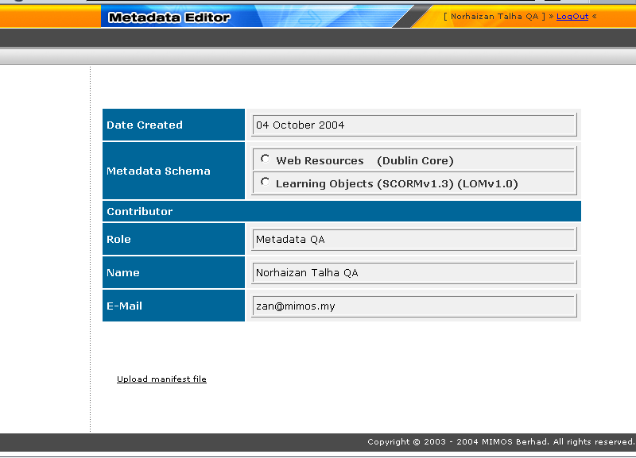
Metadata Editor front page

Slide 19
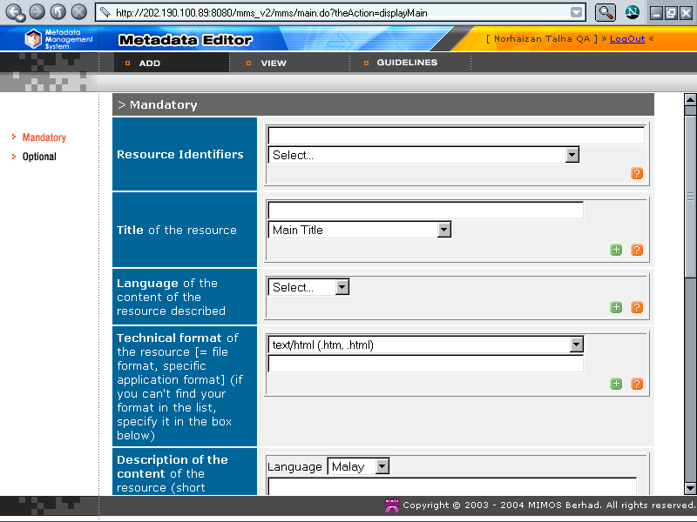
Dublin Core elements

Slide 20
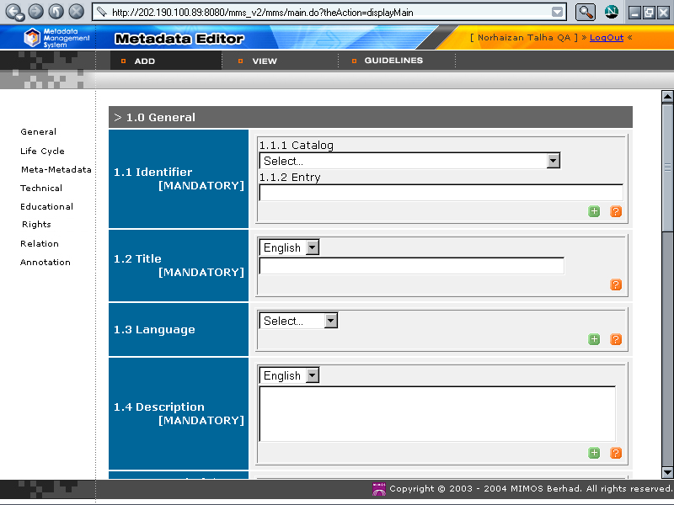
LOM elements

Slide 21
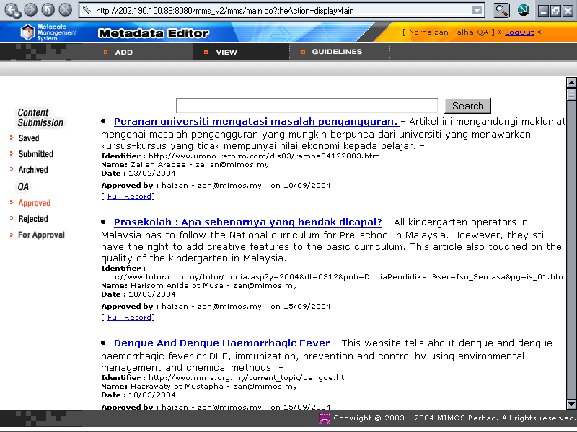
View of metadata records approved

Slide 22
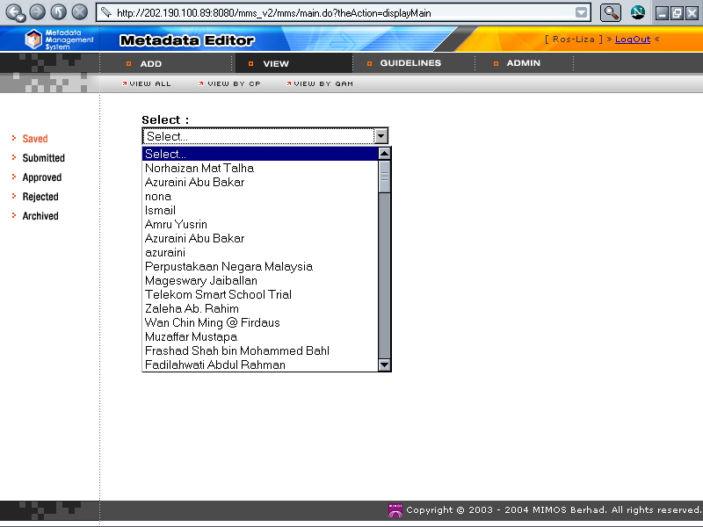
View of records by organization

Slide 23
Future directions
Some kind of “cataloging” activities have been implemented by organization with vast amount of information. But this metadata implementation using DC is the first of its kind in Malaysia.
Actively promoting and initiating metadata adoption to content providers of MyGfL.
Provide training for Metadata Management Systems to content providers.
Awareness program will be conducted for MyGfL potential content providers.

Slide 24
Conclusions
Quality metadata improved retrieval process.
Metadata creation made easy with specifically developed tool.
MMS was utilized to organize, store, retrieve and manage metadata records in MyGfL

Slide 25
Thank You

