Slide 1

The Semantic Web and
Digital Libraries
Eric Miller, W3C
DC 2004 / SILF 2004
Shanghai Library, Shanghai, China
2004-10-13
http://www.w3.org/2004/Talks/1013-semweb-em/talk

Slide 2
Thank you
謝謝

Slide 3
The W3C
International consortium directed by Tim Berners-Lee
Mission: “Lead the Web to its full potential”
Hosts: MIT, ERCIM, Keio University
Defines Web Standards
  HTML, CSS, XML, Security
  Web Accessibility Initiative (WAI)
  Web Services (SOAP, WSDL, etc.)
  Semantic Web

Slide 4
The W3C (Cont.)
Method
  Technical specifications developed with Working Groups and extensive public review
  Advanced Development to chart long term architectural directions
W3C track record: building infrastructure to address technical and social needs of the Web

Slide 5
Semantic Web
Data Integration at Web Scale
Web of data
  framework for integrating multiple sources to draw new conclusions
  architecture for describing all kinds of things (items, collections, services, processes, etc.)
Increase the utility of information by connecting it to its definitions and its context
  effective management and reuse of data at various scales (personal, group, enterprise, community, web)

Slide 6
The Semantic Web (cont.)
Increase the utility of information by connecting it to its definitions and its context
  E.g. not just “color” but a concept denoted by a Web Identifier
    http://pantone.example.com/2004/std#color
Semantic Web core specifications are W3C Recommendations as of Feb 2004
  RDF, RDF Schema, OWL

Slide 7
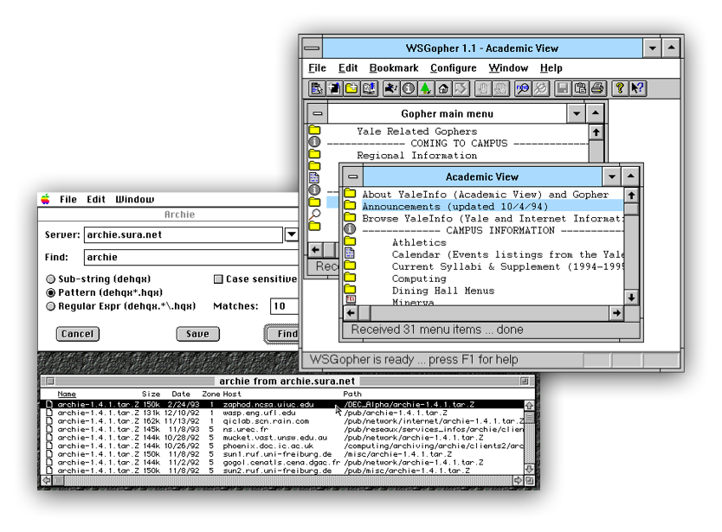
Web of Data
Circa 1993
FTP, Gopher, Archie: popular for sharing resource on the Internet
Stopped at the file level

Slide 8
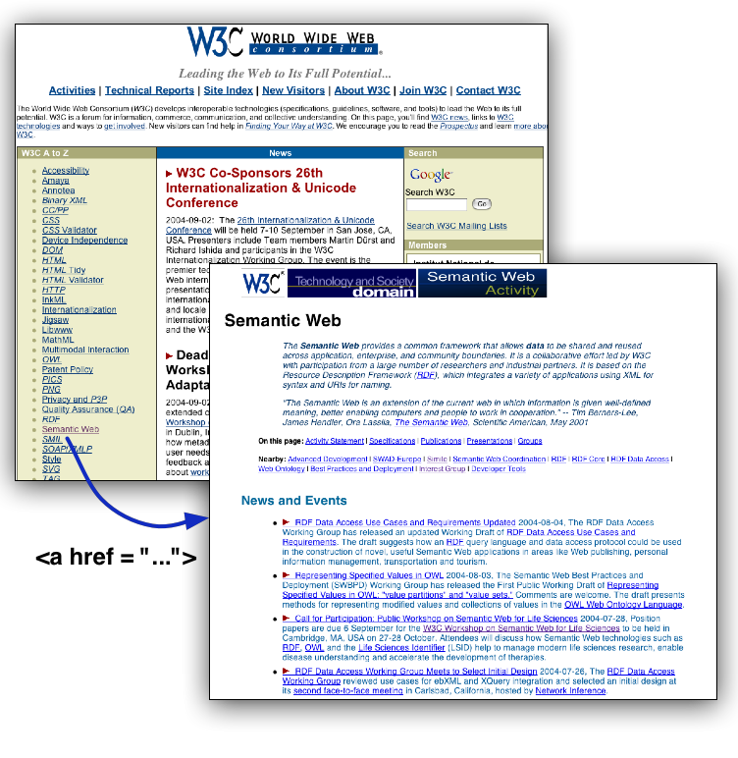
Web of Data (Cont.)
Circa 1994
HTML and URIs
Below file level
Stopped at text level

Slide 9
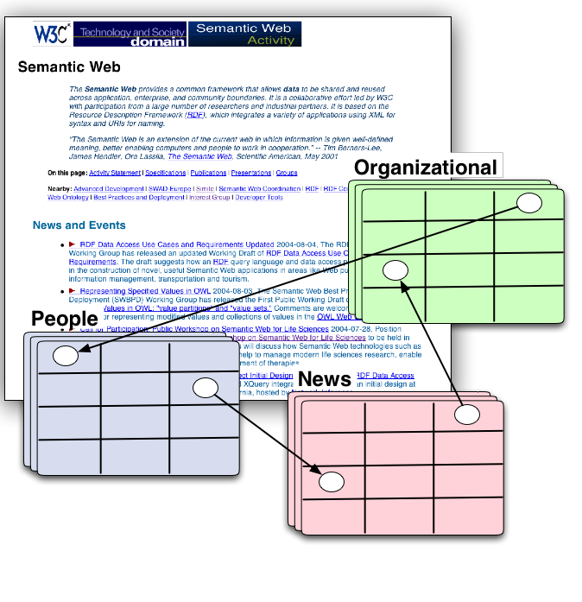
Semantic Web of Data
And now
XML, RDF, OWL, URI
Below file level
Below text level
At data level

Slide 10
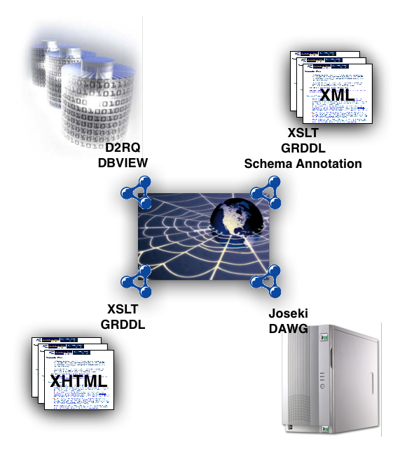
Web Evolution
Not revolution
Proving commons means for exposing data hiding in documents, servers and databases
Machine processable data on the Web

Slide 11
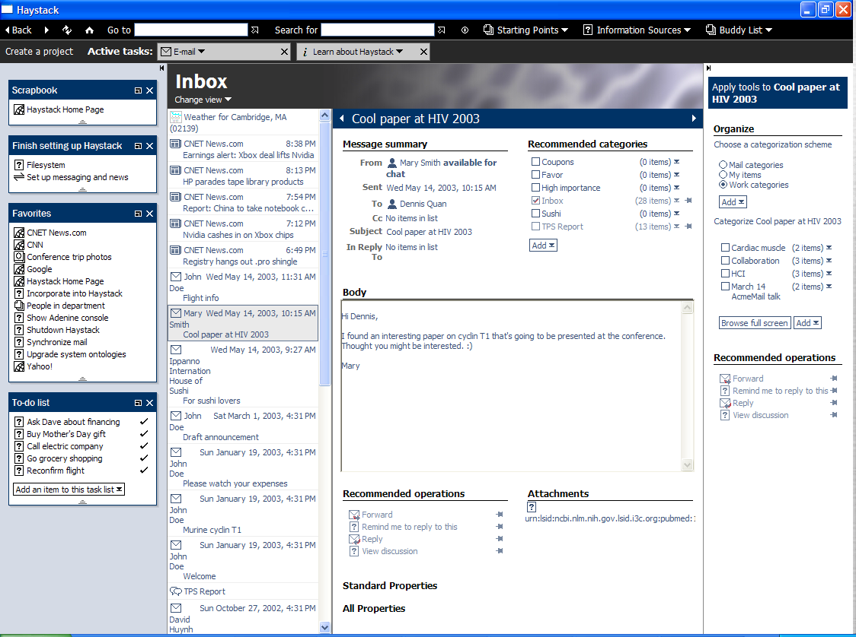
Web of Data - Personal
Haystack - User configurable universal information client
  benefits from RDF’s universal information model
Uses RDF for personalization, data, layout, preferences, etc.

Slide 12
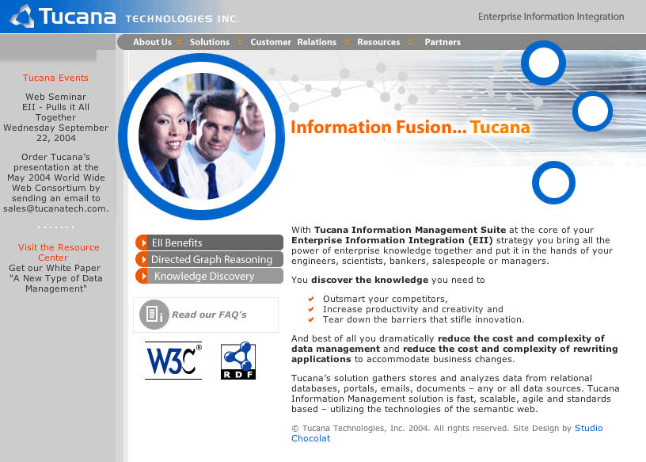
Web of Data - Enterprise
Tucana - Enterprise Information Integration
Expose diverse data sources as RDF
Scalable back-end storage

Slide 13
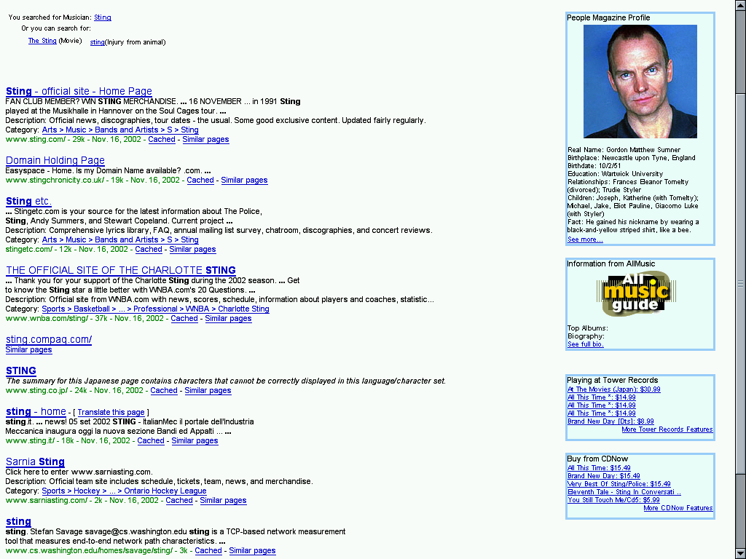
Web of Data - Web Scale
TAP
Simple tools that treats the Web a giant distributed database.
Local, independently managed knowledge bases can be aggregated

Slide 14
Phase 2
Semantic Web core specifications are W3C Recommendations as of Feb 2004
  Open Standards and Open Source tools, technologies for modeling real world resources; sharing these models across the Web.
Phase 2 launched in March 2004
  RDF Data Access - “Joining the Web”
  Best Practices and Deployment
  Advanced Development
Deployment / Facilitating 'Network Effect'

Slide 15
RDF Data Access
Working Group - Define an HTTP and/or SOAP protocol for selecting instances of RDF
  make it as easy to 'join' data on the Web as it is to merge tables in a local relational database.
Use Cases
  Personal Information Management, Product life-cycle data management, Publishing, Mobile
Use Cases and Requirements - Aug 2004; Query Language Specification - Oct 2004

Slide 16
Best Practices and Deployment
Working Group - provide guidance for developers of Semantic Web applications.
Best practices on ontology engineering guidelines, vocabulary development, educational material and demo applications.
Support initiatives for transforming selected high-visibility ontologies and thesauri to RDF/OWL.

Slide 17
Advanced Development
Collaborative development - creation of core components (e.g. libwww) that will form the basis for the Semantic Web.
Facilitate Semantic Web deployment and identify futures areas of standardization

Slide 18
Semantic Web and Thesauri
SWAD-Europe - Supporting Semantic Web standards in Europe
Targeted research, applications and outreach
  Software and case studies for collaboration, syndication and classification
  Workshops (calendaring, social networks, images, geospatial, internationalization, RDF storage, etc.)
SKOS
  encoding and mapping of thesauri, controlled vocabularies
  SKOS Web Service API
  Bridges library classification and Web technologies

Slide 19
Institutional Repositories
Project Simile - Semantic Web meets Digital libraries and personal information management
Implement a digital asset management and dissemination architecture based on Web standards
Leverage and extend DSPACE, enhancing its support for managing its support for arbitrary, heterogeneous data
Integrated project among W3C, HP, MIT Libraries, MIT CSAIL

Slide 20
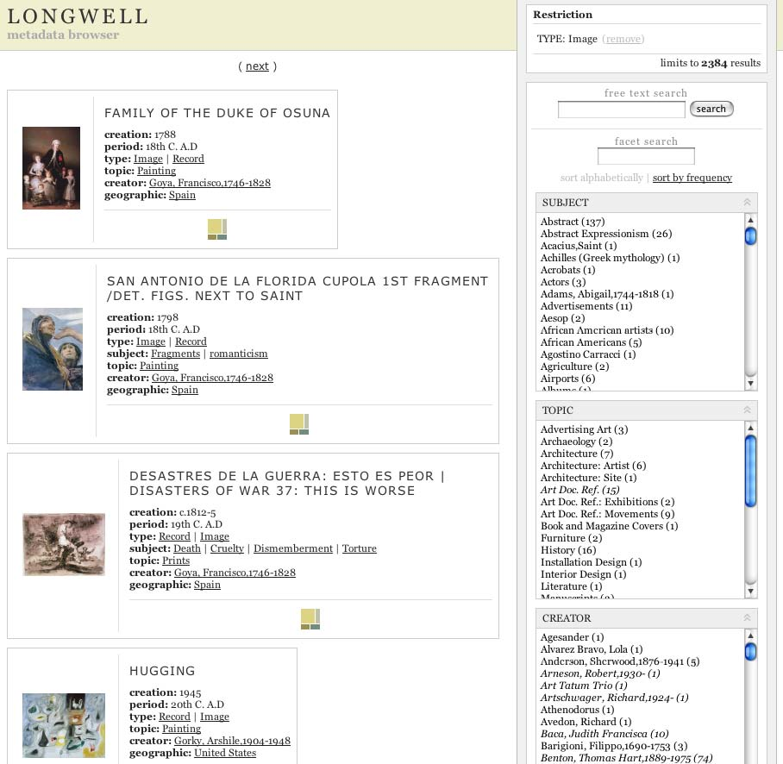
Semantic Web Browser
Common interface, framework for navigation
Architecture supports integration of heterogeneous data sources
Tools for exposing content collections in RDF
http://simile.mit.edu

Slide 21
Integrating Life Science Data
Connecting information: gene, diseases, cures
Scientists working in different locations, focusing on different problems integrating results into coherent whole
Recognized need for effective data integration from heterogeneous collections
Increasingly available datasets in RDF
Increasing scientific / vendor interest
  Semantic Web and Life Sciences Workshop, Oct 27-28, Cambridge MA

Slide 22
Lessons Learned
Benefits of common description framework
Data Integration
Trust

Slide 23
Common Framework
Many organizations are starting to realize they need ‘digital libraries’
  Even if they don’t call it that
Common data representation and architecture reduces (technical / social) costs and is more efficient
Everyone benefits

Slide 24
Breaking down Barriers of Domain Knowledge
Independent vocabularies stitched together
  Marc relator terms and Dublin Core Contributor
    MARC:illustrator refines DC:contributor
  RSS title and Dublin Core title
    RRS:title refines DC:title
More effective discovery

Slide 25
Who you trust?
When "Anyone can say anything about anything", who you trust is important
Trust is an important challenge for the Semantic Web
Libraries have long standing trusted position that is applicable on the Web

Slide 26
Role of Libraries in Semantic Web
Exposing collections - use Semantic Web technologies to make content available
Web’ifying Thesaurus / Mappings / Services
Sharing lessons learned
Persistence

Slide 27
Conclusions
Core Specifications in place
More applications / toolkits / software every day
Semantic Web is stimulating a whole new class of applications at individual, enterprise and web scale.
Growing number of user / domain communities; opportunities for more effective sharing of experience and knowledge.
Libraries have an important role to play

Slide 28
Additional Information
W3C World Wide Web Consortium
  http://www.w3.org
The Semantic Web Initiative Home Page
  http://www.w3.org/2001/sw/
Eric Miller, W3C Semantic Web Activity Lead
  http://www.w3.org/People/EM/
This Presentation
http://www.w3.org/2004/Talks/1013-semweb-em/talk

