Slide 1
Creating and Managing Controlled Vocabularies for Use in Metadata
Tutorial 4
DC2004, Shanghai Library
14 October 2004
Stuart A. Sutton & Joseph T. Tennis
Information School of the University of Washington, Seattle, U.S.A.

Slide 2
Goals of the Tutorial
Controlled vocabulary development [Joe Tennis]
  Development considerations
  Development techniques
Managing controlled vocabularies for the Web [Stuart Sutton]
  Vocabulary and vocabulary term identification
  Vocabulary declaration
  Vocabulary publication

Slide 3
Contents
Definition: What do we mean when we say “controlled vocabulary”
Issues: What are the issues in developing, generating, using and managing vocabularies?
Creation: How are controlled vocabularies created?
  Creating a new controlled vocabulary
  Creating a useful controlled vocabulary for a community already using many different vocabularies
Form and Use: How are controlled vocabularies represented and used?
  URI references for identifying vocabulary terms
  Human-readable strings that represent vocabulary concepts
Management: How are controlled vocabularies managed?
  Vocabulary declarations and publication
  Simple and complex registries

Slide 4
Issues
No Controlled vocabularies are used. Many metadata initiatives do not use controlled vocabularies in generating metadata values
Vocabularies used are not identified. Even when controlled vocabularies are used, they may not be identified in instance metadata
Vocabularies are not publicly accessible. Even where the vocabulary is identified in instance metadata, public access to the vocabulary by humans and/or machines is unavailable
Vocabulary identification is lost in “dumbing down”. Even when identified in complex instance metadata (e.g., qualified Dublin Core), the identifications are lost in the process of “dumbing down”

Slide 5
Definition
Controlled vocabulary (CV): A finite set of distinct values for a metadata property
  Different from a “metadata vocabulary” which defines a finite set of properties (i.e., a schema)
  In the metadata statement “dc:subject=cybernetics”, we are concerned only with the controls placed on the right-hand side of the statement (i.e.,the scheme or value space)
Not just for the “subject” property!
  With the exception of properties with uncontrolled value strings in Dublin Core (e.g., dc:description), all properties can successfully use controlled vocabularies to increase precision and enhance meaning
  E.g., the DCMI vocabulary for use with the dc:type vocabulary is a “controlled vocabulary”
Notes:
“A Metadata Vocabulary is a set of metadata terms (properties, classes, and instances, of those classes) managed as a coherent unit by an agency.” Guidelines for machine-processable representation of Dublin Core Application Profiles: Draft CWA, July 2004. <http://ftp.cenorm.be/public/ws-mmi-dc/mmidc116.htm>

Slide 6
Controlled Vocabulary Development

Slide 7
Vocabulary Development
Two types of development
  Creating a new controlled vocabulary
  Creating a useful controlled vocabulary for a community already using many different vocabularies

Slide 8
Developing Vocabularies
Creating a new controlled vocabulary
  Gather data from your community combination of ways
    Representatives speak for users (vet ideas in committee)
    Gather information about the community and its information needs
    Gather user search data
  Construct vocabulary
    Identify terms
    Identify relationships between terms
  Maintain vocabulary
    Keep it current and useful!
    Based on user, domain, and representative input

Slide 9
Creating a New Controlled Vocabulary
Gather data from your community [1/3]
  Representatives speak for users
    Committee meetings
    Draft vocabularies
    Vet vocabularies to group
  Good things about this approach
    Faster
    Cheaper
  Cons of this approach
    No real user data
    No way of knowing whether what you built works

Slide 10
Creating a New Controlled Vocabulary
Gather data from your community [2/3]
  Information needs of a community
    What terms are in the documents they use?
      E.g. web pages, journal articles, maps?
    How is the community structured?
      Who creates information, who consumes it, who stores it?
      Are there standards (educational standards for example) that shape information flow?
      Are there basic philosophical assumptions about the information flow? (does it all need to be captured or just part of it?)

Slide 11
Creating a New Controlled Vocabulary
Gather data from you community [3/3]
  What search terms do they use?
  What tasks do they perform that they need information for?
  What habits do they have for searching for information (other people?) - how does that affect how you build your vocabulary?
  All three of these data collection activities will help you construct the terms and relationships between terms.

Slide 12
Creating a New Controlled Vocabulary
Construct Vocabulary
  Identify terms
    Pull together synonyms, disambiguate homographs
    Any term that is not “official” can be used as an aid in search (expanding the query to direct it to the “official” term
  Identify relationships between terms
    What are the relationships between terms that will aid the user during search and retrieval?
    Make those relationships explicit in your metadata.
  These actions make a controlled vocabulary “controlled”

Slide 13
Creating a New Controlled Vocabulary
Maintain the vocabulary
  Check search logs…see where search is successful and where it fails
  Where it fails, adjust the vocabulary
  Add new terms as needed
  Take out terms as they are not needed
  Think about using those terms as query expansion

Slide 14
Developing Vocabularies
Creating a useful controlled vocabulary for a community already using many different vocabularies
  Merging vocabularies
  Create high-level “switching” vocabulary
  Create a third new vocabulary and link to similar terms in the existing vocabularies

Slide 15
Developing Vocabularies
None of these options are ideal
All three options require careful understanding of the community (domain) and the use/users of the vocabularies
Addressing the terms in these vocabularies with URIs helps disambiguate the individual terms, because these terms will be defined in namespaces

Slide 16
Developing Vocabularies
Merging Vocabularies
  The vocabularies (terms and relationships between terms) can be merged in order to facilitate search
  The structure of each vocabulary must be accounted for in the merging
  We must account not just for the occurrence of similar or the same terms, but also the meaning of those terms as they’re used by the indexers and the searchers

Slide 17
Developing Vocabularies
Create a high-level “switching” vocabulary
  This ignores most of the relationship structure of the existing vocabularies
  Imposes a broad “umbrella-like” structure to the vocabularies
  Easier to do (with an accurate understanding of the vocabulary, domain, and users), but search may suffer a bit (potential loss of search control)

Slide 18
Developing Vocabularies
Create a third new controlled vocabulary and link its terms to similar terms in existing vocabularies
  More time intensive and costly than the other two options, and more involved than crafting a vocabulary from scratch
  It is costly because you have to monitor all the changes made to each of the linked vocabularies, and you must add these to the search query expansion in a thoughtful way, requiring a lot of time and effort

Slide 19
Infrastructure to Support Exposure and Use of Vocabularies
Identifying, Declaring and Publishing Vocabularies

Slide 20
Webized Controlled Vocabularies
“Webized” controlled vocabularies and
vocabulary terms are:
  Persistently and uniquely identified
      URIs for names/tokens/identifiers
  Formally declared by means of a schema language
      Represented in XML or RDF/XML
  Made Web-available by being published
      Published through a Web-accessible registry

Slide 21
Vocabulary Term Identification
Assertion 1: All webized controlled vocabulary terms must be assigned a URI
    “The most fundamental specification of Web architecture …
    is that of the Universal Resource Identifier, or URI. The
    principle that anything, absolutely anything, ‘on the Web’
    should be identified distinctly by an otherwise opaque string
    of characters … is core to the universality [of the Web].”
        Tim Berners-Lee, “Web Architecture from 50,000 Feet” <http://www.w3.org/DesignIssues/Architecture.html>
  Required by the DCMI Abstract Model [Draft]
    “The Dublin Core Abstract Model requires that all terms
    (elements, element refinements, encoding schemes and
    controlled vocabulary terms) … that are compliant with the
    model must be assigned a URI reference that identifies the
    term.”
        Andy Powell, “Guidelines for assigning identifiers to metadata terms” <http://www.ukoln.ac.uk/metadata/dcmi/term-identifier-guidelines>

Slide 22
Vocabulary Term URI Construction
Goals
  Persistence. URI should have indefinite existence (in perpetuity?)
  Uniqueness. By definition, URI should never identify more than one entity (vocabulary, vocabulary term or version of a vocabulary or vocabulary term)
  Resolvability. If possible, URI should resolve using currently available Web browsers
URI reference partitioning
  XML namespace URI reference
    E.g., http://purl.org/gem/GEMS/
  Vocabulary term name
    E.g., Physics
  Resulting URI
    http://purl.org/gem/GEMS/Physics

Slide 23
Persistent URI Reference Strategies
Possible strategies:
  Use project-specific URL
      E.g., http://myproject.org/metadata/vocabs/color#Red
    Questionable persistence
  Use PURL
      E.g., http://purl.org/gem/educationLevel/Grade 2
    Reliable intermediary (resolution service) for persistence
  Use “info” URI
      E.g., info:ddc/22/eng//004.678
    Persistent identification but info URIs cannot be “resolved” using current Web browsers
      DCMI Working Draft: “Guidelines for assigning identifiers to metadata terms”
      <http://www.ukoln.ac.uk/metadata/dcmi/term-identifier-guidelines>

Slide 24
Vocabulary Term Declaration
Assertion 2: All controlled vocabulary terms must be “declared”
  To “declare” a term is to create a machine-processable representation of the term by means of a schema language
  XML and RDF/XML
  Relationships among versions of a vocabulary and its terms should be declared
    Area of research and exploration
    See Guidance information for naming, versioning, evolution, and maintenance of element declarations and application profiles Draft CWA, July 2004
      <ftp://ftp.cenorm.be/public/ws-mmi-dc/mmidc117.htm>

Slide 25
Examples: Declaration
DCMI Type Vocabulary
GEM Education Level Vocabulary

Slide 26
Vocabulary Management Information
<?xml version="1.0" encoding="UTF-8" ?>
<!DOCTYPE rdf:RDF (View Source for full doctype...)>
<rdf:RDF xmlns:dcmitype="http://purl.org/dc/dcmitype/" xmlns:dcterms="http://purl.org/dc/terms/"
xmlns:dc="http://purl.org/dc/elements/1.1/" xmlns:rdfs="http://www.w3.org/2000/01/rdf-schema#"
xmlns:rdf="http://www.w3.org/1999/02/22-rdf-syntax-ns#">
<!-- CONTROLLED VOCABULARY MANAGEMENT INFORMATION -->
<rdf:Description rdf:about="http://purl.org/dc/dcmitype/">
<dc:title xml:lang="en-US">The DCMI Types namespace providing access to its content by means
of an RDF Schema</dc:title>
<dc:publisher xml:lang="en-US">The Dublin Core Metadata Initiative</dc:publisher>
<dc:description xml:lang="en-US">The Dublin Core Types namespace provides URIs for the entries of the
DCMI Type Vocabulary. Entries are declared using RDF Schema language to support RDF applications.
The Schema will be updated according to dc-usage decisions.</dc:description>
<dc:language xml:lang="en-US">English</dc:language>
<dcterms:requires rdf:resource="http://dublincore.org/documents/dcmi-type-vocabulary/" />
<dc:source rdf:resource="http://dublincore.org/documents/dcmi-type-vocabulary/" />
<dc:source rdf:resource="http://dublincore.org/usage/terms/" />
<dcterms:requires rdf:resource="http://purl.org/dc/elements/1.1/" />
<dcterms:isReferencedBy rdf:resource="http://purl.org/dc/terms/" />
<dcterms:issued>2000-07-11</dcterms:issued>
<dcterms:modified>2002-05-22</dcterms:modified>
</rdf:Description>
<!-- TERM DECLARATIONS -->
…
…
</rdf:RDF>

Slide 27
Vocabulary Term Declarations
<!-- TERM DECLARATIONS -->
<dcterms:DCMIType rdf:about="http://purl.org/dc/dcmitype/Collection">
<rdfs:label xml:lang="en-US">Collection</rdfs:label>
<rdfs:isDefinedBy rdf:resource="http://purl.org/dc/dcmitype/" />
<rdfs:comment xml:lang="en-US">A collection is an aggregation of items. The term collection means
that the resource is described as a group; its parts may be separately described
and navigated.</rdfs:comment>
<rdf:type rdf:resource="http://www.w3.org/2000/01/rdf-schema#Class" />
<dcterms:issued>2000-07-11</dcterms:issued>
<dc:type rdf:resource="http://dublincore.org/usage/documents/principles/#vocabulary-term" />
<dcterms:hasVersion rdf:resource="http://dublincore.org/usage/terms/history/#Collection-001" />
</dcterms:DCMIType>
<dcterms:DCMIType rdf:about="http://purl.org/dc/dcmitype/Dataset">
<rdfs:label xml:lang="en-US">Dataset</rdfs:label>
<rdfs:isDefinedBy rdf:resource="http://purl.org/dc/dcmitype/" />
<rdfs:comment xml:lang="en-US">A dataset is information encoded in a defined structure
(for example, lists, tables, and databases), intended to be useful for direct machine
processing.</rdfs:comment>
<rdf:type rdf:resource="http://www.w3.org/2000/01/rdf-schema#Class" />
<dcterms:issued>2000-07-11</dcterms:issued>
<dc:type rdf:resource="http://dublincore.org/usage/documents/principles/#vocabulary-term" />
<dcterms:hasVersion rdf:resource="http://dublincore.org/usage/terms/history/#Dataset-001" />
</dcterms:DCMIType>
...
…
</rdf:RDF>

Slide 28
GEM educationLevel Vocabulary (XML)
<?xml version="1.0" encoding="UTF-8" ?>
<xs:schema xmlns:xs="http://www.w3.org/2001/XMLSchema"
xmlns="http://purl.org/gem/instance/level/" targetNamespace="http://purl.org/gem/instance/level/"
elementFormDefault="qualified" attributeFormDefault="unqualified">
<xs:annotation>
<xs:documentation xml:lang="en">GEM controlled vocabulary for designating the education level of the audience for a resource. Created in 1996 by the GEM Consortium.</xs:documentation>
<xs:annotation>
<xs:simpleType name="Level">
<xs:union>
<xs:simpleType>
<xs:restriction base="xs:Name">
<xs:enumeration value="Preschool education">
<xs:enumeration value="Kindergarten">
<xs:enumeration value="Grade 1">
<xs:enumeration value="Grade 2">
…
<xs:enumeration value="Grade 11">
<xs:enumeration value="Grade 12">
<xs:enumeration value="Adult/continuing education">
<xs:enumeration value="Higher education">
<xs:enumeration value="Vocational education">
</xs:restriction>
</xs:simpleType>
</xs:union>
</xs:simpleType>
</xs:schema>

Slide 29
Examples:
Instance Metadata
Dewey Decimal Classification
GEM Subject

Slide 30
DDC Instance in RDF
<?xml version='1.0' encoding='UTF-8'?>
<rdf:RDF xmlns:rdf='http://www.w3.org/1999/02/22-rdf-syntax-ns# '
xmlns:rdfs='http://www.w3.org/2000/01/rdf-schema#'
xmlns:dc='http://purl.org/dc/elements/1.1/ '
xmlns:dcterms='http://purl.org/dc/terms/'>
<rdf:Description>
<dc:subject>
<dcterms:DDC>
<rdf:value>930</rdf:value>
<rdfs:label>History of the ancient world (to ca. 499 A.D.)</rdfs:label>
</dcterms:DDC>
</dc:subject>
</rdf:Description>
</rdf:RDF>

Slide 31
GEM Instance in RDF (Value URI)
<?xml version='1.0' encoding='UTF-8'?>
<rdf:RDF xmlns:rdf='http://www.w3.org/1999/02/22-rdf-syntax-ns#' xmlns:dc='http://purl.org/dc/elements/1.1/'>
<rdf:Description>
<!-- GEM hierarchical subject: Arts--Photography -->
<dc:subject rdf:resource='http://purl.org/gem/instance/
subject/GEMS/arts_photography'/>
</rdf:Description>
</rdf:RDF>

Slide 32
Vocabulary Term Publication
Assertion 3: All controlled vocabulary terms must be “published”
  Web-addressable vocabulary registries
  Registry complexity continuum:
    From simple, human-readable HTML pages documenting vocabularies and vocabulary terms
    To complex blends of human-readable pages and declared machine-addressable vocabulary schemes
  Registry examples:
    Simple Registry⎯
    Gateway to Educational Materials: <http://www.thegateway.org/about/documentation/gem-controlled-vocabularies/>
    Complex Registry⎯
    DCMI Registry:
    <http://www.dublincore.org/dcregistry/>

Slide 33
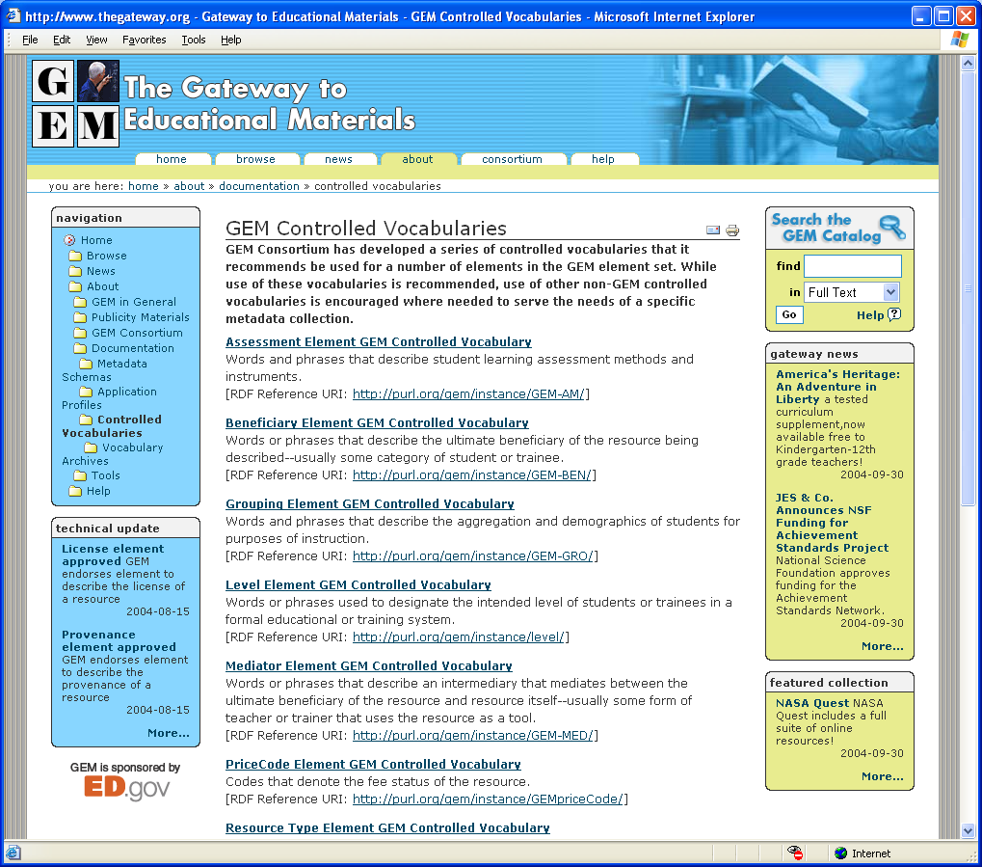
Simple Registry: GEM

Slide 34
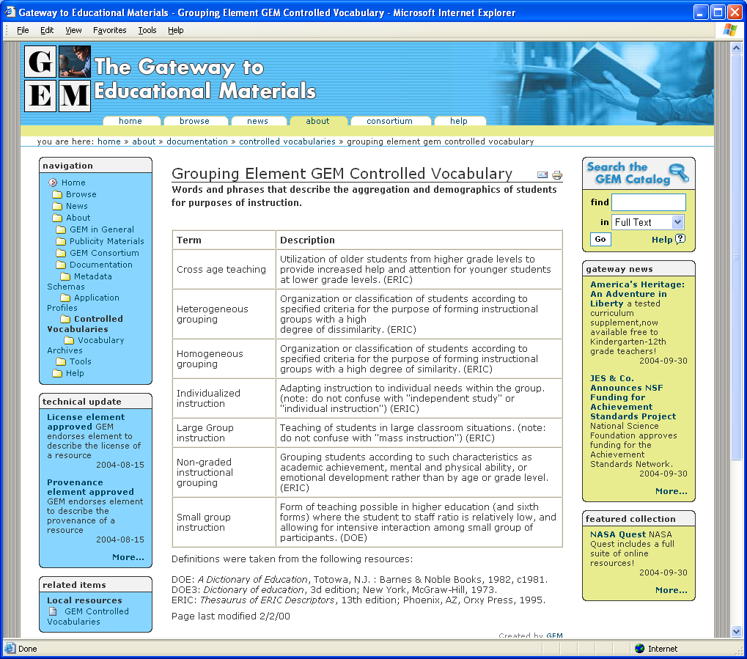
GEM: Student Grouping Vocabulary

Slide 35
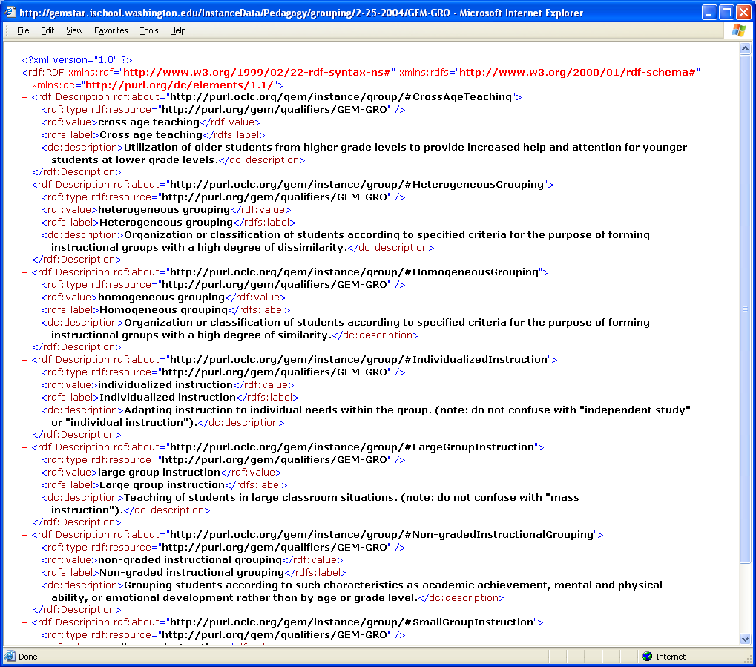
GEM: Student Grouping Vocabulary (RDF)

Slide 36
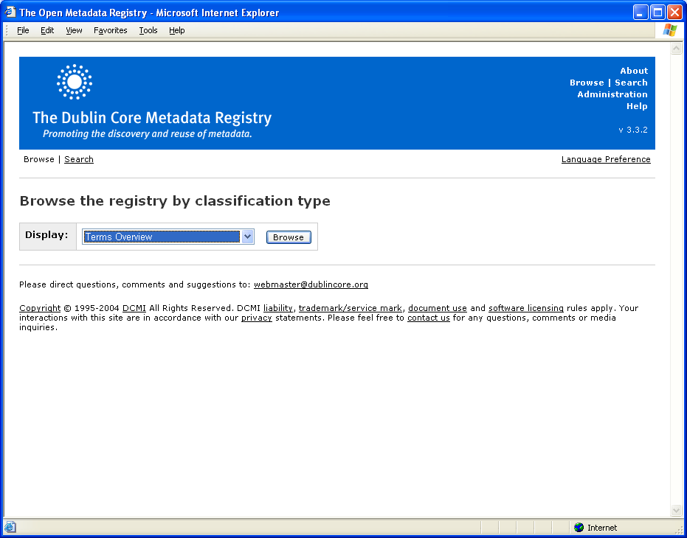
Complex Registry: DCMI

Slide 37
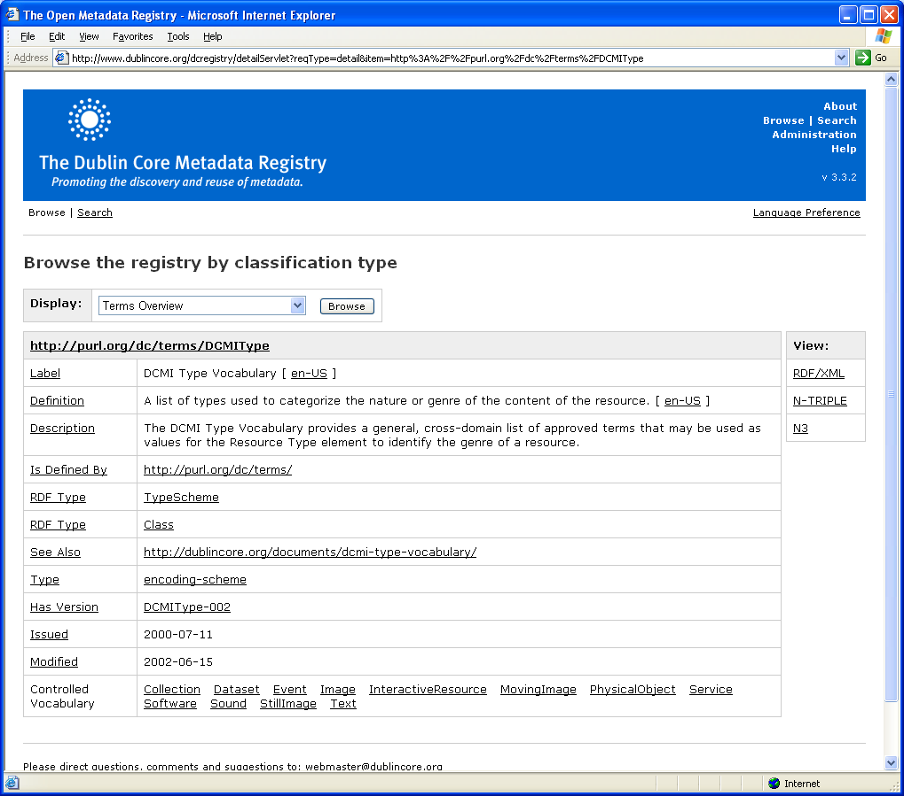
DCMI Type Vocabulary

Slide 38
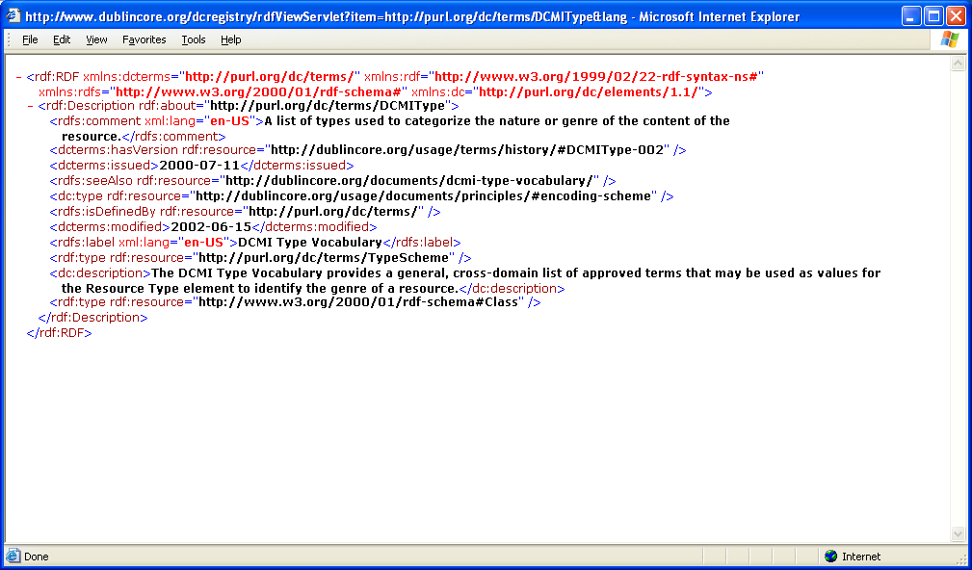
DCMI Type Vocabulary RDF

Slide 39
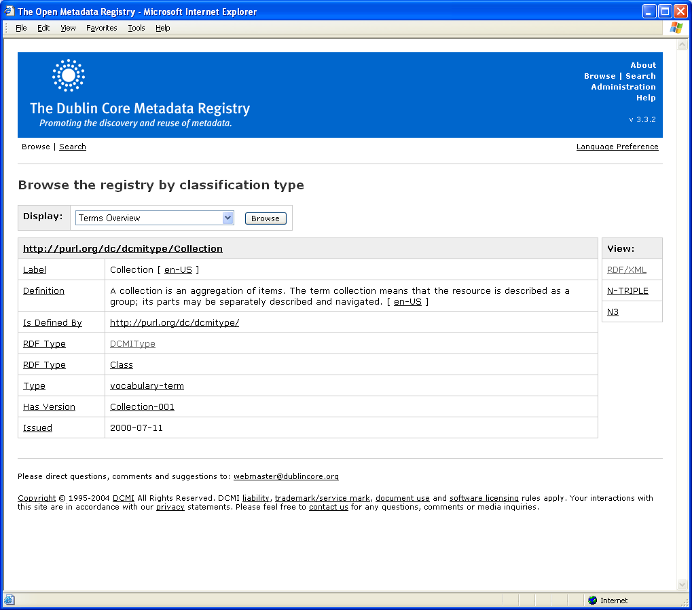
DCMI Type Term: “Collection”

Slide 40
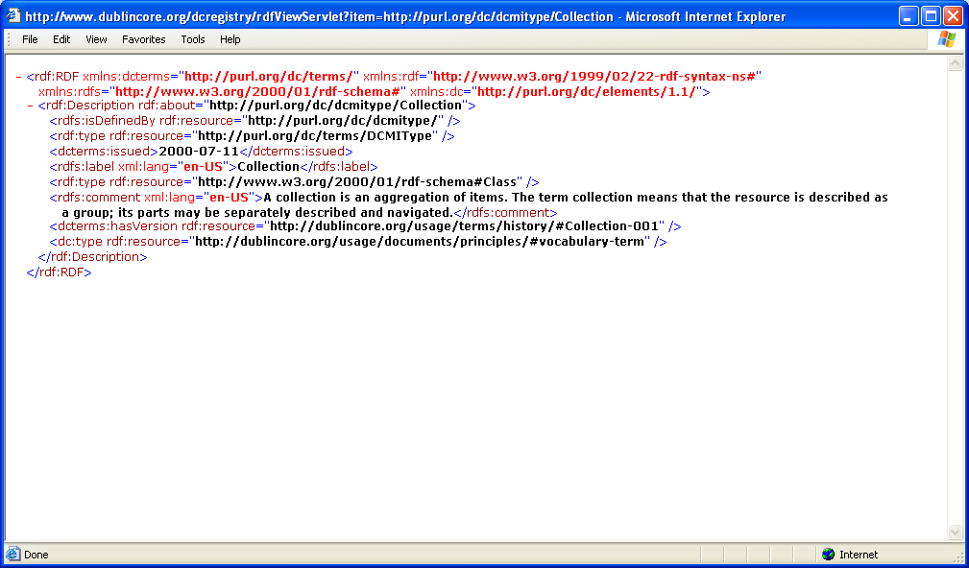
DCMI Type Term “Collection” (RDF)

Slide 41
Questions?
Thank you for your attention
Stuart A. Sutton
sasutton@u.washington.edu
Joseph Tennis
jtennis@u.washington.edu

