Slide 1

A Metadata Model Based on the Concept of Structured Digital Object (SDO) and Its Application in Digital Libraries
- From Concept to Prototype System
Ying LI, Hidehiro ISHIZUKA
Graduate School of Library, Information and Media Studies, University of Tsukuba, Japan
Wednesday, October 13, 2004

Slide 2

Outline of Presentation
Introduction
Body
Conclusion

Slide 3
Introduction
Definition of Metadata
&
the Concept of Structured Digital Object (SDO)
A Metadata Model Based on the Concept of SDO
Research Purposes

Slide 4
Introduction
- Definition of Metadata
Definition of Metadata :
  Data about data
  Metadata is a set of structured digital objects about resources in digital libraries.
the Concept of Structured Digital Object
SDO is metadata

Slide 5
Introduction
- A Metadata Model Based on the Concept of SDO
Metadata Model Based on the Concept of SDO
  metadata
  elementary (atomic) unit
  hierarchy structure
Research Purposes
  all the different granularities
  individual
  precise search
  reuse & sharing resources
  interoperability

Slide 6
Elementary (Atomic) Unit
<docAuthor> LI, Ying</docAuthor>
<docAuthorLastName>LI<docAuthorLastName>
<docAuthorFirstName>Ying </docAuthorFirstName>

Slide 7
Hierarchy Structure for SDO
・・・・・・
Coarse
The first layer: set for primary documents
e.g. set={anthrax-related articles}
The second layer: a primary document
e.g. an article on anthrax.
The third layer: set for a part of a primary document
e.g. set={title, abstract,…}
Granularity
The fourth layer: a part of a primary document
e.g. title, abstract, a table, a figure, reaction formula.
The fifth layer: set morpheme
e.g. set={word, mol. formula, a cell value of table, ..}
The sixth layer: morpheme
e.g. a word, molecular formula.
・・・・・・・
Fine
* Source: H. Ishizuka, Y. Li” Digital Library System Based on Concept of Computer-processable Digital Objects ”,
Proceedings of Digital Library - IT Opportunities and Challenges in the New Millennium, pages 315-326, 2002.7,
Beijing.

Slide 8
Body
Design Objective ⇔ Enhancing the Functionality
a Global Digital Library Based on SDO Metadata
Proposal of the Global Digital Library & Its Functions :
  Using the metadata model based-SDO,
  Restructuring existing resources in existing digital libraries,
  Forming "Global Digital Library ".
  Global Digital Library has a feature of a portal site.
  Satisfying users for precise search,
Meeting individual user need to different granularities information.
Providing Web Services for information services,
  & the function of Topic Maps to associate SDOs with information resources.
  Solving interoperability problems,
  Achieving goals: reusing, sharing information.

Slide 9
Main Items
Architecture of the Design for a Global Digital Library Based on SDO Metadata
Developing Prototype for a Global Digital Library Based on SDO Metadata

Slide 10

Architecture
Subsystem: Creating Metadata Model
Matching
Heterogeneous Resources
in Existing Digital Library
Metadata Set
Based-SDO
Web Services
Forming
Metadata
Network Structure
Resources
Searcher’s Access
Subsystem: Accessing and Replying
Global Digital
Library Based-SDO
Hierarchy Structure
With a portal site property
Topic Maps
Searcher’s
Access
Web Services
Reply
Reply
Fig. Architecture of the Prototype

Slide 11
Subsystem : Creating Metadata Model
Subsystem: Creating Metadata Model
Heterogeneous Resources
in Existing Digital Library
Definition of SDO
Metadata Set
Based-SDO
②
①
Matching
③
Forming
Global Digital
Library Based-SDO
Hierarchy Structure

Slide 12



Subsystem: Accessing & Replying
Heterogeneous Resources
in Existing Digital Library
Web Services
⑥
①
Web Services
Topic Maps Metadata Based Network Structure
④
⑦
Metadata SDO
Hierarchy Structure
③
Global Digital
Library Based-SDO
Hierarchy Structure
⑤
②

Slide 13
Prototype: Show Screenshot
Granularity
Web Services
Topic Maps

Slide 14
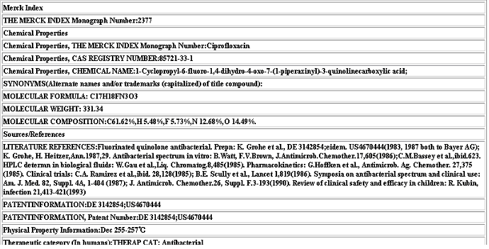
Granularity of the Existing Merck Index Data

Slide 15
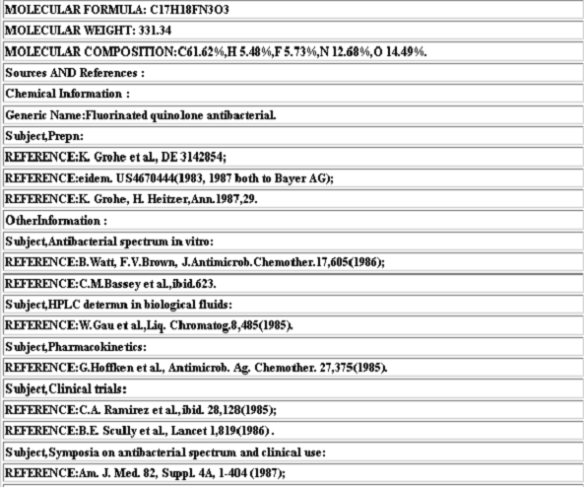
Granularity of the Global Digital Library
Based-SDO Hierarchy Structure

Slide 16
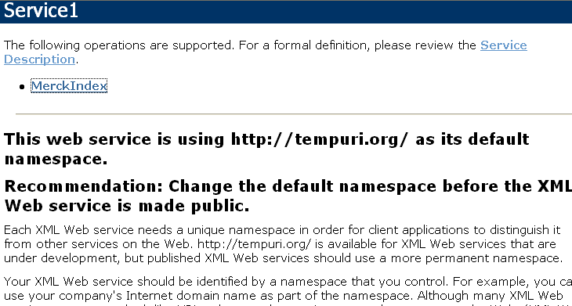
Web Services for Merck Index
Web Services for Merck Index

Slide 17
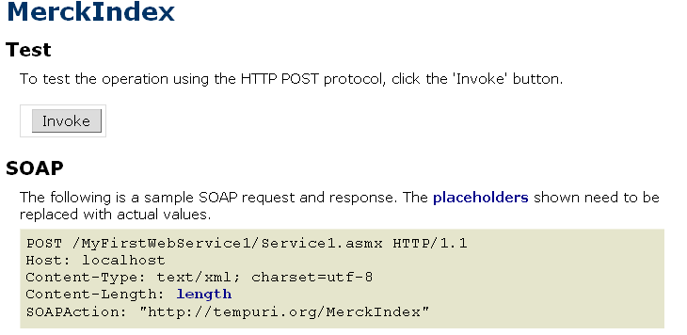
Invoking Merck Index

Slide 18

Invoked Result

Slide 19
Granularity of the Global Digital Library
Based-SDO Hierarchy Structure

Slide 20
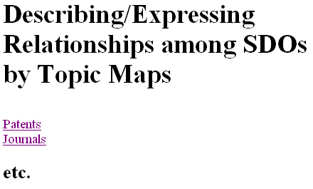
Describing/Expressing SDOs Relationships by Topic Maps

Slide 21
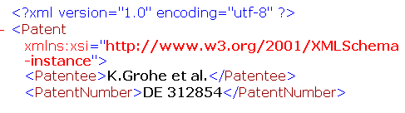
Resources Discovery by Topic Maps

Slide 22
XML Topic Maps (XTM)
<?xml version="1.0" encoding="UTF-8"?>
<?xml-stylesheet type="text/xsl" href="TopicMapsExample.xsl"?>
<topicMap xmlns:xlink="http://www.w3.org/1999/xlink">
<topic>
<baseName>
<baseNameString>Ciprofloxacin</baseNameString>
</baseName>
<occurrence>
<instanceOf>
<topicRef xlink:href="TopicMapsPatentsOccurrence.xml"/>
</instanceOf>
<resourceData>Patents</resourceData>
</occurrence>
<occurrence>
<instanceOf>
<topicRef xlink:href="TopicMapsJournalsOccurrence.xml"/>
</instanceOf>
<resourceData>Jurnals</resourceData>
</occurrence>
</topic>

Slide 23

Future Work -Application to E-learning
By Topic Maps, Linking Between Relevant Teaching Materials, and Discoverying
Contract-Based
Service Request
Internet
Web Services
(SOA)
Text Based on SDO
Result Set
Sharing Teaching Materials by
Web Services
Developing Teaching Materials Based on SDO

Slide 24
Conclusion
Structured Digital Object is :
  Metadata
  Different granularities: from atomic to Coarse
  Hierarchy structure
  Up-to-date and practical use of Metadata, Web Services (SOA), and Topic Maps
  Reuse & Sharing Resources, Interoperability, Individual, Precise search
Structured Digital Object can be applied in the fields of :
  Global Digital library
  E-learning
  etc.

Slide 25
Thank you for your kind attention！
謝 謝 ！
ご清聴ありがとうございました。

