Slide 1
Issues, Experiences and a Project Coherence and Interoperability in Agricultural Information Systems –
Issues, Experiences and a Project
Johannes Keizer
FAO of the United Nations

Slide 2
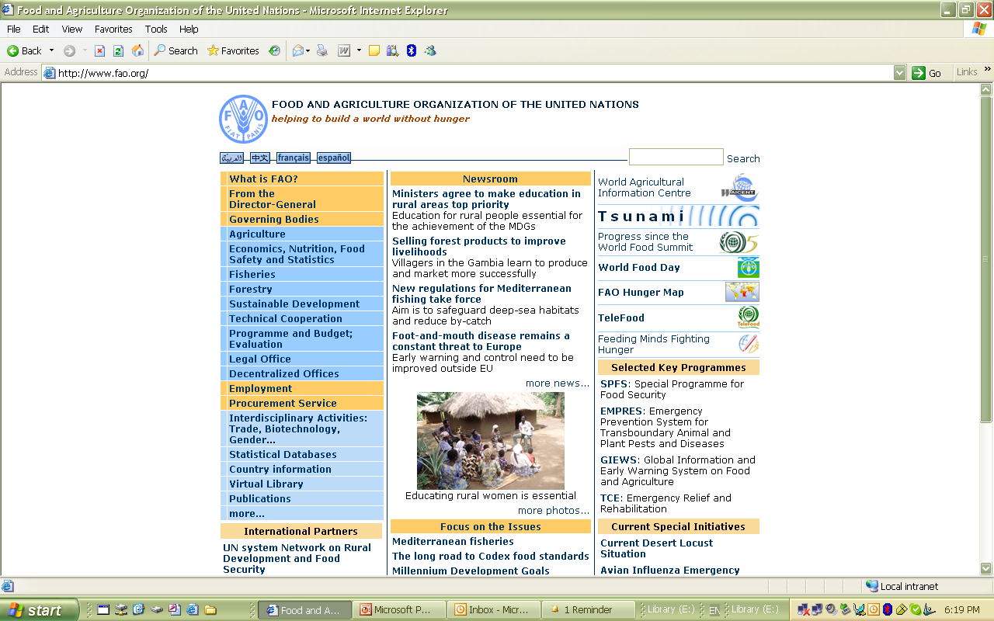
World Food Summit 1996
Reducing Hunger and Poverty in the World by 50% in 2015
"The Rome Declaration calls upon us to reduce by half the number of chronically undernourished people on the Earth by the year 2015 .... If each of us gives his or her best I believe that we can meet and even exceed the target we have set for ourselves.""The Rome Declaration calls upon us to reduce by half the number of chronically undernourished people on the Earth by the year 2015 .... If each of us gives his or her best I believe that we can meet and even exceed the target we have set for ourselves.“
"We have the possibility to do it. We have the knowledge. We have the resources. And with the Rome Declaration and the Plan of Action, we've shown that we have the will."
Our Division’s Goal:
Combating Hunger with Information

Slide 3

Different Needs for Knowledge……
A researcher at IWMI who needs information on Irrigation and Land Deterioriation
The Secretary of the Ministry of Agriculture who needs Legal Information on Pesticide Regulations
let us imagine a researcher in Colombo, who working on the consequences of irrigation for land deterioration
The Extension Worker in Tamil Nadu who every week needs to answer different questions of the farmers
A library that wants to set up a new portal on sustainable fishery livelihoods

Slide 4




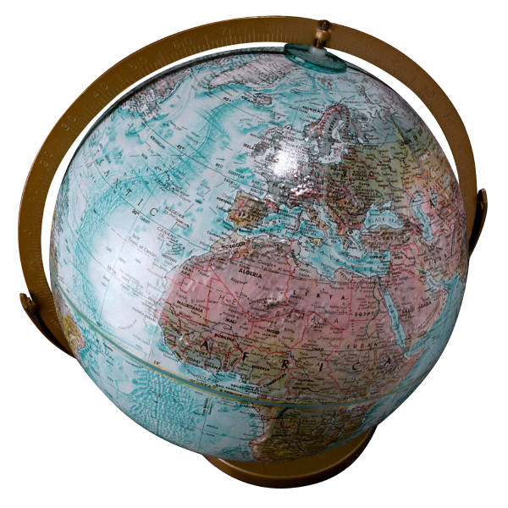
And many sources…….
Land Deterioriation
Pesticide Regulations
Farmer questions
new web portal
Research DBs
Gov.Archives
Websites
FAO
WHO
CGIAR
USDA
GIS Services
CABI
Libraries
CAAS
GeoNW
NAL
University Resources
University Resources
University Resources
DLML
ICAR

Slide 5
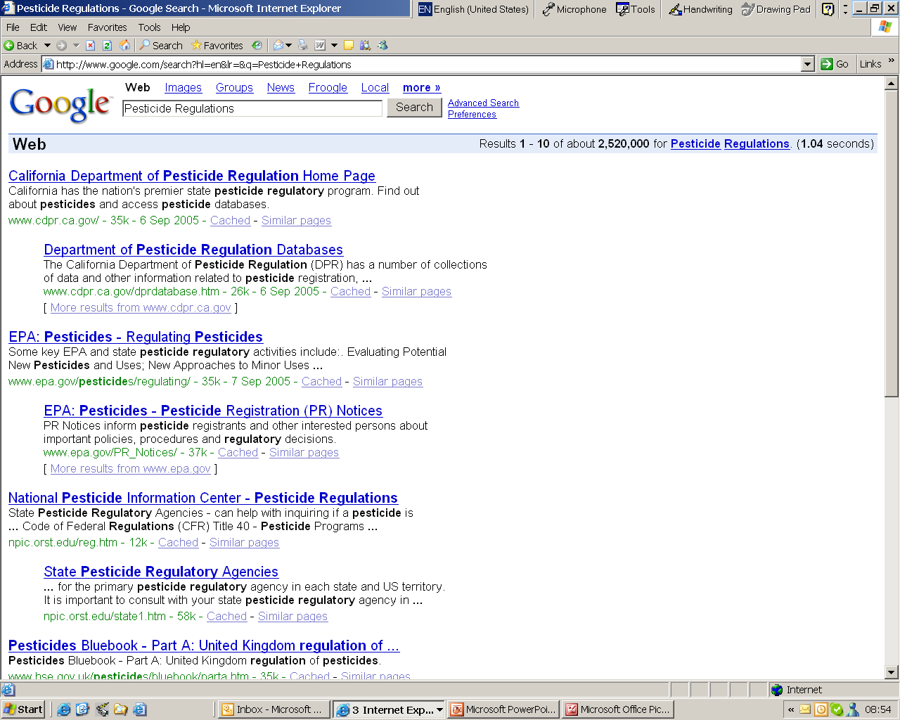
And many sources…….
Land Deterioriation
Pesticide Regulations
Farmer questions
new web portal
There is nothing to resolve this problem at the moment
Research DBs
Gov.Archives
Websites
CGIAR
GIS Services
FAO
WHO
GeoNW
USDA
CABI
Libraries
CAAS
NAL
University Resources
University Resources
University Resources
DLML
ICAR

Slide 6
The problem has not been created by the Internet Revolution
But the Internet Revolution has created the expectation that there are easy solutions

Slide 7
AGRIS: an example solution from the 70s
FAO program from 1975
More than 200 AGRIS centres all over the world collecting bibliographical references
Nearly 3 million bibliographical references
Standardized through proprietary protocols and software
Executed as a specific task for FAO
Crisis with the advent of the Internet and the investment in own information systems of partners

Slide 8
Solutions tried…..
Portals
how many empty shells are out there?
Aggregators/Subject Gateways
what happens when the project money finishes?
Harvesters
searching 10.000.000 records in simple DC is not better than full text searching
simple accumulation does not solve the problem

Slide 9
Wanted!
A sustainable way to access, disseminate and re-use decentralized information and knowledge resources

Slide 10
The solution?
XML buses, web services…..
but this gives only the tools and the technology

Slide 11
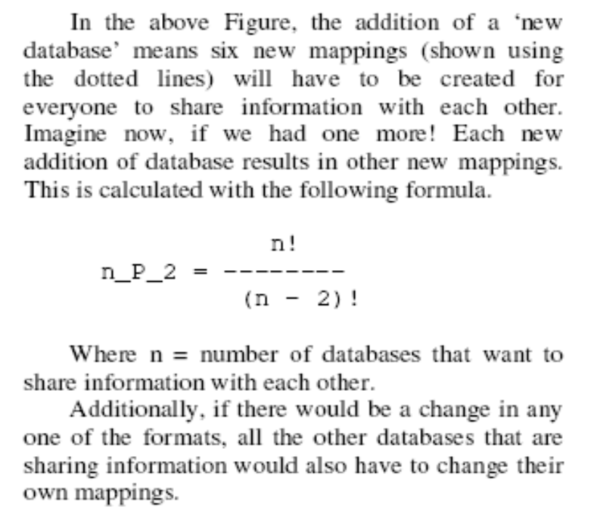
The problem is about meaning
AGRIS
AGRIPPA
AQUASTAT
new dataset
service
etc.
service
2
AGRIS
services
AGRIPPA
common
exchange layer
AQUASTAT
new
database

Slide 12
The concept
Value-added
information
services
Aggregated Database View
Subject
specific Portals
News feed service
Information System (n)
…
Common exchange layer (Vocabularies,Ontologies, RDF/XML)
Shared layer of
interoperability
dataset1
dataset2
datasetn
Distributed
Datasets
…

Slide 13
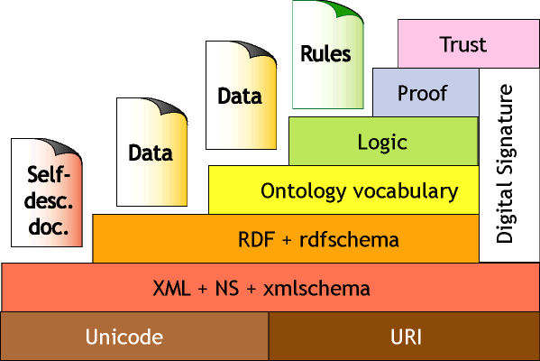
….in a bigger context
©Berners-Lee

Slide 14
Ingredients for Realization
Agreed Exchange Schemas
AgMES
AGRIS AP
Other Schema Projects
Subject Vocabularies
AGROVOC
Ontologies
And this is the biggest issues with our stakeholders
Agricultural Ontology Service (AOS)
An Implementation Mechanism
Alliance for coherence in Agricultural Information systems
Capacity Building

Slide 15
AgMES – Agricultural Metadata Element Set
established namespace for the Agricultural domain
implementation independent set of elements that provides elements in addition to DC, DCTerms, ISO19115, etc. to store and exchange metadata without compromising interoperability within and outside the domain.
at the moment limited to the description of textual data but open to register elements to describe other datatypes
AgMES

Slide 16
AgMES Specifications for DC Refinements
2.3.8 subjectThesaurus
Name
subjectThesaurus
Label
subjectThesaurus
Definition
A classified list of terms or keywords, in a particular field, for use in indexing and information retrieval.
Comments
Below are some possible schemes that may be used for expressing the values of subject Classification. If you wish to use one that has not been listed here, simply indicate the correct reference URI, in XML one can indicate this using the attribute “scheme” and in RDF by using “rdf:isdefinedby”.
Version
1.1
Registration Authority
FAO
Language
English
Obligation
Optional
Datatype
Character String
Maximum Occurrence
Repeatable
Element Refined
DC.Subject
Scheme
free-text; it is preferable to have the value from a controlled list. Here are some possible Schemes.
(AGS) AGROVOC
Multilingual agricultural thesaurus produced by FAO, and used for indexing and cataloguing.
(AGS) CABT
A controlled vocabulary of terms, especially key words, in agricultural sciences for use in indexing and information retrieval created and produced by CAB International.
(AGS) ASFAT
A controlled vocabulary of terms, especially key words, in fisheries for use in indexing and information retrieval created by ASFA (Aquatic Sciences and Fisheries Abstracts).
(AGS) NALT
A controlled vocabulary of terms, especially key words, in agricultural sciences for use in indexing and information retrieval created by National Agricultural Library (NAL) of United States.
(DC) MeSH
Medical Subject Headings
(DC) LCSH
Library of Congress Subject Headings

Slide 17
AGRIS AP: an Application Profile for OAI Services in Agriculture
It is based on established metadata namespaces such as DC, AgMES, AGLS therefore making the data OpenURL compliant;
It is qualified Dublin Core and makes complex searches on data sets possible
Maintains high quality of data by promoting use of controlled vocabulary;
The use of XML to exchange makes it compatible with different software and platforms allowing easier management;
It is an “exchange layer” that allows users to have their choice of proprietary applications but still exchange information;
Enables harvesting of metadata by service providers for value added services such as the OAI;
Handles multilinguality in a consistent way;

Slide 18
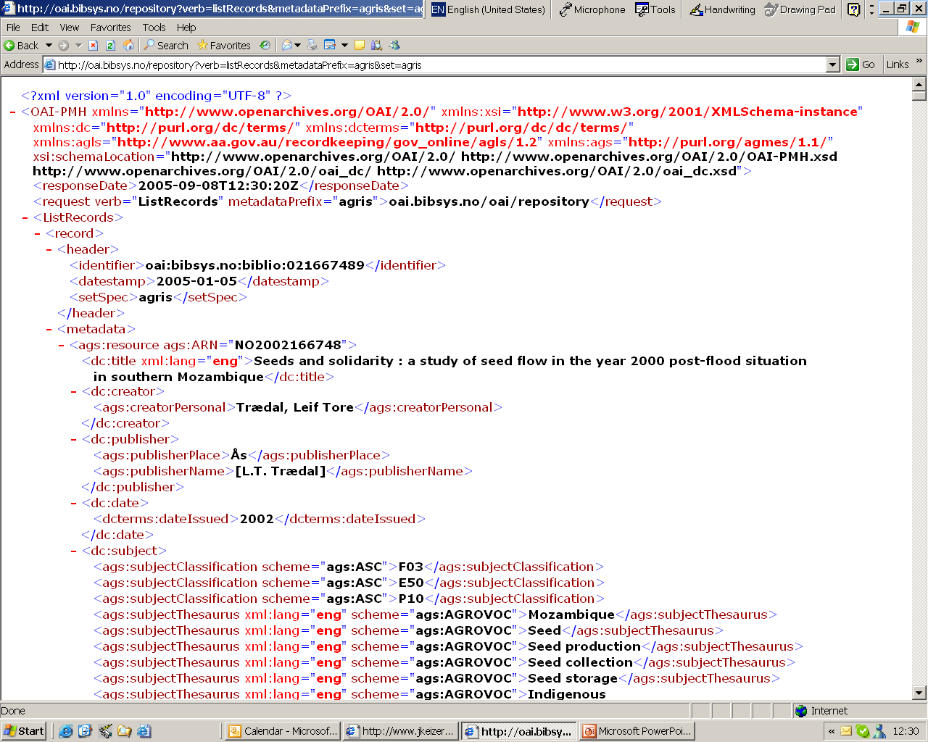
http://oai.bibsys.no/repository?verb=listRecords&metadataPrefix=agris&set=agris

Slide 19
Other schema projects already ongoing
Event metadata: exploring use of DC and AgMES
Project/Person/Organizations: exploring the use of CERIF with local extensions in AgMES
Plant Production and Protection: exploring the use of Darwin Core (1.0 and 2.0) (DwC), the ABCD Schema.

Slide 20
Implementation Successes
2004: Wageningen University and Vikki Science Library rejoin the AGRIS network by implementing data exchange with the AGRIS AP (mapping MARC to the AGRIS AP)
2005: GFIS (Global Forestry Information Service) decides to use the AGRIS AP as the Basis for their Data Exchange
2005: The Research Centres of the CGIAR start to map their metadata repositories (all different) to an AGRIS AP based CGIAR –AP to interchange data within and without the network
2005: FAO makes the entire AGRIS respository (3 million records) available in the AGRIS AP Exchange Format
2005: Expert Consultation in October will discuss the possibility of a common standard for Agricultural Open Archives.

Slide 21
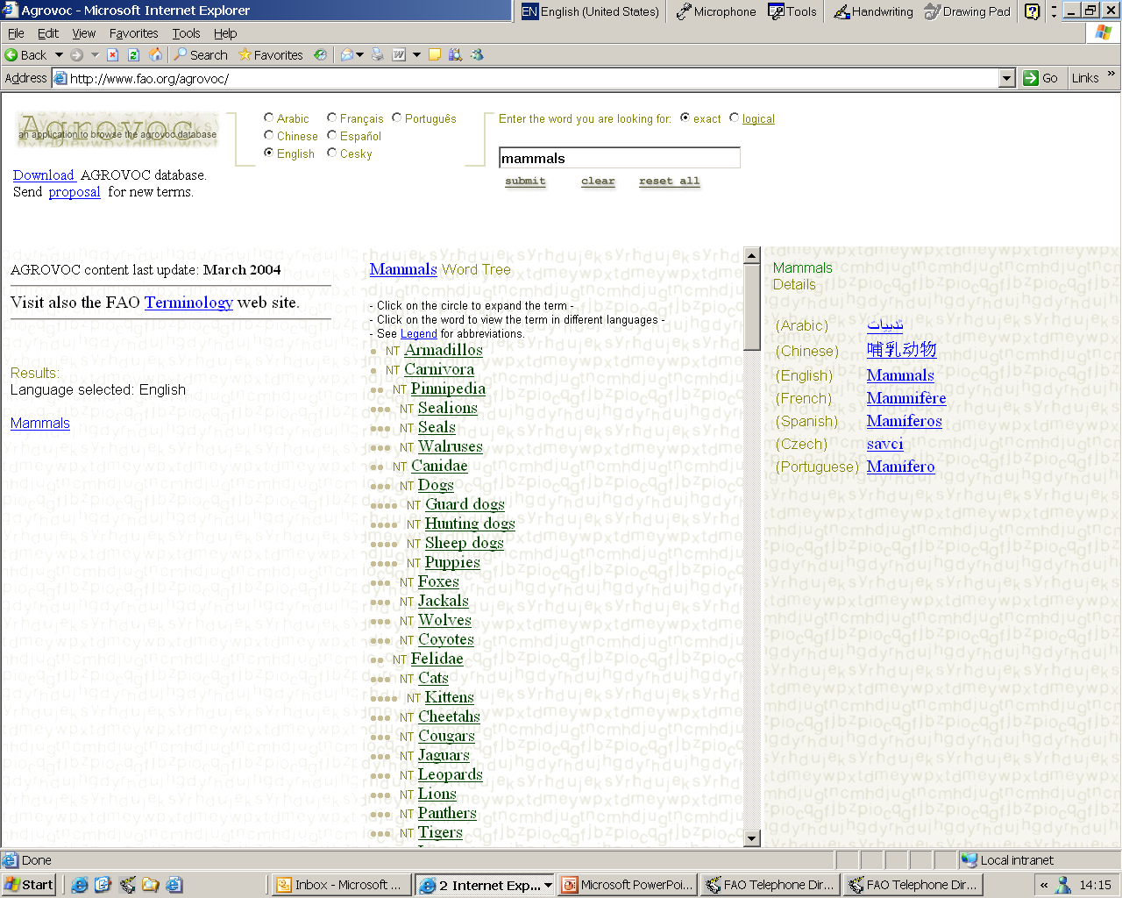
Vocabularies: AGROVOC, a starting point

Slide 22
Project: Agricultural Ontology Service
better semantic help for agricultural information systems
Agricultural Ontology
Service (AOS)
Ontologies
Thesauri
Federated storage and description facility
Other Knowledge Organization Systems (KOSs)
Glossaries
Categorization Schemes
Notes:
Therefore we are working on building a central repository for agricultural related information by collecting in a single (CENTRALIZED?) service, thesauri, classifications schemes, topic trees, glossaries, as well as domain specific ontologies.
This will be a point of reference for IS in the agricultural area.
We also contributed in preparing grant proposals to the EU for ontologies life cycle, ontologies for ethics, etc.

Slide 23
AOS Elements
AGROVOC Concept Server
KOS registry
KOS registry
Metadata
and
subject
ontologies
AGROVOC Concept Server
Other KOS
(thesauri,
word lists,
etc.)
……
Domain concepts
Notes:
The main two elements of the AOS initiative are the AGROVOC CS and the registry of KOS.
The CS will be built starting from AGROVOC. We are currently working on improving the thesaurus by refining its semantics.
We have begun the AGROVOC revision by reducing the number of Top Terms. Next phase will be harmonizing lexicalisations in terms of capitalisation and singlular/plural.
The FAO glossary will be used as a source for definitions and the FAOTERM will supplement the AGROVOC with additional translations.
Later on CGIAR terminologies will be used to expand the CS and build sub-domain ontologies to add to the registry.
Starting from the CS specific domain ontologies are built. In FAO we actually have a fishery ontology, and 3 specific ontologies related to food safety. They are still in early stages and more effort needs to be made to coherently represent concepts. It’s a long process. Collaborations or funding are welcome to speed up the process!

Slide 24
Modeling and Changing AGROVOC
  Conversion to UTF-8
  Modified structure to store multiple classification schemes
  Incorporation of specific vocabularies
  Revised RDBMS scheme for ontology representation
  Implementation of further languages (Thai, Indian Languages, Korean, Hungarian…..)
  Designed OWL models
  Export to OWL format (v0.8b)
  Export to SKOS format (v0.8a)
  AGROVOC web services to be published

Slide 25
Main Issues
  Getting a correct and sustainable presentation of the concept/term/string relationship in a multilingual environment
  Creating a distributed and decentralized, but coherent maintenance environment for vocabularies

Slide 26
Relationships
between
concepts
Relationships
between
Relationships
Concept
Relationship
designated by
annotation relationship
Relationships
between
terms
Lexicalization/
Term
Note
Other information:
language/culture
subvocabulary/scope
audience
type, etc.
manifested as
Relationships
between
strings
String

Slide 27
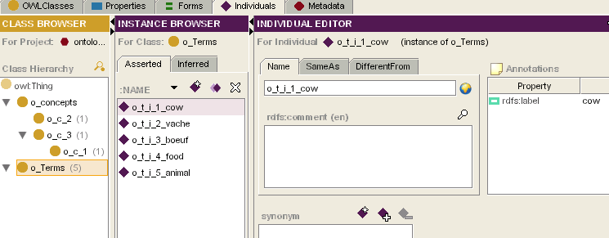
Conceptual structure of a thesaurus in OWL
concept level
string level
term level
All terms are created as instances of the class o_terms. All at the same level. Only one language per term.

Slide 28


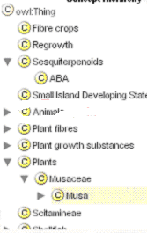

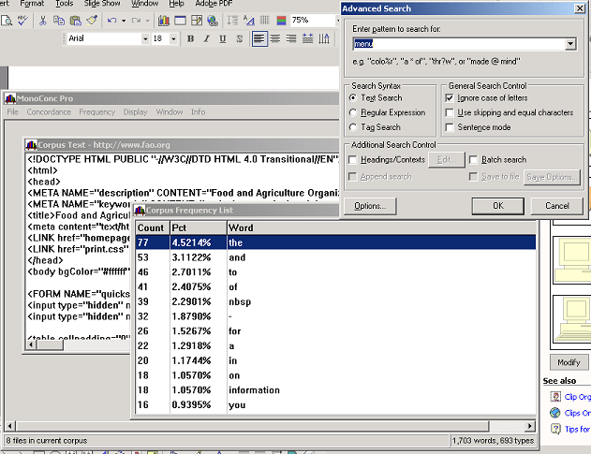
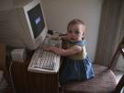
Terminology Workbench
Concept Hierarchy
text corpus
.doc, .pdf, .xml, etc.
input
AOS/CS Workbench
concordance
pattern-matching
multilingual
Notes:
This tool should serve to detect and fix erroneous relations, as well as refine the current relationships used in the thesaurus (RT, USE/USE FOR), etc.

Slide 29
Successes
AGROVOC as de facto Standard with many of our partners
Many downloads a month for the use in different information systems
Language coverage is growing faster
A working model for the representation of the thesaurus in OWL and for a workbench for collaborative maintenance

Slide 30
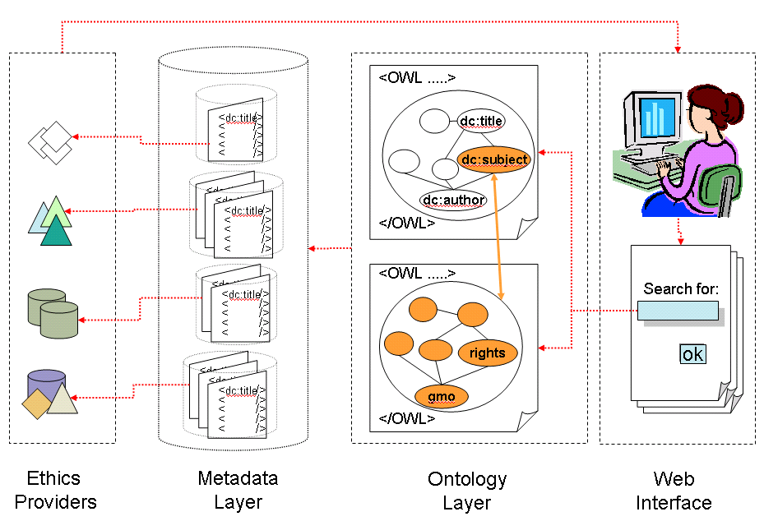
Representation of Application Profiles as Ontologies
The ontology layer offers:
  the possibility of reasoning within the domain through precise specifications of concepts, relations, and rules
  the possibility of inferring new data from existing data

Slide 31
Implementation Successes
not so many, but
AGROVOC has become already a link between different information systems in and outside FAO (GIS, Project, Documents)
Some demonstrators of semantically enhanced applications

Slide 32
The Vision - a semantic space in the web
Network of Data and Service Providers with agreed procedures and standards – and common ontological layers
Data Provider: exposes institutional open archives of data and information
Development Agencies and NGOs
Research Institutions
Industry Information Centres
Service Provider: provides services based on these institutional open archives
Libraries and other traditional Aggregators
Thematic or Regional Centres of Excellence

Slide 33
The Vehicle: an Alliance for Coherence in Agricultural Information Systems
Shared
Communication
Platform
Information System Managers
Information System Owners
Expert
Meetings
Consultations
Information System Designers/Developers
Donor
Organizations
External Actors

Slide 34
Functions of the Alliance
Registration and documentation of common standards
Registration and documentation of information systems Facilitation of the coherent use of standards and tools
Advocacy for a “Code of Conduct”
Establishment of mechanisms to agree on common standards and procedures
Collaborative efforts in maintaining standards
Facilitation of fund raising
Expert meetings to elaborate standards and procedures

Slide 35
Partners
Publishers
Important Agricultural Libraries
Development Agencies
Universities
IARs (CG-network)
Industry
Organizations from Related Areas (UNEPS EnOS)

Slide 36
Successes
1999: IDML Initiative
2000: Contacts to DCMI
2000: Brussels meeting and AGstandards (AgMES) initiative
2001: Launch of the Agricultural Ontology Service
2002: AOS Workshops
2003: Fertile Ground meeting for more coherence in Agricultural Information Systems
Release of AgMES
2004: AGRIS Application Profile
2005: Integration of the AOS workshops with INFITA
Strong Collaboration FAO ICT-Program CG network (CGIAR Application Profiles)
Sponsor: DFID
Partners: FAO, CGIAR, CABI, NAL. CAAS, GFIS

Slide 37
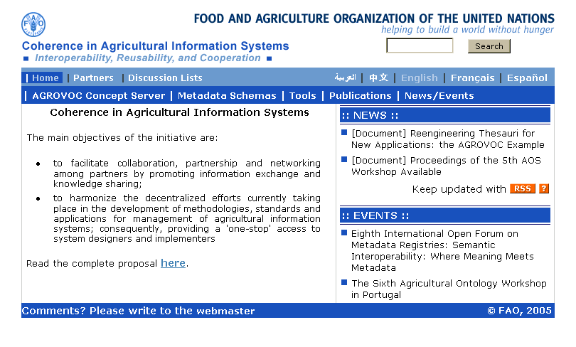

Slide 38
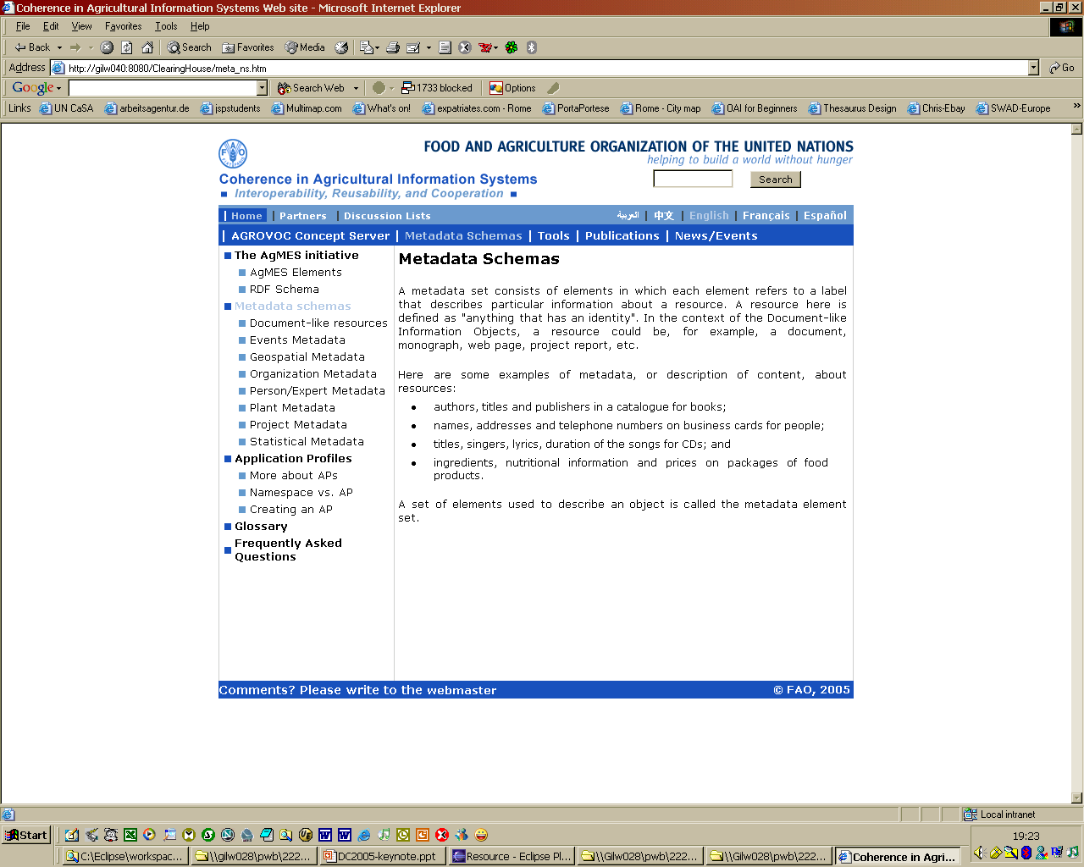

Slide 39
Credits
Stefano Anibaldi
Fynvola Le Hunte Ward
Gudrun Johannsen
Stefka Kaloyanova
Boris Lauser
Anita Liang
Irene Onyancha
Gauri Salokhe
Margherita Sini
Jim Weinheimer
and
Dagobert Soergel

