Slide 1
An Introduction to Dublin Core
Diane I. Hillmann
Cornell University
Tutorial 2: Basic Semantics at DC-2005, Madrid
13 September 2005

Slide 2
What is Metadata?
Answers come from three traditions:
  Database Management Systems (“Schemas of relational databases”)
  Library Cataloging Traditions (MARC & AACR2)
  The World Wide Web (since the mid-1990’s)
    The context for Dublin Core

Slide 3
Types of Metadata
Administrative
Descriptive
Access/Use
Preservation
Technical/Structural
Other?

Slide 4
Comparing Libraries & the Web
Library tradition:
  More than 100 years of experience, from catalog cards to MARC
  MARC Records include:
    Description (all objects)
    Subjects and classification (topical context)
    Holdings information (location)
    Administrative information required to manage records
  Distributed metadata creation based on common consensus on standards

Slide 5
The Web: One distributed Library?
The situation in the mid-1990s:
  Thousands of information providers, using a variety of metadata schemas (if anything at all)
  Search engines providing too many hits and very little precision
  Volatile resources changing addresses, disappearing, etc.
  Exponential growth in numbers and types of resources available

Slide 6
Fifteen Core Elements (1996)
Creator | Title | Subject
Contributor | Date | Description
Publisher | Type | Format
Coverage | Rights | Relation
Source | Language | Identifier

Slide 7
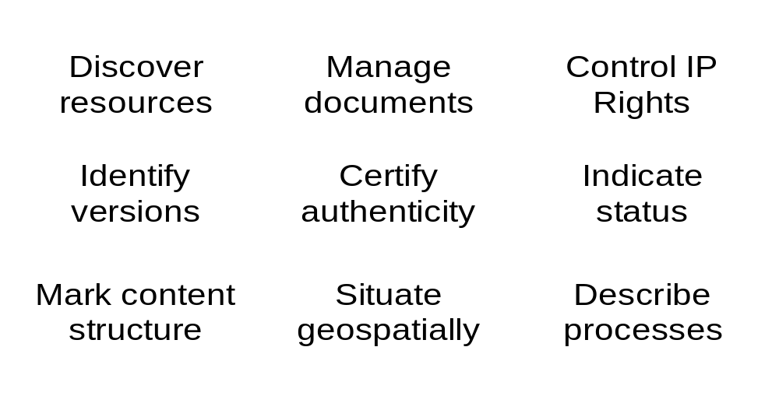
Functions of Metadata

Slide 8
Characteristics of the Dublin Core
A flat file structure, with:
  All elements optional
  All elements repeatable
Elements may be displayed in any order
Extensible
International in scope

Slide 9
Dublin Core Principles
Dumb-Down
One-to-One
Appropriate Values

Slide 10
Dumb-Down
The fifteen core elements are usable with or without qualifiers
Qualifiers make elements more specific:
  Element Refinements narrow meanings, never extend
  Encoding Schemes give context to element values
If your software encounters an unfamiliar qualifier, look it up – or just ignore it!

Slide 11
The One-to-One Principle
Describe one manifestation of a resource with one record
  Ex.: a digital image of the Mona Lisa is not described as if it were the same as the original painting
Separate descriptions of resources from descriptions of the agents responsible for those resources
  Ex.: email addresses and affiliations of creators are attributes of the creator, not the resource

Slide 12
Appropriate Values
“Best practice for a particular element or qualifier may vary by context, but in general an implementor cannot always predict that the interpreter of the metadata will always be a machine. This may impose certain constraints on how metadata is constructed, but the requirement of usefulness for discovery should be kept in mind.”
-- from “Using Dublin Core”

Slide 13
Moving Towards a Data Model
Collective realization that machine-processability requires a coherent data model
1996: “Warwick Framework” proposed at DC-2 workshop: DC as one specialized module (“resource discovery”) among many
1997: “Qualifiers” proposed for specifying meanings
  Some early adopters take this to unintended extremes: “DC.Creator.telephone-number”
1998: DCMI involvement in emerging Resource Description Framework and clarification of simple data model for Dublin Core
2000: First set of qualifiers officially approved

Slide 14
DC Data Model Finalized (2005)
Provides explicit definitions of resources
Relates DC principles and practices to the developments outside DCMI
Makes clear the relationship of DC “packages” of information to other metadata “packages”
Paves the way for future progress for DCMI

Slide 15
Terms and Values: a simple view
<term> is an element or property
<value> is a resource represented by a string or a URI
<term> = <value>
Called “property/value pairs” in the DCMI Abstract Model document
Vocabularies appear on both sides of the equal sign
Best: <term [general bucket]> = <value [specialized vocabulary]>

Slide 16
Simple and Qualified DC
Varying definitions for Simple DC:
  Only the original 15 elements, or
  All available elements, without encoding schemes or refinements
  In each case only making use of value strings
Qualified DC
  Metadata that makes use of some or all the features of the abstract model
    Element Refinements
    Value Encoding Schemes

Slide 17
Element Refinements
Make element meanings narrower, more specific:
  a Date Created versus Date Modified
  an IsReplacedBy versus Replaces Relation
Depending on syntax chosen, refinements may appear as stand-alone tags instead of with elements:
  <dct:created>2002-10-04</dct:created>, instead of:
  <dc:date><dct:created>2002-10-04 </dct:created><dc:date>
    Requires a schema to dumb-down Date Created to Date
  Dublin Core is simple enough to support both usages

Slide 18
Value Encoding Schemes
Indicate that the value is:
  a term from a controlled vocabulary (e.g., Library of Congress Subject Headings)
  a string formatted in a standard way (e.g., that "05/02" means May 2nd, not February 5th)
Even if a scheme is not known by software, the value should be "appropriate" and usable for resource discovery.

Slide 19
Application Profiles & Interoperability
Implementers want to know how their peers design metadata – to avoid "reinventing the wheel"
Information providers need to harmonize metadata usage for improved access within domains, e.g.:
  Between countries (Nordic Metadata Project)
  Preprint repositories (Open Archives Initiative)
  Subject gateways (Renardus)
  Mathematics and physics (MathNet, PhysNet)

Slide 20
Creating Metadata Records
The “Library Model”
  Trained catalogers, one-at-a-time metadata records
The “Submission Model”
  Authors create metadata when submitting resources
The “Automated Model”
  Automated tools create metadata for resources

Slide 21
Distributing Metadata Records
Mid-1990s: HTML tags embedded in Web pages
  Simple, easy to deploy, but inflexible, hard to maintain
  Bad tags like DC.Creator.eyecolor imply a non-existent support for nesting and for entity distinctions
2000+: Better XML/RDF alternatives
  RDF metadata supports complex structures without breaking simple DC grammar
  Open Archives Initiative promotes mass adoption of an XML schema for simple, unqualified Dublin Core records – along with a protocol to make them available

Slide 22
Distribution Models
Database with dedicated search engine
  Good control, little need for interoperability
  Not much re-use in other contexts
Metadata exposure and harvesting
  Standards, agreements and interoperability necessary
Embedded metadata
  Generally websites or individual documents
  Doesn’t scale well, maintenance difficult

Slide 23
Distribution Model: Metadata Harvesting
Service Providers harvest and integrate metadata from diverse Content Providers
  Presupposes standard element sets, record formats, and harvesting methods
1999+: Open Archives Initiative began as a federation of scholarly pre-print providers
  Today: aggregations using OAI-PMH creating new models of metadata services

Slide 24
Why the Harvesting Model Works
Exposing metadata facilitates:
  Reuse of available metadata
  The creation of value-added services
Low entry cost is key to deployable digital library infrastructure
  New Static Repositories version of OAI lowers entry bar even more
Individual communities have begun to customize the common infrastructure
  Simple DC minimum, but supports any metadata

Slide 25
Dublin Core Grows and Changes
DCMI Community emphasizes open participation
  Conferences, working groups, discussion lists
DCMI term set evolves as implementers coin new terms and usage patterns emerge
DCMI Usage Board reviews proposals for new metadata terms

Slide 26
Dublin Core Usage Board
Usage Board receives proposals for new elements, refinements, encoding schemes, Type terms
  Evaluates proposals in light of grammatical principles, usefulness, clarity of definition, overlap with existing terms
Moving away from review of terms “in isolation” towards review of Application Profiles

Slide 27
DCMI Namespaces and Policies
All DCMI metadata terms are given unique identity within three namespaces:
  http://purl.org/dc/elements/1.1/ - the legacy DC-15
  http://purl.org/dc/terms/ - all other elements/qualifiers
  http://purl.org/dc/dcmitype/ - a Type vocabulary
  Example: http://purl.org/dc/elements/1.1/title
Policies promote long-term stability of namespace URIs
  Changes not substantially “semantic” (i.e., corrections) will not result in change of namespace URIs

Slide 28
Finding Out More about DC
DCMI Web Site
  http://dublincore.org
“Using Dublin Core”
  http://dublincore.org//documents/usageguide/
Partiticipating in a Working Group
  http://dublincore.org/groups
Ask a question!
  http://askdcmi.askvrd.org/

Slide 29
Questions?
Thank you for your attention!
Diane I. Hillmann
Cornell University
DIH1@cornell.edu (fourth character is “one”)

