Slide 1
Controlled Vocabularies and the Dublin Core
Ron Daniel, Jr.
Tutorial 3: Vocabularies
13 September 2005

Slide 2
Agenda
  9:00 Introduction
  Overview of talk
  Introductions
  Definitions
  9:15 Which elements should use vocabularies, and which should use text?
  9:30 Factoring “Subject” into Facets
  9:50 Sources for Vocabularies
  10:00 Maintaining Vocabularies
  10:20 Q&A
  10:30 Adjourn

Slide 3
Tutorial Description
Title: Controlled Vocabularies and the Dublin Core
Instructor: Ron Daniel
Place: Aula de grados (5.1.A01)
Date & Time: 14/09/05, from 9:00 to 10:30.
Contents:
The Dublin Core defines a number of metadata elements, but what about the values for those elements? Should they be unrestricted text values or come from pre-defined vocabularies? The answer, of course, is "it depends". During this tutorial we will discuss how to determine the appropriate approach for an organization's situation. We will also cover how pre-defined vocabularies should be sourced, structured, and maintained.
This talk is oriented to an organizational intranet & knowledge management focus, not an academic & library focus.

Slide 4
Overall Context
Vocabulary development and maintenance is the LEAST of three problems:
  The Vocabulary Problem: How are we going to build and maintain the lists of pre-defined values that can go into some of the metadata elements?
  The Tagging Problem: How are we going to populate metadata elements with complete and consistent values?
    What can we expect to get from automatic classifiers? What kind of error detection and error correction procedures do we need?
  The ROI Problem: How are we going to use content, metadata, and vocabularies in applications to obtain business benefits?
    More sales? Lower support costs? Greater productivity?
    How much content? How big an operating budget?
Need to know the answer to the ROI Problem before solving the Vocabulary Problem.

Slide 5

Who we are: Ron Daniel, Jr.
Over 15 years in the business of metadata & automatic classification
  Principal, Taxonomy Strategies LLC
  Standards Architect, Interwoven
  Senior Information Scientist, Metacode Technologies (acquired by Interwoven, November 2000)
  Technical Staff Member, Los Alamos National Laboratory
Metadata and taxonomies community leadership
  Chair, PRISM (Publishers Requirements for Industry Standard Metadata) working group
  Acting chair: XML Linking working group
  Member: RDF working groups
  Co-editor: PRISM, XPointer, 3 IETF RFCs, and Dublin Core 1 & 2 reports.

Slide 6
Taxonomy Strategies: Recent & current clients
Governmental
  Chelan County Public Utilities District
  Commodity Futures Trading Commission
  Defense Intelligence Agency
  ERIC
  Federal Aviation Administration
  Federal Reserve Bank of Atlanta
  Forest Service
  GSA Office of Citizen Services (www.firstgov.gov)
  Head Start
  IMF
  Infocomm Development Authority of Singapore
  NASA (nasataxonomy.jpl.nasa.gov)
  Small Business Administration
  Social Security Administration
  USDA Economic Research Service
  USDA e-Government Program
NGOs
  CEN
  IDEAlliance
  OCLC
Commercial
  Allstate Insurance
  BHP Billiton
  Blue Shield of California
  Debevoise & Plimpton
  Halliburton
  Hewlett Packard
  Motorola
  PeopleSoft
  Pricewaterhouse Coopers
  Siderean Software
  Sprint
  Time Inc.
Commercial subcontracts
  Agency.com – Top financial services
  Critical Mass – Fortune 50 food retailer
  Critical Mass – Fortune 50 hardware retailer
  Deloitte Consulting – Big credit card
  Gistics/OTB – Direct selling giant
Notes:
Please see http://www.taxonomystrategies.com/html/clients.htm for brief descriptions of client projects.

Slide 7
Who are you? Tell us:
  Organization type:
    Academic, Governmental, Non-Profit, Corporate, Other
  Organization size:
    <10, 11..100, 101..1k, 1k..10k, 10..100k, > 100k
  Your role:
    Information architect, Metadata designer, librarian, middle manager, CIO, student, IT Technical staff, Other
  The things you want to get from this workshop
    More understanding of the use of vocabularies in Dublin Core
    Details on how to build first vocabuary
    Other

Slide 8


What is a controlled vocabulary? (Loose definition)
Hierarchical classification of things into a tree structure
Animalia
Chordata
Mammalia
Carnivora
Canidae
Canis
C. familiari
Kingdom
Phylum
Class
Order
Family
Genus
Species
Linnaeus …
44-Office Equipment and Accessories and Supplies
.12-Office Supplies
.17-Writing Instruments
.05-Mechanical pencils
.06-Wooden pencils
.07-Colored pencils
Segment
Family
Class
Commodity
UNSPSC …

Slide 9
Definitions
Term | Definition
Metadata Element | A ‘field’ for storing information about one piece of content. Examples: Title, Creator, Subject, Date, …
Metadata Value | The ‘contents’ of one Metadata Element. Values may be text strings, or selections from a predefined vocabulary.
Metadata Schema | A defined set of metadata elements. The Dublin Core is one schema.
Free Text Value | An unconstrained text metadata value. Some text values are constrained to follow a format (e.g. YYYY-MM-DD).
Vocabulary | A list of predefined values for a metadata element.
Controlled Vocabulary | A vocabulary with a defined and enforced procedure for its update.

Slide 10
Types of vocabularies
Vocabulary Type | Cplxty. | Description | Relation Type
Term List | 1 | Simple list of terms with no internal structure or relations. | None
Synonym Rings | 2 | List of sets of terms to regard as equivalent. Widely supported in search software. | Equivalence
Authority Files | 3 | List of names for known entities – people, organizations, books, etc. | Reference
Classification Schemes | 4 | Hierarchical arrangement of concepts. | Loose Hierarchy
Thesauri | 5 | Hierarchical arrangement of concepts plus supporting information and additional, non-hierarchical, relations. | “Is-a” Hierarchy plus Loose Relations
Ontologies | 6 | Arrangement of concepts and relations based on a model of underlying reality – e.g. organs, symptoms, diseases & treatments in medicine. | Model-based Typed Relations
Rarely distinguished in practice
Search engine ‘thesauri’ may be synonym rings.

Slide 11
Vocabulary control
The degree of control over a vocabulary is (mostly) independent of its type.
  Uncontrolled – Anybody can add anything at any time and no effort is made to keep things consistent. Multiple lists and variations will abound.
  Managed – Software makes sure there is a list that is consistent (no duplicates, no orphan nodes) at any one time. Almost anybody can add anything, subject to consistency rules. (e.g. File System Hierarchy)
  Controlled – A documented process is followed for the update of the vocabulary. Few people have authority to change the list. Software may help, but emphasis is on human processes and custodianship. (e.g. Employee list)
Term lists, synonym lists, … can be controlled, managed, or uncontrolled. Can’t think of any unmanaged ontologies.

Slide 12
Pop Quiz
How much control is needed over a vocabulary?

Slide 13
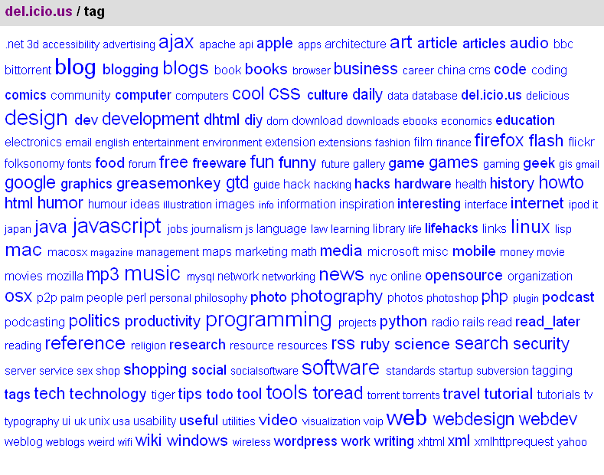
How much vocabulary control is really needed?
Controlled vocabularies are frequently mentioned
  That does not mean they are always necessary
  Control comes at a cost, but can provide significant data quality benefits by reducing variations.
Is this a well-controlled vocabulary?
  No! It is an uncontrolled, but well-managed, term list
Is this part of an appropriate solution to the ROI problem?
  Yes! There is no budget to do ongoing control and QA
Source: http://del.icio.us/tag/
Would this be appropriate for tracking royalty payments?
  Of course not!

Slide 14
Agenda
  9:00 Introduction
  9:15 Which elements should use vocabularies, and which should use text?
  9:30 Factoring “Subject” into Facets
  9:50 Sources for Vocabularies
  10:00 Maintaining Vocabularies
  10:20 Q&A
  10:30 Adjourn

Slide 15
Likelihood of Using Controlled Vocabularies for Dublin Core Elements
 | (Virtually) Mandatory | Highly Likely | Maybe | Highly Unlikely | (Virtually) Impossible
Language | RFC 3066
Format | IMT
Coverage |  | ISO 3166
Type |  | DCMI Type?
Subject |  | Custom
Creator |  |  | LDAP?
Publisher |  |  | Custom
Contributor |  |  | LDAP?
Identifier |  |  | Custom
Date |  |  |  | W3C DTF
Rights
Title
Relation
Source
Description
These four elements are the ones that take the most thought when defining a metadata schema

Slide 16
(Virtually) Mandatory: Format and Language
DC recommends specific best practices:
  Language: RFC 3066 (which works with ISO 639)
  Format: Internet Media Types (aka MIME)
These vocabularies are widely used throughout the Internet. If you want to do something else, it should be justified.
  Describing physical objects?
    Use Extent and Medium refinements instead of Format.
  Regional (vs. National) dialects?
    a) Why?
    b) Consider a custom element in addition to standard Language

Slide 17
(Virtually) Impossible: Description
Abstracts are not like subject codes

Slide 18
Highly Likely: Coverage, Type
DC recommends specific best practices:
  Coverage: ISO 3166
    ISO 3166 should be used unless you have good reasons to use something else
    Consider Getty Thesaurus of Geographic Names if you need cities, rivers, etc.
    DC provides Encodings for both
  Type: DCMITypes
    We do not think the DCMIType list is a best practice
    No widely accepted type list exists, so a custom list is likely

Slide 19
Unlikely: Date, Title, Relation, Source
Date: Could use a predefined list, but best practice is to regard it as a text field that conforms to the W3C Date & Time Format (W3C DTF).
Rights: Could come from a predefined list of allowed usages, but unlikely. Typically just a copyright statement.
Title: Could come from an authority list, but we have never seen that in a corporate context.
Relation & Source: Could come from a list of known resources, but we have never seen that. Only useful in limited collections.

Slide 20
Maybe: Creator, Contributor, Publisher, Identifier
Creator, Contributor could come from an “authority file”
  LC NAF in library contexts
  LDAP Directory in corporate contexts
    Recommended where possible
    Many exceptions where author is outside LDAP
  “Contributor” is not recommended
Publisher could come from an authority file
  Org chart in corporate contexts – e.g. internal records management system.
  May want to augment with partners, competitors, regulators, and interested third parties as part of a more general “Organization” field – e.g. a competitive intelligence portal
Identifier should be a URI
  Organization may manage these, but its typically a text field, not a controlled list.

Slide 21
Highly Likely: Subject (and extensions)
Best practice: Use pre-defined subject schemes, not user-selected keywords.
  DC Encodings (DDC, LCC, LCSH, MESH, UDC) most useful in library contexts.
  Not useful for most corporate needs
Recommended: Factor “Subject” into separate facets.
  People, Places, Organizations, Events, Objects, Products & Services, Industry sectors, Content types, Audiences, Business Functions, Competencies, …
Store the different facets in different fields
  Use DC elements where appropriate (coverage, type, audience, …)
  Extend with custom elements for other fields (industry, products, …)
  “dc:Subject” is the element to hold what is left over after the main facets have been factored out

Slide 22
Agenda
  9:00 Introduction
  9:15 Which elements should use vocabularies, and which should use text?
  9:30 Factoring “Subject” into Facets
  Non-DC Elements
  9:50 Sources for Vocabularies
  10:00 Maintaining Vocabularies
  10:20 Q&A
  10:30 Adjourn

Slide 23
DMOZ: A worst case example of a unified ‘subject’
DMOZ has over 600k categories
Most are a combination of common facets – Geography, Organization, Person, Document Type, …
(e.g.) Top: Regional: Europe: Spain: Travel and Tourism: Travel Guides
Business | Biotechnology & Pharmaceuticals | Education & Training
Regional | Europe | Ireland | Business & Economy | Employment | Health & Medical
Reference | Education | Colleges & Universities | North America | United States | Maryland | Columbia Union College | Athletics
Reference | Education | K-12 | Home Schooling | Unschooling | Chats and Forums
Science | Math | Academic Departments | South America | Colombia
Society | People | Women | Science & Technology | Mathematics
Science | Social Sciences | Linguistics | Translation | Associations
Business | Small Business | Finance | Accounting
Business | Accounting | Firms | Directories
Business | Employment | By Industry
Business | Healthcare | Employment | Regional
 | Competency (discipline) | 11
 | Geography | 9
 | Audience | 9
 | Topic | 7
 | Organization | 5
 | Doc Type | 4
 | Industry | 4
 | Process | 4

Slide 24
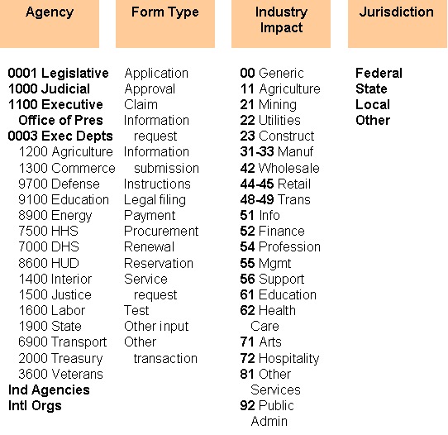
Why do we advocate a faceted approach?
Power
  4 independent categories of 10 nodes = 10,000 nodes (10⁴)
Faster construction
  Use existing taxonomies in specific fields
Reduced maintenance cost
More opportunity for data reuse
Can be easier to navigate with appropriate UI
60 nodes
24,000 combinations

Slide 25
US GSA eForms taxonomy
Agency
Form Type
Industry Impact
Jurisdiction
BRM Impact
Keyword Topic
Audience
0001 Legislative
1000 Judicial
1100 Executive Office of Pres
0003 Exec Depts
1200 Agriculture
1300 Commerce
9700 Defense
9100 Education
8900 Energy
7500 HHS
7000 DHS
8600 HUD
1400 Interior
1500 Justice
1600 Labor
1900 State
6900 Transport
2000 Treasury
3600 Veterans
Ind Agencies
Intl Orgs
Application
Approval
Claim
Information request
Information submission
Instructions
Legal filing
Payment
Procurement
Renewal
Reservation
Service request
Test
Other input
Other transaction
00 Generic
11 Agriculture
21 Mining
22 Utilities
23 Construct
31-33 Manuf
42 Wholesale
44-45 Retail
48-49 Trans
51 Info
52 Finance
54 Profession
55 Mgmt
56 Support
61 Education
62 Health Care
71 Arts
72 Hospitality
81 Other Services
92 Public Admin
Federal
State
Local
Other
Citizen Srvcs
Social Srvs
Defense
Disasters
Econ Dev
Education
Energy
Env Mgmt
Law Enf
Judicial
Correctional
Health
Security
Income Sec
Intelligence
Intl Affairs
Nat Resour
Transport
Workforce
Science
Delivery
Support
Management
Agriculture & food
Commerce
Communica-tions
Education
Energy
Env pro
Foreign rels
Govt
Health & safety
Housing & comm dev
Labor
Law
Named grps
National def
Nat resources
Recreation
Sci & tech
Social pgms
Transport
All
General
Citizen
Business
Govt
Employee
Native American
Nonresident
Tourist
Special group

Slide 26
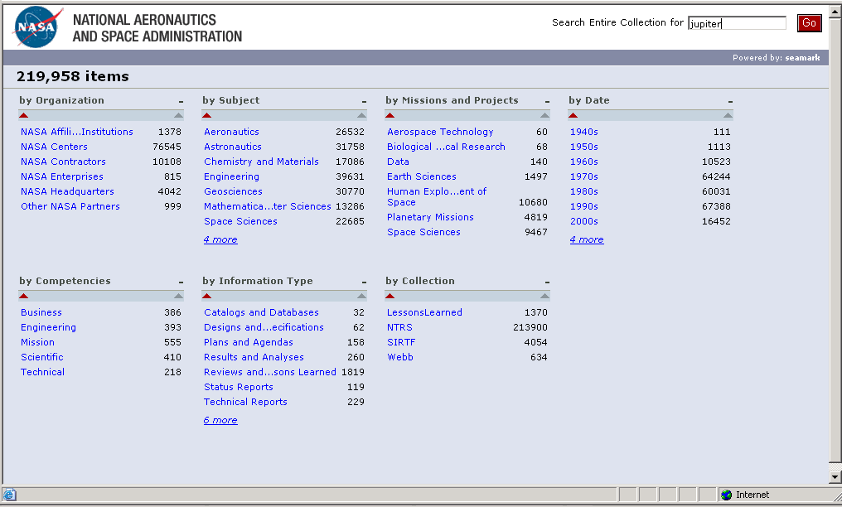
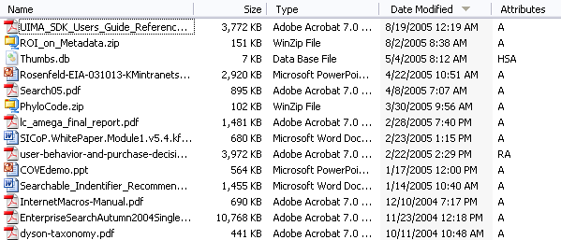
What do I do with all these facets?
Either expose them directly in the user interface (post-coordinating)
  or
Combine them in a minimal hierarchy (pre-coordination)
Post-coordination takes software support, which may be fancy or basic.
How many facets?
  Log₁₀(#documents) as a guide

Slide 27
Define metadata specification, use DC elements for Integration
Element | Data Type | Length | Req. / Repeat | Source | Purpose
Asset Metadata
Unique ID | Integer | Fixed | 1 | System supplied | Basic accountability
Recipe Title | String | Variable | 1 | Licensed Content | Text search & results display
Recipe summary | String | Variable | 1 | Licensed Content | Content
Main Ingredients | List | Variable | ? | Main Ingredients vocabulary | Key index to retrieve & aggregate recipes, & generate shopping list
Subject Metadata
Meal Types | List | Variable | * | Meal Types vocab | Browse or group recipes & filter search results
Cuisines | List | Variable | * | Cuisines
Courses | List | Variable | * | Courses vocab
Cooking Method | Flag | Fixed | * | Cooking vocab
Link Metadata
Recipe Image | Pointer | Variable | ? | Product Group | Merchandize products
Use Metadata
Rating | String | Variable | 1 | Licensed Content | Filter, rank, & evaluate recipes
Release Date | Date | Fixed | 1 | Product Group | Publish & feature new recipes
dc:identifier
dc:title
dc:description
X
X
X
X
X
dcterms:hasPart
dc:date
dc:type=“recipe”, dc:format=“text/html”, dc:language=“en”
Legend: ? – 1 or more * - 0 or more

Slide 28
Agenda
  9:00 Introduction
  9:15 Which elements should use vocabularies, and which should use text?
  9:30 Factoring “Subject” into Facets
  9:50 Sources for Vocabularies
    Which pre-existing ones should I use?
    How do I build my own? (Brief treatment)
    How do I decide on the necessary structure?
  10:00 Maintaining Vocabularies
  10:20 Q&A
  10:30 Adjourn

Slide 29
Sources for 7 common vocabularies
dc:publisher
Vocabulary | Definition | Potential Sources
Organization | Organizational structure. | FIPS 95-2, U.S. Government Manual, Your organizational structure, etc.
Content Type | Structured list of the various types of content being managed or used. | DC Types, AGLS Document Type, AAT Information Forms , Records management policy, etc.
Industry | Broad market categories such as lines of business, life events, or industry codes. | FIPS 66, SIC, NAICS, etc.
Location | Place of operations or constituencies. | FIPS 5-2, FIPS 55-3, ISO 3166, UN Statistics Div, US Postal Service, etc.
Function | Functions and processes performed to accomplish mission and goals. | FEA Business Reference Model, Enterprise Ontology, AAT Functions, etc.
Topic | Business topics relevant to your mission and goals. | Federal Register Thesaurus, NAL Agricultural Thesaurus, LCSH, etc.
Audience | Subset of constituents to whom a piece of content is directed or intended to be used. | GEM, ERIC Thesaurus, IEEE LOM, etc.
Products and Services | Names of products/programs & services. | ERP system, Your products and services, etc.
dc:type
dc:coverage
dc:subject
dcterms:audience

Slide 30
Vocabulary construction
The point of this talk is NOT to teach you how to build a vocabulary.
The point of this talk is to help you structure things so that when you DO build vocabularies, you will succeed.
  ROI and Tagging problems must be addressed so that you know the requirements
  Metadata specification must exist, and fields should be factored so that the vocabularies are as concise as possible
  Vocabularies should be taken from existing sources when possible, so that you have to do as little invention as possible
  When you do build a new vocabulary, start small, relate it back to the content, and shift into a maintenance mode as soon as possible.

Slide 31
Five vocabulary construction rules
URIs for node IDs, Publish vocabulary on web
Modify metadata spec so vocabulary is indicated
Gather data from multiple sources
  Talk with users and experts
  Analyze query logs and content
Choose and arrange terms
  Test and finalize first version
Shift into maintenance mode

Slide 32
Seven practical rules for vocabularies
  Incremental, extensible process that identifies and enables users, and engages stakeholders.
  Quick implementation that provides measurable results as quickly as possible.
  Not monolithic—has separately maintainable facets.
  Re-uses existing IP as much as possible.
  A means to an end, and not the end in itself .
  Not perfect, but it does the job it is supposed to do—such as improving search and navigation.
  Improved over time, and maintained.

Slide 33
Agenda
  9:00 Introduction
  9:15 Which elements should use vocabularies, and which should use text?
  9:30 Factoring “Subject” into Facets
  9:50 Sources for Vocabularies
  10:00 Maintaining Vocabularies
  10:20 Q&A
  10:30 Adjourn

Slide 34
CV Business Processes
Controlled Vocabularies must change, gradually, over time if they are to remain relevant
Maintenance processes need to be specified so that the changes are based on rational cost/benefit decisions, with an awareness of their impact
A team will need to maintain the vocabularies on a part-time basis
Vocabulary team reports to some other steering committee

Slide 35
What could possibly go wrong with a little edit?
ERP (Enterprise Resource Planning) team made a change to the product line data element in the product hierarchy.
They did not know this data was used by downstream applications outside of ERP.
An item data standards council discovered the error.
If the error had not been identified and fixed, the company’s sales force would not be correctly compensated.
“Lack of the enterprise data standards process in the item subject area has cost us at least 30 person days of just ‘category’ rework.”
Source: Danette McGilvray, Granite Falls Consulting, Inc.

Slide 36
Definitions about the Controlled Vocabulary Governance Environment
Change Requests & Responses
Published CVs and STs
Consuming Applications
1: Syndicated Terminologies change on their own schedule
2: CV Team decides when to update CVs
Web CMS
Syndicated Terminologies
Archives
ISO
3166-1
Intranet
Search
Vocabulary Management System
ERMS
’
Other External
’
Notifications
CVs
3: Team adds value via mappings, translations, synonyms, training materials, etc.
Intranet Nav.
ERP
DAM
Custodians
…
Other Internal
4: Updated versions of CVs published to consuming applications
Other Controlled Items
…
’
’
Controlled Vocabulary Governance Environment

Slide 37
Other Controlled Items
CV Team will have additional items to manage:
  Team Charter, Goals, Performance Measures
  Editorial rules
  Team processes
  Tagger training materials (manual and automatic)
  Outreach & ROI
    Communication plan
    Website
    Presentations
    Announcements
  Vocabulary Roadmap

Slide 38
CV Governance: Generic team charter
CV Team is responsible for maintaining:
  The Taxonomy, a multi-faceted classification scheme
  Associated materials, such as:
    Editorial Style Guide
    Training Materials
    Metadata Standard
    Team rules and procedures (subject to CIO review)
Team evaluates costs and benefits of suggested change
CV Team will:
  Manage relationship between providers of source vocabularies and consumers of the CVs
  Identify new opportunities for use of the CVs across the Enterprise to improve information management practices
  Promote awareness and use of the CVs

Slide 39
Other Controlled Items - Editorial Rules
To ensure consistent style, rules are needed
  Akin to “Chicago Manual of Style”
Issues commonly addressed in the rules:
  Sources of Terms
  Abbreviations
  Ampersands
  Capitalization
  Continuations (More… or Other…)
  Duplicate Terms
  Fidelity
  Hierarchy and Polyhierarchy
  Languages and Character Sets
  Length Limits
  Numbers in Labels
  “Other” – Allowed or Forbidden?
  Plural vs. Singular Forms
  Relation Types and Limits
  … and many more
Must also address issue of what to do when rules conflict – which are more important?
Rule Name | Editorial Rule
Use Existing Vocabularies | Other things being equal, reusing an existing vocabulary is preferred to creating a new one.
Ampersands | The character '&' is preferred to the word ‘and’ in Term Labels. Example: Use Type: “Manuals & Forms”, not “Manuals and Forms”.
Special Characters | Retain accented characters in Term Labels. Example: España
Serial comma | If a category name includes more than two items, separate the items by commas. The last item is separated by the character ‘&’ which IS NOT preceded by a comma. Example: “Education, Learning & Employment”, not “Education, Learning, & Employment”.
Capitalization | Use title case (where all words except articles are capitalized). Example: “Education, Learning & Employment” NOT “Education, learning & employment” NOT “EDUCATION, LEARNING & EMPLOYMENT”
… | …

Slide 40

Roles in Two Taxonomy Governance Teams
Executive Sponsor
  Advocate for the taxonomy team
Business Lead
  Keeps team on track with larger business objectives
  Balances cost/benefit issues to decide appropriate levels of effort
    Specialists help in estimating costs
  Obtains needed resources if those in team can’t accomplish a particular task
Technical Specialist
  Estimates costs of proposed changes in terms of amount of data to be retagged, additional storage and processing burden, software changes, etc.
  Helps obtain data from various systems
Content Specialist
  Team’s liaison to content creators
  Estimates costs of proposed changes in terms of editorial process changes, additional or reduced workload, etc.
  Small-scale Metadata QA Responsibility
Taxonomy Specialist
  Suggests potential taxonomy changes based on analysis of query logs, indexer feedback
  Makes edits to taxonomy, installs into system with aid of IT specialist
Content Owner
  Reality check on process change suggestions
Business Lead
Custodians
  Responsible for content in a specific CV.
Training Representative
  Develops communications plan, training materials
Work Practices Representative
  Develops processes, monitors adherence
IT Representative
  Backups, admin of CV Tool
Info. Mgmt. Representative
  Provides CV expertise, tie-in with larger IM effort in the organization.
Team structure at a different org.

Slide 41
Taxonomy governance | Where changes come from
Firewall
Firewall
Firewall
Application
Application
Application
Tagging
Tagging
UI
Tagging
UI
UI
UI
UI
UI
Application Logic
Content
Content
Tagging
Tagging
Tagging
Logic
Logic
Logic
Taxonomy
Taxonomy
Staff
Staff
Query log
Query log
notes
notes
analysis
analysis
‘
‘
missing
missing
’
’
concepts
concepts
End User
End User
Tagging Staff
Tagging Staff
Recommendations by Editor
Small taxonomy changes (labels, synonyms)
Large taxonomy changes (retagging, application changes)
New “best bets” content
Team considerations
Business goals
Changes in user experience
Retagging cost
Taxonomy Editor
Taxonomy Editor
experience
experience
Taxonomy Team
Requests from other
Requests from other parts of the organization
parts of NASA
Notes:
The taxonomy must be changed over time.
Suggestions for changes can come from users, through query log analysis, and staff, from feedback form.
Governance structure needed to make sure changes are justified.

Slide 42
Agenda
  9:00 Introduction
  9:15 Which elements should use vocabularies, and which should use text?
  9:30 Factoring “Subject” into Facets
  9:50 Sources for Vocabularies
  10:00 Maintaining Vocabularies
  10:20 Q&A
  10:30 Adjourn

Slide 43
Contact Info
Ron Daniel, Jr.
+1-925-368-8371
rdaniel@taxonomystrategies.com

