Slide 1


SKOS Core Tutorial
DC-2005 Madrid
Semantic Web Best Practices and Deployment
Alistair Miles
CCLRC Rutherford Appleton Laboratory
Tutorial 5: SKOS
15 September 2005

Slide 2
Intro
SKOS
  http://www.w3.org/2004/02/skos/
  Simple Knowledge Organisation System(s)
SKOS Core
  http://www.w3.org/2004/02/skos/core/
  Goal: Simple, flexible, extensible, machine-understandable representation for…
    Thesauri
    Classification Schemes
    Taxonomies
    Subject Headings
    Other types of ‘controlled vocabulary’…

Slide 3
Overview
Development and status
SKOS Features
Extending SKOS Core
Other topics:
  SKOS Core and DCMI metadata terms
  SKOS Core and OWL
  HTTP

Slide 4
Development
SKOS Core is maintained by W3C SWBPD-WG
Public, consensus-driven, design by open community
All discussion in public, via
  public-esw-thes@w3.org
Review proposals for change every 2-3 months
  http://www.w3.org/2004/02/skos/core/proposals
Publish revised working drafts
  http://www.w3.org/TR/swbp-skos-core-guide
  http://www.w3.org/TR/swbp-skos-core-spec

Slide 5
Status
Completed second review
Plan 3rd review November 2005
Change management policy
  http://www.w3.org/TR/swbp-skos-core-spec/#secChange
unstable, testing, stable
Most at testing, some at unstable
Feedback on all aspects of work presented here welcome!
  public-esw-thes@w3.org
Translations most welcome!
  http://www.w3.org/2004/02/skos/core/translations

Slide 6
Basics
SKOS Core is an application of the Resource Description Framework
  RDFS Classes and RDF Properties
…This tutorial will be demonstrating how to use the classes and properties of the SKOS Core Vocabulary to express the basic structure and content of a concept scheme as an RDF graph

Slide 7
Concept Schemes
‘Concept scheme’ is a blanket term for…
  Thesauri
  Classification Schemes
  Taxonomies
  Subject Headings
  Terminologies
  Other types of controlled vocabularies…
Defined as…
  ‘A set of concepts, optionally including statements about semantic relationships between those concepts.’

Slide 8
RDF
Why choose RDF as the basis for a standard?
Most compelling reasons…
Ease of combination with other meta-information standards
  (KOS data is re-used in a great variety of contexts, in combination with DCMI terms and many others)
Flexibility and ease of extension, to cope with variations in structure and style
  Variations between KOS types (e.g. ‘thesaurus’ vs. ‘classification scheme’) and within KOS types (compare e.g. the AAT or GEMET with ISO2788)

Slide 9
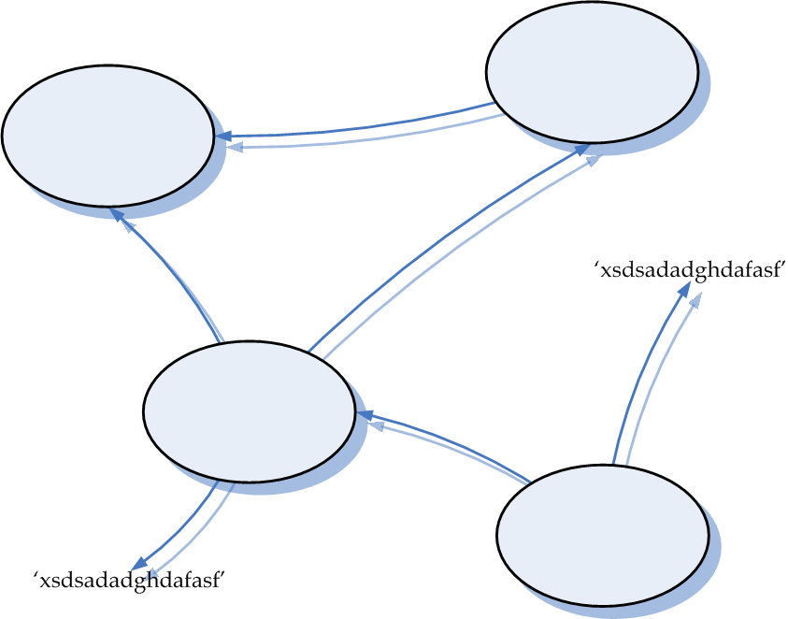
Quick RDF: a ‘Graph’

Slide 10
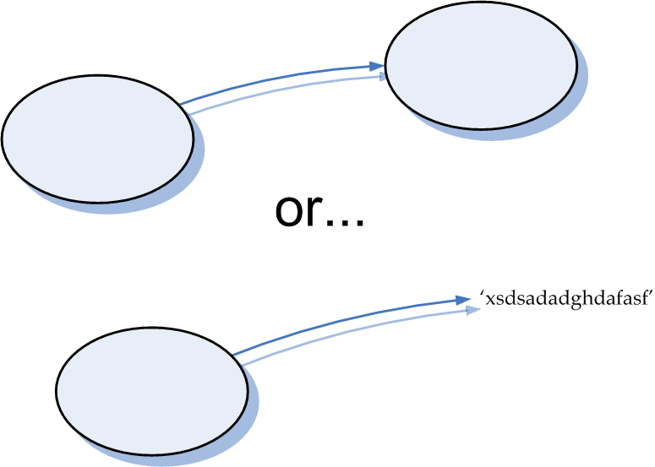
Quick RDF: a ‘Statement’
A.K.A. a ‘Triple’

Slide 11
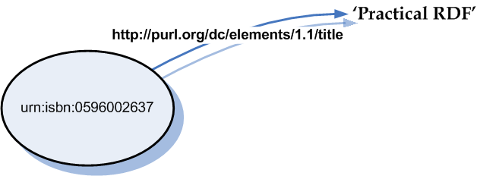
Quick RDF: URIs for Naming

Slide 12
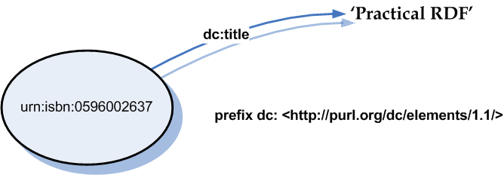
Quick RDF: QNames

Slide 13
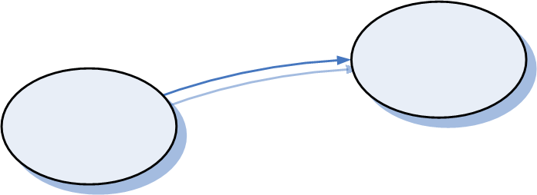
Quick RDF: Lingo
Resource = thing
Literal = string of characters (?lang, ?datatype)
Statement = Triple = (s, p, o) =
Property = (…, p, …)
Graph = a set of Statements =
RDF Description (of some thing) = a set of Statements (about that thing)

Slide 14
Quick RDF: Serialisation
N-Triples
<urn:isbn:0596002637> <http://purl.org/dc/elements/1.1/> ‘Practical RDF’.
Turtle
@prefix dc: <http://purl.org/dc/elements/1.1> .
<urn:isbn:0596002637> dc:title ‘Practical RDF’ .
RDF/XML
<rdf:RDF
xmlns:rdf=‘http://www.w3.org/1999/02/22-rdf-syntax-ns# ’
xmlns:dc=‘http://purl.org/dc/elements/1.1/’>
<rdf:Description rdf:about=‘urn:isbn:0596002637’>
<dc:title>Practical RDF</dc:title>
</rdf:Description>
</rdf:RDF>
XHTML 2.0
<head xmlns:dc=‘http://purl.org/dc/elements/1.1/’>
<meta about=‘urn:isbn:0596002637’ property=‘dc:title’>Practical RDF</meta>
</head>

Slide 15
Aah…

Slide 16
Story So Far (1)…
Goal
  To express the content and structure of concept schemes in a machine-understandable way
Development
  Open, collaborative, consensus-driven
Status
  May evolve within defined change management policy
Technology
  Resource Description Framework (RDF)
RDF
  Graphs, statements (triples), resources, properties, literals…

Slide 17
Features…

Slide 18
Controlled Vocabulary
Love
  Strong feelings of attraction towards, and affection for, another adult, or great affection for a friend or family member.
Awe
  A feeling of great respect sometimes mixed with fear or surprise.
Joy
  A feeling of bliss and great happiness.

Slide 19
Process
Identify
Describe
Publish

Slide 20
Identify
Step 1: Identify concepts…
  http://www.example.com/concepts#love
  http://www.example.com/concepts#awe
  http://www.example.com/concepts#joy
N.B. Could just as well be
  http://foo.bar.org/1234/5678
  urn:
  info:

Slide 21
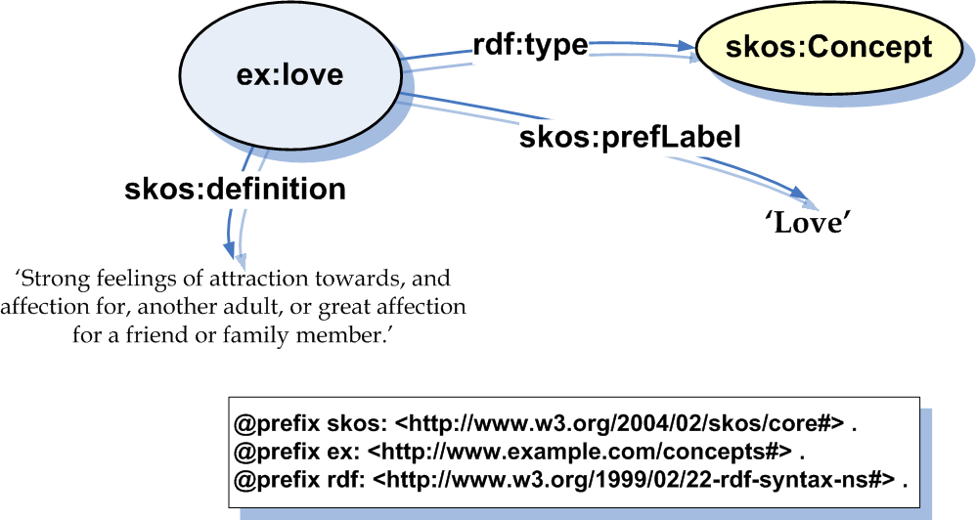
Describe
Step 2: Describe…

Slide 22
Publish
Step 3: Publish…
  One way is to:
    Create an RDF/XML serialisation (concepts.rdf)
    Put this file on an HTTP server (http://www.example.com/concepts)
  Another way is to:
    Load statements into a dedicated RDF server (Joseki, Sesame, Kowari …)

Slide 23
Concepts
N.B. SKOS Core is oriented towards the identification and description of concepts.

Slide 24
Thesaurus (USE/UF)
Love
  UF Affection
Affection
  USE Love

Slide 25
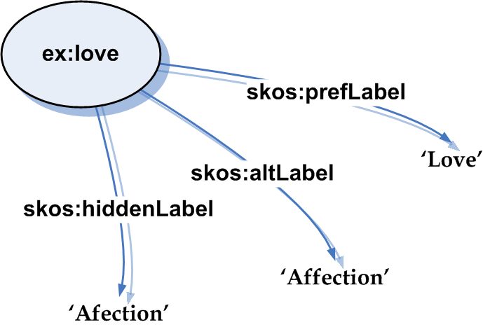
Lexical Labels

Slide 26
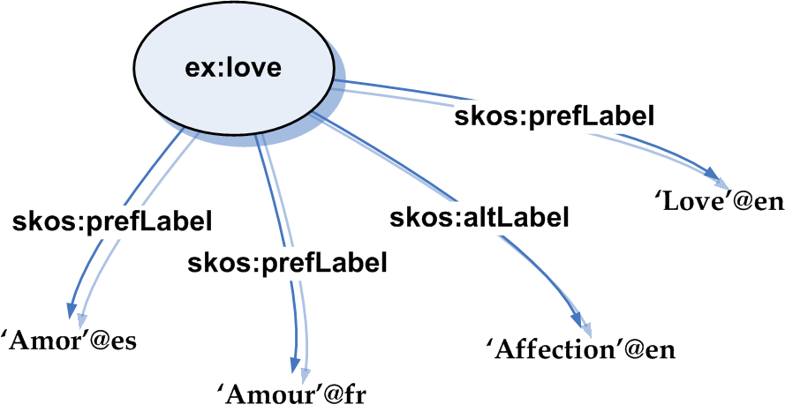
Multilingual Labels
N.B. No more than one skos:prefLabel per language

Slide 27
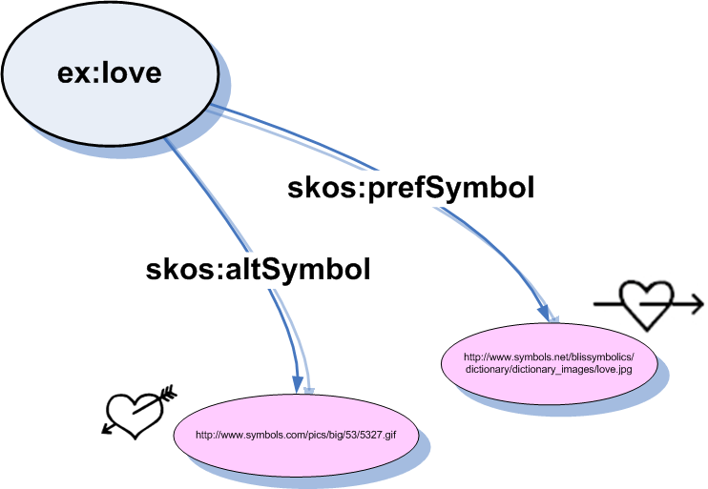
Symbolic Labels

Slide 28
Thesaurus (BT/NT)
Love
  BT Emotion
Emotion
  NT Love
  NT Awe
  NT Joy

Slide 29
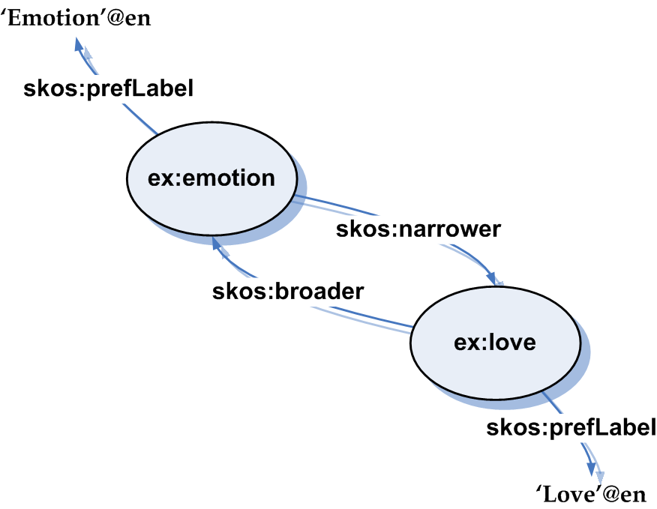
Broader/Narrower
N.B.
skos:broader owl:inverseOf skos:narrower .
skos:narrower owl:inverseOf skos:broader .
skos:broader a owl:TransitiveProperty .
skos:narrower a owl:TransitiveProperty .

Slide 30
Thesaurus (RT)
Love
  RT Beauty
Beauty
  RT Love

Slide 31
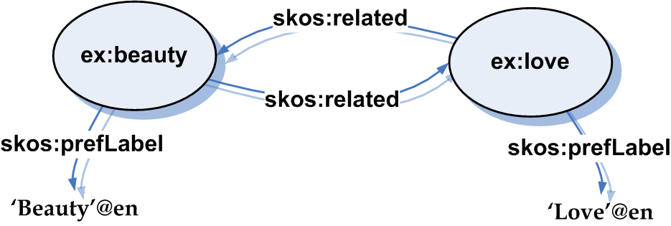
Related
N.B.
skos:related a owl:SymmetricProperty .

Slide 32
Aah…

Slide 33
Story So Far (2)…
Basic Structure
  skos:Concept
Lexical Labelling
  skos:prefLabel, skos:altLabel, skos:hiddenLabel
Symbolic Labelling
  skos:prefSymbol, skos:altSymbol
Documentation
  skos:definition
Semantic Relations
  skos:broader, skos:narrower, skos:related

Slide 34
Features…

Slide 35
Documentation Properties
skos:note
    e.g. ‘Anything goes.’
skos:definition
    e.g. ‘A long curved fruit with a yellow skin and soft, sweet white flesh inside.’
skos:example
    e.g. ‘A bunch of bananas.’
skos:scopeNote
    e.g. ‘Historically members of a sheriff's retinue armed with pikes who escorted judges at assizes.’
skos:historyNote
    e.g. ‘Deleted 1986. See now Detention, Institutionalization (Persons), or Hospitalization.’
skos:editorialNote
    e.g. ‘Confer with Mr. X. re deletion.’
skos:changeNote
    e.g. ‘Promoted “love” to preferred label, demoted “affection” to alternative label, Joe Bloggs, 2005-08-09.’

Slide 36
Documentation as…
Allowed patterns:
  Documentation as an RDF Literal
  Documentation as a Related Resource Description
  Documentation as a Document Reference

Slide 37
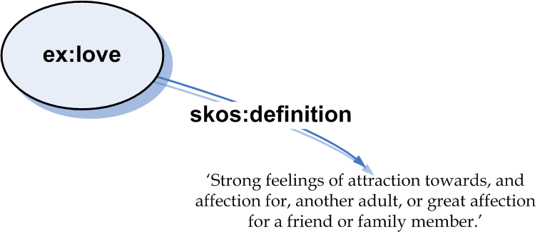
…RDF Literal

Slide 38
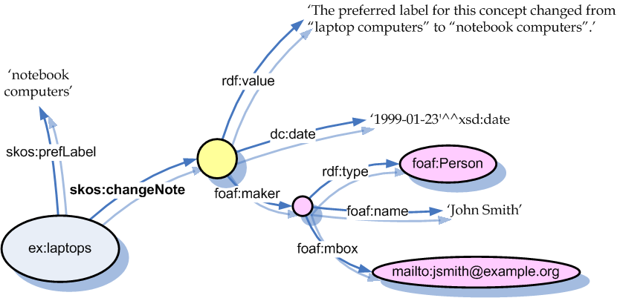
…Related Resource Description

Slide 39
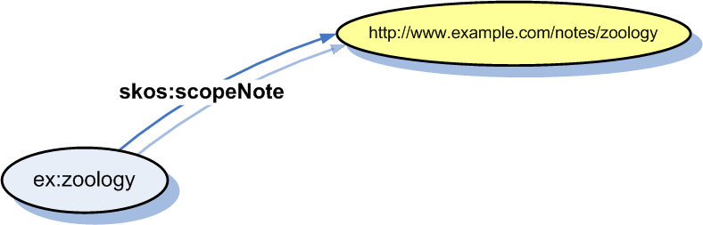
…Document Reference

Slide 40
Documentation as…
Allowed patterns:
  Documentation as an RDF Literal
  Documentation as a Related Resource Description
  Documentation as a Document Reference
  … N.B. this takes SKOS Core outside OWL DL …

Slide 41
Concept Schemes
Organise a set of concepts into a concept scheme

Slide 42
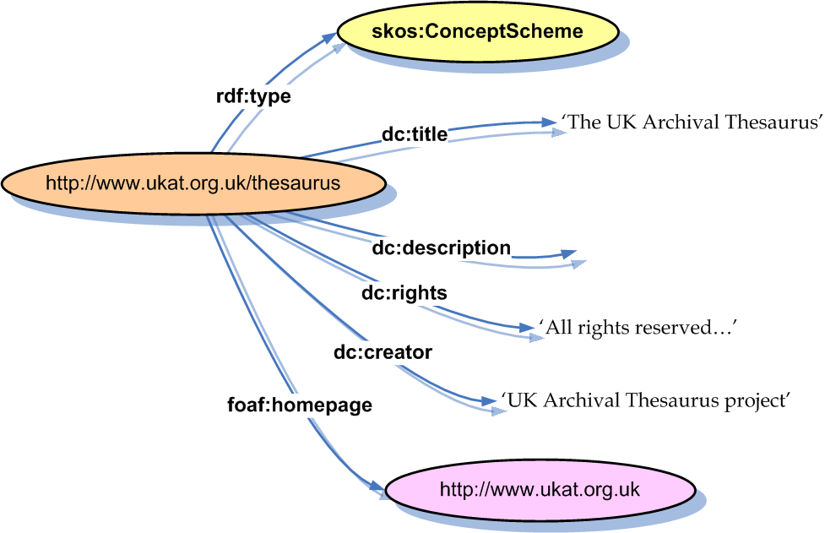
Concept Scheme

Slide 43
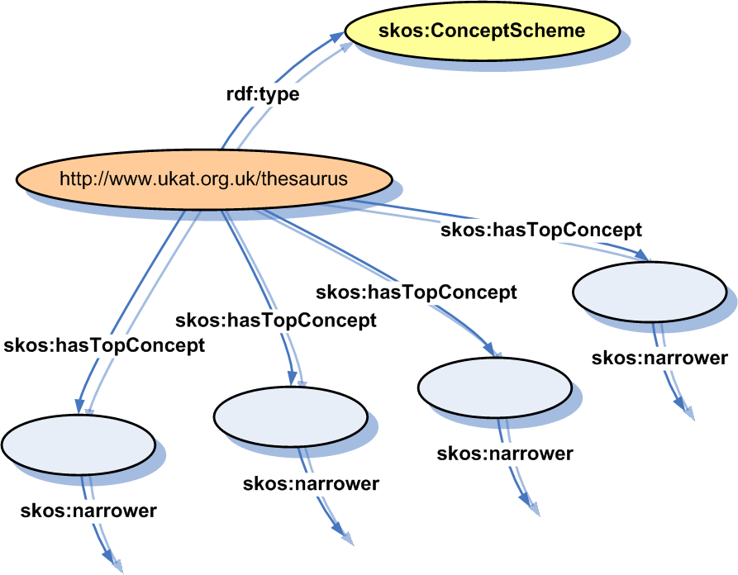
Top Concepts

Slide 44
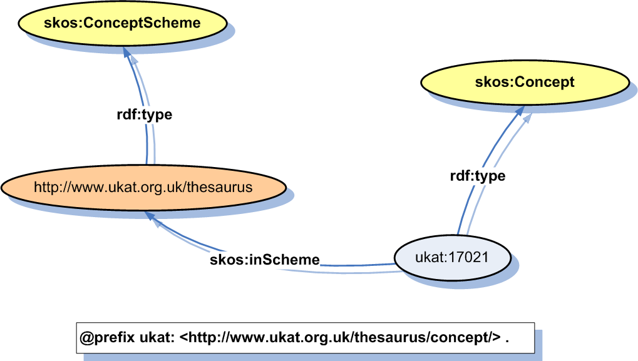
Concepts in Scheme

Slide 45
Subject Indexing
Simple functionality based on dc:subject

Slide 46
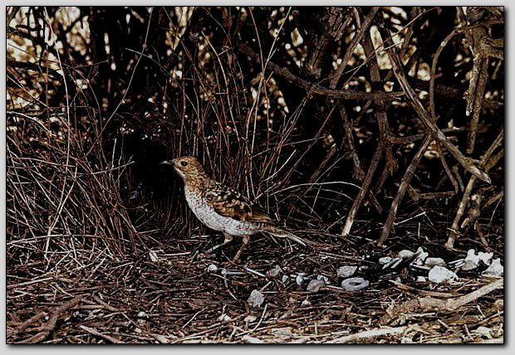
Spotted Bowerbird

Slide 47
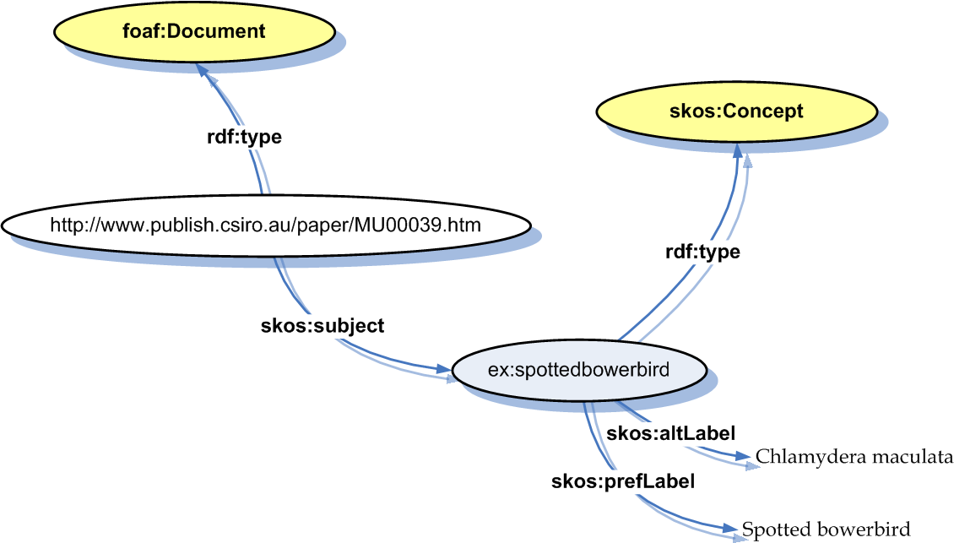
Subject
N.B.
skos:subject rdfs:subPropertyOf dc:subject .
skos:subject rdfs:range skos:Concept .

Slide 48
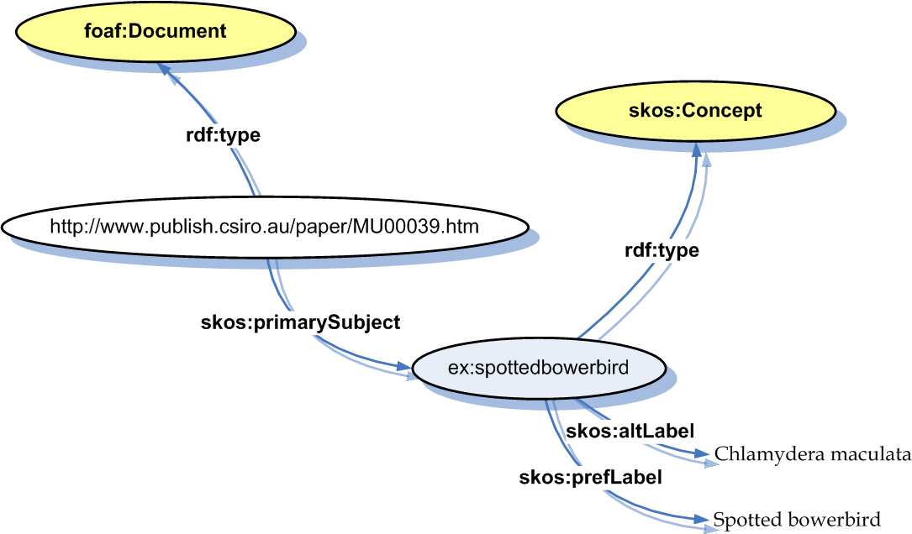
Primary Subject
N.B. no more than one primary subject per concept scheme.

Slide 49
Subject Inverses
skos:isSubjectOf
  inverse of skos:subject
skos:isPrimarySubjectOf
  inverse of skos:primarySubject

Slide 50
Subject Generality
Subject generality rule:
{
?d skos:subject ?x .
?x skos:broader ?y .
}
=>
{
?d skos:subject ?y .
}
I.e. if a document is about ‘bowerbirds’ and ‘birds’ is broader than ‘bowerbirds’, then the document is about ‘birds’ too.
Use to implement simple query expansion.

Slide 51
Node Labels
<milk by source animal>
buffalo milk
cow milk
goat milk
sheep milk

Slide 52
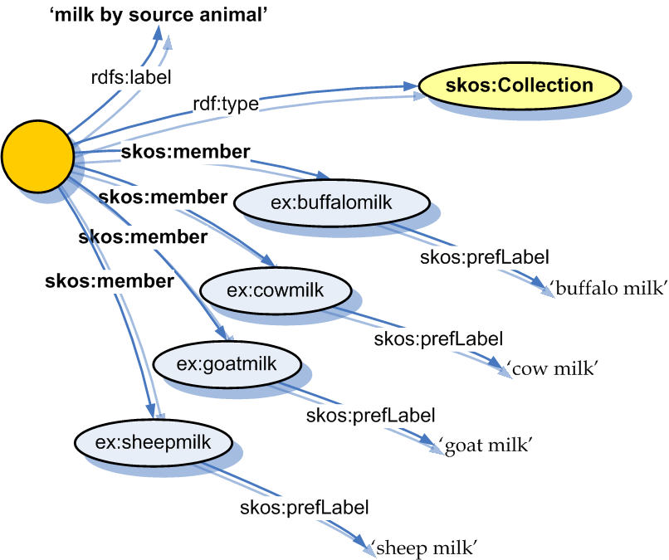
Meaningful Collections

Slide 53
Node Labels in Hierarchy
milk
<milk by source animal>
buffalo milk
cow milk
goat milk
sheep milk

Slide 54
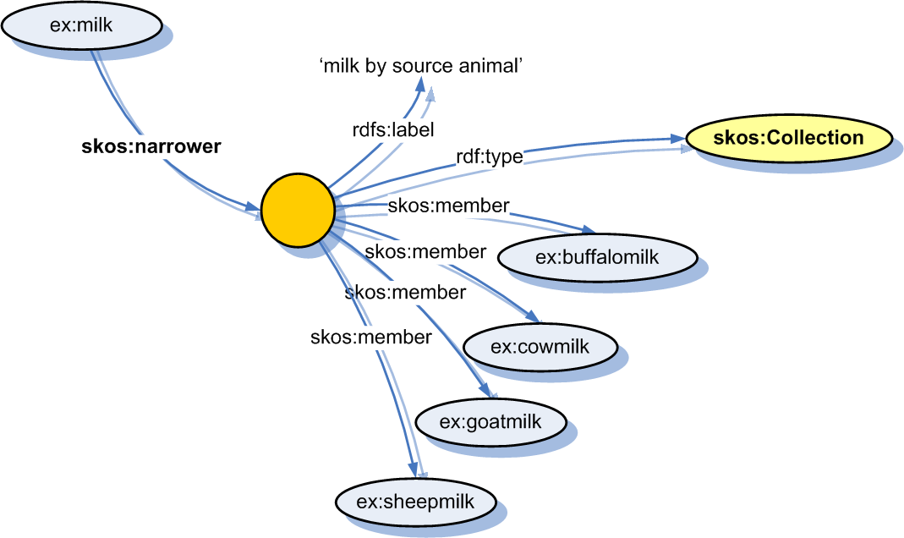
Collectable Properties

Slide 55
Nested Node Labels
chairs
<chairs by form>
armchairs
easy chairs
<chairs by form: back form>
heart-back chairs
oval-back chairs
N.B.
A member of a collection may be a concept or another collection.

Slide 56
More on Collections…
See SKOS Core Guide for…
  Meaningfully ordered collections
  Nested ordered/unordered collections
  Rules for collections
  Rules for collectable properties

Slide 57
Aah…

Slide 58
Story So Far (3)…
Documentation Properties
  skos:note, skos:definition, skos:example, skos:scopeNote, skos:historyNote, skos:editorialNote, skos:changeNote
Documentation Patterns
  …as RDF Literal, as Related Resource Description, as Document Reference
Concept Schemes
  skos:ConceptScheme, skos:hasTopConcept, skos:inScheme
Subject Indexing
  skos:subject, skos:isSubjectOf, skos:primarySubject, skos:isPrimarySubjectOf
Node Labels and Guide Terms
  skos:Collection, skos:OrderedCollection, skos:member, skos:memberList

Slide 59
HTTP Publishing
You may use any type of HTTP URI as an identifier for a concept …
  ‘#’ is OK, e.g. http://www.example.com/concepts#love
  ‘/’ is OK, e.g. http://www.example.com/concepts/love
(N.B. httpRange-14 is resolved)
    http://lists.w3.org/Archives/Public/www-tag/2005Jun/0039

Slide 60
HTTP Publishing
HTTP Behaviour for ‘#’
  N.B. you can’t actually GET http://www.example.com/concepts#love
  Current practice in semantic web community: http://www.example.com/concepts should respond to GET with …
    Response code 200 (success)
    Content-type: application/rdf+xml
    A message that describes all concepts in the namespace

Slide 61
HTTP Publishing
HTTP Behaviour for ‘/’
  http://www.example.com/concepts/love must respond to GET with …
    Response code 303 (redirect see other)
  What you should be redirected to is an open question …
    HTML document?
    RDF document?
    XHTML 2.0 document with embedded RDF?
    Content negotiable resource?
  I suggest …
    Content negotiable resource, supporting at least application/rdf+xml and preferably also text/html, describing the concept

Slide 62
Extensions Intro
SKOS Core can be extended by refining the classes and properties of the SKOS Core Vocabulary …

Slide 63
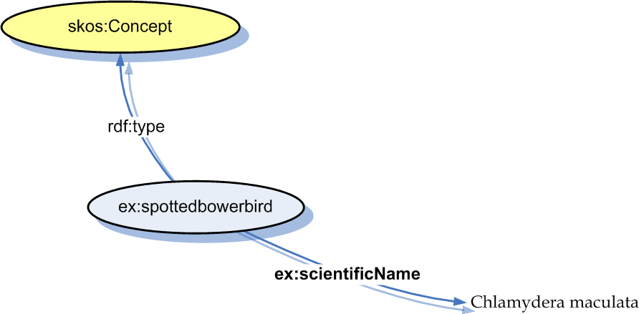
Labelling

Slide 64
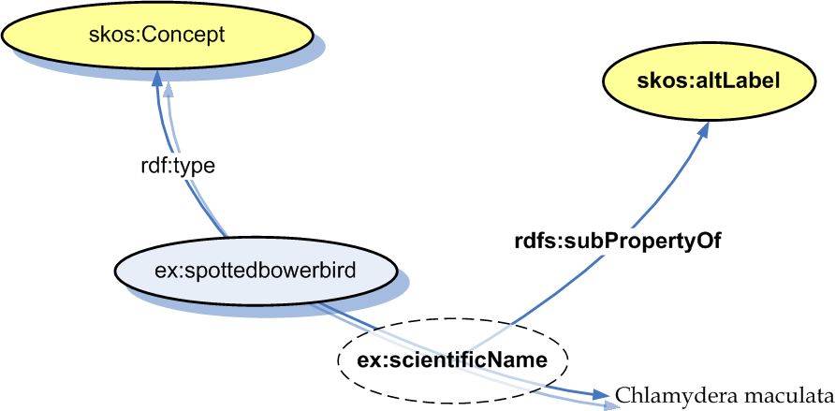
Labelling

Slide 65
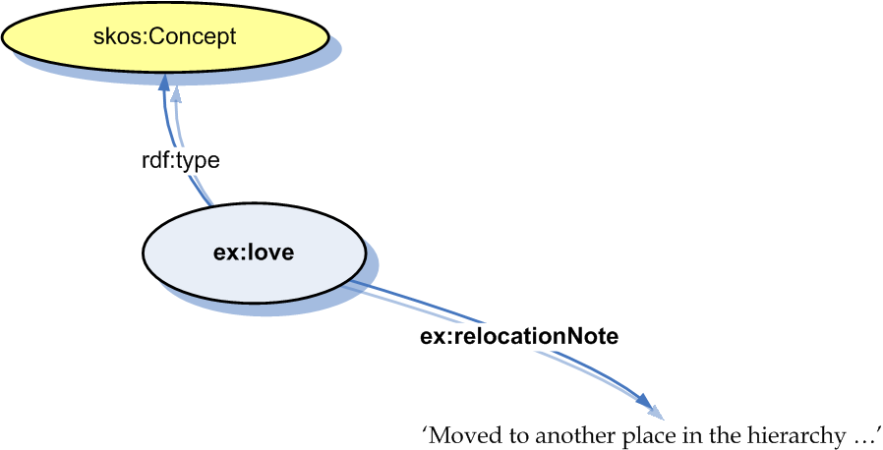
Documentation

Slide 66
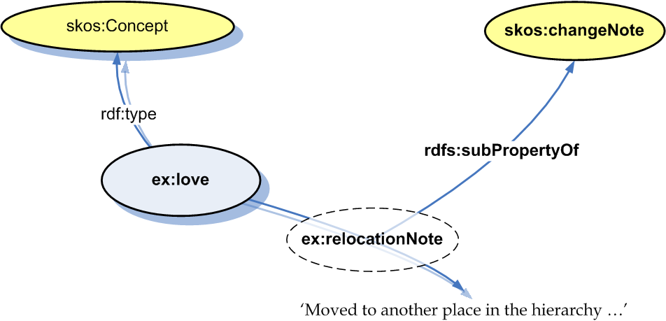
Documentation

Slide 67
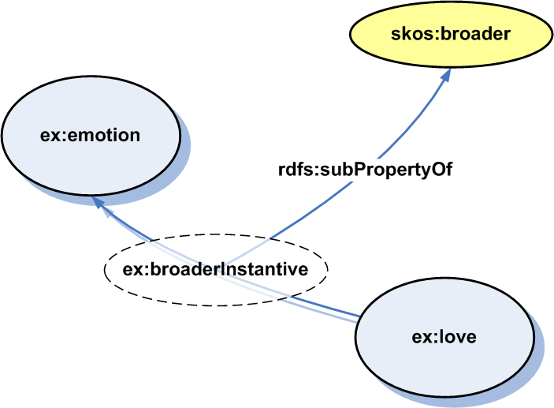
Semantic Relations

Slide 68
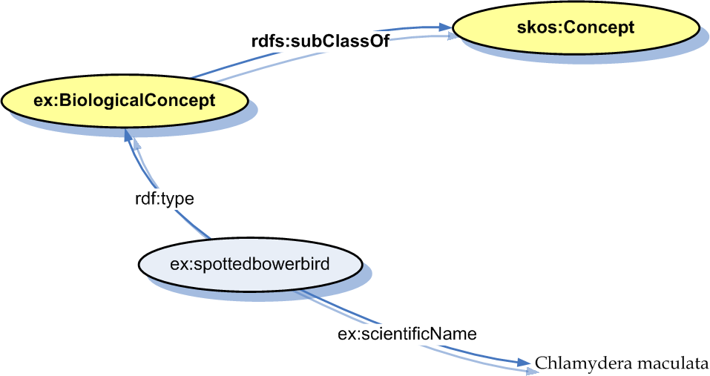
Classes of Concept

Slide 69
Fundamental Facets
E.g. AAT …
  Physical Attributes
  Styles and Periods
  Agents
  Activities
  Materials
  Objects

Slide 70
Fundamental Facets
Model fundamental facets as disjoint classes of concept …

Slide 71
Fundamental Facets
# standard namespace prefixes
ex:PhysicalAttributesConcept a rdfs:Class;
rdfs:subClassOf skos:Concept .
ex:StylesAndPeriodsConcept a rdfs:Class;
rdfs:subClassOf skos:Concept .
ex:AgentsConcept a rdfs:Class;
rdfs:subClassOf skos:Concept .
ex:ActivitiesConcept a rdfs:Class;
rdfs:subClassOf skos:Concept .
ex:MatieralsConcept a rdfs:Class;
rdfs:subClassOf skos:Concept .
ex:ObjectsConcept a rdfs:Class;
rdfs:subClassOf skos:Concept .

Slide 72
Fundamental Facets
# standard namespace prefixes
# Example of using the classes …
ex:300024978 a ex:AgentsConcept;
skos:prefLabel ‘People’.
# Declare disjointness …
ex:PhysicalAttributesConcept
owl:disjointWith ex:StylesAndPeriodsConcept;
owl:disjointWith ex:AgentsConcept;
owl:disjointWith ex:ActivitiesConcept;
owl:disjointWith ex:MaterialsConcept;
owl:disjointWith ex:ObjectsConcept .

Slide 73
Weighted Semantic Relations
# standard namespace prefixes
# Declare the bits we need …
ex:WeightedRelation a rdfs:Class;
rdfs:subClassOf rdf:Statement .
ex:weight a rdf:Property;
rdfs:domain ex:WeightedRelation;
rdfs:range xsd:integer .
# Now use them …
[] a ex:WeightedRelation;
rdf:subject ex:love;
rdf:predicate skos:related;
rdf:object ex:joy;
ex:weight ’56’ .

Slide 74
Compound Concepts
MESH ‘qualified concepts’ e.g. …
  Calcimycin [standards]
  Leukemia [complications]

Slide 75
Compound Concepts
# Declare some bits …
ex:CompoundConcept a rdfs:Class;
rdfs:subClassOf skos:Concept .
ex:main a rdf:Property;
rdfs:domain ex:CompoundConcept;
rdfs:subPropertyOf skos:broader .
ex:qualifier a rdf:Property;
rdfs:domain ex:CompoundConcept;
rdfs:subPropertyOf skos:broader .
# Now use them …
<http://www.example.com/someDocument>
skos:subject [
a ex:CompoundConcept;
ex:main ex:Calcimycin;
ex:qualifier ex:standards;
].

Slide 76
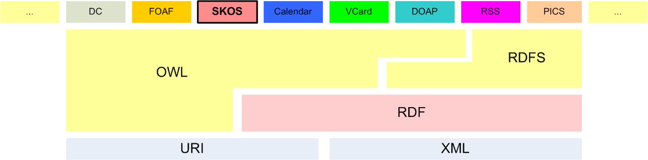
Semantic Web

Slide 77
SKOS Core and RDFS/OWL
Disjoint?
  Should skos:Concept be disjoint with …
    rdf:Property ?
    rdfs:Class ?
    owl:Class ?
DL?
  Should SKOS Core be an OWL DL ontology?
    Means not allowing flexibility in range of documentation props

Slide 78
Story So Far (4)
HTTP Publishing
Extension by Refinement
SKOS Core and OWL

Slide 79
Summary
Goals, development, status and nature of SKOS Core
SKOS Core features
HTTP, extensions & OWL

Slide 80
Links
  SKOS Core Homepage
    http://www.w3.org/2004/02/skos/core
  SKOS Core Guide
    http://www.w3.org/TR/swbp-skos-core-guide
  SKOS Core Vocabulary Specification
    http://www.w3.org/TR/swbp-skos-core-spec
  Mailing list
    mailto:public-esw-thes@w3.org
    http://lists.w3.org/Archives/Public/public-esw-thes/
  This presentation
    http://isegserv.itd.rl.ac.uk/cvs-public/skos/press/dc2005/tutorial.ppt
  Diagrams used in this presentation (feel free to re-use)
    http://isegserv.itd.rl.ac.uk/cvs-public/skos/press/dc2005/img/
    Thanks for listening ☺

