Slide 1
Towards an Interoperability Framework for Metadata Standards
  Presenter: Mikael Nilsson <mini@nada.kth.se>
  Co-authors:
  Pete Johnston <pete.johnston@eduserv.org.uk>
  Ambjörn Naeve <amb@nada.kth.se>
  Andy Powell <andy.powell@eduserv.org.uk>

Slide 2
Interoperability for DC metadata
Reusing existing properties...
  in new application profiles
  in new syntaxes
Adding new properties to...
  existing application profiles
  existing syntaxes
Introducing new values to existing properties
Expressing existing APs in new syntaxes

Slide 3
Abstract information flow
Abstract Model
Metadata terms
are used in
Application profiles
are encoded using
usage
Metadata syntax
transfer
Interoperable
interpreter
Metadata syntax
transfer
Ad-hoc
Interpreter

Slide 4
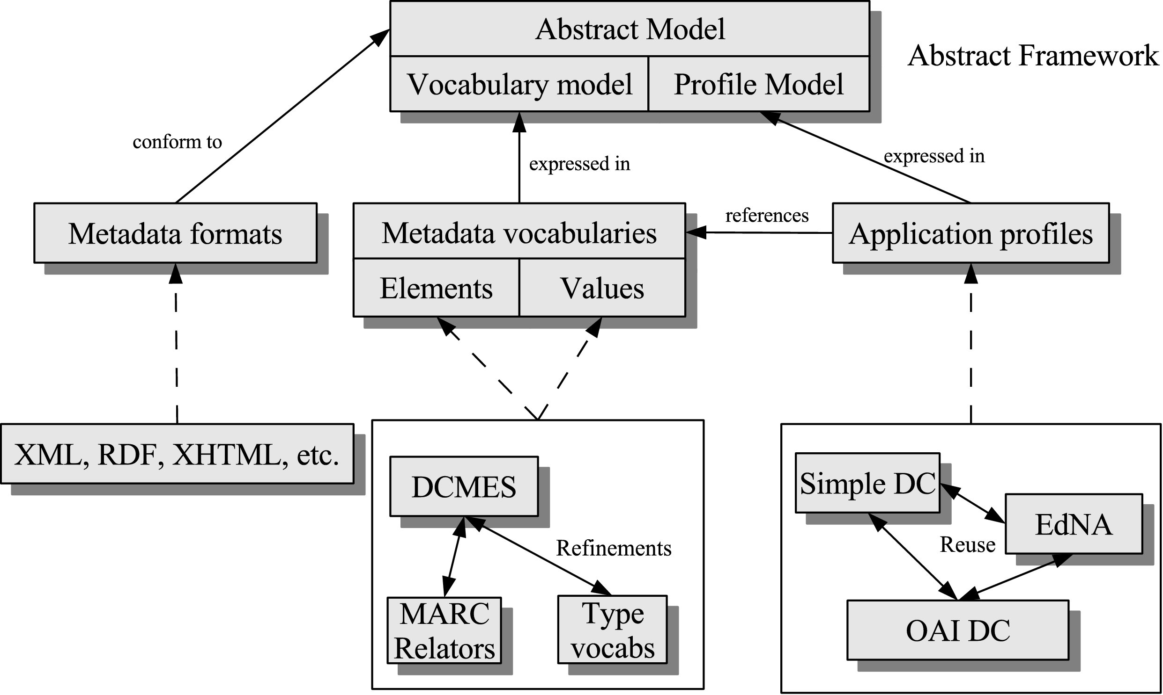
The Dublin Core Framework

Slide 5
DCMI Abstract Model
Refined and formalized version of the “DCMI Grammatical Principles”
Abstract Model
  Defines the core constructs used in DC metadata: properties, vocabulary encoding schemes, etc...
  Basis for defining vocabularies, profiles and syntaxes
defined using
Vocabularies/profiles
uses
Instance metadata

Slide 6
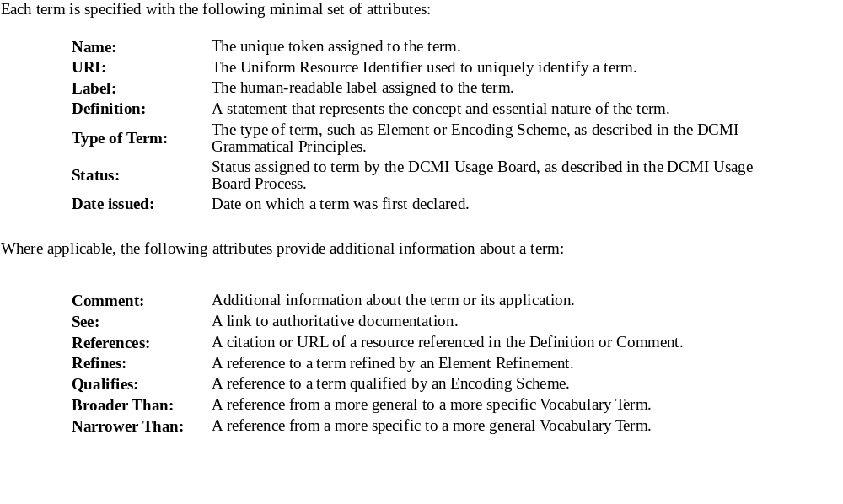
Vocabulary Model (elements)
Example: http://dublincore.org/documents/dcmi-terms/

Slide 7
Vocabulary Model (values)
No real consensus on how to describe value vocabularies.
Value vocabularies come in many kinds
  simple lists
  thesauri
  taxonomies
  ontologies
  etc.
SKOS?

Slide 8
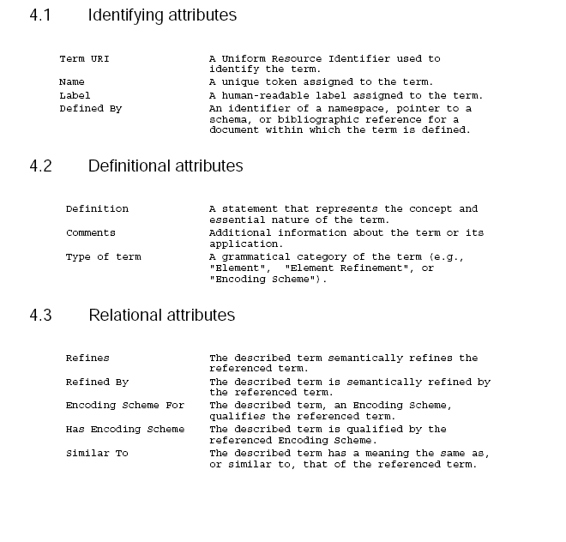
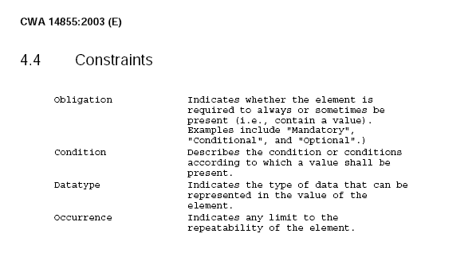
Profile Model
Example: CEN/ISSS CWA 14855

Slide 9
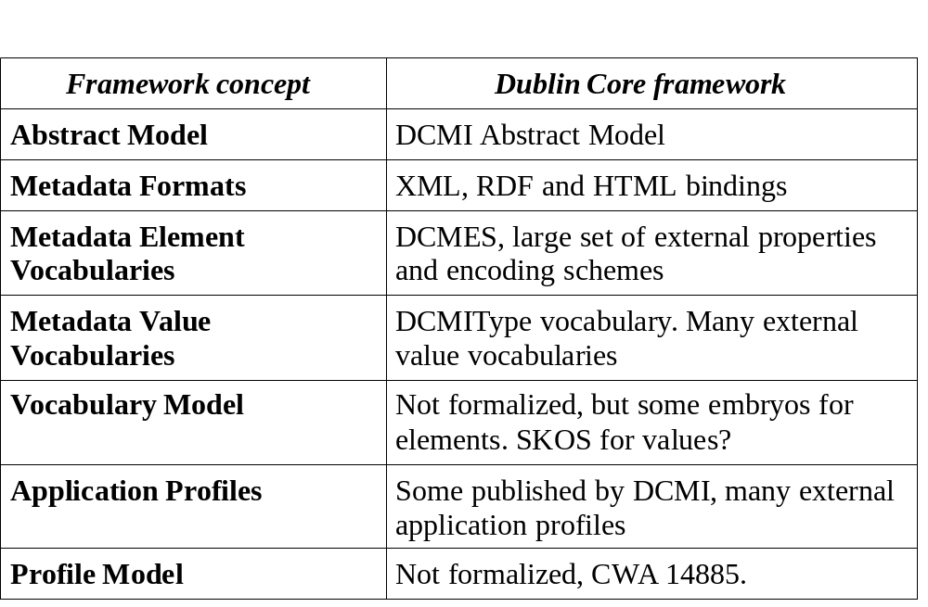
Where we are (DC family)

Slide 10
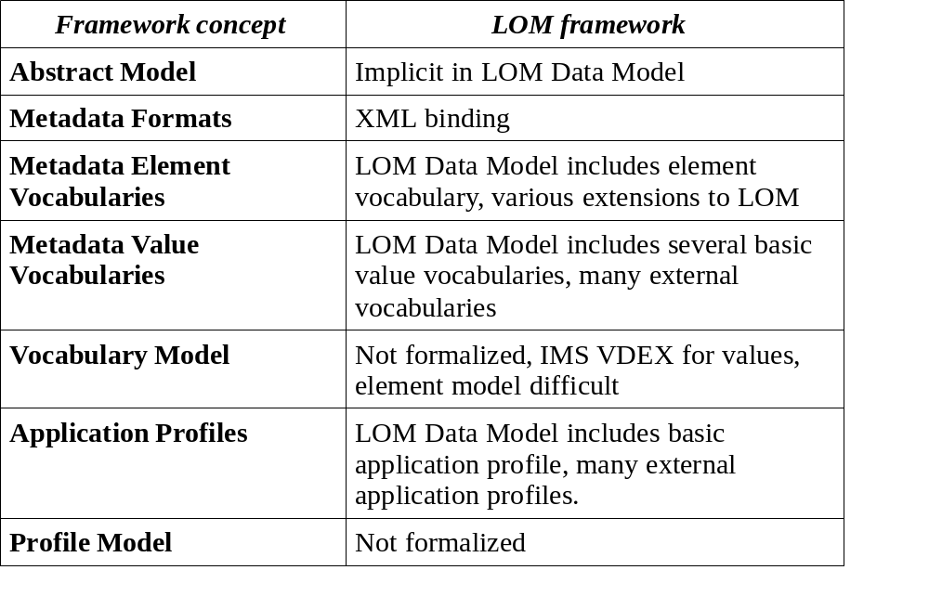
Where others are (IEEE LOM family)

Slide 11
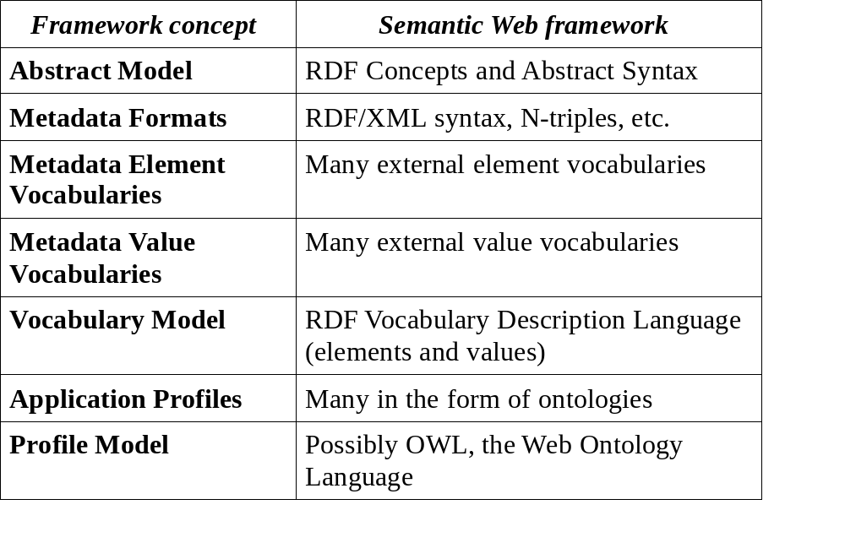
Where others are (RDF family)

Slide 12
Cross-framework interoperability
How about interoperability between
  DC <==> IEEE LOM <==> RDF <==> MPEG-7 etc.?
All follow the same basic pattern
BUT – very different abstract models
In general: cross-framework is hard
DC <==> RDF works – as models are intentionally compatible
See also “The Future of Learning Object Metadata Interoperability”, in Koohang A. (ed.) Learning Objects: Standards, Metadata, Repositories, and LCMS, in press.

Slide 13
Terminology
Stop using “metadata standard” or “schema”
Start using either
  abstract model
  metadata format/syntax
  metadata vocabulary
  application profile
“What kind of specification am I trying to produce?”
  Most: application profile (+ some vocabulary)

Slide 14
Take home message
Formalized models (DCAM, vocabs, profiles) pave the way for interoperable processing
A clear framework helps us fill in the blanks
Much progress over the last year! See DC-ARCH...
The word ”schemas” is overused...

