Slide 1
Basic Dublin Core Semantics
DC 2006 Tutorial 1, 3 October 2006
Marty Kurth
Head of Metadata Services
Cornell University Library

Slide 2
Getting started
Let’s introduce ourselves
Let’s discuss our expectations for the tutorial

Slide 3
We’ll cover
An introduction to metadata
Key features of the Dublin Core
Dublin Core metadata in a broader context
Important aspects of the DCMI community

Slide 4
An introduction to metadata

Slide 5
What is metadata?
A (hopefully) straightforward place to start:
Metadata consists of statements we make about resources to help us find, identify, use, manage, evaluate, and preserve them.

Slide 6
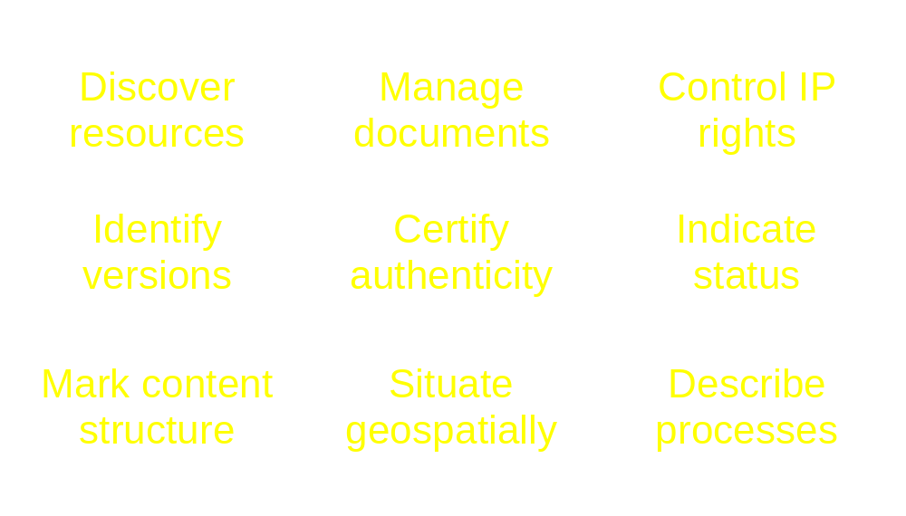
Some typical metadata functions

Slide 7
Metadata building blocks (in words)
The basic unit of metadata is a statement.
A statement consists of a property (aka, element) and a value.
Metadata statements describe resources.

Slide 8
Metadata building blocks (in pictures)
property
1
resource
statement
describes
1
value
(An oversimplification of the DCMI abstract model for resources!)

Slide 9
What are the properties and values in these metadata statements?
245 00 $a Amores perros $h [videorecording]
<title>Nueve reinas</title>
<type>MovingImage</type>

Slide 10
Who cares about metadata?
The term “metadata” has meaning in contexts such as:
  Data modeling
  Library cataloging
  Internet/World Wide Web resource discovery
    Led to a convergence between the first two
    Formed the context in which Dublin Core arose

Slide 11
Key features of the Dublin Core

Slide 12
How and why did the Dublin Core come to be in 1995?
Dramatic increase in the number of document-like resources on the net
Slow improvement in indexing services made resources hard to discover
Belief that descriptive metadata would improve discovery
Perceived need for a descriptive standard that was simple to apply (by non-professionals)

Slide 13
Dublin Core Metadata Element Set
Creator | Title | Subject
Contributor | Date | Description
Publisher | Type | Format
Coverage | Rights | Relation
Source | Language | Identifier

Slide 14
Characteristics of the Dublin Core
A flat element structure, with:
  All elements optional
  All elements repeatable
Elements displayed in any order
Extensible (elements, qualifiers)
Syntax independent
International
Subject independent

Slide 15
Resources for which DC is often used
DCMI Type Vocabulary
Collection | Dataset | Event
Image | Interactive Resource | Moving Image
Physical Object | Service | Software
Sound | Still Image | Text

Slide 16
Dublin Core principles
Dumb-down
The one-to-one principle
Appropriate values

Slide 17
Dumb-down
Simple DC does not use element refinements or encoding schemes and statements only contain value strings
Qualified DC uses features of the DCMI Abstract Model, particularly element refinements and encoding schemes
Dumbing-down is translating qualified DC to simple DC (property dumb-down and value dumb-down)
For more info, see the DCMI Abstract Model!

Slide 18
Element refinements
Element refinements narrow the meaning of DC elements
  hasVersion and isVersionof refine relation
  bibliographicCitation refines identifier
Element refinements are properties, so we typically render them independently
  <dcterms:alternative>Nine queens</dcterms:alternative>
  <dcterms:issued>2000-07-11</dcterms:issued>
For more information on rendering DC terms, attend the Basic Syntax Tutorial!

Slide 19
Encoding schemes
Vocabulary encoding schemes
  Indicate that a value comes from a controlled vocabulary (e.g., that “Spanish American literature” is an LCSH term)
Syntax encoding schemes
  Indicate that a string is formatted in a standard way
  (e.g., that “1956-11-12” follows ISO 8601)
DCMI recommends using encoding schemes with coverage, date, format, language, subject, and type
For more information on rendering encoding schemes, attend the Basic Syntax Tutorial!

Slide 20
The one-to-one principle
Create one metadata description for one and only one resource
  E.g., do not describe a digital image of the Mona Lisa as if it were the original painting
Group related descriptions into description sets
  I.e., describe an artist and his/her work separately, not in a single description

Slide 21
Appropriate values
Use elements and qualifiers to meet the needs of your local context, but . . .
Remember that your metadata may be interpreted by machines and people, so . . .
Consider whether the values you use will aid discovery outside your local context and . . .
Make decisions about your local practices accordingly

Slide 22
Origins of the DCMI Abstract Model
DC community realized early that machine-processing requires a coherent data model
(1996) “Warwick Framework” proposed at DC-2:
Saw DC as one “metadata package” among others
(1997) Qualifiers proposed for specifying meanings
(1998) DCMI functional requirements inform W3C Resource Description Framework (RDF) and RDF informs early Dublin Core data model
(2000) First set of qualifiers officially approved

Slide 23
DCMI Abstract Model (2005)
Defines resources in terms of semantic relationships among classes, properties, and values
Defines a model for DCMI descriptions, description sets, and records
Serves as a foundation for future DCMI developments
Serves as a conceptual model for metadata initiatives outside DCMI

Slide 24
DCMI namespaces and policies
All DCMI terms have unique identity within three namespaces:
  http://purl.org/dc/elements/1.1/ - DCMES (15 elements)
  http://purl.org/dc/terms/ - DCMI elements and qualifiers
  http://purl.org/dc/dcmitype/ - DCMI Type Vocabulary
DCMI namespace policies promote long-term stability of namespace URIs
  Only substantial semantic changes will result in change of namespace URIs

Slide 25
Dublin Core metadata in a broader context

Slide 26
Metadata creation and distribution models
Federation
  Extensive specifications, standards, protocols, training
Harvesting
  Basic agreements, reliance on best practices
Gathering
  Automated indexing of content, algorithms yield results from search terms, less likely to use descriptive metadata per se

Slide 27
Harvesting model key features
Integrating metadata from many sources calls for common element sets, record structures, and harvesting protocols
Open Archives Initiative Protocol for Metadata Harvesting serves as a framework for sharing metadata and mandates ‘simple DC’ as a common metadata format
Harvesting promotes metadata reuse
Best practices balance cost and interoperability
Communities add value to basic infrastructure (more complex metadata, new uses for protocol)

Slide 28
Application profiles & interoperability
Application profiles enable:
  Implementers to use DC metadata in conjunction with non-DC metadata
  Implementers to benefit from the experience of their peers
  Communities to harmonize metadata usage for greater interoperability
For more information on application profiles, attend the Application Profiles Tutorial!

Slide 29
Important aspects of the
DCMI community

Slide 30
Dublin Core grows and changes
DCMI emphasizes open participation
  Conferences, working groups, discussion lists
DCMI term set evolves as implementers coin new terms and usage patterns emerge
DCMI Usage Board reviews proposals for new metadata terms

Slide 31
Dublin Core Usage Board
Considers proposals for new terms (elements, refinements, encoding schemes, DCMI Type Vocabulary terms)
  Evaluates proposals in light of grammatical principle, semantic clarity, usefulness, and overlap with existing terms
Evaluates constructs that use DCMI terms, such as application profiles

Slide 32
Find out more about DC
DCMI Web Site
  http://dublincore.org
Using Dublin Core
  http://dublincore.org//documents/usageguide/
DCMI Abstract Model
  http://dublincore.org/documents/abstract-model/
DCMI Working Groups
  http://dublincore.org/groups
AskDCMI
  http://askdcmi.askvrd.org/

Slide 33
Questions?
Or please send questions to:
Marty Kurth
Cornell University Library
mk168@cornell.edu

Slide 34
Acknowledgement
Many thanks to Diane Hillmann for sharing the slides from an earlier version of this tutorial with me.

Slide 35
Interested in DC origins and history?
Lagoze, Carl. “The Warwick Framework: A Container Architecture for Diverse Sets of Metadata.” D-Lib Magazine July/August 1996. <http://www.dlib.org/dlib/july96/lagoze/07lagoze.htm>
Miller, Eric J. “An Overview of the Dublin Core Data Model.” 6 June 1999. <http://dublincore.org/1999/06/06-overview/>
Weibel, Stuart. “Metadata: The foundations of resource description.” D-Lib Magazine July 1995. <http://www.dlib.org/dlib/July95/07weibel.html>
Weibel, Stuart L, and Carl Lagoze. “An element set to support resource discovery: The state of the Dublin Core: January 1997.” International Journal on Digital Libraries 1 (1997): 176-86.

