Slide 1

Application Profiles: A Tutorial
Diane I. Hillmann
Cornell University

Slide 2

Definitions & Goals
What is an Application Profile?
Why Application Profiles?
Major issues in AP Development
Communities & Process

Slide 3
Application Profile:Definition
“A Dublin Core Application Profile (DCAP) is a declaration specifying which metadata terms an organization, information provider, or user community uses in its metadata. By definition, a DCAP identifies the source of metadata terms used—whether they have been defined in formally maintained standards such as Dublin Core, in less formally defined element sets and vocabularies, or by the creator of the DCAP itself for local use in an application. Optionally, a DCAP may provide additional documentation on how the terms are constrained, encoded or interpreted for application-specific purposes.” --CEN CWA 14855:2003

Slide 4
Purpose of Application Profiles
Document semantics and constraints for a particular set of instance metadata
Provide focus and documentation of community consensus and intent
Identify emerging semantics as possible candidates for formal standardization
Guides for semantic crosswalks and specifications for DTDs
Documentation for rules and and criteria by which a specific set of metadata was created
-- CEN CWA 14855:2003

Slide 5
Are Application Profiles only for DC?
No, but DC has pushed the usage of APs and provided important guidelines
CanCore is a good example of a non-DC AP
Other schemas will provide different challenges

Slide 6
Who is an AP for?
Short term: humans
  “Principle of readability”: include enough information to be of optimal usefulness for its intended audience
  Provide better quality control for metadata within and beyond specific domains or projects
Longer term: machines
  Machine-readable APs will make interoperability more achievable at several levels
  Increased precision by identifying terms with Uniform Resource Identifiers (URIs) brings us closer to the goals of the Semantic Web

Slide 7
Why not use just one metadata standard?
Different starting points
Different functional requirements
Different levels of granularity for different things
Different “views” of reality
The days of “one size fits all” standards are over
  But domains are now overlapping and becoming “liquid”
The challenge now is interoperability and re-purposing
[Slide derived from presentation by Godfrey Rust, 5/2005]

Slide 8
Major AP Issues
Human vs. machine needs
Mixing and matching in a diverse metadata world
Requirements for legitimate re-use
Breaking new ground with new properties

Slide 9
Components of an AP
Human readable documentation
  Property descriptions and relationships
  Domain specific instruction
  Obligation and constraints
Machine readable versions coming
  Based on RDF
  Eliminate redundancy and contextual information not necessary for machine processing

Slide 10
Using properties from other schemas
Currently a great deal of contention and discussion about the technical issues around re-use of properties
  Based on differences between XML and RDF, and the realities of how they relate
  Ergo, best to consider re-use a “semantic intention” which will need some extensive effort to deploy
  There are no hard-and-fast rules here, yet!

Slide 11
“How To” with caveats
Determining reusability of terms
  Is the term a real “property” and defined as such within the source schema?
  Is the term declared properly, with a URI and adequate documentation and support?
  In general, properties whose meaning is partly or wholly determined by its place in a hierarchy are not appropriate for reuse without reference to the hierarchy.

Slide 12
Using the “Term Decision Tree”
Developed as a method for determining compliance with the DC Abstract Model
Assists in identifying the appropriate “level” for a term: element, element refinement, encoding scheme
Available at: http://dublincore.org/architecturewiki/TermDecisionTree

Slide 13
Identification of Terms
CORES Resolution (12/02): preferred method of identification is a citation to a URI
URIs are established for all DCMI terms, and are in the process for IEEE/LOM and MARC 21 among others
URIs will be required for terms in Application Profiles reviewed by the DC Usage Board

Slide 14
Legitimating re-use
Take care, consider property definitions carefully
At this stage requirements are still being developed and some re-factoring is inevitable
Document your choices and decisions for those who will need to clean up behind you!

Slide 15
Creating new properties in an AP context
Caveats
  No firm rules yet!
For the adventurous, here’s a start at a path:
  Declaring new properties
  Documenting new properties
  Registration/Exposure

Slide 16
Declaring new properties
Where to start:
  Do your research! See what others have done, whether there are terms already in use
  Enlist your community for guidance and support
  Define Name, Label, Definition, Relationships, etc. (see the template)
  Determine a URI (implies a stable “home” for your terms)

Slide 17
Documenting new properties
Minimum: a web page, with the relevant information available to other implementations
Better: a web page and an accessible schema using your terms as part of your application profile
Best: all terms available on a distributed registry

Slide 18
Declaration, documentation, publication
Declaration: “This term comes from LCSH, and LCSH is identified in my metadata by this URI: info:lcsh”
Documentation: “When I use the term “X” I’m referring to the term and definition referenced here: http://my_vocabulary/X”
Publication: “You can find out about the Dublin Core terms here: http://dublincore.org/dcregistry/”

Slide 19
Registering local vocabularies and terms
Process similar to registration of elements/properties
Use standard thesaural structures and practices, such as those in NISO Z39.19 – 2003 (http://www.niso.org/standards/resources/Z39-19.pdf)
Plan for the sustainability of the vocabulary over time!

Slide 20
Getting Started With Your AP
Determining AP scope and purpose
Choosing a basic schema (format)
Attributes for describing terms
Setting up documentation, decision making and community review processes
Maintaining realistic expectations
Standardization/review

Slide 21
Scope and Purpose
Defining a community or project for your AP
How is the community organized? Does it already exchange metadata?
What are the community’s unmet needs?
Is there a pre-existing communication forum? A group of metadata aware practitioners?

Slide 22
Making Schema Choices
Look at what others in the domain are using (Does not have to be DC)
Consider:
  stability/volatility of the standard (and whether it really IS a standard)
  how the community for the standard integrates new needs and ideas
  startup and maintenance costs for use in an individual project (higher for more complex formats and implementations)
Document choices and reasoning for your successors (they will thank you)

Slide 23
Organizing Communities
“Taking OAI and DC ‘off the shelf’ as proven standards having widespread acceptance in the digital libraries community was decisive, permitting OLAC to unite disparate subcommunities and reach consensus. In particular, DC was simple, applicable to all kinds of resources, and widely used outside our community. Had we come to our first workshop with the proposal that the community needed to invent a metadata standard, all our resolve would have dissipated in factionalism. Thus, not only was DC both simple and mature, it was also a political expedient.”
--Steven Bird and Gary Simons, Building an Open Language Archives Community on the DC Foundation (in “Metadata in Practice,” ALA Editions, 2004)

Slide 24
Looking at your Community
Who are the target users?
Who are the stakeholders in the community
What resources are available for the task?
  Communications avenues
  People
What are the political realities?

Slide 25
Maintaining Realistic Expectations
Creating an Application Profile takes time, requires organizational effort and persistence
There are still open questions on implementation and syntax—which will not be answered quickly
Best to consider this work at present in the context of semantic agreements and documentation, pending further work

Slide 26
Standardization/Review
For APs based on Dublin Core, the DC Usage Board is preparing to provide review
DC UB reviews will likely provide guidance on DC compliance primarily
Work is ongoing on including APs as part of distributed registries
This may not be a model that can be sustained or reproduced in other communities!

Slide 27
Example: Collection Description AP
Actively in development by the DC Collection Description Working Group
Poised for review by the DC Usage Board
  Determining “conformance” with the DC Abstract Model
  Latest version: http://dublincore.org/groups/collections/collection-application-profile/

Slide 28
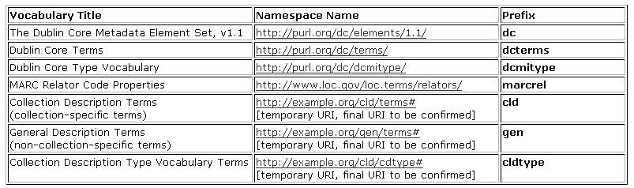
Namespaces used in Collection Description AP
Notes:
Note the number of namespaces, and that two (DCMIType and cldtype) are value vocabularies, not attibute or property vocabularies

Slide 29
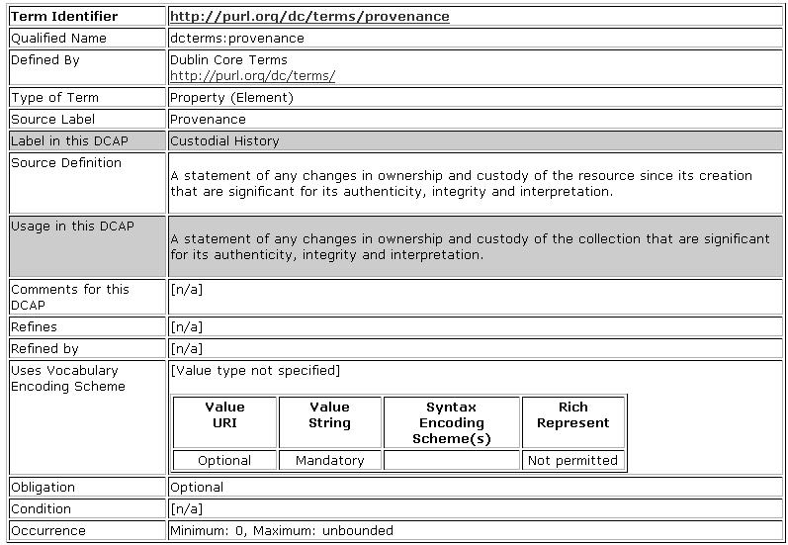
Notes:
An example of use of a DCMI term:
-- Note that the attributes have different names than the ones from the CEN document, though most of the concepts
are the same or similar
-- Note that this AP uses a different label for the term
-- Note the boxes under vocabulary encoding schemes, which specify what kind of values are expected when controlled
vocabularies are used. In this case there is no particular vocabulary specified, but the FORM of the value is specified.
-- Note that this format is explicitly for human consumption, but that it includes all the information needed for a machine
presentation

Slide 30
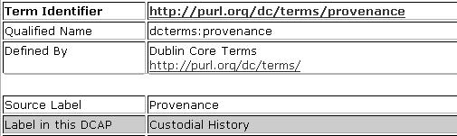
Identifying Attributes
First four attributes come directly from DCMI
Greyed attribute “Label in this DCAP” specifies the label that this community prefers for this attribute

Slide 31
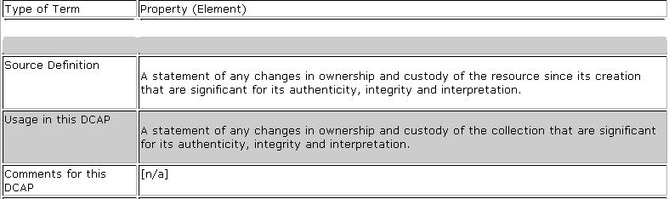
Definitional Attributes
“Type of term” and “Source Definition” are from DCMI term declaration
“Usage in this DCAP” and “Comments for this DCAP are added (or not) by the community defining the Application Profile

Slide 32
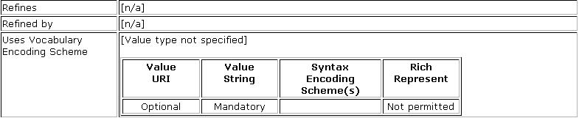
Relational Attributes
Because “Type of Term” is element it cannot refine another term; this term has no refinements
No Vocabulary encoding scheme is recommended; a value string representation is mandated

Slide 33

Constraints & Obligations
Because use of the element is Optional in this AP, no occurence is required, but any number of iterations is allowed
No special conditions are imposed

Slide 34
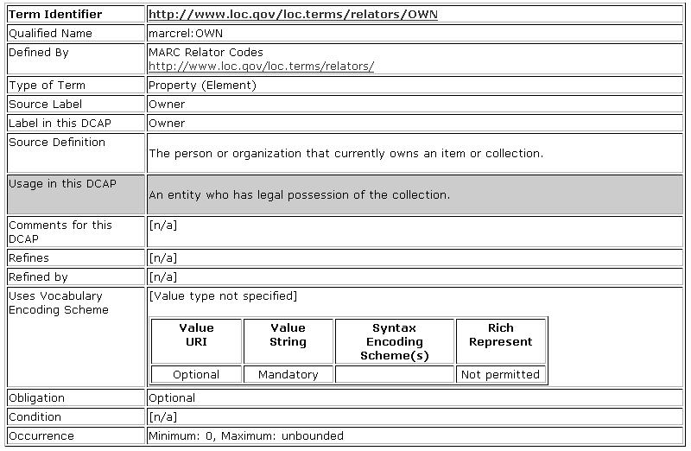
Notes:
Here the AP specifies use of a property from another vocabulary, the MARC Relator terms. Some of these are approved for use with DC in general (see the guidelines for more information) but owner is not, and therefore cannot be dumbed down to Contributor.

Slide 35
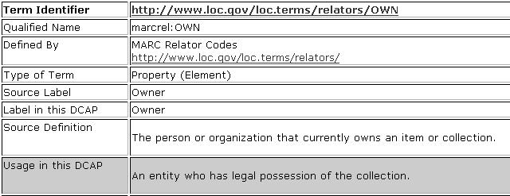
ID & Definition: Non-DCMI Term
Term originates in LC namespace but is NOT able to be dumbed down to Contributor
Still includes information from the originating term declaration PLUS specific community usage

Slide 36
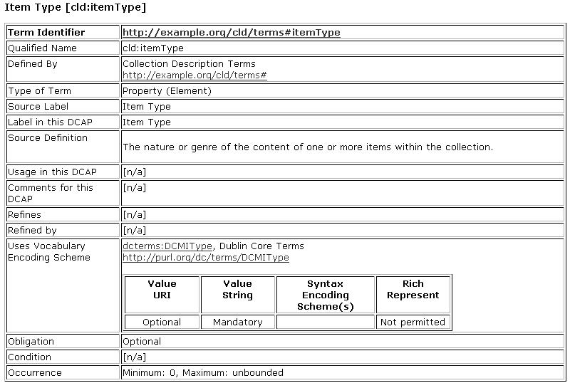
Notes:
Here is an example of a new term declared as part of this AP. Note that there is nothing grayed as “different” or specific to the AP.

Slide 37
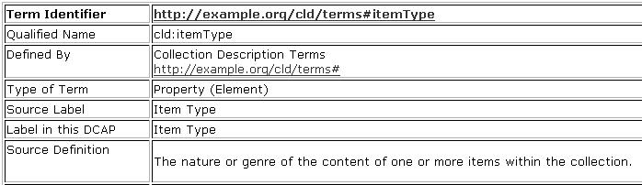
New Term Declaration
http://example.org will be replaced by “real” namespace to be conforming
Since this term is new, all attributes are specific to the community, none are “greyed”

Slide 38
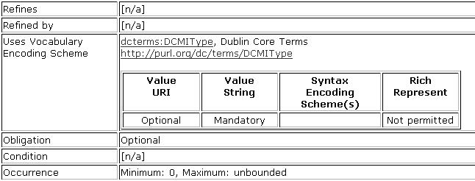
New Term Declaration, cont.
Note the use of DCMIType vocabulary for this new term
DCMIType vocabulary is also specified for Type in this DCAP

Slide 39
Thank you!
Thanks for your attention
Please feel free to provide feedback to:
Diane Hillmann
dih1@cornell.edu

