Slide 1
AGROVOC and the
OWL Web Ontology Language: the
Agriculture Ontology Service
Concept Server
OWL model
DC 2006
Mexico, 4 October 2006

Slide 2
Outline
Background
Needs and purposes
Our approach
Current status and Next steps
Open issues
Conclusion

Slide 3
Background (1/2)
AGROVOC
  Used worldwide
  Multilingual
  Term-based, limited semantics
  Maintained as a relational database
  Distributed in several formats
  (RDBMS, TagText, ISO2709, ...)

Slide 4
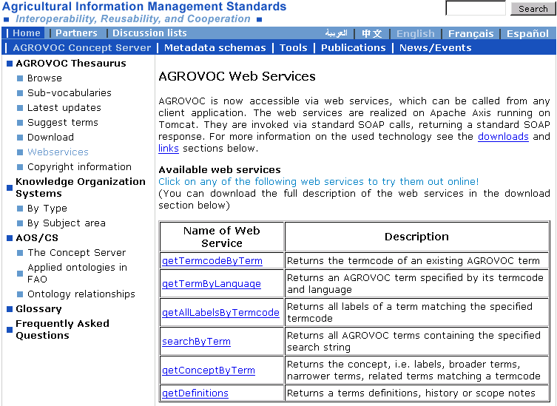
Background (2/2)
Draft versions available in TBX, SKOS, OWL
Access to full thesaurus through Web Services
Agricultural Ontology Service (AOS)

Slide 5

Needs and purposes (1/2)
ship
or
container
ship or navire or เรือ or …
vessel
vessel
Notes:
Make connections between several information systems
Help the user by exploiting more semantics
Make multilingualism a reality

Slide 6
Needs and purposes (2/2): better serving web applications
Semantic navigation of knowledge
Semantic navigation of resources (bibliographical metadata, etc.)
Intelligent query expansion
Terminology brokering
Improved natural language processing
  Language recognition
  Improved parsing (combinatorial)
  Extended concept resolution
Inferencing / Reasoning
Clustering and ranking
Notes:
to facilitate its use for developing agricultural domain terminologies, including ontologies, without requiring the terminologist to start from scratch;
to enable the development of applications using semantic technologies; and
to enable interoperability between applications using these ontologies.

Slide 7
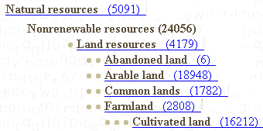
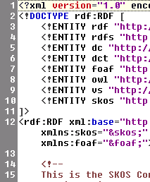
Our approach (1/11)
Better defined
structure
AGROVOC
Better defined
structure
RDBMS
XML formats (e.g. TBX)
RDFS formats (e.g. SKOS)
Notes:
express more semantic relations between a pair of entities
further refine relations (more specific)
specify attributes (e.g. number of legs, size of land mass)

Slide 8
Our approach (2/11)
Concept-based
More semantics
“Language-independent”
Easy integration with other KOS
Easy sharing within the Web
Better defined
structure:
the CS
ontology + OWL
Notes:
In particular we want OWL DL for computational completeness
RDF doesn’t support some characteristics which our OWL model has such as inverse, functional properties
1) RDF basis
(sub)classes, individuals
(sub)properties, domain, range, XML Schema datatypes
2) OWL Lite
equality, inequality
inverse, transitive, symmetric, functional properties cardinality 0/1, allValuesFrom, someValuesFrom
3) OWL DL
conjunction, disjunction, negation
hasValue, enumerated types, full cardinality
4) OWL Full
metaclasses

Slide 9
Our approach:
The OWL model (3/11)
Why OWL?
  Built on top of RDF, increased interest, future support
  W3C recommendation
  Represented as triples
  Interoperable and web-enabled (linking multiple ontologies)
  Reuse of existing tools, no proprietary RDBMS
  Reasoning is possible: to arrive at conclusions beyond what is asserted + consistency checks
  A revision was needed → better semantic and refinement
Problems
  Backward compatibility with legacy systems
  Many desirable kinds of information must be represented tortuously or cannot be represented at all
Notes:
Why OWL:
built on top of RDF
optimized for the Web
able to express semantics about entities in terms of simple propositions (represented as triples)
has extensive apparatus for representing classes and individuals and for relating them to each other in more complex ways than do the other RDF-based languages
reasoning is possible: to arrive at conclusions beyond what is asserted
suitable for linking multiple ontologies through common concepts
consistency checks can be performed

Slide 10
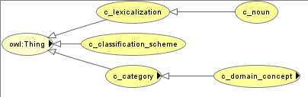
Our approach:
The OWL model (4/11)
Concept / Term / term variants
Language issue
  ‘has_lexicalization’/ ‘lexicalized_with’ functional
AOS/CS base URI: http://www.fao.org/aos/agrovoc
Notes:
Each language should be able to express the domain concepts for which it had lexicalizations and for which others may not.
Accurate lexical equivalences (e.g. translations, synonyms).
We obtain a conceptually richer model.
Each term is a separate entity in every language that can be linked to concepts, to other terms and to term variants of the same term.
All descriptor = domain_concepts!
Modelling lexicalizations as a separate concept will make it possible to establish relationships amongst various lexicalizations that describe a concept and thus provide for much powerful semantics.

Slide 11
Our approach:
The OWL model (5/11)
Concepts are classes AND instances
  Classes → to support hierarchy and inheritance
  Instances → to keep OWL DL
Terms are instances of a specific class

Slide 12
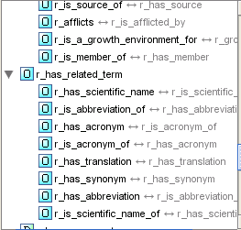
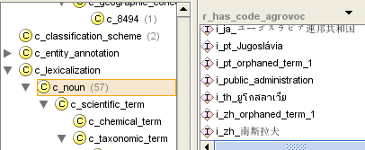
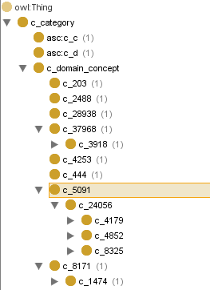
Our approach:
The OWL model (6/11)
Disambiguation:
en_plane vs de_plane
en_sole_1 vs en_sole_2

Slide 13
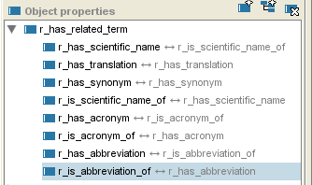
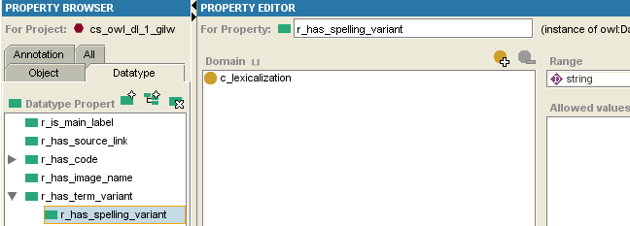
Our approach:
The OWL model (7/11)
Term-to-Term and
Term-to-Variants
Relationships

Slide 14

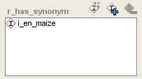


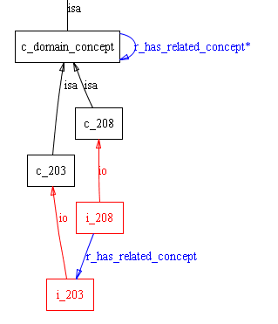
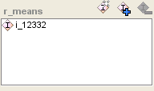
Our approach:
The OWL model (8/11)
Inheritance
Relationships
instantiations
Notes:
In OWL DL it is not possible to treat classes as instances. Therefore, in order to instantiate a relationship for two concepts, we need to instantiate these concepts and connect the instances with the respective relationships

Slide 15
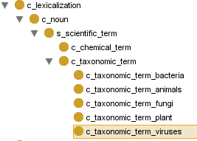

Our approach:
The OWL model (9/11)
Other elements
  Status for concepts and terms
  (suggested, approved, reviewed, deprecated)
  has_date_created
  has_date_last_updated
  Scope notes / images / definitions
  Sub-vocabularies
Notes:
all this created using object properties or data type properties

Slide 16
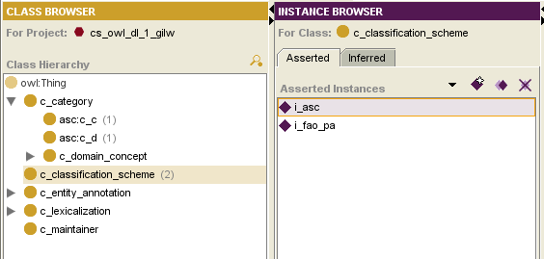
Our approach:
The OWL model (10/11)
Classification schemes and categories

Slide 17
Our approach:
Backward compatibility (11/11)
Backward compatibility with a traditional thesaurus
  Main descriptor (is_main_label)
  Term codes references
  UF+
  Scope notes
  etc.

Slide 18
Current status
What exists concretely of the model:
  Description of the model
  Relationship definition (in collab. with CNR)
  Test project
  Full AGROVOC conversion procedure
  Performance tests
  AOS/CS Workbench construction

Slide 19
Next steps
AGROVOC refinement and conversion
Build the AOS/CS Workbench
Extensive tests
  scalability at storage and operational level
  performance at the maintenance and data retrieval level
  integration of and linkage to datasets
Create a network of ontology experts
  Workshops/Trainings
NeOn results
Notes:
Feedback from audience is important

Slide 20
Open issues
Assign attributes to relationships
Distinguish concepts instances from individuals
Validity of relationships (or context)
Ontology lifecycle, versioning
(owl:priorVersion, owl:backwardCompatibleWith)
Ontology mapping and merging
No more words but URIs in IS
Better exploitation of the potentiality at the application level: powerful IR
Ontology Web services (OWS)
Notes:
OWL DL classes cannot be individuals → we need to create an ‘artificial’ instance

Slide 21
Conclusion
AOS is still a success story and is gaining terrain in private sector
More ontologies in FAO
NeOn toolkit
Meta-model?

Slide 22
acliang@alum.mit.edu boris.lauser@fao.org margherita.sini@fao.org johannes.keizer@fao.org
Questions?
Thank you

Slide 23
Real needs / examples
example: three FAO information systems
FIRMS
FIDI statistics
Globefish
Fishery fact sheets
Trade flow
Fish Market reports

Slide 24
Process
results from
Species
Commercial sp. group
on
Prices
belongs
targets
Fishery commodity
Fishery commodity
document
on
concerns
Stock
Fishery
Trade flow
Market
lands in
from
to
located
Landing place
Country origin
Country destination
Area

Slide 25
Process
Frozen
results from
Species
Commercial sp. group
on
Octopus vulgaris
Cephalopod
Prices
belongs
targets
Fishery commodity
Fishery commodity
document
Increase
on
concerns
Frozen cephalopod
Frozen cephalopod
Stock
Fishery
Trade flow
Market
Octopus – Cape Blanc
lands in
from
to
located
Landing place
Country origin
Country destination
Area
Tokyo
Nouadhibou
Mauritania
Japan

Slide 26
Process
results from
Species
Commercial sp. group
on
Prices
belongs
targets
Fishery commodity
Fishery commodity
document
on
concerns
Stock
Fishery
Trade flow
Market
lands in
from
to
located
Landing place
Country origin
Country destination
Area

